Slide 1

(a)
readout I
qubit I
qubit II
20mK
I₀
50 Ω
A
4K
LO
ACQ
(b)
00, 01, 10, or 11
readout
Y(π/2)
iSWAP
Z(π/2)
iSWAP
X₁₂(π)
Y(π/2)
ν₀₁[φ(t)], a(t)
0
50
100
150
200 ns

Slide 2
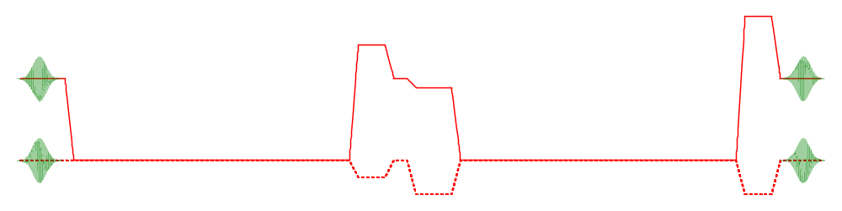
readout I
qubit I
qubit II
20mK
I₀
I₀
50 Ω
A
New version on next slide!
4K
LO
ACQ
00, 01, 10, or 11
Y_{π/2}
iSWAP
Z_{π/2}
X_{π/2}

