Slide 1



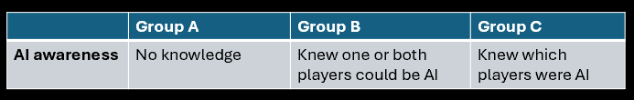
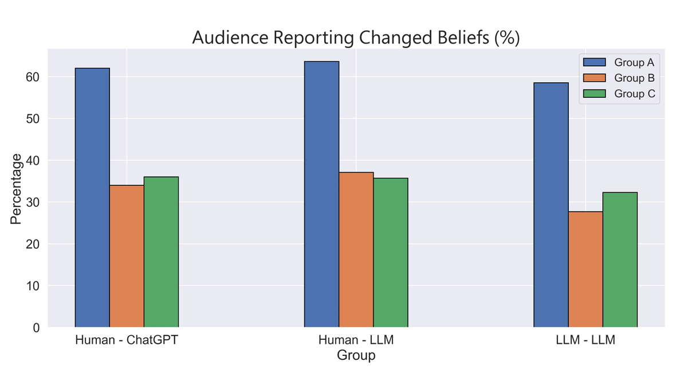
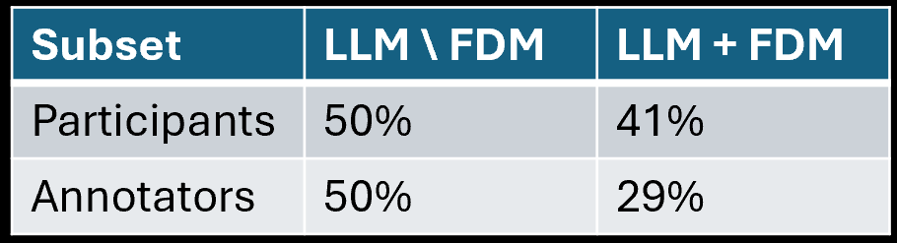
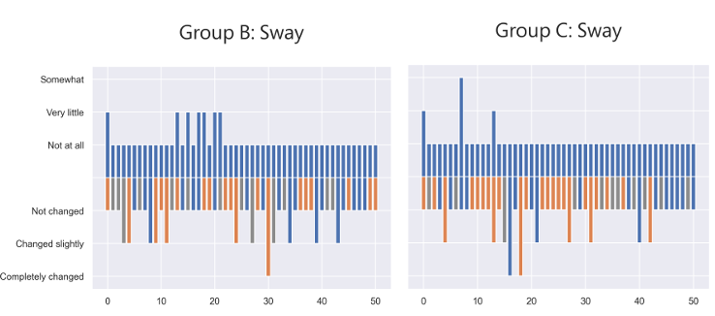
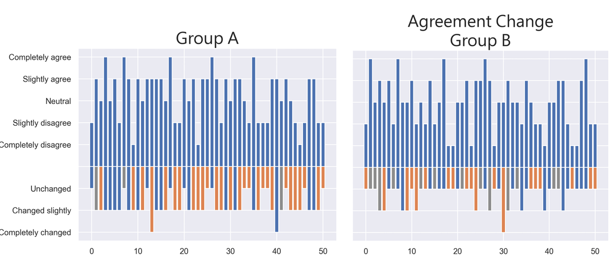
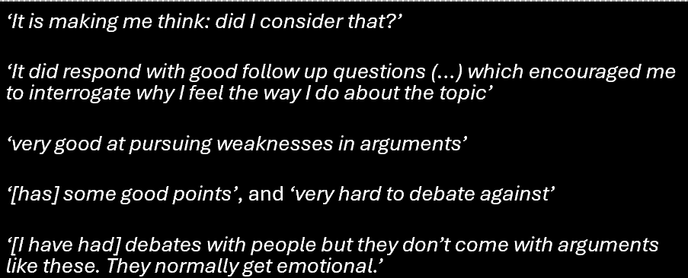
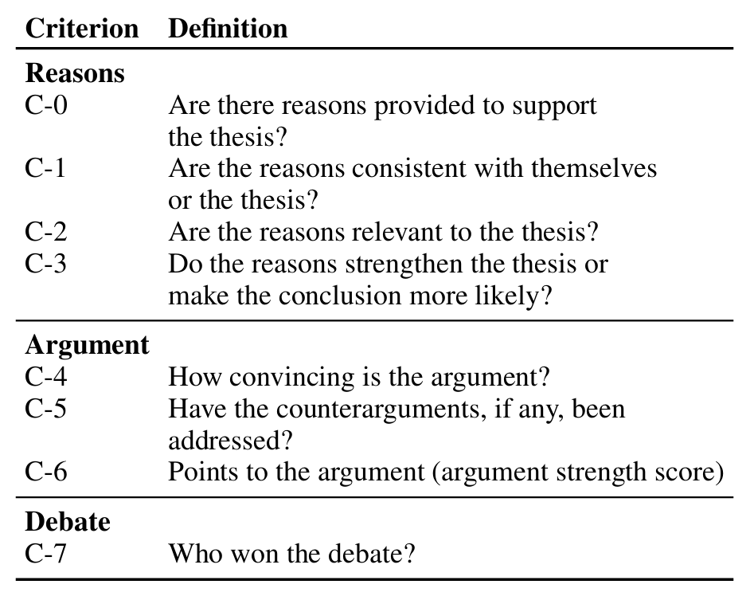
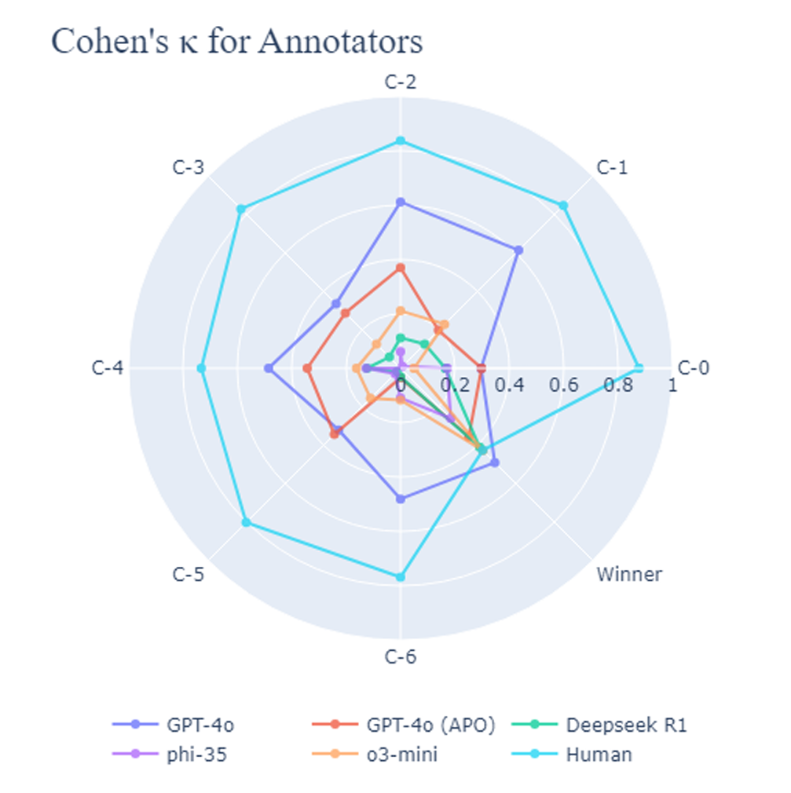
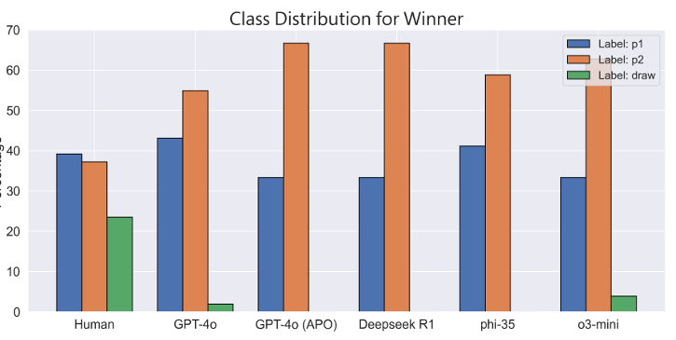
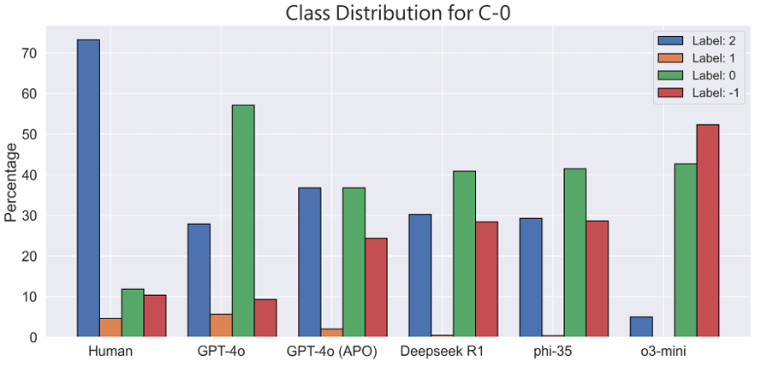
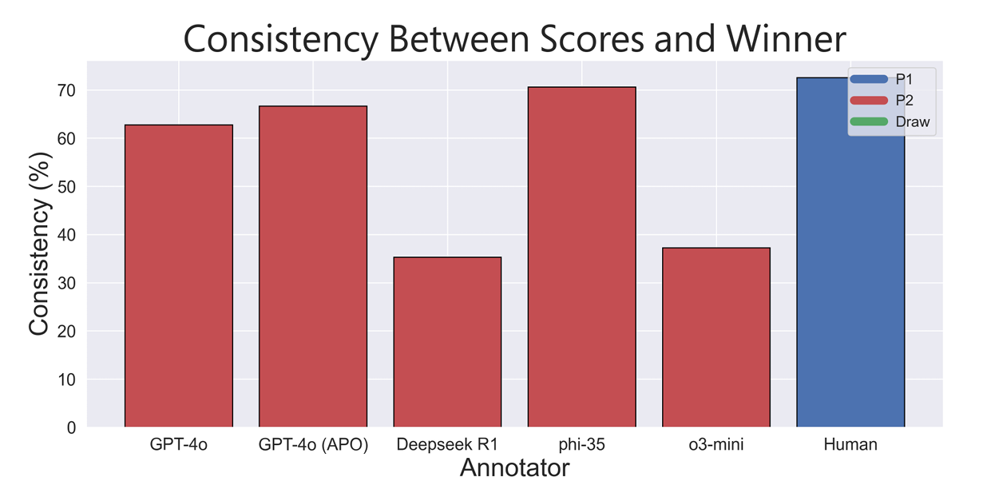
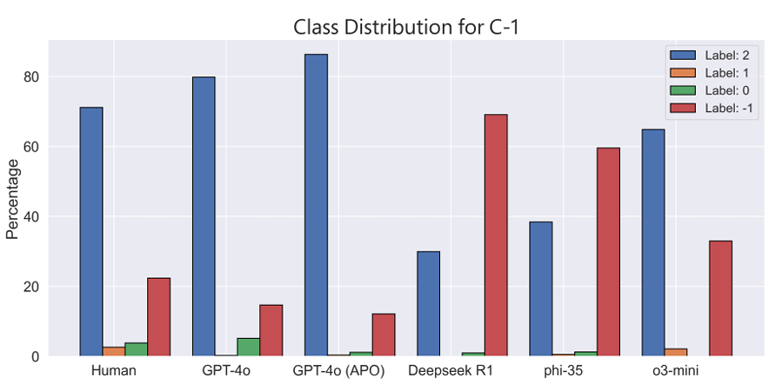

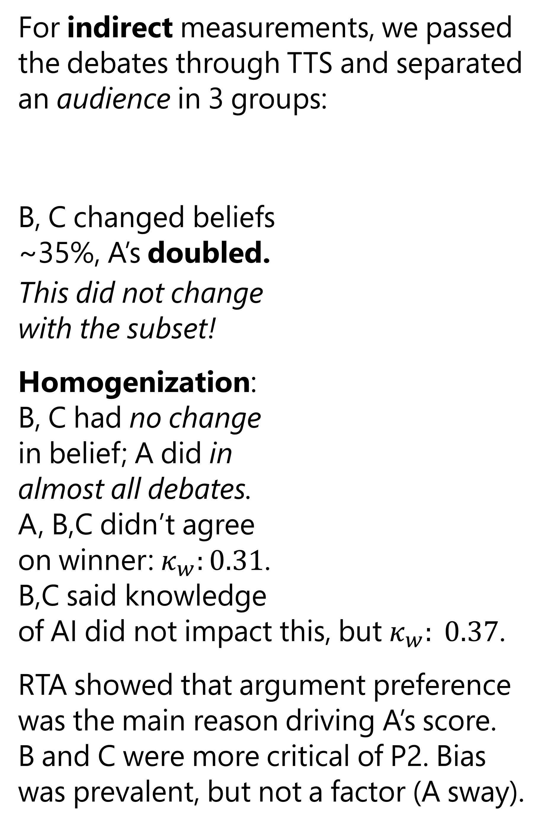
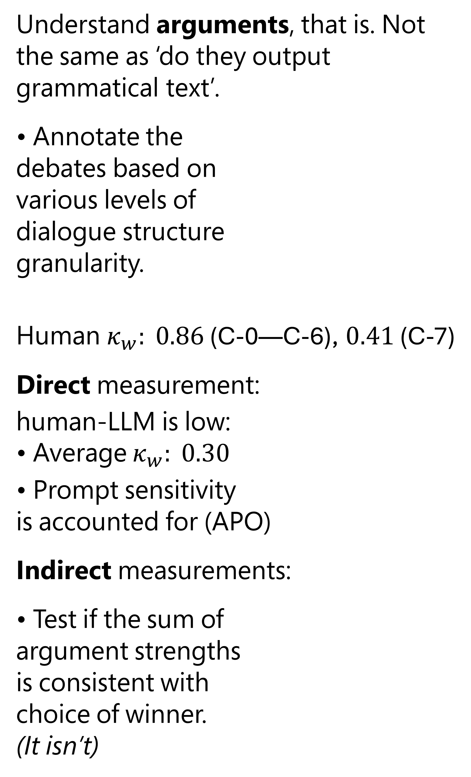
The Thin Line Between Comprehension and Persuasion in LLMs
``
Adrian de Wynter¹^{,2} and Tangming Yuan²
¹Microsoft ²The University of York
Can LLMs Understand? (holistically)
For indirect measurements, we passed the debates through TTS and separated an audience in 3 groups:
B, C changed beliefs ~35%, A’s doubled.
This did not change with the subset!
Homogenization: B, C had no change in belief; A did in almost all debates. A, B,C didn’t agree on winner: $κ_{w}:0.31$. B,C said knowledge of AI did not impact this, but $κ_{w}: 0.37$.
RTA showed that argument preference was the main reason driving A’s score. B and C were more critical of P2. Bias was prevalent, but not a factor (A sway).
1
Problem
5
Do LLMs understand what it is being talked about? There’s a lot of opinions on that, explicitly or implicitly.
This is important: if LLMs are deployed in safety-critical applications, knowing whether they understand is important.
Rather, can they convincingly showcase understanding when asked?
More importantly, does it matter?
In our direct measurement, we reviewed the quantitative responses to the surveys for both debaters and audience (right, TTS).
Self-perceived win-rate was unstable:
Human concessions were more common in LLM+FDM (10/28) versus LLM\FDM (1/10).
Anthropomorphism was frequent. Most participants reported a pleasant interaction; though 8% noted lying, bullying, or gaslighting.
2
Framing
What is understanding?
• We’ll use Kvanvig (2003)’s definition: a collection of information along with the reason why it occurs.
It is not the only definition!
Measuring understanding
We’ll take two approaches:
• Wittgenstein: words take meaning from context. Test understanding from context.
• Turing: a machine passes the Imitation Game if it successfully convinces a human
Test understanding through persuasiveness.
4
Can LLMs Understand? (compositionally)
6
What have we learnt?
Understand arguments, that is. Not the same as ‘do they output grammatical text’.
• Annotate the debates based on various levels of dialogue structure granularity.
Human $κ_{w}: 0.86$ (C-0—C-6), $0.41$ (C-7)
Direct measurement:
human-LLM is low: • Average $κ_{w}: 0.30$
• Prompt sensitivity is accounted for (APO)
Indirect measurements:
• Test if the sum of argument strengths is consistent with choice of winner. (It isn’t)
LLMs-as-judges do not super-duper understand the context, but kind of do, to the extent dialogue requires.
Then again, they are very persuasive, especially when:
Undisclosed, and
To bystanders.
Thus, successful dialogue does not require understanding.
To which extent LLMs can and should be trusted? We need stricter disclosure guidelines
Philosophically, does it matter that an agent can’t show understanding (i.e., pass a test), if it is convincing enough?
3
Approach
We build a corpus of informal debates: the purest form of ‘convince me’ dialogue acts there is.
Three splits:
1. Human vs LLM (‘LLM \ FDM ‘) 2. Human vs LLM + FDM 3. LLM vs LLM + FDM
We steer the LLM with a formal dialogue model (FDM): a collection of rules controlling the agent’s behaviour.
• Data skewness affects performance, as in ‘LLMs overindex in the wrong things’.
(This shouldn’t be!)
Adrian de Wynter adewynter@microsoft.com

