Slide 1
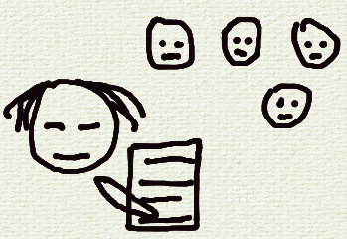
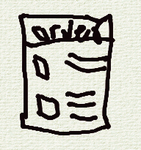

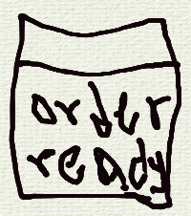
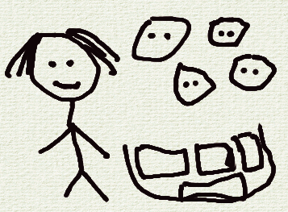
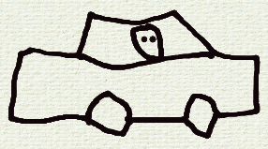
UX Design Storyboard
Scenario: An app that can be used to place large orders in advance
Collect orders from co-workers
(stressful & error-prone)
Finds an app that can be used
to place group orders
Place group orders easily with-
out error
Receives notification that order
Is ready
Drives to the CoffeeHouse to
Collect coffee items
All orders are correct and all
co-workers are happy

Slide 2
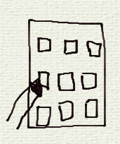
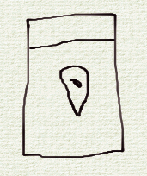
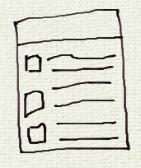
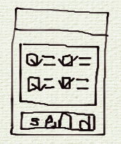
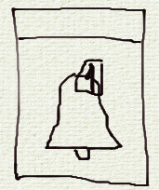
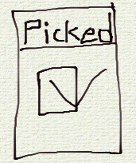
UX Design Storyboard
Scenario: An app that can be used to place large orders in advance - Close-up
Anika opens the app
She selects the nearest Coffee-
House pickup location
She fills in her order and co-
worker’s orders
She confirms and sends the
orders
She receives notification that
orders are ready for pickup
After successful pickup, orders
are marked with status “picked”

