Slide 1

Ecommerce App for an Animal Shelter
Badrudeen Adewumi Abdul-hameed

Slide 2
Project overview
The product:
Insert a few sentences about the app, website, or other product that you designed and the target users
Preview of selected polished designs.
Project duration:
Insert the time that you worked on this design project - e.g., Month Year to Month Year

Slide 3
Project overview
The problem:
Insert one to two sentences about the problem(s) you were trying to solve.
The goal:
Insert one to two sentences about the goal of the project.

Slide 4
Project overview
My role:
Identify your role in the project - e.g., lead UX designer, UX researcher, etc.
Responsibilities:
List the responsibilities you had throughout the project - e.g., user research, wireframing, prototyping, etc.

Slide 5
User research
Personas
Problem statements
User journey maps
Understanding
the user

Slide 6
User research: summary
Write a short paragraph describing your user research.
This can include the type of research you conducted, assumptions that you made going into the research, and how your assumptions changed after conducting research.

Slide 7
User research: pain points
1
2
3
4
Pain point
Pain point
Pain point
Pain point
Write one to two sentences reflecting on the pain point listed above and how it will guide designs moving forward.
Write one to two sentences reflecting on the pain point listed above and how it will guide designs moving forward.
Write one to two sentences reflecting on the pain point listed above and how it will guide designs moving forward.
Write one to two sentences reflecting on the pain point listed above and how it will guide designs moving forward.

Slide 8
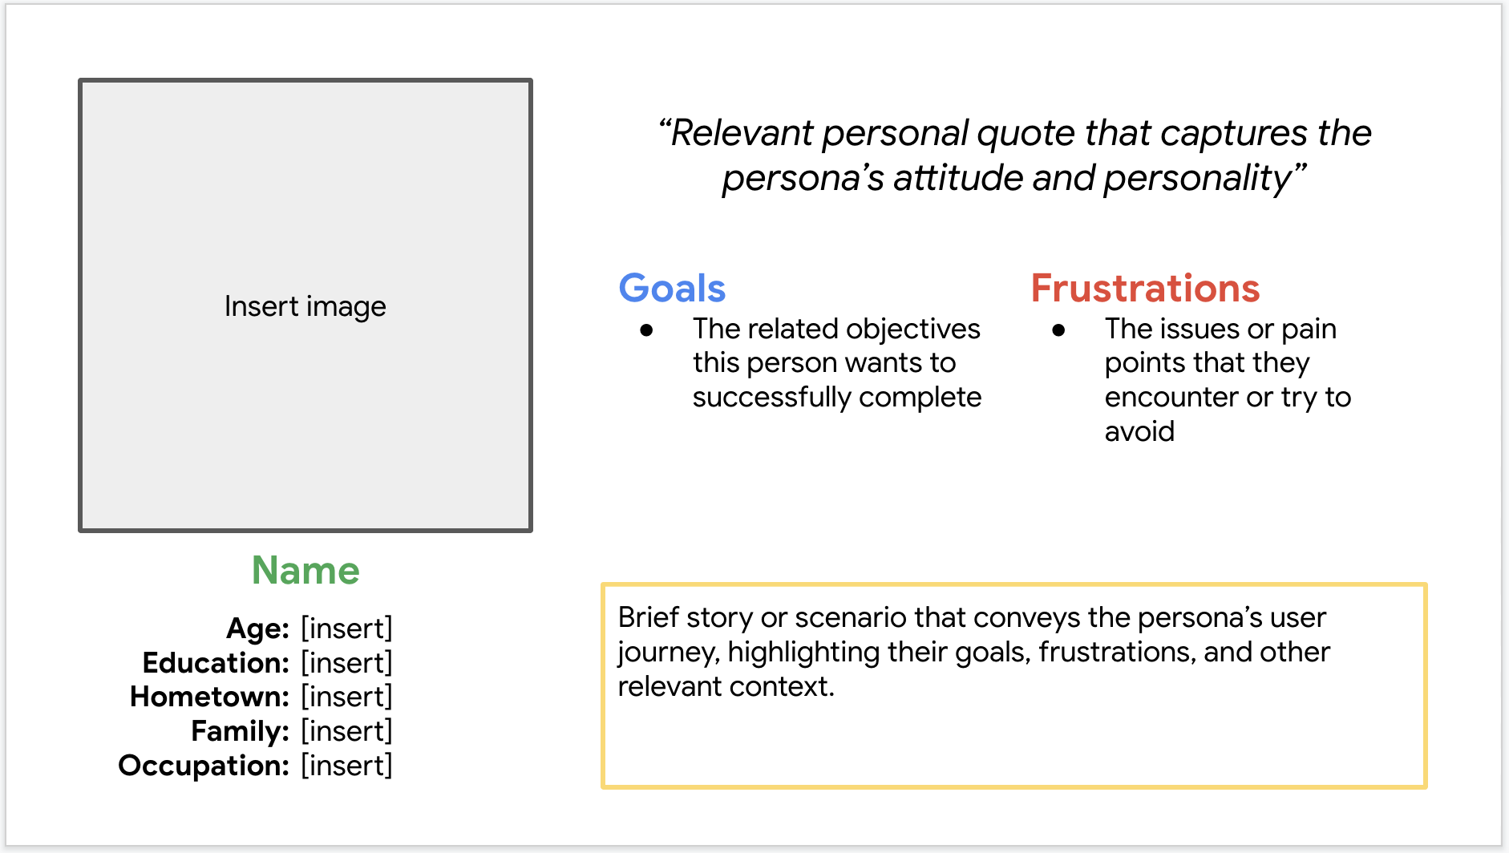
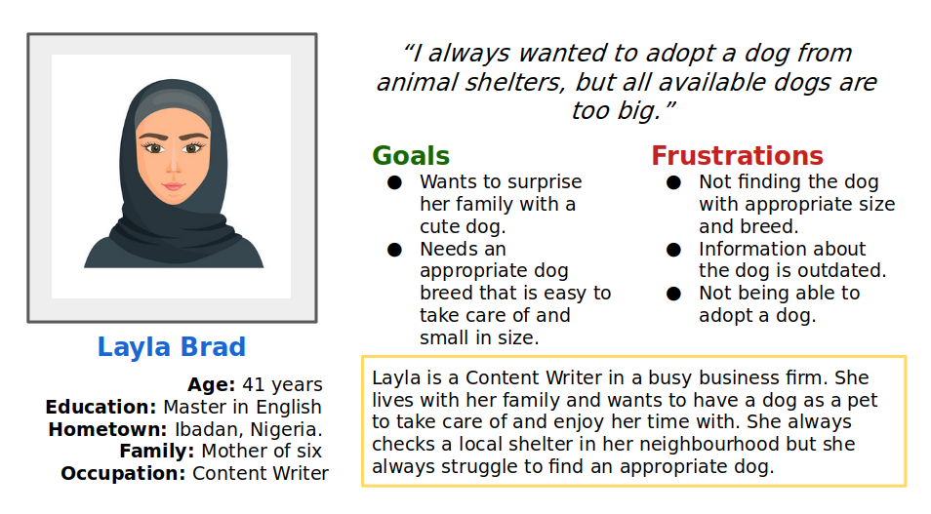
Persona: Layla Isaac
Problem statement:
Layla is Content Writer and a mother of six children who needs a small cute dog for her family to help manage loneliness and depression by giving them companionship.

Slide 9
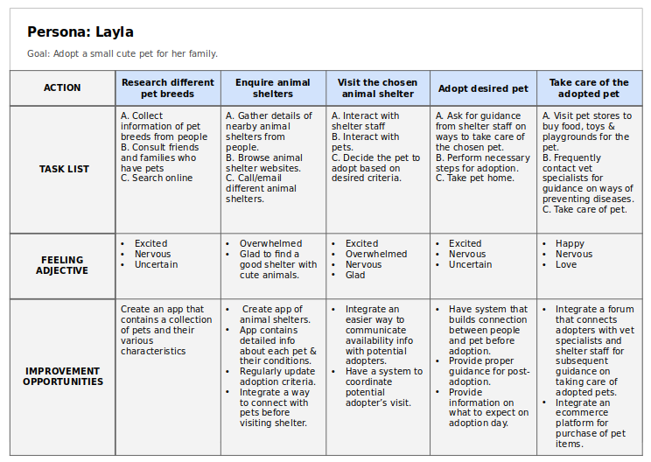
User journey map
Layla’s user journey map revealed how helpful it would be for users to adopt and own pets from animal shelters.
Image of user journey map

Slide 10
Paper wireframes
Digital wireframes
Low-fidelity prototype
Usability studies
Starting
the design

Slide 11
Paper wireframes
[Your notes about goals and thought process]
Image of paper wireframes including five different versions of the same screen and one image of the new, refined version

Slide 12
Digital wireframes
Description of the element and its benefit to the user
[Your notes about goals and thought process]
Insert first wireframe example that demonstrates design thinking aligned with user research
Description of the element and its benefit to the user

Slide 13
Digital wireframes
Description of the element and its benefit to the user
[Your notes about goals and thought process]
Insert second wireframe example that demonstrates design thinking aligned with user research
Description of the element and its benefit to the user

Slide 14
Low-fidelity prototype
[Link to low-fidelity prototype and brief description of the user flow]
Screenshot of prototype with connections or prototype GIF

Slide 15
Usability study: findings
Write a short introduction to the usability studies you conducted and your findings.
Round 1 findings
Round 2 findings
1
Insert finding
1
Insert finding
2
Insert finding
2
Insert finding
3
Insert finding
3
Insert finding

Slide 16
Refining
the design
Mockups
High-fidelity prototype
Accessibility

Slide 17
Mockups
Before usability study
After usability study
[Your notes about goals and thought process]
Image of selected screen before usability study
Image of selected screen after usability study

Slide 18
Mockups
Before usability study
After usability study
[Your notes about goals and thought process]
Image of selected screen before usability study
Image of selected screen after usability study

Slide 19
Mockups
Main mockup screen for display
Main mockup screen for display
Main mockup screen for display
Main mockup screen for display

Slide 20
High-fidelity prototype
[Link to high-fidelity prototype]
Screenshot of prototype with connections or prototype GIF

Slide 21
Accessibility considerations
1
2
3
Insert one to two sentence summaries describing each accessibility consideration applied in your designs.
Insert one to two sentence summaries describing each accessibility consideration applied in your designs.
Insert one to two sentence summaries describing each accessibility consideration applied in your designs.

Slide 22
Going forward
Takeaways
Next steps

Slide 23
Takeaways
Impact:
Insert one to two sentences summarizing the impact of your designs. In the real world, you’d include data like number of downloads or sign ups, but since this is a course project, you can include a positive quote from a peer or study participant.
What I learned:
Insert a few sentences summarizing what you learned throughout the project.

Slide 24
Next steps
1
2
3
Insert a few sentences summarizing the next steps you would take with this project and why.
Insert a few sentences summarizing the next steps you would take with this project and why.
Insert a few sentences summarizing the next steps you would take with this project and why.

Slide 25
Insert a few sentences summarizing the next steps you would take with this project and why. Feel free to organize next steps in a bullet point list.
Let’s connect!
Insert a brief sentence or two about contacting you and/or reviewing more of your work.
Provide your contact information here. This might include your email address, phone number, and website or link to other professional platforms.

