Slide 1

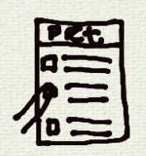
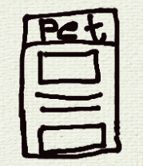
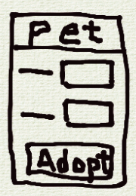
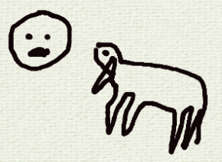
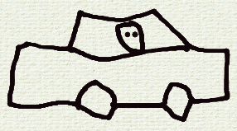
UX Design Storyboard
Scenario: An app that allows lovers of pet to browse and adopt pets at their convenience – big picture
Musa feels lonely and depressed being alone at home
He finds shelter app and selects an animal
Musa watches the pet’s video and read info about the pet
He inputs the checkout info to complete the adoption of the pet
Musa drives to the shelter to pickup his adopted pet
Musa returns home with the pet feeling happy

Slide 2
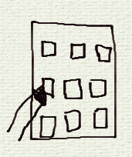

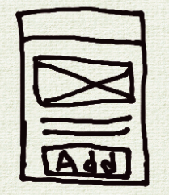

UX Design Storyboard
Scenario: An app that allows lovers of pet to browse and adopt pets at their convenience – Close-up
Musa opens the shelter app
He browses through a list of pets and selects one
He views the pet’s info and watches her video
Musa adds the desired pet to cart.
He inputs the checkout details
He confirms the checkout for complete adoption of the pet

