Slide 1

Automated and Adaptive Feature Selection for Enhancing Machine Learning Performance on Large and Diverse Datasets
Student Name: Adeyemi Adekunle
Student ID:240254665 Student Email: adeyemi.adekunle@yorksj.ac.uk
Supervisor Name: Dr Anu Bala

Slide 2
The Coversheet
Student Name (unless anonymised) | Adeyemi Adekunle
Student Number (as shown on student ID card): | 240254665
Word Count / Pages / Duration / Other Limits:
Assessment component number (1,2 or 3) | 3
Assessment type
Attempt Number:
Date of Submission: | 28 January 2026

Slide 3
I have read and understood the Academic Misconduct statement. | Tick to confirm ☐
I have read and understood the Generative Artificial Intelligence use statement. | Tick to confirm ☐
I am satisfied that I have met the Learning Outcomes of this assignment (please check the Assignment Brief if you are unsure) | ​​​ Met ☐
Self-Assessment – If there are particular aspects of your assignment on which you would like feedback, please indicate below. Optional for students
Suggested prompt questions- How have you developed or progressed your learning in this work? What do you feel is the strongest part of this submission? What feedback would you give yourself? What part(s) of this assignment are you still unsure about?

Slide 4

Table of Content
Introduction (The Problem)
Aim, Objectives, Research Questions & Hypothesis
What is Feature Selection?
Literature Review & Research Gap
Proposed Contribution
Framework Architecture
Datasets Overview
Preprocessing Pipeline
Dataset Profiling (Meta-Features)
Heuristic Rules
Experimental Setup
Evaluation Metrics & Statistical Testing
Results: Predictive Performance
Results: Runtime & Stability
Discussion
Conclusion
Recommendations & Future Work
Executive Summary
References & Q&A

Slide 5
Introduction (The Problem)
Key point: Modern datasets can be high-dimensional, noisy, and inconsistent
Manual feature selection is slow and inconsistent
One FS method does not work best on every dataset
Wrong FS choice can reduce accuracy, increase runtime, and reduce stability

Slide 6
Aim, Objectives, Research Questions + Hypothesis
Research Questions:
Which dataset characteristics suggest FS is beneficial?
Does heuristic FS improve performance vs No-FS?
What trade-offs appear (accuracy vs runtime vs stability)?
Hypotheses:
H₀: Heuristic-FS does not significantly improve performance/efficiency vs No-FS
H₁: Heuristic-FS improves performance and/or efficiency vs No-FS on some datasets
Aim:
Build and evaluate an explainable heuristic-adaptive FS framework.
Objectives:
Use dataset meta-features to select FS family + feature count
Compare No-FS vs Heuristic-FS across datasets and models
Evaluate with performance + runtime + stability

Slide 7
What is Feature Selection(FS)
Feature selection reduces the feature set to keep the most informative variables.
Why it matters:
Reduces noise and redundancy
Speeds up training + inference
Helps reduce overfitting
Improves interpretability
FS families:
Filter: fast, model-agnostic (e.g., ANOVA, mutual information)
Wrapper: searches subsets, often accurate but expensive (e.g., RFE)
Embedded: selection happens inside learning (e.g., L1 regularisation)

Slide 8
Literature + Gap
What research has shown:
FS can improve generalisation and efficiency, but results depend on dataset properties
No single FS method dominates across all problems (No Free Lunch idea)
Heavy adaptive approaches exist (AutoML/meta-learning/RL), but they’re costly and less transparent
Gap:
Need for a lightweight + explainable + practical adaptive FS approach

Slide 9
Contribution (What I am building)
A Heuristic Decision Engine that:
Profiles dataset meta-features: p/n, correlation, sparsity, imbalance, variance.
Select an FS family: filter/wrapper / embedded.
Chooses a sensible feature count k (bounded by dataset size/dimensionality
Evaluates impact using consistent models + metrics.

Slide 10
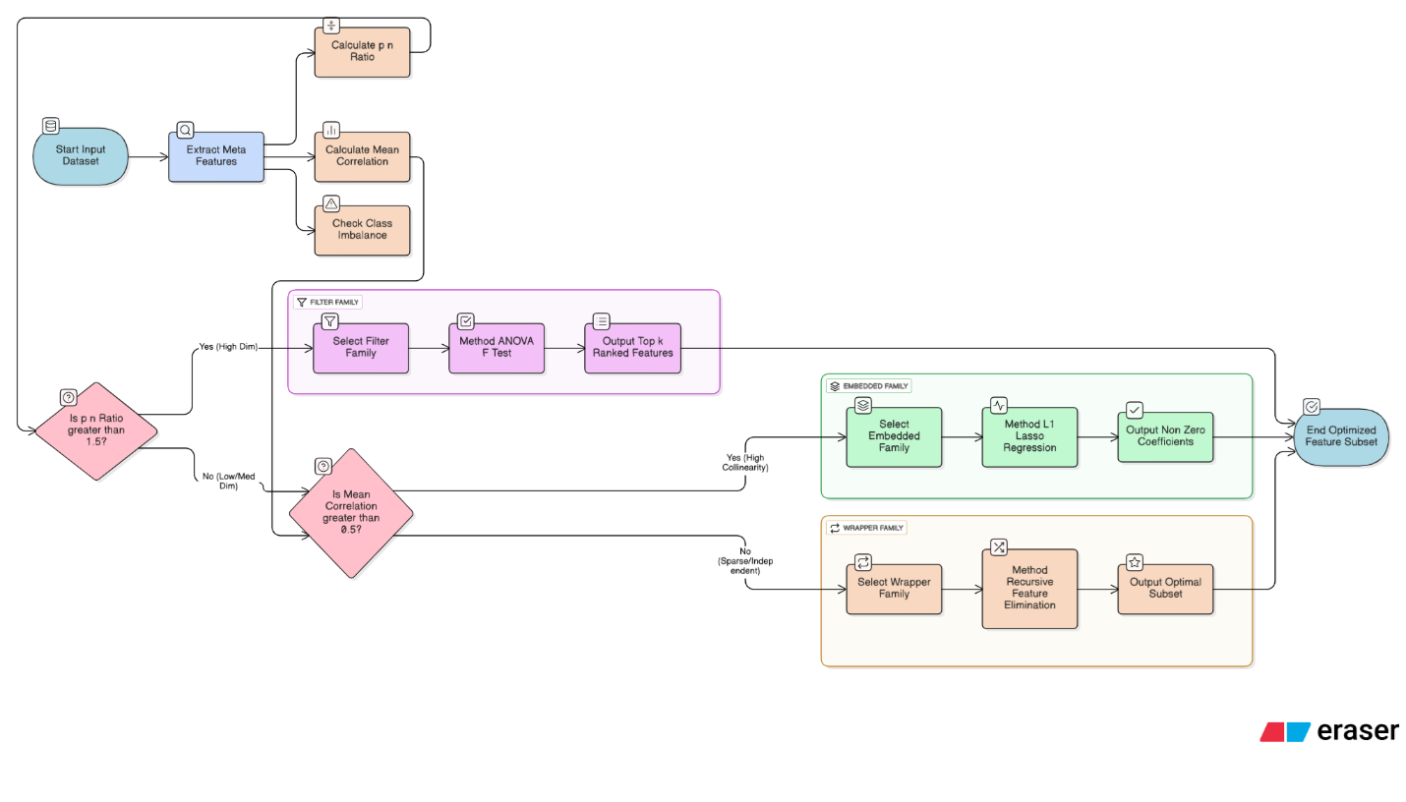
Framework Architecture
Workflow:
Dataset input
Preprocessing pipeline
Dataset profiling
Decision rules (heuristics)
Apply selected FS method
Train models + evaluate
Results: metrics + stability + stats + interpretability

Slide 11
Datasets Overview
The Datasets:
Bank Marketing — finance, mixed categorical/numeric, imbalance
Breast Cancer Wisconsin (Diagnostic) — healthcare, low-dimensional numeric
CIFAR-10 (tabular subset of pixels) — vision, high-dimensional (3,072 features
Dataset | Domain | Samples | Features | Classes | Citation
Bank Marketing | Finance | 45,211 | 16 | 2 | Moro, Cortez and Rita (2014)
Breast Cancer Wisconsin (Diagnostic) | Healthcare | 569 | 30 | 2 | Street, Wolberg and Mangasarian (1993)
CIFAR-10 | Computer Vision | 60,000 | 3,072* | 10 | Krizhevsky (2009)

Slide 12
Preprocessing Pipeline
Unified pipeline:
Missing value handling
One-hot encoding for categorical features (Bank)
Scaling/normalisation for LR/LDA
Stratified split or CV (to preserve class ratios)
Imbalance handling: SMOTE for Bank only
Fixed random seeds for reproducibility

Slide 13
Meta-Features (Dataset Profiling)
Meta-features extracted:
p/n ratio (dimensionality vs sample size)
Mean absolute correlation/multicollinearity
Sparsity (esp. after encoding)
Variance/low-variance proportion
Class imbalance ratio
Why these:
They are fast to compute and strongly linked to FS behaviour and risks (overfitting/runtime instability).

Slide 14
Heuristic Rules
Decision logic:
If p/n is high (very high-dimensional) → prefer filter (fast)
If correlation is high → prefer embedded (e.g., L1) to reduce multicollinearity
If dataset is moderate size + moderate p → allow wrapper (e.g., RFE)
If data is imbalanced → use stability-aware selection + evaluate with F1/AUC
Choose k dynamically, e.g., a small % of p for very high-dimensional datasets, with bounds

Slide 15
Experimental Setup
Models used:
Linear: Logistic Regression (LR), Linear Discriminant Analysis (LDA)
Non-linear: Random Forest (RF), XGBoost
Conditions compared:
Baseline: No Feature Selection
Proposed: Heuristic-Adaptive Feature Selection
Evaluation:
Cross-validation - 3-fold CV × 2 seeds = 6 runs
FS applied inside training folds only (no leakage)

Slide 16
Metrics + Statistical Testing
Performance metrics:
Accuracy
F1-score (especially for imbalance)
AUC (binary or one-vs-rest for multiclass)
Efficiency:
Runtime (FS + training time)
Stability:
Kuncheva Index (or Jaccard corrected) across folds
Statistics:
Paired comparisons (paired t-test / ANOVA depending on your final analysis)

Slide 17
Results –Predictive Performance
Key points :
Breast Cancer (low-dimensional, correlated):
Heuristic made little/no reduction, so accuracy, F1, AUC, and stability stayed the same across models.
Bank Marketing (imbalanced, sparse after encoding):
Accuracy remains misleadingly high, but clear drops in F1 and AUC show poorer minority-class detection and higher risk in imbalanced settings.
CIFAR-10 (3,072-D tabular pixels):
Strong dimensionality reduction improves efficiency, but accuracy, F1, and AUC consistently fall because univariate filters ignore spatial and interaction structure.
Dataset | Model | Acc (No-FS) | Acc (Heuristic) | F1 (No-FS) | F1 (Heuristic) | AUC (No-FS) | AUC (Heuristic)
Bank Marketing | Logistic Regression | 0.895 | 0.875 | 0.528 | 0.265 | 0.888 | 0.672
Bank Marketing | LDA | 0.897 | 0.88 | 0.466 | 0.177 | 0.873 | 0.671
Bank Marketing | Random Forest | 0.895 | 0.86 | 0.559 | 0.262 | 0.919 | 0.639
Bank Marketing | XGBoost | 0.902 | 0.863 | 0.583 | 0.306 | 0.925 | 0.677
Breast Cancer | Logistic Regression | 0.972 | 0.972 | 0.961 | 0.961 | 0.994 | 0.994
Breast Cancer | LDA | 0.954 | 0.954 | 0.935 | 0.935 | 0.991 | 0.991
Breast Cancer | Random Forest | 0.956 | 0.956 | 0.94 | 0.94 | 0.986 | 0.986
Breast Cancer | XGBoost | 0.958 | 0.958 | 0.943 | 0.943 | 0.989 | 0.989
CIFAR-10 | Logistic Regression | 0.293 | 0.23 | 0.295 | 0.219 | 0.724 | 0.666
CIFAR-10 | LDA | 0.191 | 0.177 | 0.19 | 0.172 | 0.627 | 0.603
CIFAR-10 | Random Forest | 0.346 | 0.24 | 0.34 | 0.232 | 0.767 | 0.696
CIFAR-10 | XGBoost | 0.325 | 0.225 | 0.321 | 0.222 | 0.757 | 0.676

Slide 18
Results –Runtime and Stability
Key Points
CIFAR-10:
Large reduction (3,072 → 153) improves efficiency, but Accuracy, F1, and AUC drop due to loss of interaction/spatial signal.
Bank Marketing:
Moderate reduction (47 → 30), but runtime increases because RFE is expensive, and F1/AUC declines under class imbalance.
Stability (KI):
High stability (≈1.0) reflects consistent or conservative selection, so it must be read together with F1, AUC, and leakage checks.
Dataset | Model | Runtime (No-FS) | Runtime (Heuristic) | Feat (No-FS) | Feat (Heuristic) | Stability (Heuristic)
Bank Marketing | Logistic Regression | 5.302 | 27.904 | 47 | 30 | 1
Bank Marketing | LDA | 0.19 | 23.481 | 47 | 30 | 1
Bank Marketing | Random Forest | 12.032 | 26.505 | 47 | 30 | 1
Bank Marketing | XGBoost | 6.897 | 37.203 | 47 | 30 | 1
Breast Cancer | Logistic Regression | 0.006 | 0.014 | 30 | 30 | 1
Breast Cancer | LDA | 0.003 | 0.012 | 30 | 30 | 1
Breast Cancer | Random Forest | 0.349 | 0.359 | 30 | 30 | 1
Breast Cancer | XGBoost | 0.36 | 0.372 | 30 | 30 | 1
CIFAR-10 | Logistic Regression | 70.456 | 18.877 | 3072 | 153 | 0.594
CIFAR-10 | LDA | 3.315 | 11.926 | 3072 | 153 | 0.594
CIFAR-10 | Random Forest | 3.746 | 12.359 | 3072 | 153 | 0.594
CIFAR-10 | XGBoost | 77.483 | 31.849 | 3072 | 153 | 0.594

Slide 19
Discussion
Key message: The heuristic is data-regime dependent; it behaves well when the dataset structure matches the assumptions behind the FS family choice.
Breast Cancer: “Safe adaptation” — little/no performance change because the dataset is already low-dimensional and high-signal; FS mainly supports interpretability and redundancy control.
Bank Marketing: “Reliable failure” — wrapper FS became expensive and harmed minority detection; SHAP indicates leakage-prone predictors can dominate, creating the accuracy paradox.
CIFAR-10 tabular: filter FS improves feasibility but loses information because tabular pixels don’t preserve spatial meaning; highlights the limit of classical FS on raw image vectors.

Slide 20
Conclusion
What was learned + hypothesis outcome:
The framework successfully used meta-features to select FS families and feature counts in a transparent way (rule-based, auditable).
Performance gains were not consistent across all datasets/models; results confirm trade-offs rather than a universal win.
Efficiency gains appear mainly when dimensionality is extreme (e.g., CIFAR-10), but may be cancelled by wrapper overhead in sparse/encoded data (Bank).
Hypothesis outcome
Overall: H₀ cannot be universally rejected (no consistent improvement across all datasets).
Nuanced support for H₁: heuristic-FS can improve efficiency and sometimes be “safe” (no loss) in low-dimensional settings, but needs guardrails for imbalance/leakage and non-tabular structure.

Slide 21
Recommendations and Future Work
Framework improvements (practical)
Add leakage screening rules (flag and exclude features like “duration”-type predictors before FS).
Make wrapper selection minority-aware (optimise for F1/AUC or use class weights) instead of accuracy-driven elimination.
Add a “cost check”: if wrapper FS runtime is likely to dominate (sparse one-hot), fall back to a fast filter/embedded option.
Evaluation extensions
Test on more datasets + report effect sizes and stronger stability analysis across more resamples.
For image-like data
Replace raw pixels with better representations (e.g., PCA or CNN embeddings) before applying tabular FS, because spatial structure is otherwise lost.

Slide 22
Executive Summary
This study evaluates a heuristic-adaptive feature-selection framework designed to select appropriate feature-selection strategies based on dataset characteristics. Using interpretable meta-features such as dimensionality, correlation, sparsity, and class imbalance, the framework applies rule-based decisions to balance accuracy, runtime, and stability.
Experiments on healthcare, finance, and computer-vision datasets show that heuristic feature selection is data-regime dependent: it behaves safely in low-dimensional data, improves efficiency in very high-dimensional settings, but can degrade minority-class performance in imbalanced and sparse datasets.
Overall, the framework provides a transparent and computationally efficient decision-support tool, highlighting practical trade-offs rather than guaranteeing universal performance gains.

Slide 23
References
Guyon, I. and Elisseeff, A. (2003) ‘An introduction to variable and feature selection’, Journal of Machine Learning Research, 3, pp. 1157–1182.
Kohavi, R. and John, G.H. (1997) ‘Wrappers for feature subset selection’, Artificial Intelligence, 97(1–2), pp. 273–324. https://doi.org/10.1016/S0004-3702(97)00043-X
Tibshirani, R. (1996) ‘Regression shrinkage and selection via the lasso’, Journal of the Royal Statistical Society: Series B, 58(1), pp. 267–288.
Kuncheva, L.I. (2007) ‘A stability index for feature selection’, Artificial Intelligence and Applications, pp. 421–427.
Khaire, U.M. and Dhanalakshmi, R. (2022) ‘Stability of feature selection algorithm: A review’, Journal of King Saud University – Computer and Information Sciences, 34(6), pp. 2415–2433. https://doi.org/10.1016/j.jksuci.2020.07.010
Moro, S., Cortez, P. and Rita, P. (2014) ‘A data-driven approach to predict the success of bank telemarketing’, Decision Support Systems, 62, pp. 22–31. https://doi.org/10.1016/j.dss.2014.03.001
Street, W.N., Wolberg, W.H. and Mangasarian, O.L. (1993) ‘Nuclear feature extraction for breast tumour diagnosis’, Proceedings of the IEEE International Symposium on Biomedical Engineering, pp. 861–870.
Lundberg, S.M. and Lee, S.-I. (2017) ‘A unified approach to interpreting model predictions’, Advances in Neural Information Processing Systems, 30, pp. 4765–4774.

Slide 24
Q&A
Thank you

