Slide 1

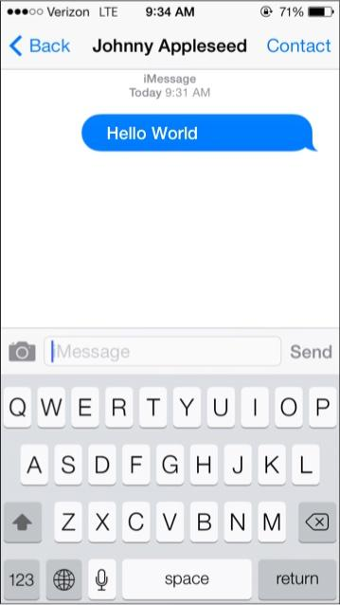



Hello World
Create It With
in cooperation with
Day 3 :
Hello Controls
Notes:
We

Slide 2


Hello World App
Say Hello to the...Tools Palette in Depth
in the last two days, you have been adding controls to Cards to create our Hello World App. This was done using the tools palette that allows you to change between Edit (top right) and Run (top left) mode, add controls, and edit bitmap images with the paint tools.
To get recap, you drag any control onto a card. You can also double-click an object to create a object of that type in the center of the card. But first lets do a review of the available controls

Slide 3

Hello World App
Control Resources
Devin Asay, from Brigham Young University, has done a wonderful job creating Learning to Program with Livecode. This is based on his college course and you will find a great deal of well written explanations and suggestions on coding with LiveCode.
LiveCode Objects
Properties of Objects in LiveCode
Scripting Object Properties
Groups

Slide 4

Hello World App
Buttons
Push button
Buttons are fundamental entities that allow you to interact with devices, for example with mechanical buttons on a keyboard or a remote control, or graphical buttons on a touch sensitive computer display
All button objects in LiveCode are highly flexible and customizable. Common settings include the ability to show and hide the border or fill, and to display an icon.
Check box button
Radio button
Default button
Rectangle button
Tab Panel button
Introduction
Using Tab Buttons
Using Radio Buttons
Using Button icons
LESSONS

Slide 5

Hello World App
Fields
There are 5 basic field types in LiveCode, all of which you can add to your stack from the Tools Palette.
Label field: a single line, non-editable field
Text entry field: a single line, editable field for user data entry.
Scrolling field: a multi line, scrollable, editable field. Basic table field: a basic table field allowing data to be displayed in cells
Scrolling list field: a multi line, scrollable, non-editable field allowing the user to make single or multiple selections
Label field
Text entry field
Scrolling field
Basic table field
Scrolling list field

Slide 6
Hello World App
Menus
Menus are used to display a list of choices. The pulldown menu displays a standard pulldown menu, The option menu allows a choice from a list. The combobox allows the user to type an option or choose from a list. Popup menus can be displayed underneath the cursor and used to provide context sensitive options anywhere in your application.
Option Menu
Pulldown Menu
Combo box
Pop Up Menu

Slide 7
Hello World App
Scrollbars
Progress Bar
Scroll bars can be used as a progress bar to display a value, a slider to allow the user to choose a value, or to scroll objects. (Note that you don’t need to use a scrollbar object with fields or groups as these can display a built-in scroll bar.) Sliders and scrollbars can be displayed both horizontally and vertically – to display vertically, resize so that the height is greater than the width.
Slider
Little Arrows
Scrollbar

Slide 8
Hello World App
Images
LiveCode supports a wide range of media formats, allowing you to produce rich media applications.
The image object allows you to import or reference images, manipulate images by script or interactively with the paint tools, and save them out in different formats with variable compression options. Support extends to alpha channeled PNG images and animated GIF images. Images can be imported and reused within a stack to create custom or interactive interface elements.
Image

Slide 9
Hello World App
Players
Use the player object to display and interact with any media formats supported by QuickTime. LiveCode allows you to turn on and off tracks within a movie, pan, zoom or change location within a QTVR movie, set callback messages that trigger scripts at specific points in the movie, and stream movies from a server.
Player

Slide 10
Hello World App
Graphics
Polygon
Line
LiveCode supports the creation and manipulation of Vector graphics via the graphic tools and by script. LiveCode supports paths with variable fills, gradients, blended and antialiased graphics.
Rectangle
Rounded Rectangle
Oval
Freehand Polygon
Freehand
Line Size
Line Color
Fill Color

Slide 11






Hello World App
Select Tool
Paint
Bucket Tool
Spray Tool
LiveCode has a vast array of paint tools that allow some simple image editing within image controls
To use the paint tools you
1 Add an image area to the stack.
2. Ensure the paint tools are shown in the Tools Palette by clicking the fold out triangle.
3. Select one of the paint tools.
4. The paint tool can be used within the image area.
Eraser Tool
Freehand Tool
Pencil Tool
Brush Tool
Fill Color
Line Color
Line Size

Slide 12

Hello World App
Data Grid
The LiveCode Data Grid enables you to integrate powerful tables and forms into your LiveCode projects. Data grids combine LiveCode groups and behaviors to provide you with a simple, yet flexible means of displaying your data in just about any way you want.
The LiveCode Data Grid is a remarkable and versatile control. We will shortly create a basic data grid and look at at a small portion of it’s functionality.
Data Grid
LiveCode Data Grid
Introduction Data Grid Fundamentals Example: Creating a List of People
Working With Data Grid Forms
LESSONS

Slide 13
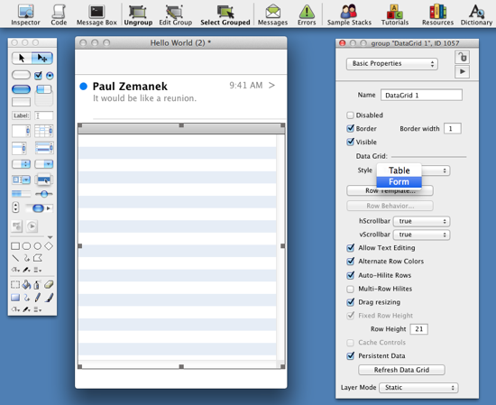
Hello World App
Let’s learn about the Data Grid Control
1. First add a grid control from the Tool Palette.
2. Open the Property Inspector for it (this can be accessed by double-clicking on the control, from the toolbar, from the Object menu and from context sensitive menus).
2
1

Slide 14
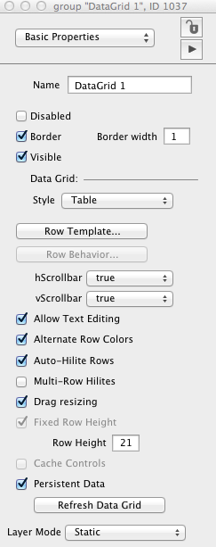
Hello World App
Say Hello to the...Property Inspector
The last two days, you have been setting values on properties of our controls in your Hello World App. The Property Inspector allows you to view and edit the properties for any selected object. Properties control how an object looks and some aspects of a control’s behavior.
To recap, the Inspector can be accessed by double clicking on a selected object, from the toolbar, from the Object menu and from context sensitive menus.
Let’s learn more...

Slide 15
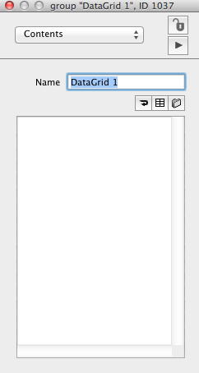
Hello World App
Contents
The contents section of the property inspector will show the textual contents of the current selected object. If this is a text field then this will be the contents of the field. In the case of a data grid Table you can see the contents of each cell here.

Slide 16
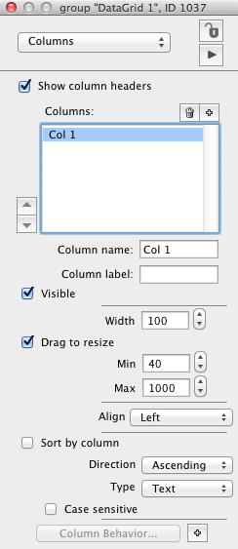
Hello World App
Columns
A column, in the context of a table style Data Grid, can be seen as an individual group for a specific data set within the grid.
An example could be an address book with a different users details (columns could be Name, Last Name, Address and Phone number).

Slide 17
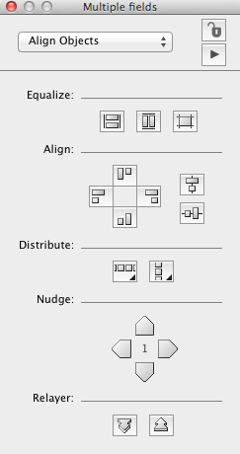
Hello World App
Align Objects
*Note: The Align Objects option ONLY appears if you have multi objects selected on your card.
1
To open the Align Objects Inspector, select multiple objects by dragging over them, then open the Inspector and choose Align Objects from the menu at the top of the Inspector. The Align Objects pane will automatically be displayed if you select multiple objects of different types.
There are a number of other options under 'Align Objects'
1. Make the widths and/or height of objects equal.
2. Align objects six different ways.
3. Space objects equally (horizontally or vertically).
4. Nudge objects one pixel at a time.
5. Change the layer of controls.
2
3
4
5

Slide 18
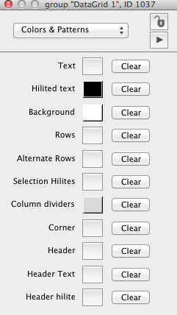
Hello World App
Colors & Patterns
This section allows you to change the various colors of the selected LiveCode control. Each item deals with a specific color. Some examples for a datagrid are:
Text is the default color of the text
hilited text is the color of the text when there is a selection
Row is the color of every odd row
Alternate row is the color of each even row

Slide 19
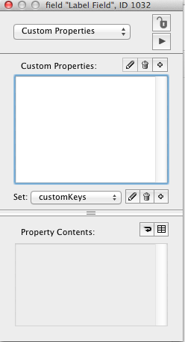
Hello World App
Custom Properties
A custom property is a property that you create for an object, in addition to its built-in properties. You can define custom properties for any object, and use them to store any kind of data. You can create as many custom properties for an object as you want.
Use a custom property when you want to:
associate data with a specific object
save the data with the object in the stack file
access the data quickly
More on Custom Properties Here

Slide 20
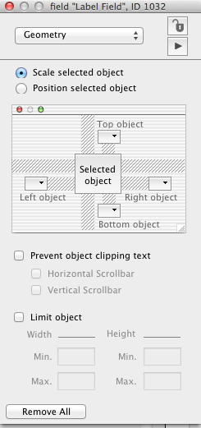
Hello World App
Geometry
The geometry manager is one way to manage the assets of your stack when the user resizes a stack window.
It is often the case that stacks need to be resizable particularly when they may contain a variable volume of content. We’ll come back to this later in the course.
Geometry Manager Lesson

Slide 21
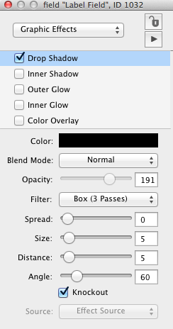
Hello World App
Graphic Effect
Graphic effects are one way to make your LiveCode controls more aesthetically pleasing. The graphics effects available are some of the most common ones found in many popular photo editing applications.
Using Graphic Effects

Slide 22
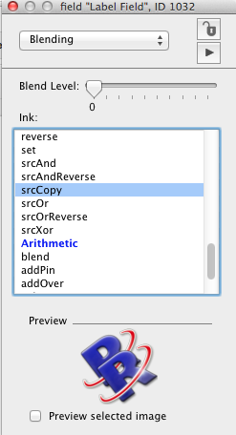
Hello World App
Blending
Blend modes determine how an object's colors combine with the colors of the pixels underneath the object to determine how the object's color is displayed. To set the blend mode of an object, use the Blending pane in the Inspector or set the object's ink property. All objects in LiveCode support blend modes, with the exception of stacks.

Slide 23
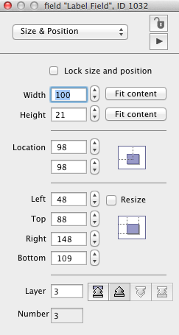
Hello World App
Size & Position
This allows for fine granular control over the size and position of a selected object.

Slide 24
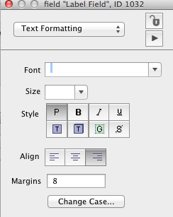
Hello World App
Text Formatting
This allows you to set the various Text based properties for a LiveCode object. You are able to select from the various in-built system fonts, set the size of the text, give the text some styling (e.g bold), Align the text and set the margins of the text.

Slide 25
Hello World App
Let’s set a Data Grid property
1
1. Make sure you have added the grid properly and have selected Basic Properties.
2. The property we will set first is Style. This will tell LiveCode to format the grid in the style of a Table or a Form.
Table: The grid will be a series of rows and columns.
Form: The grid will be series of a Template which is defined by you.
2

Slide 26
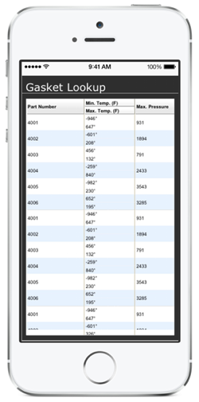
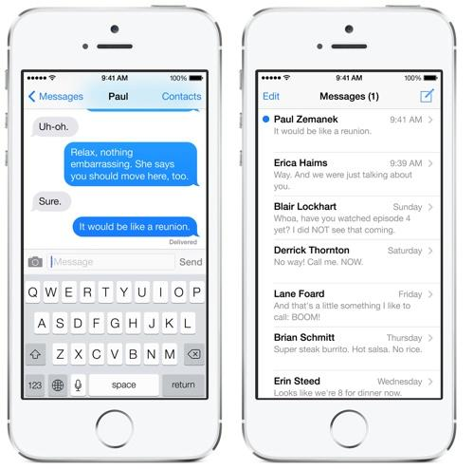
Table Grid
Form Grid
Hello World App
Table vs. Form
Cols
Template
A data grid table shows information in a grid, like a spreadsheet. A data grid form shows information in rows, with data item in cols as shown.
Today we want to use the Form style. As you can see, the Form allows us to use a template to style the data. So for each row, LiveCode will use a template you have designed and populate the template with that rows data.
Let’s take a two different views of how the template process works..
Rows

Slide 27
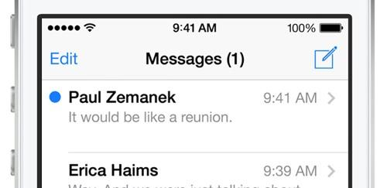
Hello World App
3
4
2
1
Process Flow
View
Data
set the dgData...
On FillInData
Row
Template
5
Add a Row Template.
Code FillInData to set the Array Data to controls in the Template.
Load the data in an array.
Set the array to the grid
FillInData displays each data item in the array in the list.
The new row appears in the Grid.
6
set the dgData of group "MsgList" to MsgData

Slide 28
1
Create Row Template
Hello World App
NameofSender
MsgTime
>
Physical Flow
View
MessageText
3
Get Data
4
Set Data Array to the Grid
FillInData
Array
set the dgData of group "MsgList" to MsgData
6
5
2
Code FillInData
on FillInData pDataArray
set the text of field “NameofSender” of me to pDataArray["NameNameofSender"]
…
set the text of field “MsgTime” of me to pDataArray["MsgTime"]
end FillInData

Slide 29
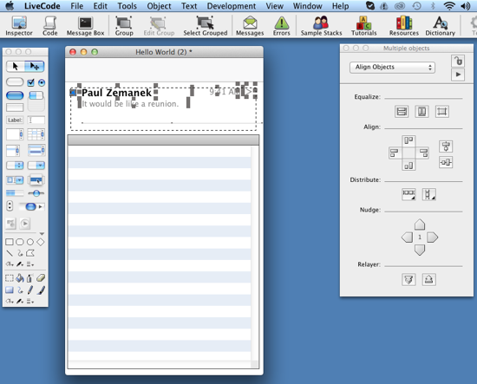
Hello World App
Step
1
Create a Row Template
If you think about it, we have already created our template in the last lesson. Let’s save time and effort [always a good idea] and copy our controls.
1. Select all of the controls as you see. Make sure not to select the header or the grid.
2. You should see the selector dark gray boxes on all of the controls.
3. Now copy the controls to the clipboard. Just copy, do not paste yet.

Slide 30
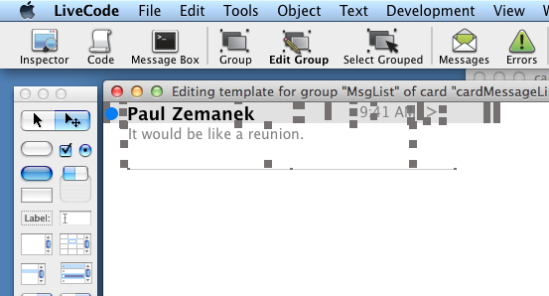
Hello World App
Step
1
Create a Row Template
Just a design issue to be careful of. Many forget to size the controls to fill the area desired. You will see that we have sized the Sender Name and the message text to the correct size.
1
3
2
1. Size the Sender Name just before the Message time. Not too close or it will overlap if the day is long
2. The Message text is below the time, but extended to the right alignment of the time. *Turn off the Don’t Wrap
3. The time should be aligned right, and the name and message aligned left.

Slide 31
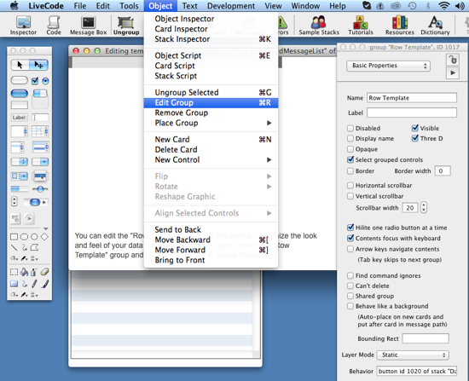
Hello World App
Step
1
3
Create a Row Template
4
1. Now click and select only the data grid open the Property Inspector.
2. Click Row Template button in the Property Inspector.
3. You will see a gray box on the top of the pop-up. Select it. Dark gray boxes will appear to indicate that it is selected.
4. Now select in “Object” in the menu, then “Edit Group”.

Slide 32
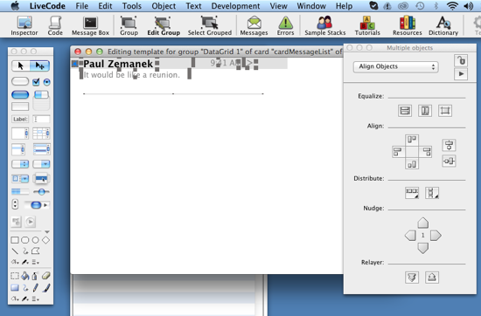
Hello World App
Step
1
Create a Row Template
1. Paste your template controls.
2. While they are still all selected, move them to the top left corner as you see on the right.
Congratulations, you are on your way to creating your first row template. Since we are going to set our data to these controls, LiveCode needs to have the name set so it can identify each control.

Slide 33
Hello World App
Step
1
Create a Row Template
Let’s look at our row template as see what data we will need:
New Message - Will indicate if there is a new message.
Sender - The person who sent the message.
Message Text - The actual message text.
Message Time - The time of the message.
Navigation Arrow - No Data
Separator Line - No Data
2
4
1
5
3
6

Slide 34
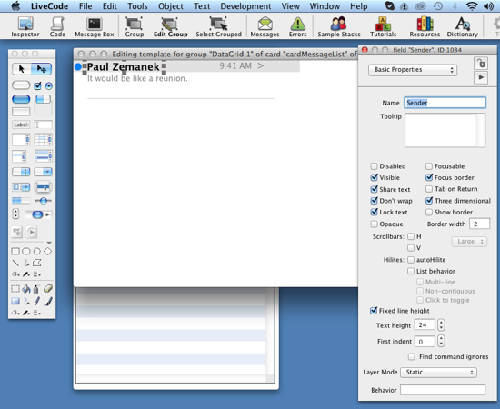
Hello World App
Step
2
1
Create a Row Template
1
4
3
Please select each control and set the name property accordingly. In LiveCode you can have spaces in the Name of controls, but it is good programing practice not to have spaces and just set your name as one word.
NewMessage
Sender
MessageText
MessageTime

Slide 35
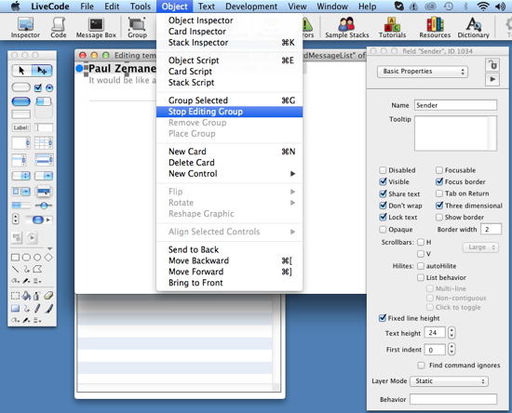
Hello World App
2
Step
1
Create a Row Template
1
The next step is to save you row template.
1. Select the “Stop Editing Group” from the Object menu.
2. Then to complete and save the template, you must close the window. On the Mac, it is the Red circle and on Windows is will be the “x” option.
3. You will be prompted to save - YOU MUST click the Save option, or all your changes will be lost.2

Slide 36
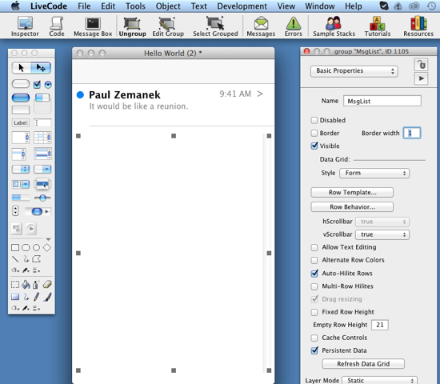
Hello World App
Step
1
Create a Row Template
We now need to set a few properties so LiveCode can style the grid so as to emulate the Message List. The three properties need to be turned off [uncheck the box]. You grid should now look like the image on the right.
1
4
Border
Alternate Row Colors
Fixed Row Height
Click Row Behavior to start Step 2 in our process.
2
3

Slide 37
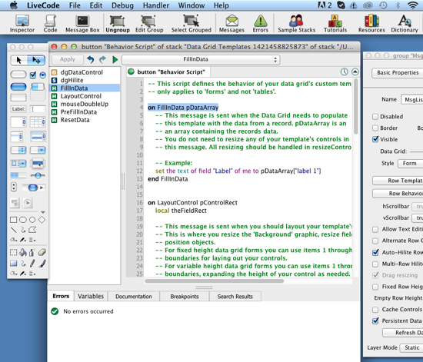
Hello World App
Step
2
Code FillInData
We now need to set a few properties so LiveCode can style the grid so as to emulate the Message List. The three properties need to be turned off [uncheck the box]. You grid should now look like the image on the right.
1
2
1. Select FillInData on the left list. This will display and highlight the where we need to code next.
2. Next we need to understand and change the default Example code.

Slide 38
Hello World App
Step
2
Code FillInData
<< Connects the Data to the Control
Property
Control
Control Name
Your Data
1
set the text of field "Sender" of me to pDataArray["Sender"]
2
3
4
Connecting the Row Template Controls with the Data
FillInData is called for each row in your grid. It’s job is to connect your data to the control. For example, the first sender is "Paul Zemanek" - FillInData will take that data and set it to the text of field “Sender”.
1. First is the command. “Set” tells LiveCode that it is going to set a property
2. What Property of what Control do you want to set or update [* in FillInData you MUST put of me]
3. The “to” is the connector. It is a more simple way to say “=”
4. Where in your DataArray to get the value from.

Slide 39
Hello World App
Step
2
2
4
1
Code FillInData
Do you see the connection?
3
Current code in FillInData...
set the text of field "Label" of me to pDataArray["label 1"]
--The values of NewMessage will show the circle if it is new
-- or will hide the circle if it is not
set the visible of graphic "NewMessage" of me to pDataArray["newmessage"]
--The rest of the text of the fields are set
set the text of field "Sender" of me to pDataArray["Sender"]
set the text of field "MessageText" of me to pDataArray["MessageText"]
set the text of field "MessageTime" of me to pDataArray["MessageTime"]
change the code to...
1
2
3
4
Click the Apply Button and you are good to go!

Slide 40
Hello World App
Step
3
2
4
1
Get Data
Do you see the connection?
Today is quite a complex lesson, so we wish to make it a little easier for you. We will be covering data in great detail in a future lesson, so for now we provided you a file to copy from. [It will also save you time from typing everything.]
3
1
put "true" into MsgData[1]["NewMessage"]
put "Paul Zemanek" into MsgData[1]["Sender"]
put "It would be like a reunion." into MsgData[1]["MessageText"]
put "9:41 AM" into MsgData[1]["MessageTime"]
2
1. Find and open the LoadMessages.txt in today’s lesson file.
2. Highlight all of the text and copy it to the clipboard.
3
4
Take a moment to save your work

Slide 41
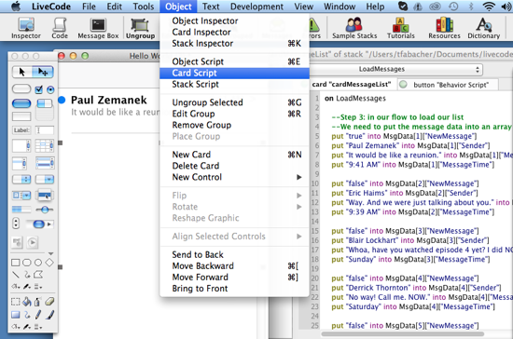
Hello World App
Step
3
Get Data
1
2
New we need to open the code editor and paste in our data.
3
1. Click on on the stack, so the Object Menu appears.
2. Select Card Script.
3. Just Paste in the LoadMessages text and LiveCode will automatically do everything needed to import it.
Next we simply have to connect the data to the grid. Luckily this can be done with just 1 line of code in LiveCode.

Slide 42
Hello World App
Step
4
Set Data Array to the Grid
Property
Control
Control Name
Your Data
1
set the dgdata of group "MsgList" to MsgData
2
3
4
Setting the Data to the Grid
We have put in a placeholder where you should add the code to set you data to the grid:
1. First is the command. “Set” tells LiveCode that it is going to set a property
2. We are setting the dgdata property of the grid MsgList.
3. The “to” is the connector. It is a more simple way to say “=”
4. We have already build the data above into MsgData. We are just connecting them here.
--Step 4: in our flow to load our list
--Below is the code that will send the data to the grid.

Slide 43
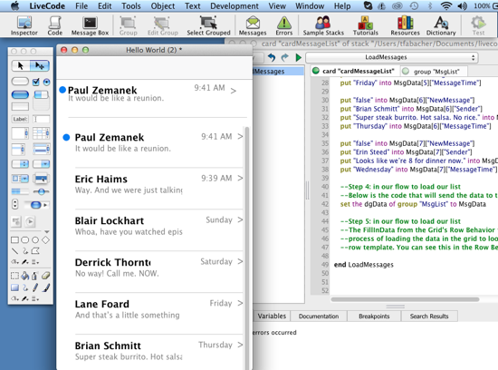
Hello World App
Step
5
1
2
Grid calls FillInData
It is finally time for the FillIndata to use the template and data to emulate the iPhone Message List.
1. Click Apply on the Code Editor.1
2. Then click the Green “Play” or Continue button. It you get a pop-up just say OK.
3. BINGO! You will witness the LiveCode magic - the list will appear in live.
3

Slide 44
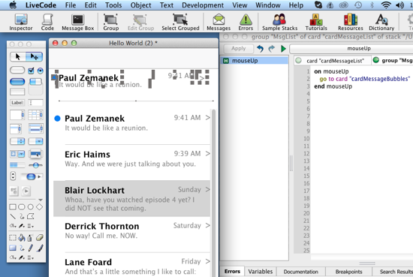
Hello World App
Step
6
Congratulations!
3
1
There is just a few things remaining.
1. Select the old controls [make sure you have not selected the header or the grid] and hit the delete key.1
2. Now select the grid and size it to fill in the body area of the App., like your iPhone.
3. Last we need to add the code to go the Message Bubble card. Do this from the Edit Script option on the Grid...click Apply and we are done!
2
on mouseUp
go to card "cardMessageBubbles"
end mouseUp

Slide 45

Hello World App
Congrats on learning: Controls
Don’t forget to save your LiveCode Project!
Visit LiveCode
If you wish to learn more…

