Slide 1

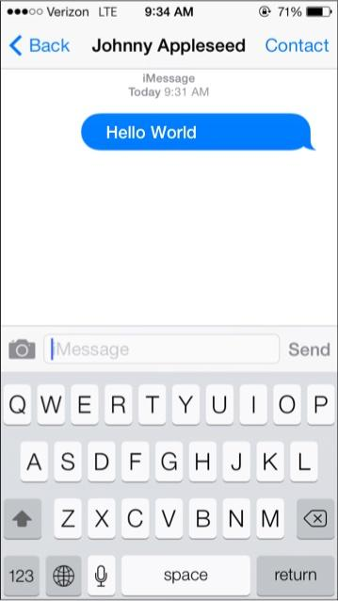



Hello World
Create It With
in cooperation with
Day 2 :
Hello Stacks and Cards

Slide 2

Hello World App
Understanding the
1
2
3
You create a user interface window, which are called Stacks and Cards.
Then you populate the Cards with controls, like buttons, check boxes, text fields or list.
You use LiveCode’s English-like programming language to tell your application how to behave.

Slide 3
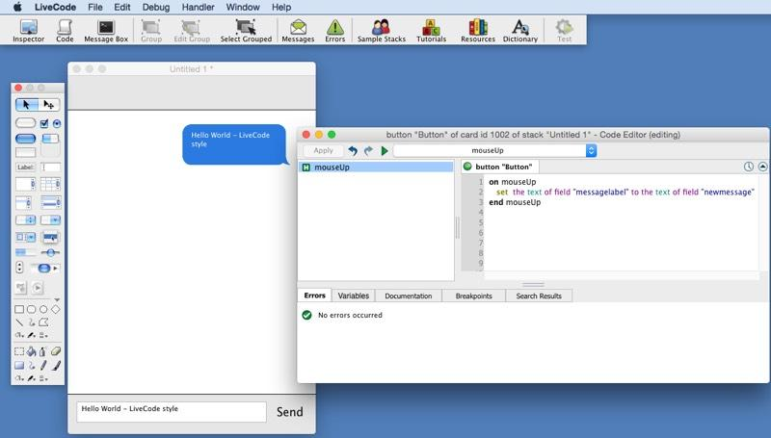
Hello World App
First open your HelloWorld livecode project and you should see the
1
The LiveCode...123
3
User Interface windows with Stacks and Cards.
Add controls like buttons to the Cards.
Tell LiveCode what to do and how to behave.
2

Slide 4
Hello World App
Understanding Cards and Stacks
Card(s)
Main Stack
The first step in creating a LiveCode application is creating the window for the user will see, which in LiveCode is called a stack.
One card is created by default when a new stack is created. You can then keep adding more cards to your stack as needed.
Card(s)
Card(s)
Sub Stack
Sub Stack

Slide 5
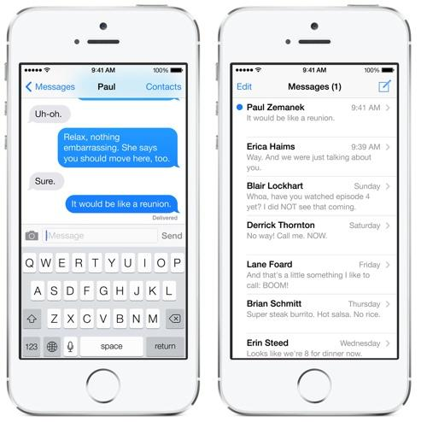
Stack
Hello World App
Understanding Cards and Stacks
Here is an example of an app with two cards. You see 2 different screens. In LiveCode this is 2 cards on one stack.
Controls
Card1
Card2

Slide 6
Hello World App
Internet Resources
LESSONS
Occasionally We will send you off the lesson to explore other resources on the internet which will help you to gain a better understanding of the concepts we are covering here.
These lessons will help you feel more comfortable with Stacks and Cards.
Adding Objects to a Stack Navigating Around a Stack How do I use the Project Browser?
Beginners Guide

Slide 7
Hello World App
Let’s Create a Message List Card
When creating an App, you first want to have a design of your User Interface. Luckily for us, Apple has already done the design work. Our goal is to emulate the Message App seen on the right with LiveCode.
The first step is to Add a New Card...

Slide 8
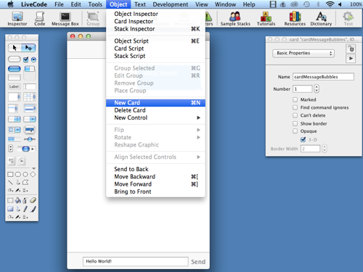
Hello World App
Add a New Card
Since the message list requires a new and different user interface, we will need a new card.
1. Open your app then choose “Object” and “New Card” from the menu.
2. You will see a new card in your stack with no controls.
1

Slide 9
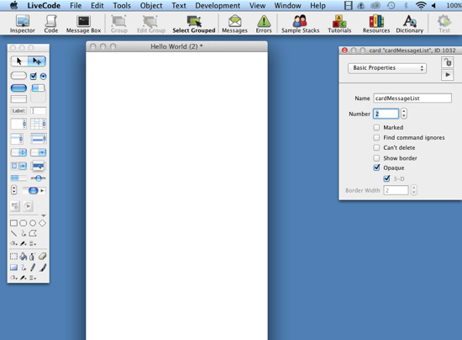
Hello World App
Set the Card Name
LiveCode uses the name of the controls, Stacks and Cards for you to use in code, so it is important to set names that you will remember and are relevant.
1. Double click the card to open the Property Inspector.
2
1
2. Set the Name to:
“cardMessageList”

Slide 10
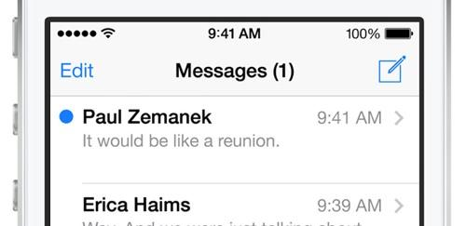
Hello World App
Let’s look and see the controls that are needed
By looking at the Message list, we see that there are 6 controls that will be needed:
New Message
Person
Message text
Message Time
Navigation Arrow
Separator Line
2
4
1
5
3
6

Slide 11

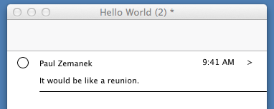
Hello World App
2
4
1
5
Now lets add the controls to our new card. When you first add them, they will not look the same, but we will style them very soon.
3
6
New Message [Circle]
Person [label]
Message text [label]
Message Time [label]
Navigation Arrow [label]
Separator Line [line]
2
4
1
5
6
3

Slide 12
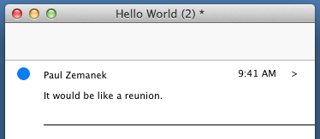
Hello World App
Set the New Message Indicator Circle
1
Open the Inspector for the Circle.
1. As with the rectangle in lesson 1, make it Opaque.
2. Go to Colors & Patterns in the Inspector menu. Set the Fill color (the button immediately next to the Clear button) to blue [RGB 25, 121, 252].
1

Slide 13
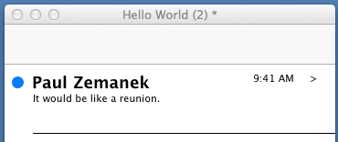
Hello World App
2
Make the label match the Person’s name style
Select the field. Go to Font in the Inspector.
Set the font size to 18.
Set to bold.
2
Note: You may also need to adjust the size of the label and the location to make it match.

Slide 14
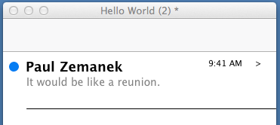
Hello World App
The message just needs a little color change
3
Go to Font.
Set the font size to 12.
Go to Colors & Patterns.
Set the Text color to Nickel gray [RGB 128, 128, 128]
The Line Broder color is Silver gray [RGB 204, 204, 204]
3

Slide 15
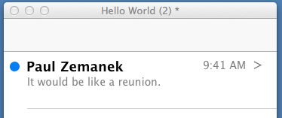
Hello World App
4
Same with the Time, Navigation and Line
5
6
Go to Font.
Set the time font size to 14 and arrow to 18
Go to Colors & Patterns.
Set the Text color to Nickel gray [RGB 128, 128, 128]
The Line Border color is Silver gray [RGB 204, 204, 204]
4
5
6

Slide 16
Stack
Hello World App
Moving Between Cards
Now that we have finished our first item, the next question is how do we move between our 2 cards in our stack.
The answer is that it needs to be coded. We will get started… but first you need to learn how to move between cards in the LiveCode edit mode.
Card1
Card2

Slide 17
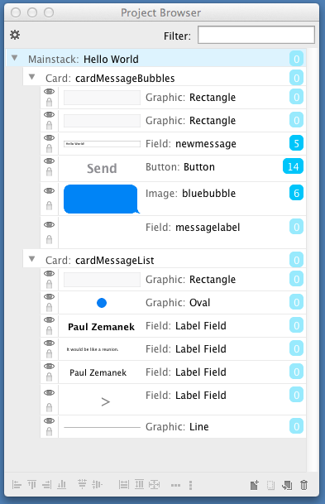
Hello World App
Say Hello to the
Project Browser
The Project Browser provides an overview of your stacks, Cards and Controls in tree form, showing you all the open stacks, cards and controls that make up your application. You also have access to some of the basic properties of controls as well as editing code, adding, deleting and aligning controls. Learn More Here

Slide 18
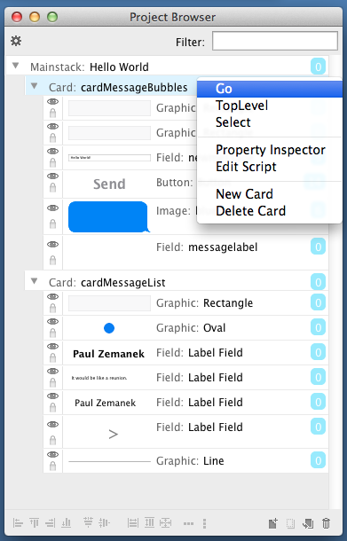
Hello World App
Open the Project Browser and have a look at your App
Take a look and find the card:
cardMessageBubbles
Let’s move to the card by clicking on it. Then Right Click in Windows or Ctrl+Click on the Mac. The menu will pop-up and select “Go”. The cardMessageBubbles will appear.

Slide 19
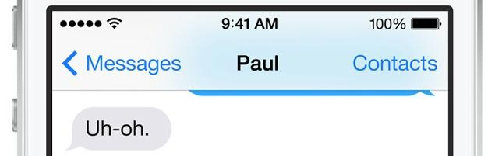
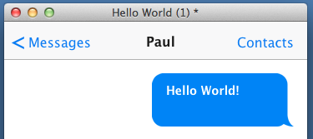
Hello World App
1
2
3
4
Create the Header for the Message Card
We need to add 4 controls to the header and set their style. *Turn off ThreeD for Buttons
Add a button and set the label to “<”
Next button set to “Messages”.
Add a label field as “Paul” for the Person. Set the text style to bold.
Add a button and name it “Contacts”, which will open the contacts list in another lesson.
See the Results

Slide 20
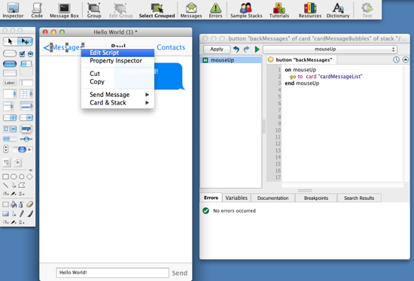
Hello World App
Code the Button to go to the Message List
4
1
3
2
1. Right click the < + Message button and you will see “Edit Script”.
2. LiveCode will open the script windows and type:
on MouseUp
go to card "cardMessageList"
end MouseUp
3. Click the Apply button
4. Run the App (top left of Tools) and Click...

Slide 21
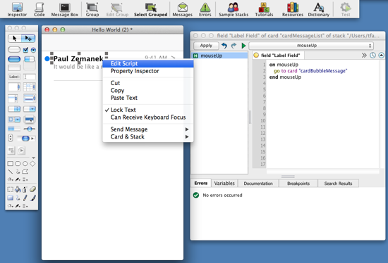
Hello World App
Let’s move again *Go back to Edit Mode First
1
3
2
1. Right click the “Person Name” label and you will see “Edit Script” - click it.
2. LiveCode will open the script windows and type:
on MouseUp
end MouseUp
3. Click the Apply button
4. Run the App and Click...
go to card "cardMessageBubbles"

Slide 22
Stack
Hello World App
You should be moving between Cards!
Card1
Card2

Slide 23

Hello World App
Congrats on learning: Stacks and Cards
Don’t forget to save your LiveCode Project!
Visit LiveCode
If you wish to learn more…

