Slide 1


Open Source Documentation
Adeyinka Oresanya
Software engineer,
FireSwitch Technologies

Slide 2

What is Open Source Documentation?
The art of creating communicable materials used to instruct users or contributors of an open-source software on:
How it works
How to put it together (assembly & installation)
How to use it
How to keep it running (maintenance).

Slide 3
Why Documentation?
Empowers new contributors
Attracts contributors to your project/community
Ensures continuity and long-term sustainability
Improves collaboration
Reduces support burden

Slide 4
When is Open Source Documentation Crucial?
When onboarding new users and contributors.
When introducing new features or functionalities.
When resolving bugs and technical issues.
When seeking community feedback and contributions.

Slide 5
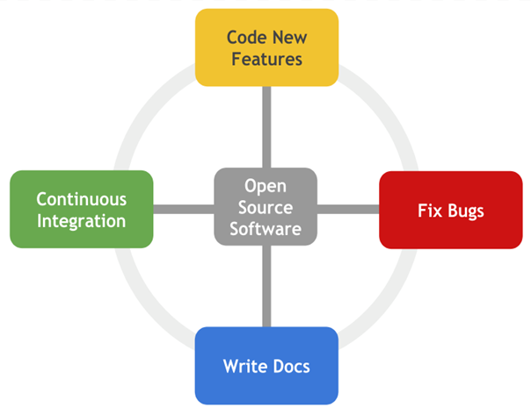
When to Write Open Source Documentation
• Early and Often
• During Development
• For New Releases
• When Issues Arise

Slide 6
Where can OS Documentation be found?
Project websites and wikis: e.g. https://github.com/chaoss/chaoss-slack-bot/wiki
Collaboration platforms like GitHub, GitLab: e.g. https://github.com/adeyinkaoresanya/badging-bot/blob/adeyinka-tutorial-contributions/TUTORIAL.md
Community forums and mailing lists

Slide 7
Tools and platforms used for collaboration
GitHub, GitLab, BitBucket
READMe, Google Docs, Confluence, Read the Docs
Slack channel, Discord

Slide 8
How to get started contributing to OS Docs
Take a course in technical writing (e.g. https://developers.google.com/tech-writing)
Read documentation made by other people.
Join the OSS community if the project has one.
Use the project/product to understand how it works.

Slide 9
How to get started contributing to OS Docs
Read the contribution guide first!
If you notice a bug or doc issue, create an issue first and ask to be assigned to it.
Make meaningful contributions even as you take baby steps.
Respect maintainers’ time. Be patient.

Slide 10
THANK YOU :)

