Slide 1

Communicating Data Effectively
Adeyinka J. Oresanya

Slide 2






About Me
Ph.D candidate, University of Ibadan
Co-organiser, AISaturdays Ibadan
Microsoft Student Partner
@TechieGriot
Adeyinka J. Oresanya
adeyinkaoresanya@gmail.com
medium.com/data-griot

Slide 3
Human Factors in a Data Scientist
Empathy
Communication
Imagination
Curiosity
Leadership
Creativity
Source: https://www.youtube.com/watch?v=qrhRfPY4F4w

Slide 4

Most important skill…
Asking the right questions from your data!

Slide 5
What communication does to data
Actionable insights
Impact
Persuade/influence

Slide 6

How do we communicate data effectively?
Embed your data in a story
Stories appeal to human emotions
They arouse curiosity
They facilitate dialogue

Slide 7
How do we communicate data effectively?
Embed your data in a story
Plot – What context is essential?
Twists – What is interesting about my data?
Ending – What action do I want my audience to take away from the information at hand?

Slide 8

How do we communicate data effectively?
Understand the context of your communication
Who – To whom would you be communicating?
What – What do you want your audience to know or do?
How – How will you communicate it to them?
– How can you use data to make your point?

Slide 9

How do we communicate data effectively?
Who?
Audience is King!
Know who your audience are – Technical? Non-technical?
Identify the decision maker(s)

Slide 10
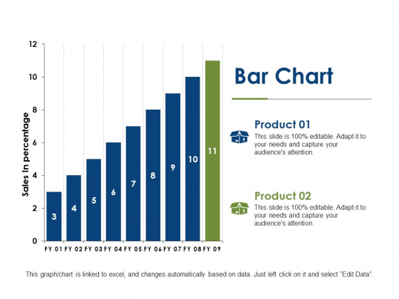
How do we communicate data effectively?
What?
You always want your audience to know or do something
Articulate why they should care about the information you put across
Don’t simply present data!
Be confident in making recommendations based on your analysis

Slide 11

How do we communicate data effectively?
How?
Live presentation or written document?
What tone do you want to set?

Slide 12

How do we communicate data effectively?
What data is available?
Always use data as a supporting evidence of the story you want to tell

Slide 13
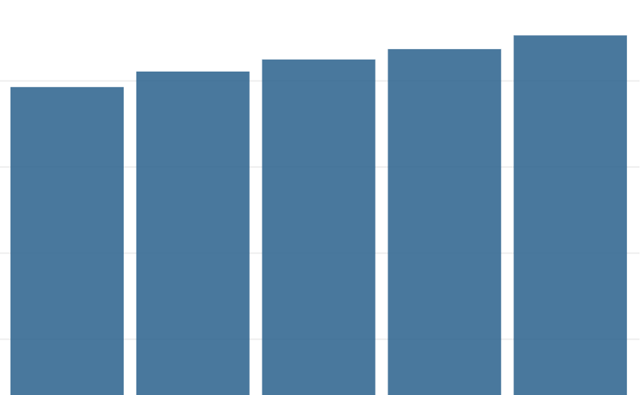
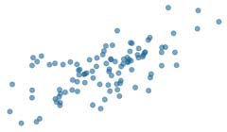
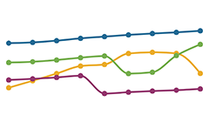
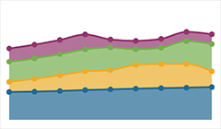
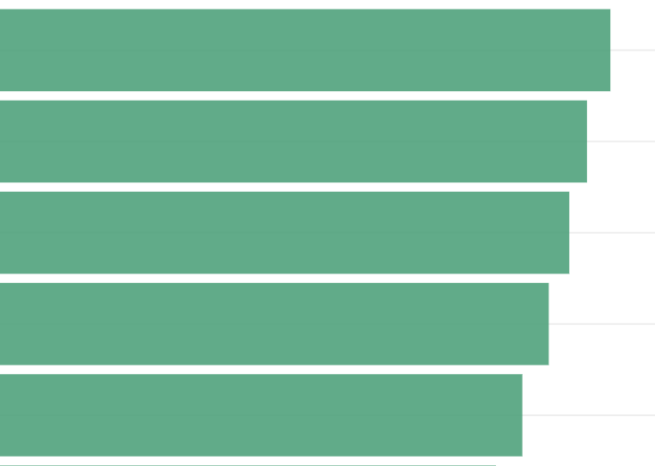
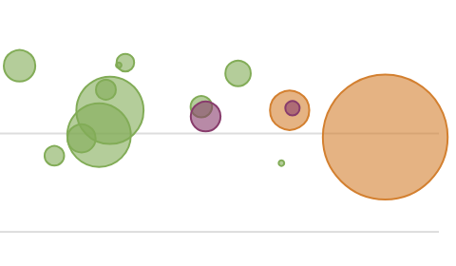
How do we communicate data effectively?
Use the right visual
Size
Change over time
Correlation
Column chart
Line chart
Scatter plots
Bar chart
Area chart
Bubble chart

Slide 14
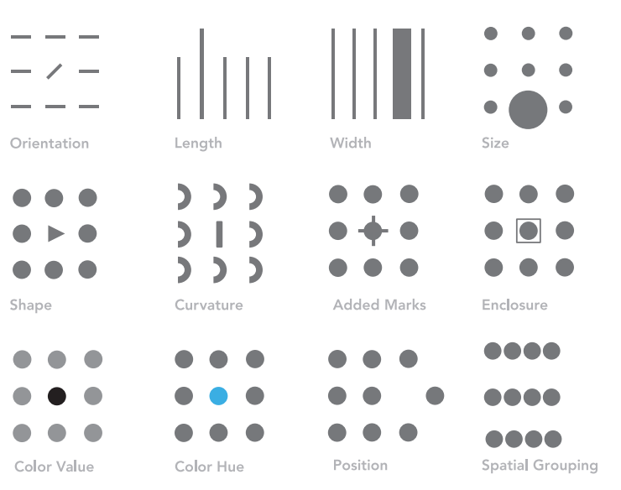
How do we communicate data effectively?
Focus attention
Where do you want your audience to pay attention
Use of pre-attentive attributes
Strategic and intentional use of colour
Careful use of explanatory text
Do not emphasize multiple things in a visual, at least not at the same time

Slide 15
Focus Attention
Smallholder farmers in Southwestern Nigeria are using television as information source
Two-thirds of the farmers source their agricultural information from television
Source: Field Survey, 2018
© 2020 Adeyinka J. Oresanya. All rights reserved

Slide 16


