Slide 1

Decode the Repo: Strategies for understanding and contributing to complex codebases
Adeyinka Oresanya
@AYK_dev
Technical Lead, CHAOSS

Slide 2
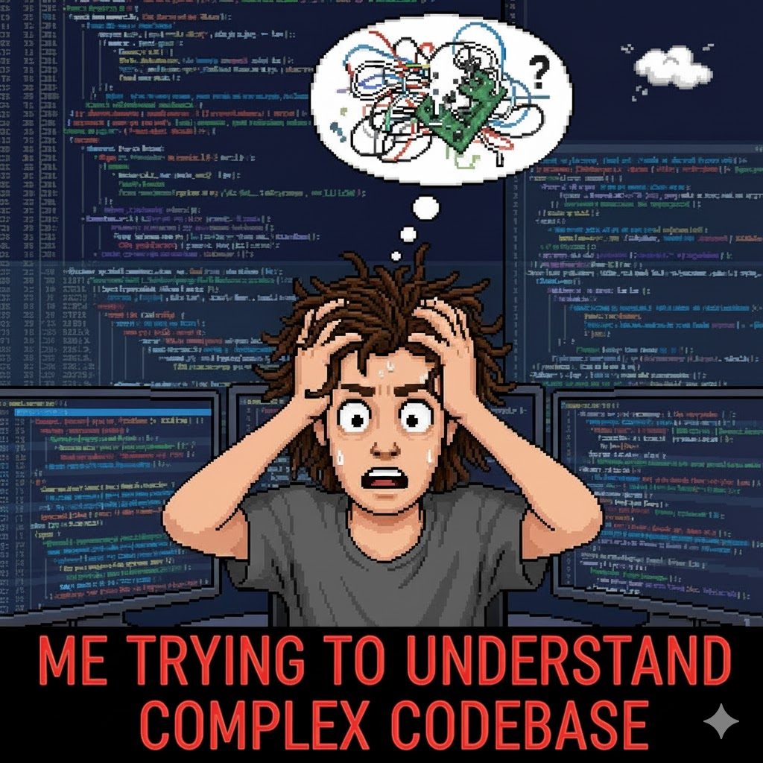
The Struggle is Real!
Too many files
Zero docs
Cryptic function names

Slide 3
Why it matters
Complex repos are where real learning and growth happen.
The ability to decode a repo makes you:
A faster learner
A more valuable contributor
A better team player

Slide 4
The first contact
Don’t dive in — observe first:
Understand what the project/product is about.
Navigate the project/product like a user would.
Document the user flow.
You could take note of bugs and other issues alongside.

Slide 5
Take a Tour
Start with the README
Next is the Contributing.md
Any other guide or docs about the project e.g. Wiki pages
Discussions
Communication channels
Then on to the big one – the source files!

Slide 6
Build a Mental Model
Find the entry point of the app
Simplify what you see:
Draw your own diagram of the flow
Write a 1-sentence summary for each module
Keep a “What I think this does” notebook
Validate your assumptions by reading small sections of code

Slide 7
Tools and Techniques
git blame
commit history
VSCode’s outline for navigation
Code assistants e.g GitHub Copilot, GetOnboard

Slide 8
Demo

Slide 9
Make a Small Contribution
Start small, but start right.
Fix a typo or update docs → get a PR merged → learn review flow.
Trace one bug → learn system interactions.
Contribute tests → deepen code understanding.

Slide 10
Sustaining Confidence
Don’t expect to understand everything
Focus on one module at a time
Keep personal notes
Review merged PRs weekly
Ask questions publicly — it helps everyone

Slide 11
Q & A

