Slide 1


Slide 2






About Me
Data manager, Katalista Ventures
Contributor, CHAOSS
@AYK_dev
Adeyinka J. Oresanya
adeyinkaoresanya@gmail.com
medium.com/developers-compass

Slide 3
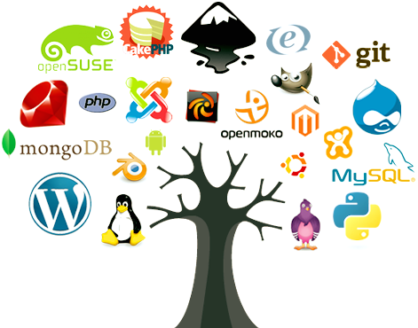
Open source vs proprietary software
What is open-source software (OSS)?
Freely distributed source code
Easily accessed
Can be modified

Slide 4

Open source vs proprietary software
What is proprietary software?
Closed and copyrighted source code
Licensed for purchase
Limited use in terms of distribution and modification

Slide 5
Benefits of open source software
For individuals
Faster project starts, no initial cost outlay
Community-driven reliability and security
Better community-based collaboration
Real-life, hands-on experience
More employment opportunities

Slide 6
Benefits of open source software
For organisations
Lower cost
Faster launches
No contract lock in
Community-based intel and support
Improved hiring

Slide 7
How do I contribute to open source?
Code contribution
Non-code contribution:
designer
Community manager
researcher
Project manager
Technical writer
Marketing specialist

Slide 8
Where do I find OS projects to contribute to?
https://docs.github.com/en/get-started/exploring-projects-on-github/finding-ways-to-contribute-to-open-source-on-github
https://hackernoon.com/how-to-find-open-source-projects-for-beginners
https://opensource.guide/how-to-contribute
https://www.firsttimersonly.com/
https://opensauced.pizza/
CHAOSS (https://chaoss.community/)

Slide 9
Tools and Platforms used for collaboration
Version control:
GitHub
Gitlab
Bitbucket
Communication channel:
Slack
Discord

Slide 10
Best practices when contributing to OS projects
Use the project/product to understand how it works
Read the contribution guide first!
Join the community if they have one
If you notice a bug, create an issue first and ask to be assigned to it
Make meaningful contributions even as you take baby steps
Respect maintainers’ time. Be patient

Slide 11


Slide 12


