Slide 1
A PROJECT PRESENTATION ON DESIGN AND CONSTRUCTION OF AN SMART IRRIGATION SYSTEM BY ADEYINKA, ADEMOLA ABDULWAHAB (14/30GR015) DEPARTMENT OF COMPUTER ENGINEERING UNIVERSITY OF ILORIN SUPERVISED BY: DR. A. T. AJIBOYE 25TH MARCH,2018.

Slide 2
PRESENTATION ONLINE
Project Title
Presentation Outline
Introduction to background information
Problem Statement
Aim and Objectives of the project
Significance and Scope of the project
Highlights of literature review
Intended methodology (up to design level)
Result
Conclusion

Slide 3
INTRODUCTION
In the present era one of the greatest problems faced by the world is water scarcity and agriculture being a demanding occupation consumes plenty of water. Therefore a system is required that uses water judiciously[5].
Smart irrigation systems estimate and measure diminution of existing plant moisture in order to operate an irrigation system, restoring water as needed while minimizing excess water use[5].

Slide 4
PROBLEM STATEMENT
The irrigation process is a quite strenuous activity which is starting to become very difficult for farmers to carry out because they have to supply water throughtout the entire agricultural field and try to give all plants the required amount of water.

Slide 5
AIM AND OBJECTIVES OF THE PROJECT
AIM OF THE PROJECT
The project is aimed at designing and constructing a smart irrigation system which helps supply the required amount of water to crops and reduce water wastage.
OBJECTIVES OF THE PROJECT
Measure the moisture level of the soil using soil moisture sensor.
To automatically pump the required amount of water needed by the soil.
To send messages to the farmer about the moisture level of the soil using the GSM module

Slide 6
SIGNIFICANCE AND SCOPE OF THE PROJECT
SIGNIFICANCE
The significance is it automatically irrigates the soils when the soil moisture content is low and send messages to the farmers about the moisture content and when it is done irrigating the soil.
SCOPE
The scope of the project is limited to the design and construction of an smart irrigation system . The performance as a function of irrigation type or soil type characterization is not studied.

Slide 7
LITERATURE REVIEW
S/N | AUTHOR | TITLE | METHODOLOGY | LIMITATIONS
1 | Chandan Kumar Sahu and Pramitee Behera (2015) | A Low Cost Smart Irrigation Control System | Irrigation system with the help of soil moisture sensor, and GSM controller[1] | It does not detect for availabilty of sufficient water in the tank to irrigate the soil.
2 | S. Darshana et al. (2015) | Smart irrigation system | ATMEGA 328p microcontroller coded in C++ was interfaced with servo motor, temperature and soil sensor[5] | It doesn’t send information to the farmer about the moisture content and it doesn’t perform the functionality of IOT
3 | Ahmed Ibrahim et al. (2016) | Design and Development of GSM bases automated spray irrigation system | ATMEGA328p coded with C++, microcontroller, moisture soil sensor, LCD, GSM, spray nozzles system and solenoid valve were used[6] | It cannot detect if water in pump is low

Slide 8
LITERATURE REVIEW
S/N | AUTHOR | TITLE | METHODOLOGY | LIMITATIONS
4 | Apurva Tyagi et al. (2017) | Smart Irrigation System | Irrigation system with the help of soil moisture sensor and DC motor[3] | It does not detect for availabilty of sufficient water in the tank to irrigate the soil.
5 | R.Nandhini et al. (2017) | Arduino based smart irrigation system using IOT | System that uses soil moisture sensor, humidity ,PIR sensors, arduino microcontroller and GSM module[4] | It does sense the amount of water available in the water tank.

Slide 9
METHODOLOGY
Design of the power supply unit.
Design and development of the required circuit.
Development of the flow chart.
Writing and Installation of C++ code on the microcontroller.
Simulation of the circuit on Proteus.
Construction of the power supply unit.
Interfacing the soil moisture sensor, water pump, rain sensor with the microcontroller.
Testing and evaluation of the performance of the irrigation system.

Slide 10
BLOCK DIAGRAM
SOIL MOISTURE SENSOR
ATMEGA328P
MICRO
CONTROLLER
IOT MODULE
GSM DEVICE
RAIN
SENSOR
RELAY
WATER PUMP
POWER
SUPPLY

Slide 11
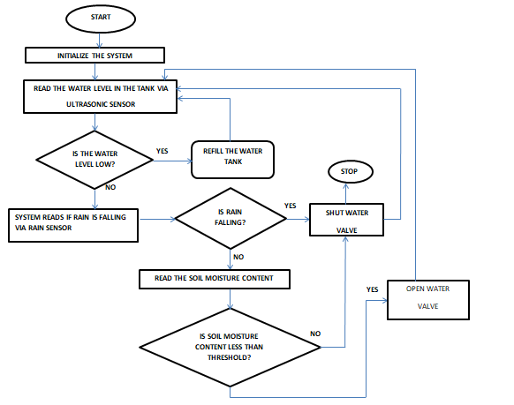
FLOWCHART

Slide 12
EXPECTED RESULT
At the end of this project, the device will be able to automatically irrigate soil ,measure the moisture content of the soil and also stop irrigation when rain is falling.
It should be able to send information to the farmer about the moisture content level and when it is done irrigating.

Slide 13
CONCLUSION
The design of the circuit has been carried out but the simulation, construction and testing have not commenced.
It can be concluded from the work done so far that the project is feasible.

Slide 14
THANK YOU FOR LISTENING.

Slide 15
REFERENCE
[1] Chandan Kumar Sahu and Pramitee Behera, “A Low Cost Smart Irrigation Control System” International Conference on Electronics and Communication System, ISSN 2249-3131 Volume 4 (2015), pp. 371-374.
[2] Frenken, k. (2005). Irrigation in Africa in figures – AQUASTAT survey -2005. Food and Agriculture Organization of the United Nations. ISBN 978-92-5-105414-7.
[3] Apurva Tyagi, Nina Gupta, Mr. Raghvendra Tiwari , Mrs. Anamika Gupta, Dr. J P Navani, “Smart Irrigation System” International Journal for Innovative Research in Science & Technology, ISSN 2349-6010 Volume 3 (March 2017), pp 9-12.
[4] R.Nandhini, S.Poovizhi, Priyanka Jose, R.Ranjitha, Dr.S.Anila (2017, December 16), Arduino Based Smart Irrigation System Using IOT, Paper presented at the 3rd National Conference on Intelligent Information and Computing Technologies. www.researchgate.net/publication/321854296
[5] S. Darsha,T. Sangavi, S. Mohan, A. Soundharya, S. Desikan, “smart irrigation system” IOSR Journal of Electronics and communication engineering (IOSR-JECE) e-ISSN: 2278-2834, p- ISSN: 2278-8735, Volume 10, Issue 3, Ver, II (May – Jun,2015), pp. 32-36.
[6] A. Ibrahim, M. Mohammed, O. Osman, A. Ismat, “Design and Development of GSM based automated spray irrigation system prototype” B.Sc Thesis, University of Khartoum, Sudan, 2016.

