Slide 1
Demo zu
Module „zypper“ [SSA 1005]

Slide 2
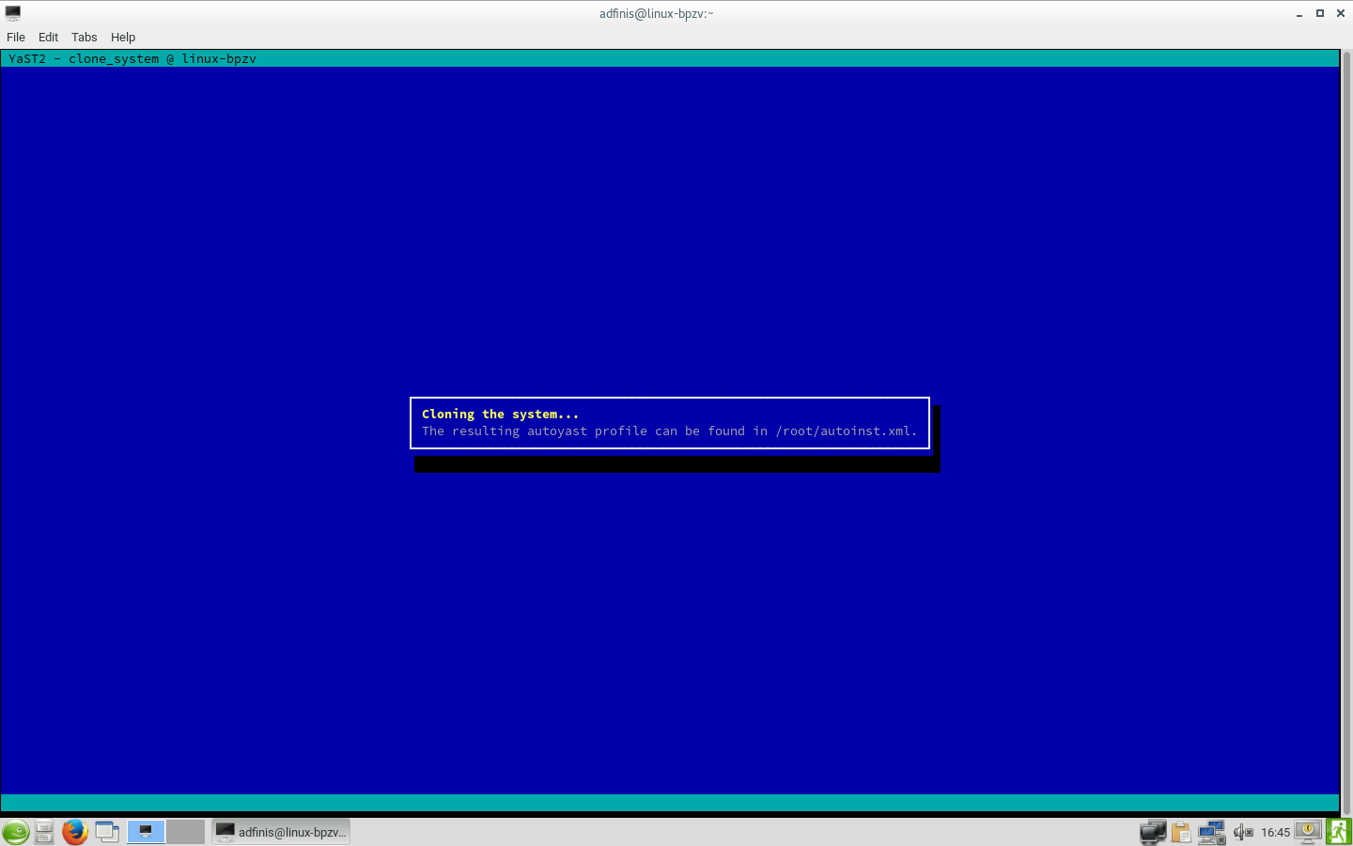
autoyast-Profil generieren

Slide 3
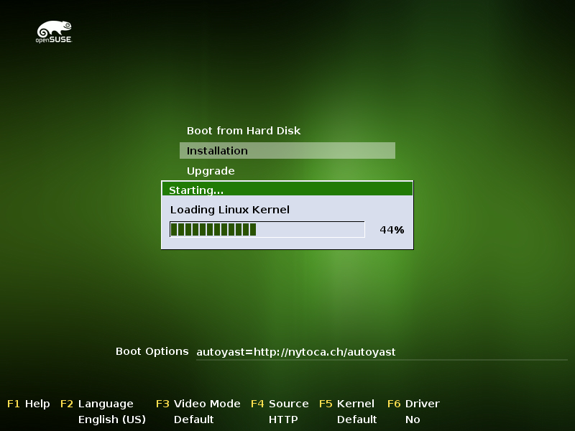
autoyast ausführen

Slide 4
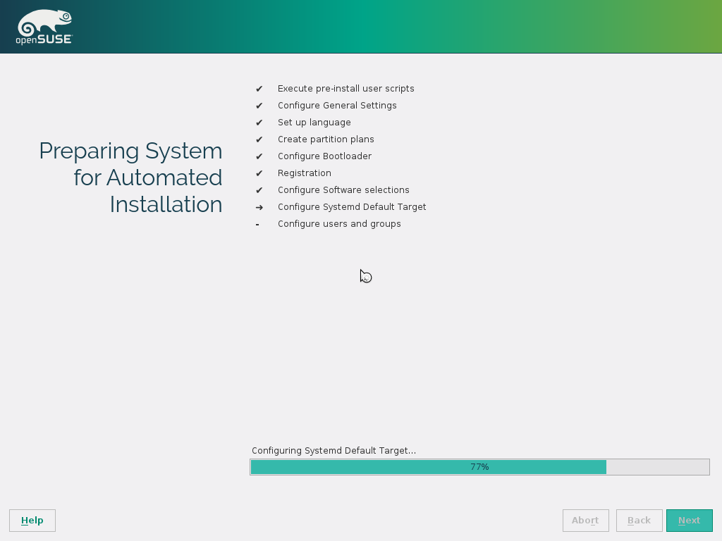

Slide 5
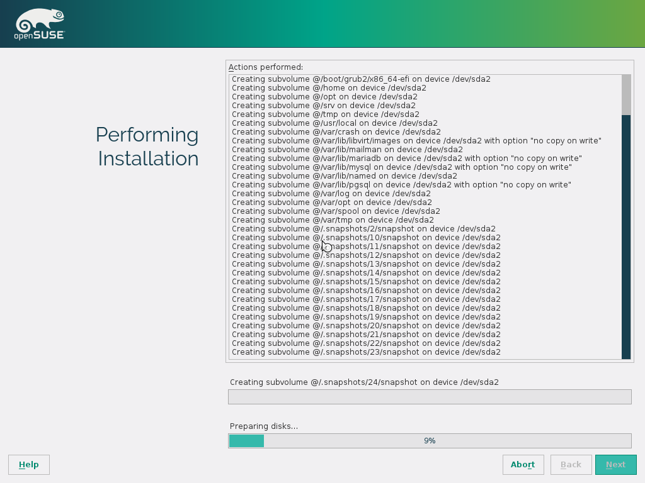

Slide 6
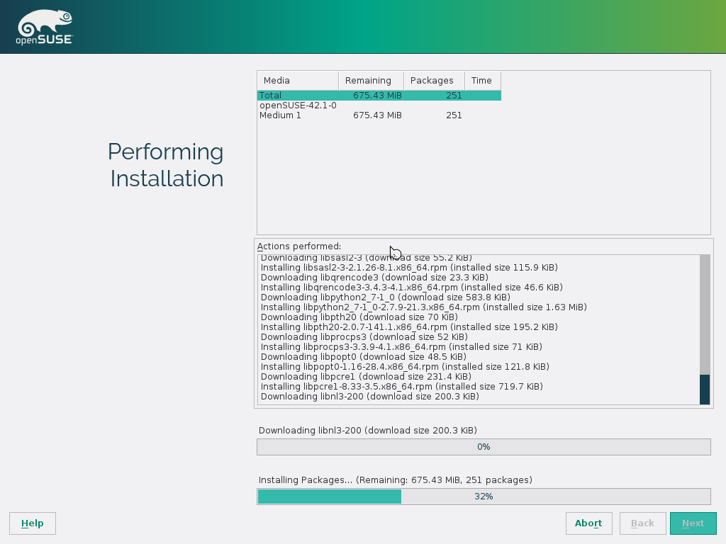

Slide 7
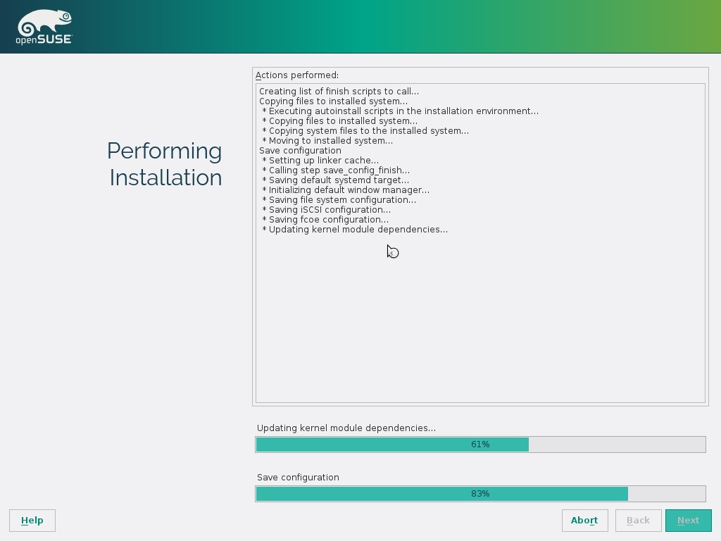

Slide 8
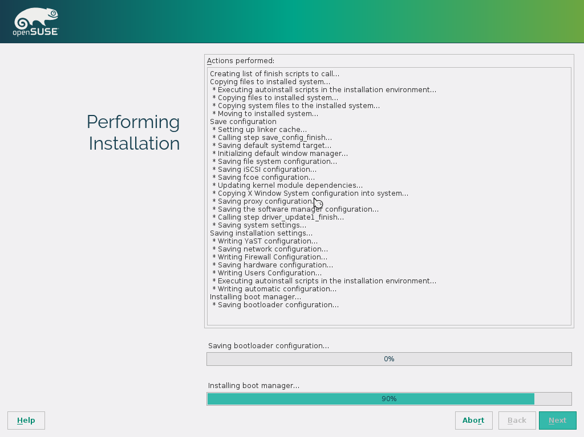

Slide 9
Screencast

Slide 10
Attribution / License
Slides, Screencast und Screenshots
Adfinis SyGroup AG, 2016, Attribution-NonCommercial 2.0
(CC BY-NC 2.0)

