Slide 1

DELIVERING ON DIGITAL TRANSFORMATION & DISRUPTIVE TECHNOLOGIES

Slide 2














4 YEARS
IN THE LAST
We've helped our clients in their digital transformation journey with our expertise in disruptive technologies (Cloud, DevOps, Analytics) that enables agility, efficiency and faster time-to-value.

Slide 3
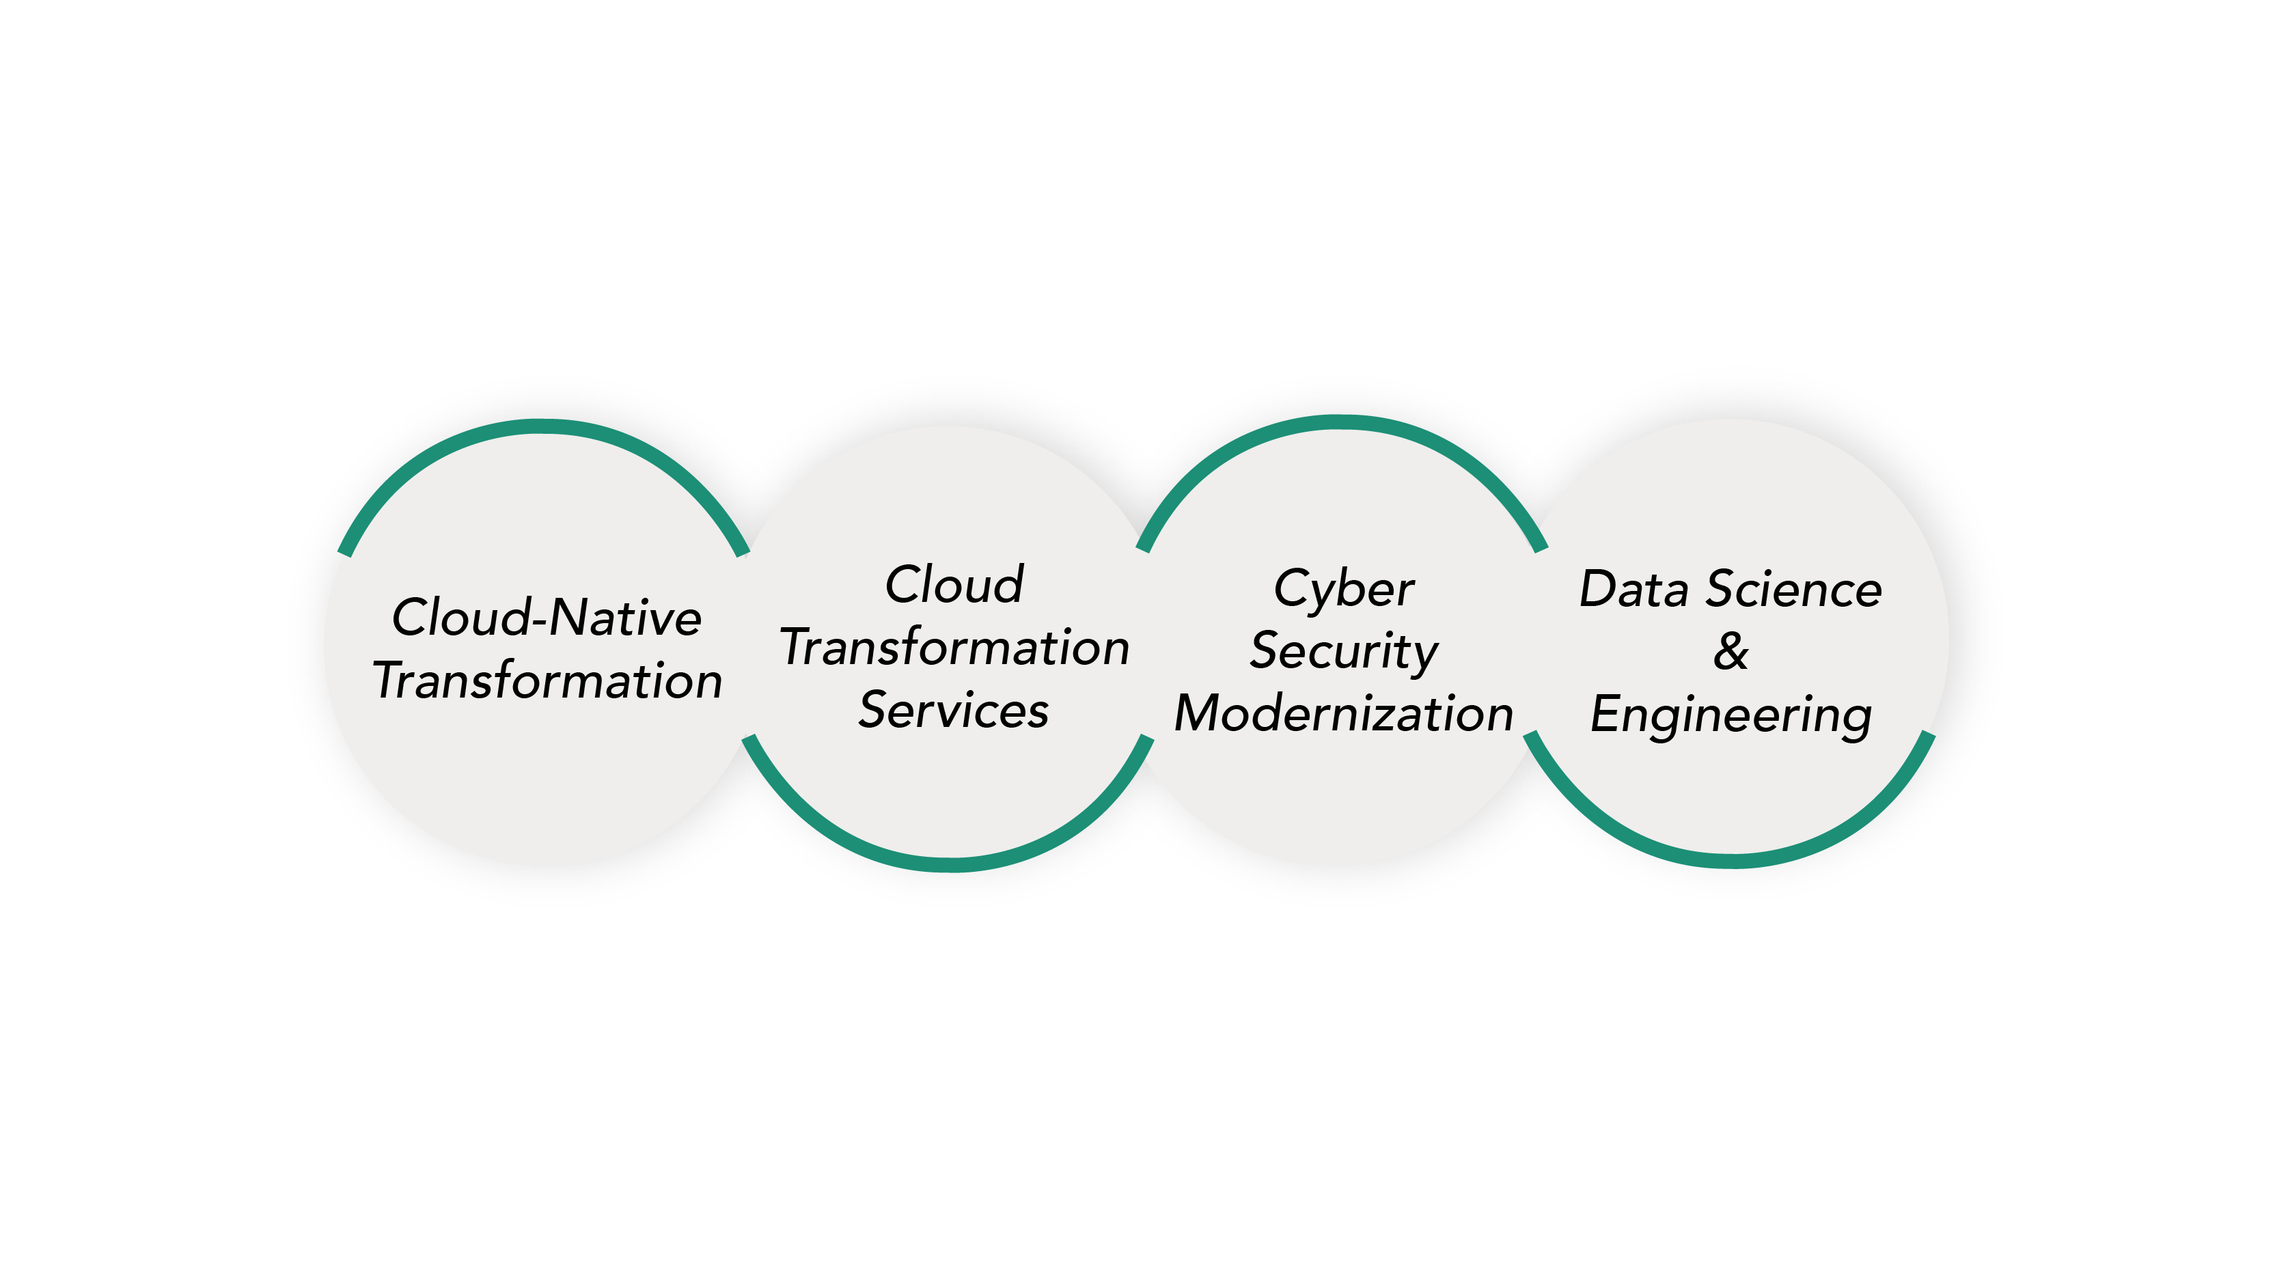
A COMPLETE DIGITAL TRANSFORMATION EXPERIENCE

Slide 4
WEBINAR
AWS EKS
Elastic Kubernetes Services

Slide 5
What is Amazon EKS?
Managed Kubernetes Service from AWS
Deploy, Scale and Manage containerized applications
Launched in June 2018
Ensuring High Availability

Slide 6
MANAGING
CONTROL PLANES
Detecting and replacing unhealthy control planes
Automated version upgrades
Automated patching of control planes

Slide 7
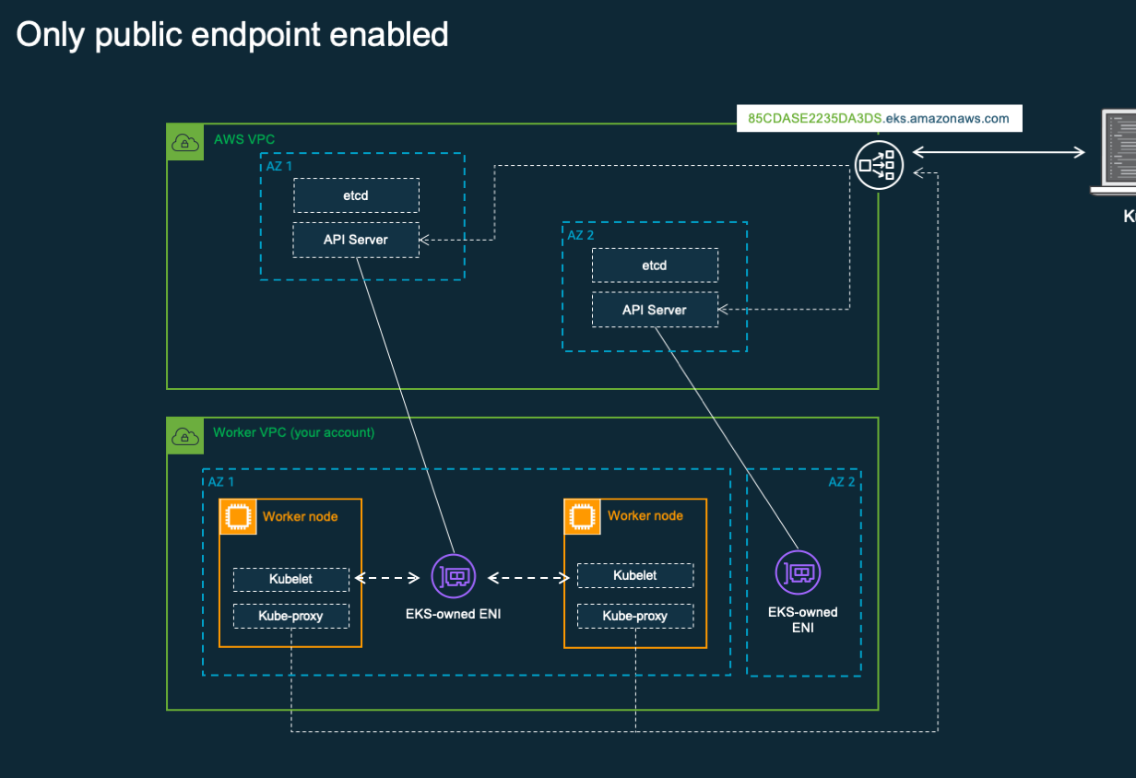
CONTROL
PLANE ARCHITECTURE
Runs single tenant Kubernetes control plane for each cluster
Atleast 2 API server nodes and 2 etcd nodes in multi AZ

Slide 8
INTEGRATES WITH
AWS SERVICES
IAM, Load balancers, VPC and DevOps specific services
like ECR, CodeBuild, CodeCommit and CodeDeploy

Slide 9
MIGRATING
TO EKS
Easily migrate any Kubernetes standard applications to EKS
Updating manifest files and deploying
Identifying the right storage drivers

Slide 10



EKS, Fargate
& ECS
Fargate if you want abstraction on Kubernetes cluster. Serverless compute engine for Kubernetes
ECS is basically docker as a service without any orchestration engine.
EKS is for complete control on cluster with Kubernetes as orchestrator

Slide 11
Features
in EKS
Autoscaling
Pod Networking in EKS with CNI plugin
ELB support (Classic, Application and Network)
Nodegroups (managed and self-managed)
Spot Instances and Spot Interrupt Handlers
Support for persistent volumes

Slide 12
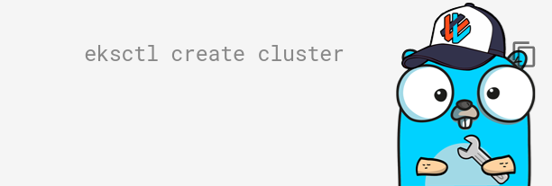
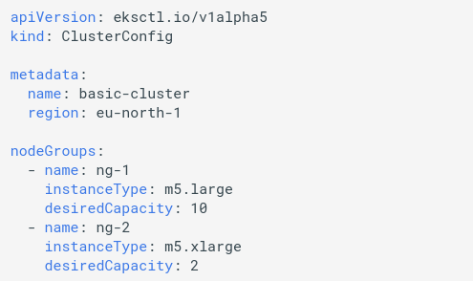
Eksctl cli tool for
Creating clusters
https://github.com/weaveworks/eksctl
eksctl create cluster -f cluster.yaml

Slide 13
EKS MAKES KUBERNETES EASIER
Manage and operate Kubernetes with ease
Task | The Old Way | With EKS
Create a cluster | Provision network and VMs Install dozens of system components including etcd Create and install certificates Register agent nodes with control plane | eksctl create cluster
Upgrade a cluster | Upgrade your master nodes Cordon/drain and upgrade worker nodes individually | eksctl upgrade cluster eksctl upgrade nodegroup
Scale a cluster | Provision new VMs Install system components Register nodes with API server | eksctl scale nodegroup

Slide 14
Eksctl commands
$ eksctl create cluster –f cluster.yaml
$ eksctl get clusters
$ eksctl get nodegroups –-cluster eks-webinar-demo
$ eksctl upgrade cluster eks-webinar-demo
$ eksctl upgrade nodegroup ng-1 --cluster eks-webinar-demo
$ eksctl scale ng ng-1 --cluster eks-webinar-demo --nodes=3 --nodes-min=2 --nodes-max=4
$ eksctl delete cluster –f cluster.yaml

Slide 15
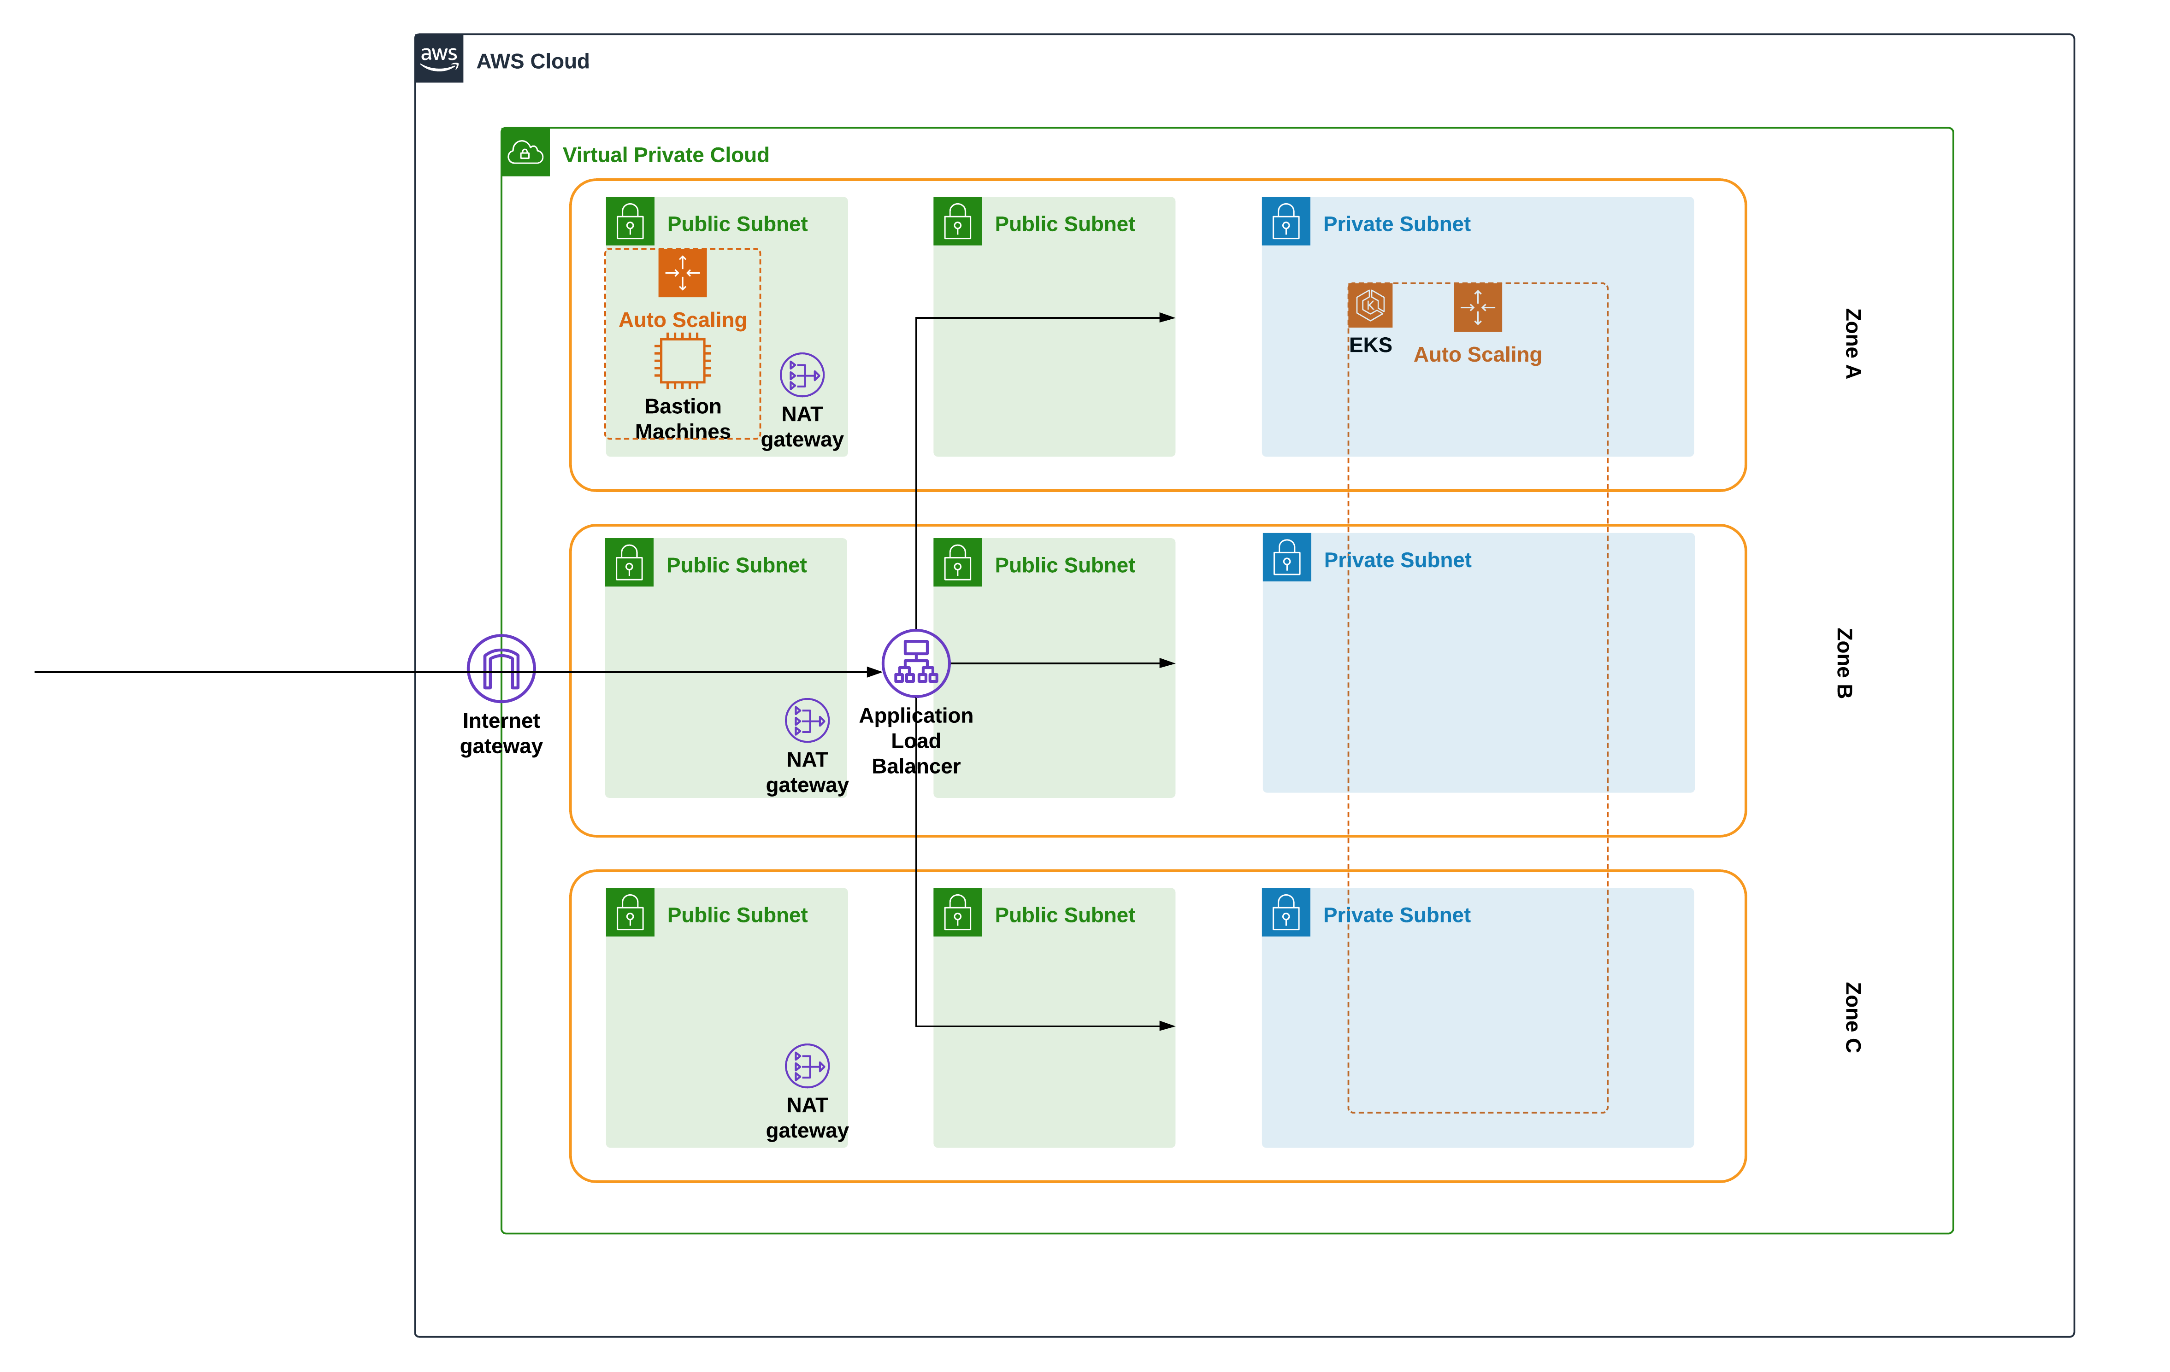
DEPLOYING
A CLUSTER

Slide 16
PRE-REQUISITES
VPC
3 Private subnets for worker nodes
3 Public subnets for load balancers
Nat gateway
Internet gateway
Tag load balancer subnets to denote ELB subnets

Slide 17
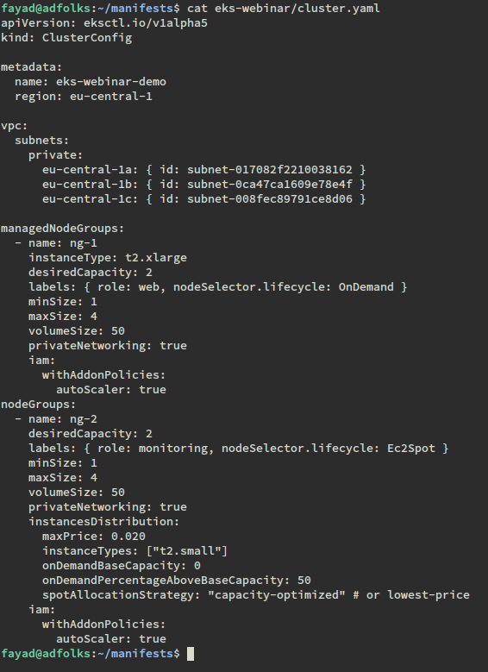
CREATING CLUSTER
WITH Eksctl

Slide 18
CLUSTER MANAGEMENT
Adding IAM user to cluster
Apply cluster autoscaler
Apply Spot Interrupt handlers

Slide 19
Adding your IAM user to cluster
Edit auth configmap with $ kubectl edit -n kube-system configmap/aws-auth
Add user specific information under mapusers
https://docs.aws.amazon.com/eks/latest/userguide/add-user-role.html

Slide 20
AUTOSCALING
Adding autoscaling specific configs in cluster.yaml before deploy
Adding tags to autoscaling groups for discovery after cluster deploy
Modifying cluster-autoscaler.yaml with your clustername, nodegroups
Applying cluster-autoscaler.yaml into cluster
https://docs.aws.amazon.com/eks/latest/userguide/cluster-autoscaler.html

Slide 21
Spot Interrupt Handlers
Defining your spot pricing strategy
Adding in cluster.yaml before deploy
Applying spot-interrupt-handler yaml into cluster after deploy
https://www.eksworkshop.com/beginner/150_spotworkers/deployhandler/
https://aws.amazon.com/ec2/spot/pricing/
https://aws.amazon.com/ec2/pricing/on-demand/

Slide 22
OBSERVABILITY
IN EKS
Eksctl commands
Kubectl commands
Observing autoscaling and nodegroup information from AWS console
Enabling Cloudwatch logging for EKS

Slide 23
EKS best practices
Deploy cluster on private subnets in multi AZ
Create public subnets on each AZ for Load balancers
Rely on nat gw for outbound
Tag ELB subnets for EKS to identify loadbalancer subnets
Define Cidr for pod networking in cluster yaml
Deploy Autoscaler and Spot interrupt handler yaml
Use service accounts for deploying applications

Slide 24
Useful resources
https://docs.aws.amazon.com/eks/latest/userguide/add-user-role.html
https://docs.aws.amazon.com/eks/latest/userguide/cluster-autoscaler.html
https://aws.amazon.com/blogs/containers/de-mystifying-cluster-networking-for-amazon-eks-worker-nodes/
https://www.eksworkshop.com/beginner/150_spotworkers/deployhandler/
https://aws.amazon.com/ec2/spot/pricing/
https://aws.amazon.com/ec2/pricing/on-demand/
https://eksctl.io/usage/creating-and-managing-clusters/
https://github.com/weaveworks/eksctl

Slide 25
Q&A

Slide 26
Thank you!
fayad@adfolk.com
nihil.b@adfolks.com
github.com/adfolks

