Slide 1
Good Morning Everyone
जय श्री राम

Slide 2
Topic :- Is there any possibility that all parameters of the galaxy are determined by using only one very large telescope. Explain with suitable example.

Slide 3
Different wavelengths reveal different things
Galaxies emit radiation across a wide range of wavelengths, from ratio waves to visible light to gamma rays. Each wavelength tells us something. different about the galaxy's composition, structure and activity.
For example:-
Visible light: Shows the distribution of stars & dust in the galaxy‘s disk.
Radio waves: Reveals the presence of gas & regions of star formation.
X-rays. Indicates the presence of black hole & hot gases.

Slide 4
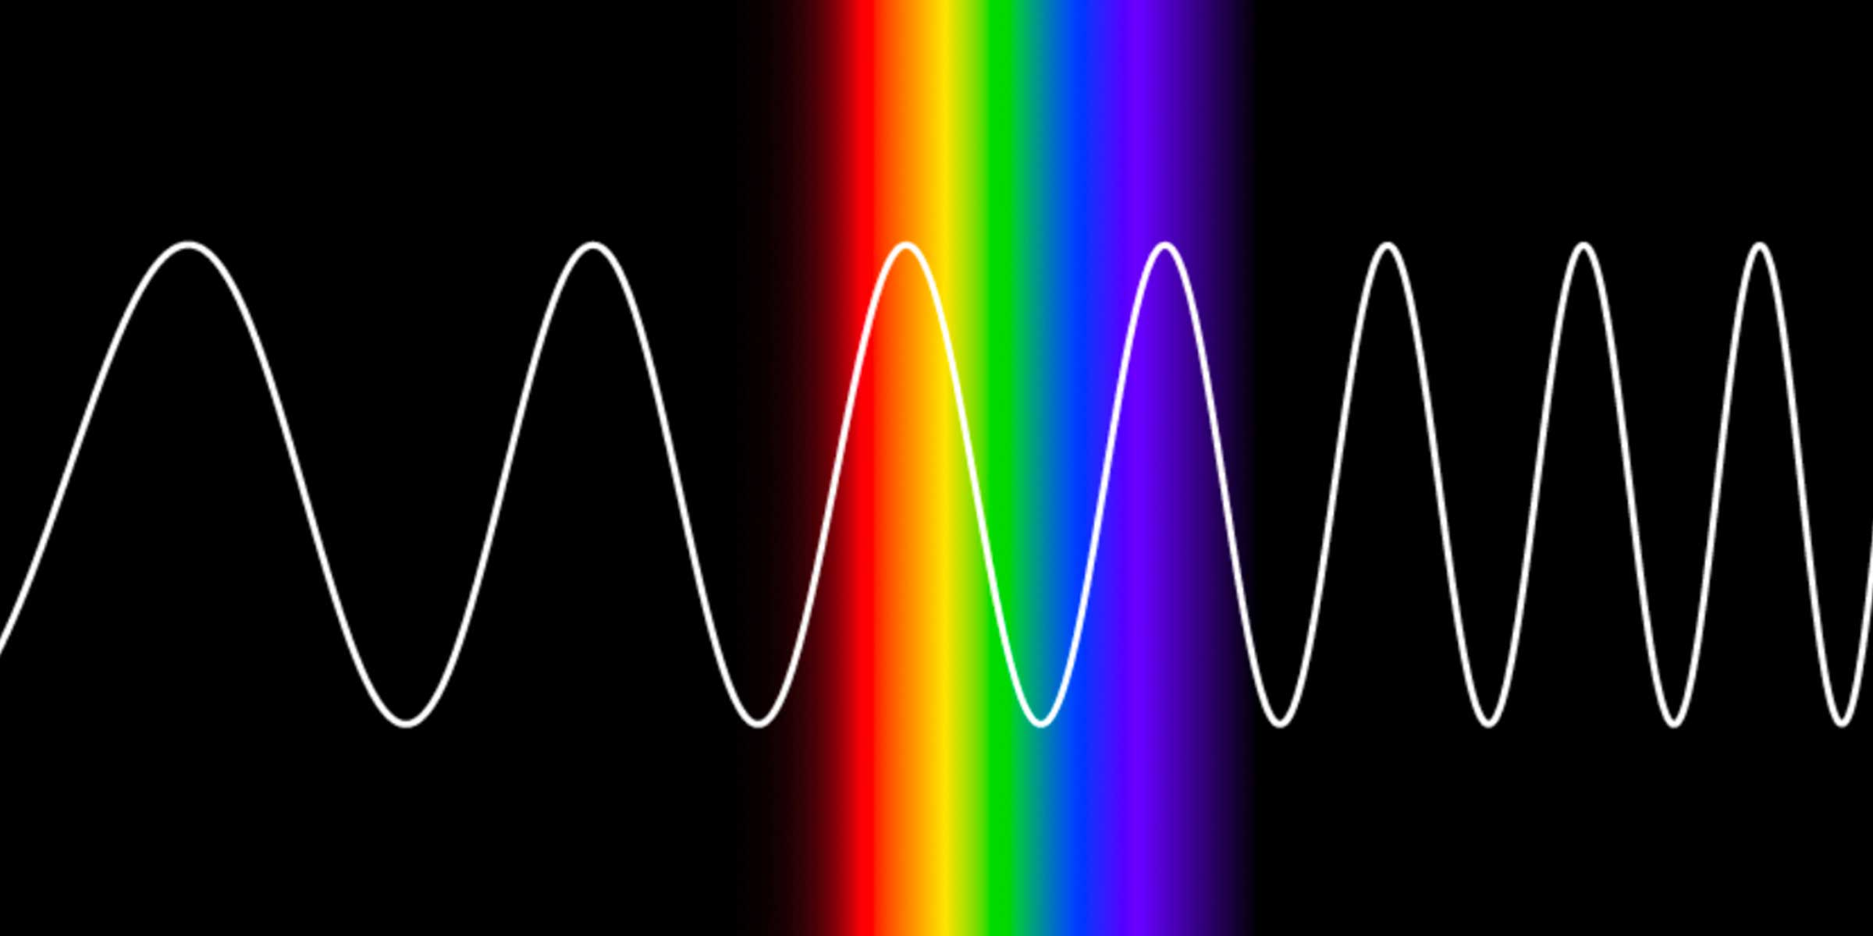
Visible Wavelength

Slide 5
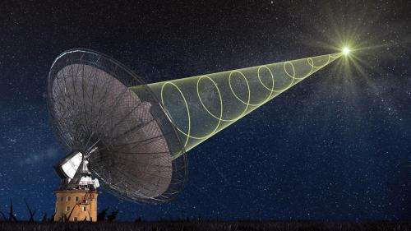
Radio waves

Slide 6
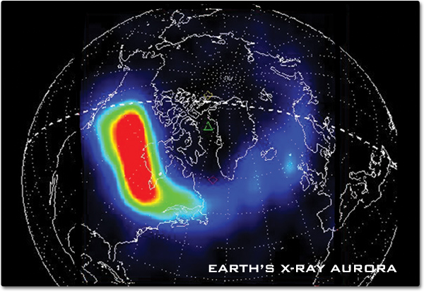
X-rays

Slide 7
A single telescope would be limited to observing in a specific range of wavelengths, missing crucial information. about the gt galaxy's other aspects.

Slide 8
Specialized instruments needed for different measurements.
Even within the same wavelength range, different instruments ne needed to measure are different parameters.
For example:
Spectrographs:- Split light into its component colors, revealing the chemical composition of stars and gas.
Interferometers - Measure the size and structure of very distant galaxies with high precision.

Slide 9
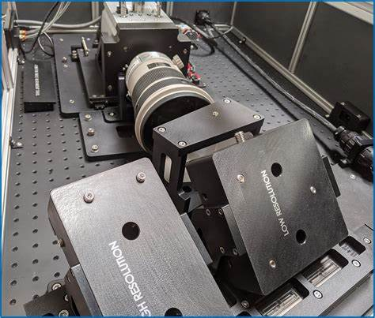
Spectrographs

Slide 10
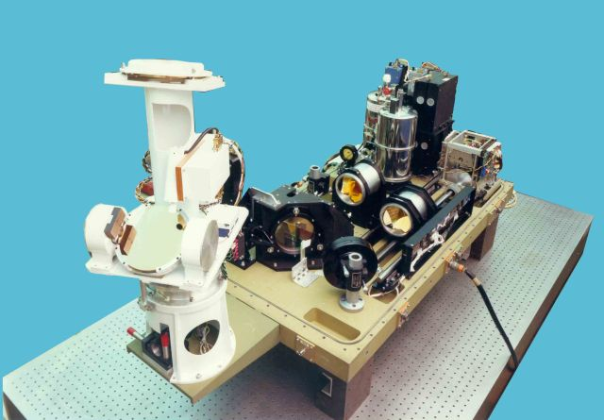
Interferometers

Slide 11
A single telescope might not have all the necessary instruments onboard to capture all the required measurements.

Slide 12
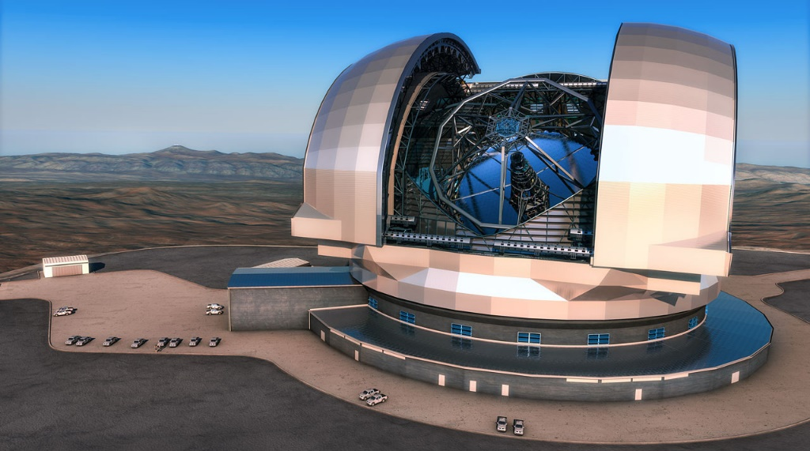
Observing time limitations!
Large telescopes are in high demand, & observing time is precious. It wouldn't be practical or efficient to use one telescope for all the observations needed to fully characterize a galaxy, especially for fainter or more distant ones.
E-ELT
In UK

Slide 13
Example
Imagine trying to understand a forest using only one tool, like a flashlight. You might see the trees in front of you, but you wouldn't known anything about the undergrowth, the insects living there, on the overall ecosystem. Studying a galaxy is similar, different tools [telescopes & instruments] are needed to reveal its complete picture.

Slide 14
Conclusion
While incredibly powerful telescopes can gather vast amounts of data about galaxies, a single one cannot capture all the necessary information to determine all their parameters It's a team effort requiring multiple instruments, wavelengths, & specialized techniques to unravel the mysteries of these magnificent cosmic system.

Slide 15
Members
Gangadiaya Manus
Jadhav Viraj
Jangid Kartik
Khairnar Atharva
Landge Mayuresh
Mahajan Aarush
More Yuraj
Patil Patik
Patil Vedant
Radadiya Om

Slide 16
Thank you

