Slide 1
Good Morning from Whole GROUP3

Slide 2
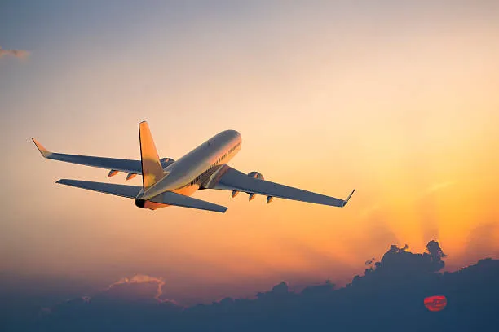
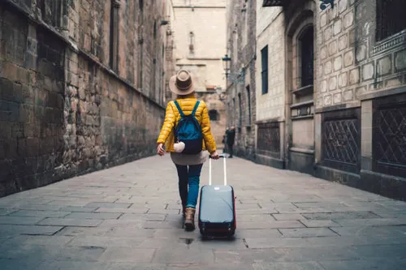
Tourism and Transport: A Perfect Connection
Exploring The Connection

Slide 3
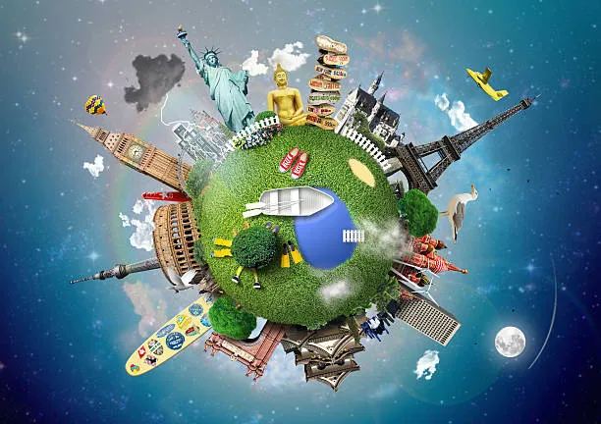
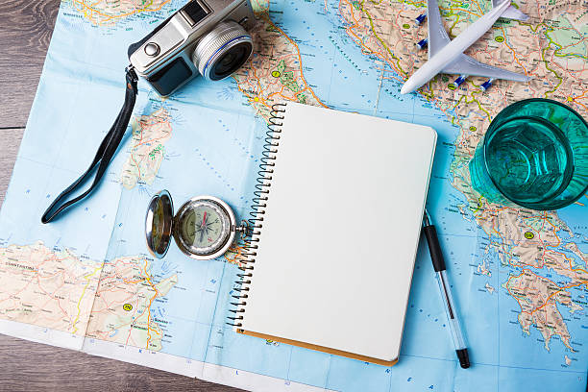
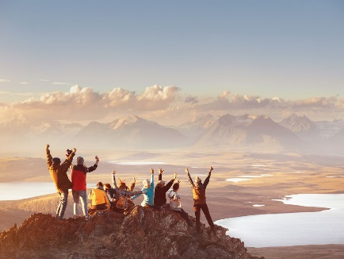
Introduction
Think about it – when we plan a trip, it's not just about the destination; it's about the journey, the adventure of getting there. That's where the magic happens, where tourism and transport join forces to create amazing experiences.

Slide 4
Getting There: Easy and Quick
When we talk about accessibility and connectivity, we mean how easy it is to reach cool places. Good transport is like a super-smooth road or a fast train – it gets us to our dream destinations without any trouble. Imagine going on a family trip – the easier it is to get there, the more fun the adventure becomes! That's what accessibility and connectivity are all about – making travel quick and stress-free.

Slide 5
Bigger and Better Tourism
Market expansion is like making our favorite destinations even more awesome. When good transport is in place, more people can easily visit a place. This means more visitors, more excitement, and more fun things to do. Imagine your favorite spots becoming even cooler with new attractions and experiences – that's the power of market expansion. Good transport turns great places into must-visit hotspots for everyone!

Slide 6
Traveling in a Snap
When transport is quick and efficient, it means less time traveling and more time enjoying your destination. It's like having a shortcut to fun! Think about your last trip – wasn't it awesome that you could get there without any long, tiring delays? That's the beauty of time and convenience. Good transport makes our trips feel like a breeze – fast, easy, and totally stress-free!

Slide 7
Money Matters in Tourism
Good transport doesn't just make our trips enjoyable; it also helps the places we visit make more money. This is called the economic impact of tourism. When we stay in hotels, eat at restaurants, or buy souvenirs, we're supporting local businesses. Good transport makes it easy for tourists to spend money, and that helps the local economy grow. It's like having a positive impact while having fun!

Slide 8
Fancy Travel Tech
Good transport isn't just about getting us places; it's also about making travel more exciting. Innovation and investment mean companies spend money on cool ideas to make our journeys better. From fast trains to high-tech planes, it's all about making travel more awesome. Good transport is like having a friend who's always bringing the latest and greatest ways to make our trips even cooler!

Slide 9
Connecting with Cultures
Good transport helps us meet new cultures. It's like making friends in different places. When we travel, we experience how people live, their traditions, and their way of life. Good transport makes it easy to explore diverse cultures – trying new foods, hearing different languages, and seeing unique traditions. It's like having a passport to understand and appreciate the amazing diversity in our world!

Slide 10
Green Travel
Good transport isn't just about speed; it's also about being kind to our planet. Environmental considerations mean thinking about how our travels affect the Earth. It's like using cleaner energy, supporting eco-friendly practices, and taking care of the environment. Imagine traveling in a way that doesn't harm our beautiful planet – that's the magic of environmental considerations. It's like having a friend who cares about our planet as much as we do!

Slide 11
Building Better Travel
When we say planning and development, we mean carefully organizing our trips. Good transport isn't random; it's the result of a plan to create better ways to travel.
Think about roads, airports, and train stations – they're not there by chance. They're part of a plan to make our travels smoother and more enjoyable. Good transport is like having a friend who's great at planning, making sure our journeys are well-organized and full of excitement!

Slide 12
Not Always Smooth Sailing
Good transport has its challenges, but guess what? Challenges bring opportunities!
When we talk about challenges and opportunities, we mean that sometimes things don't go perfectly. There might be traffic, delays, or other bumps in the road. But here's the cool part – every challenge is a chance to make things even better.
Imagine you planned a trip, and suddenly there's a little hiccup. Instead of getting upset, we see it as an opportunity to find new and creative solutions. Challenges push us to think outside the box and make our travels more awesome. It's like turning road bumps into shortcuts to even better adventures! Good transport is like having a friend who sees challenges as exciting opportunities for improvement.

Slide 13
Conclusion
Good transport and tourism go hand in hand, making our trips easy and exciting. It means quick and stress-free travel to amazing destinations, boosting local economies, embracing diverse cultures, and caring for our planet. Innovation in transport brings us cooler ways to travel, and smart planning ensures our journeys are well-organized. Challenges become opportunities, and every trip becomes a unique story. In essence, good transport is the key to unlocking unforgettable adventures, connecting us with the world in the most incredible ways.

Slide 14
Members
Gangadiaya Manus
Jadhav Viraj
Jangid Kartik
Khairnar Atharva
Landge Mayuresh
Mahajan Aarush
More Yuraj
Patil Patik
Patil Vedant
Radadiya Om

Slide 15
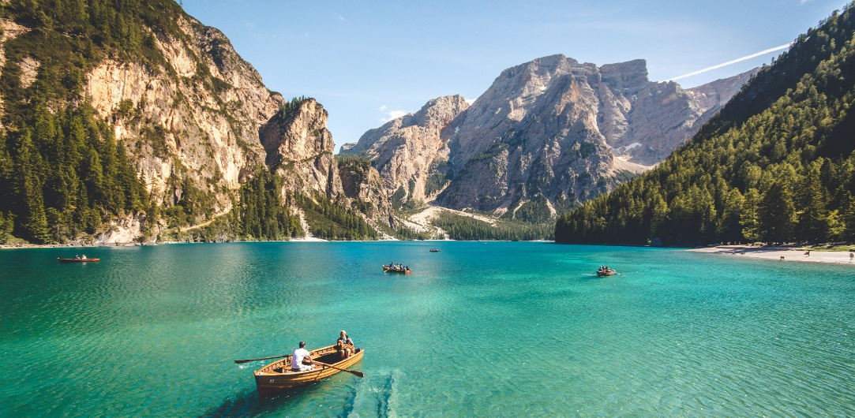
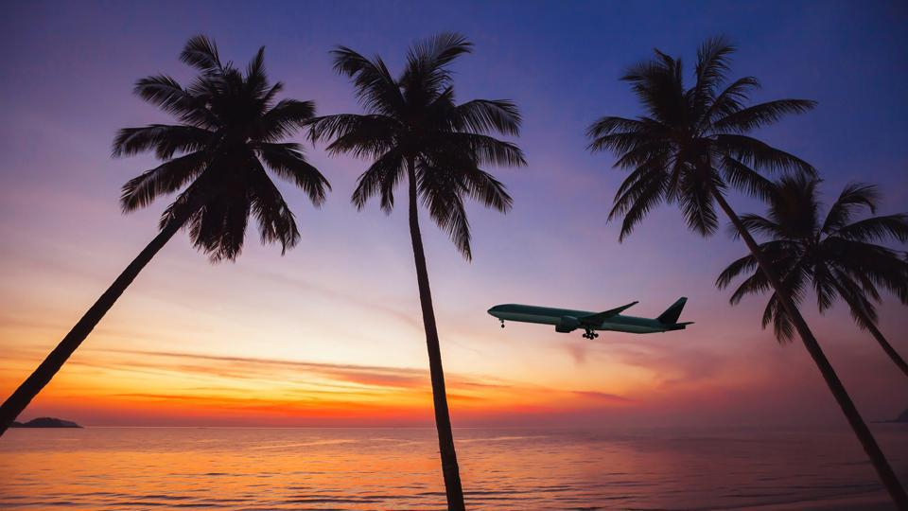
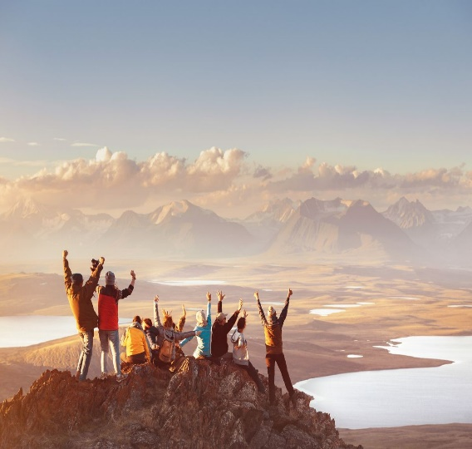
Thank You

