Slide 1
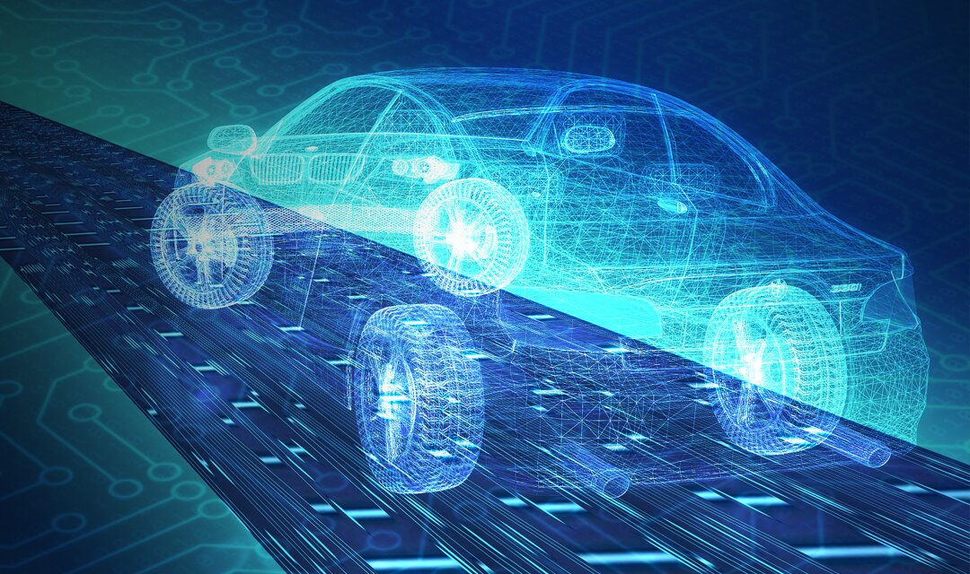
Sali – Your AutoDrives Booking Bot
By: Alexandra Dumitras-Geli 1003408314
Jennifer Palfi 1003202438
Nicole Stafferie
Melanie Zaky

Slide 2
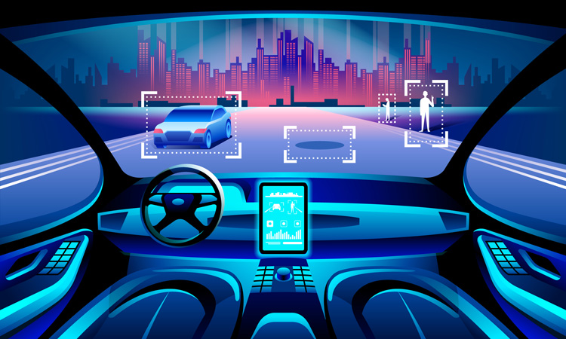
The Problem
Manually operating vehicles is a concept of the past as we move into an era of autonomous, self-driving cars
It is then worth questioning, if people aren’t driving their cars themselves anymore, would they need to own a car?
Could there be an autonomous car rental system to cater to this?

Slide 3
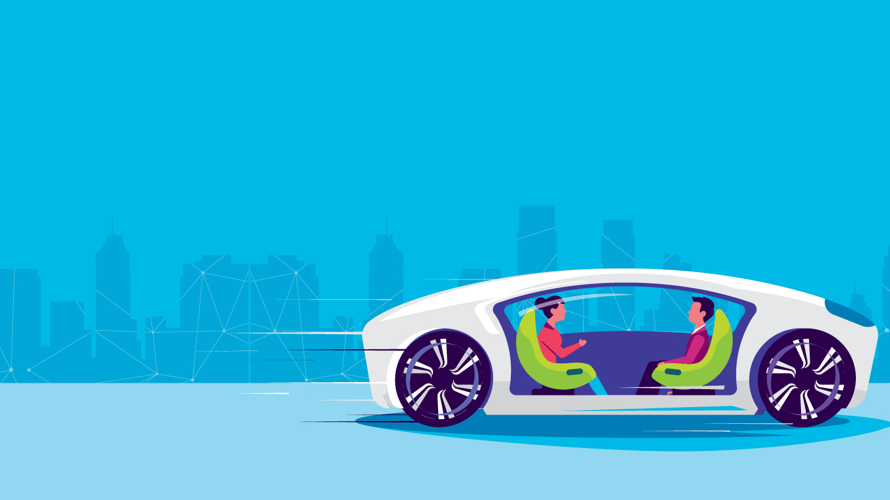
The Goals
Accomplish the entire booking process for users seeking to book an autonomous vehicle
Design a flow of questions that was conversational and simple to follow
Create an excellent, personalized customer experience leaving no questions unanswered

Slide 4
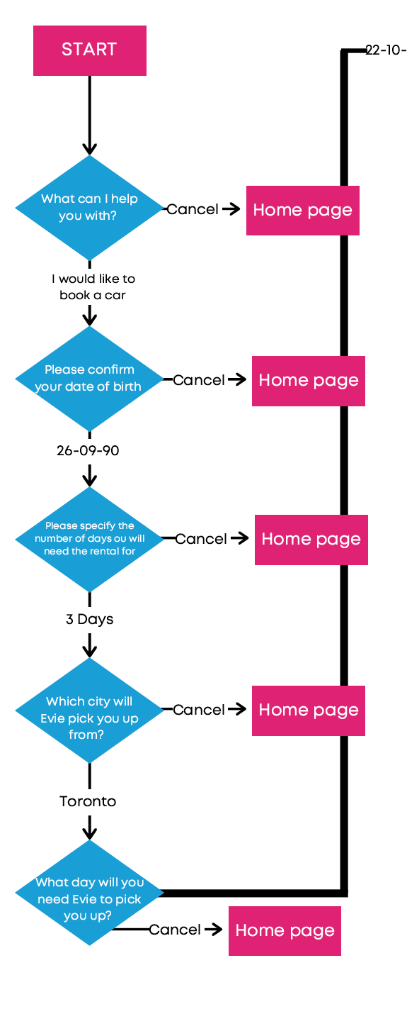
Overview of Sali- the Booking Bot
Sali is a responsive chatbot that assists users in booking an autonomous vehicle service for themselves
Looking to answer the question of:
How might we build a chatbot to help people book an autonomous vehicle?

Slide 5
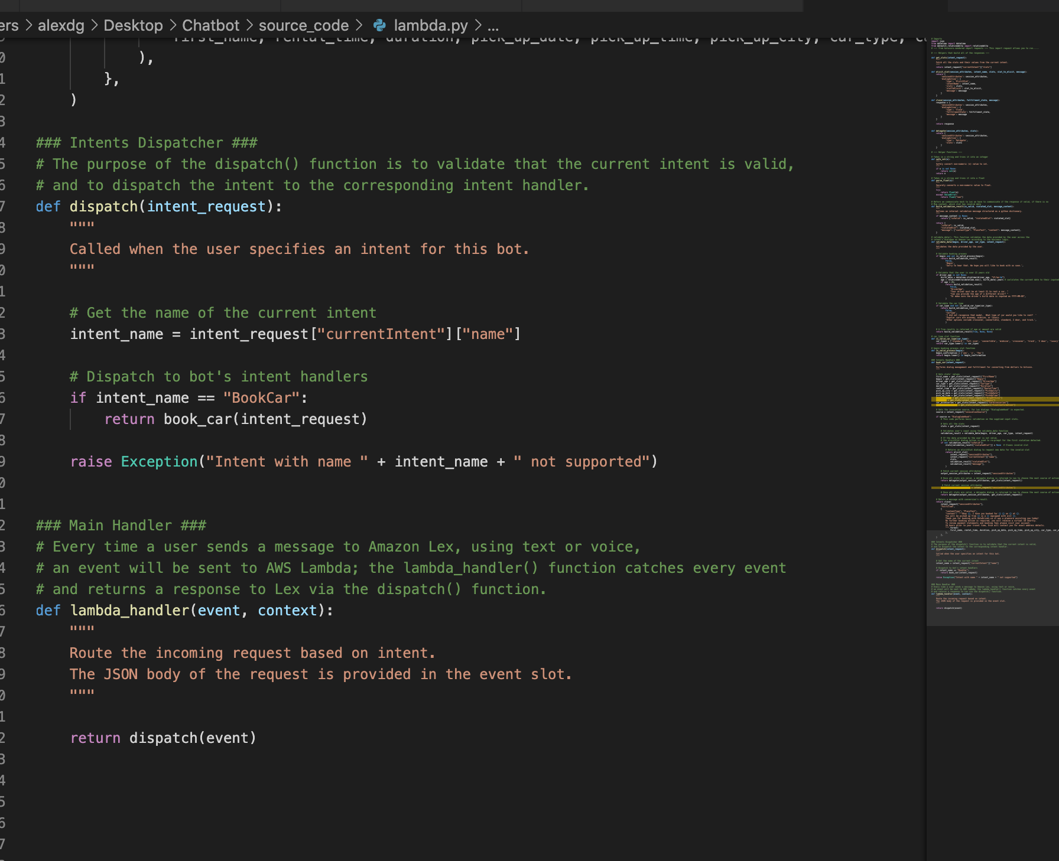
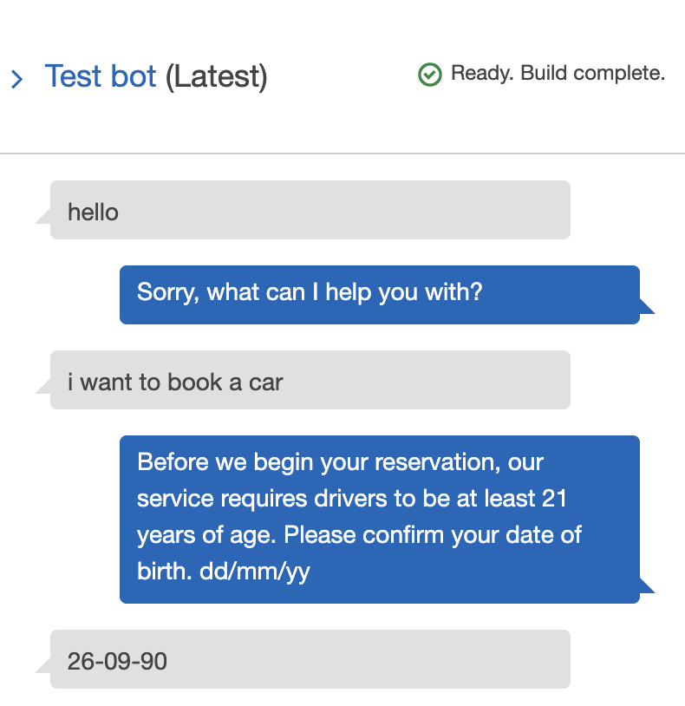
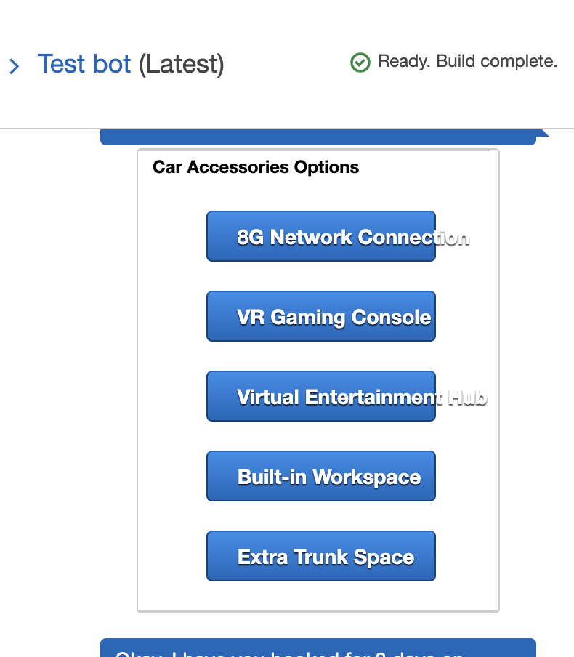
Amazon Lex
Notes:
Our focus for this project was to utilize a developer chat bot rather than focusing on the user interface. So we decided to use two tools from amazon web services, and they are amazon lex which is the chat bot and amazon lambda, which is the back end programming that provides the chat bot with the required business logic to identify, meet, and respond to the user’s request of booking an autonomous vehicle.

