Slide 1
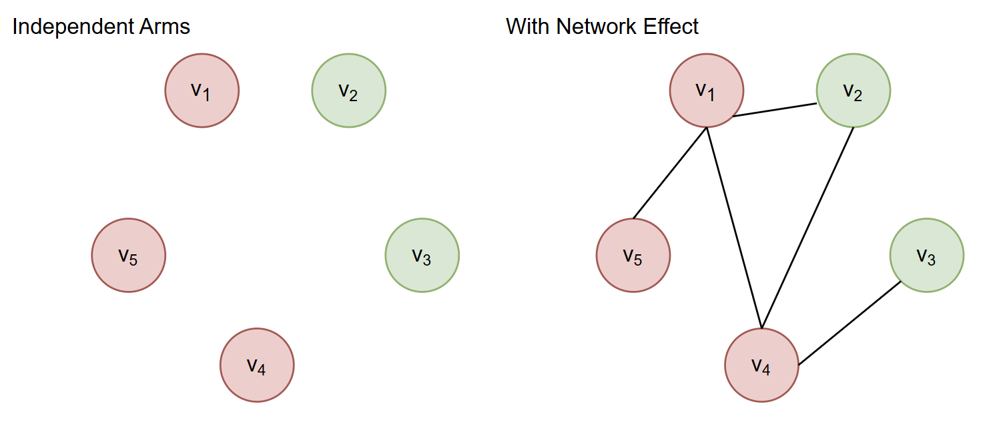
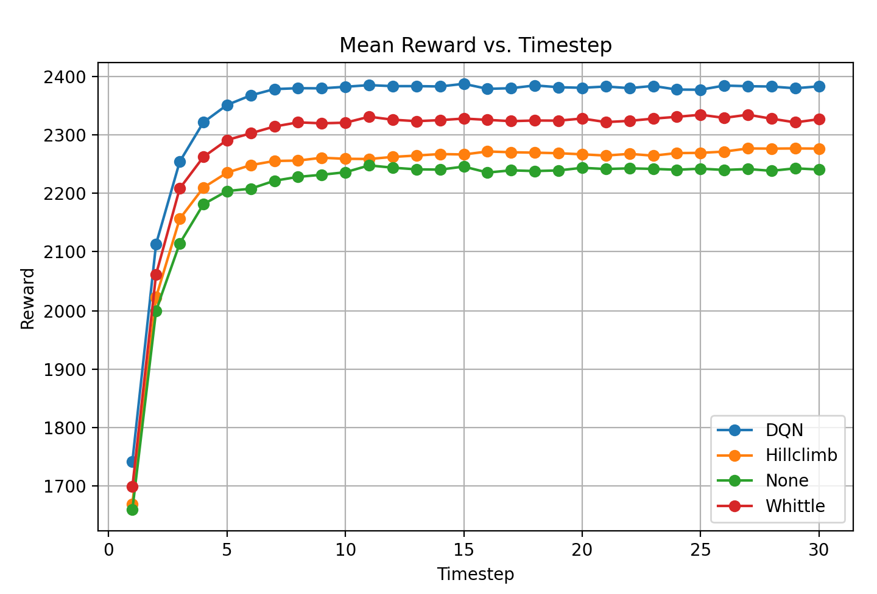
Networked Restless Multi-Armed Bandits with Reinforcement Learning Hanmo Zhang, Kai Wang
Problem: arms of a Restless Multi-Armed Bandit are independent, ignoring potentially relevant network effects in real-world situations
Proposed Solution: NRMAB model - RMAB + independent cascade
Problem: Tradition Whittle Index used to solve RMAB ignores network effect. Size of state-action space precludes solving exact Bellman Equation.
Solution: Deep Q Network with Greedy Hill Climbing

