Slide 1
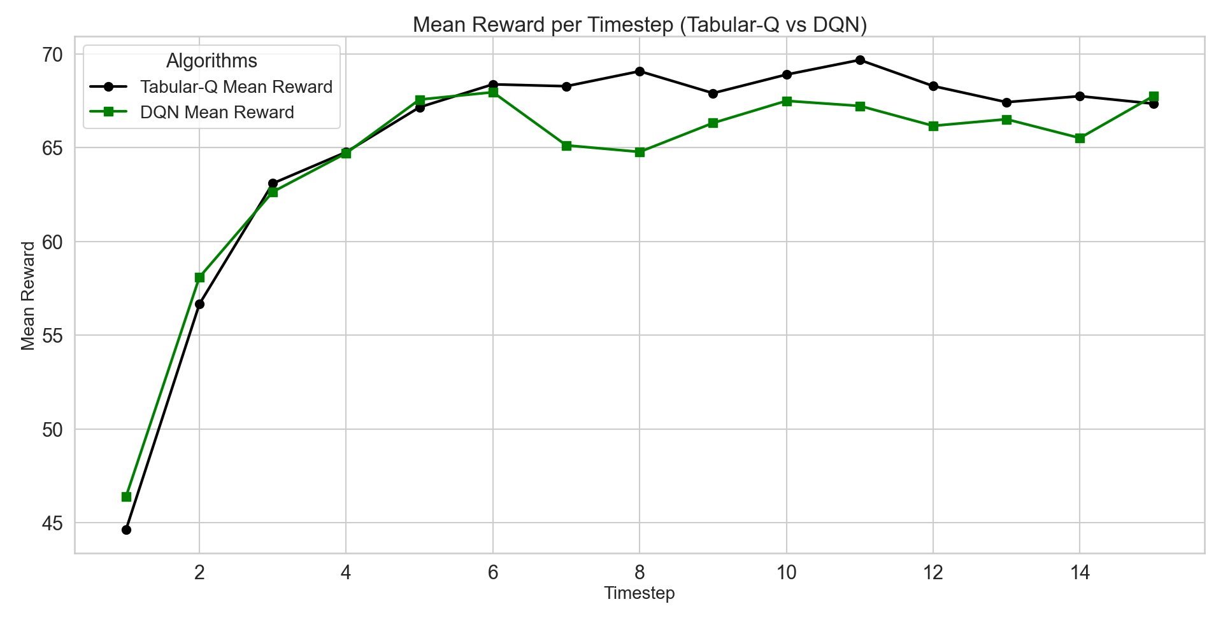
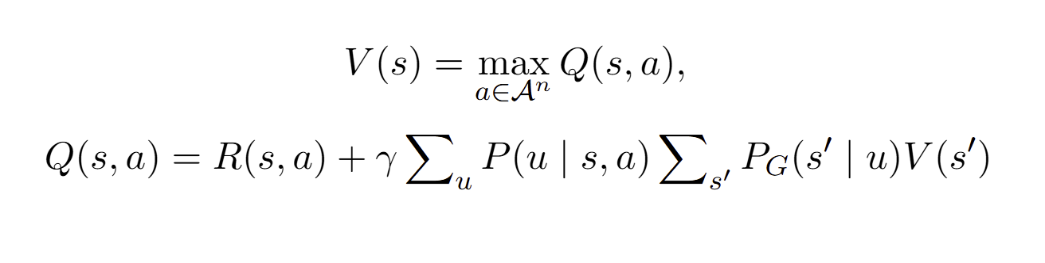
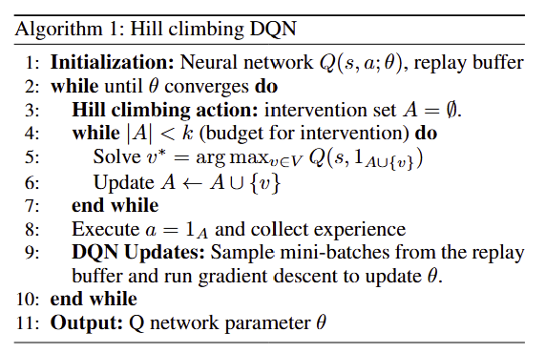
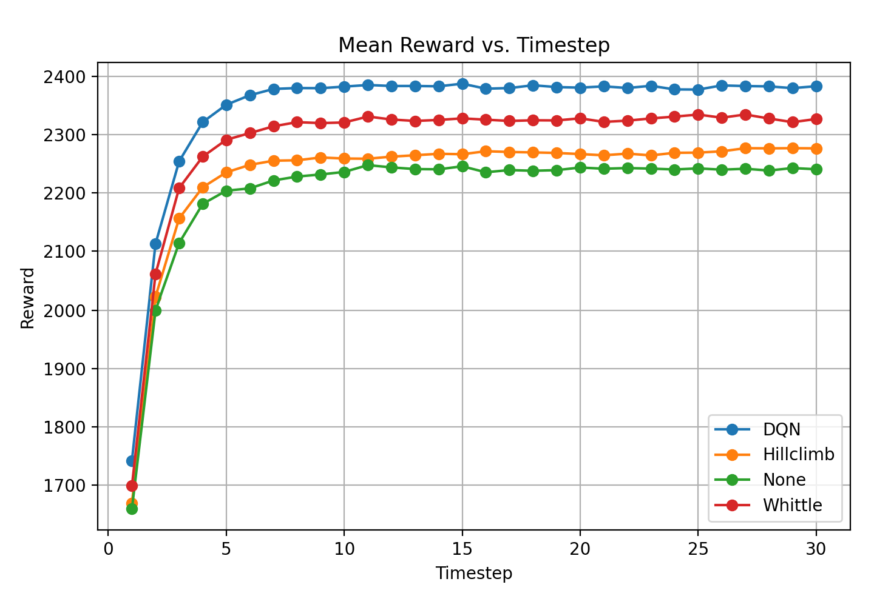
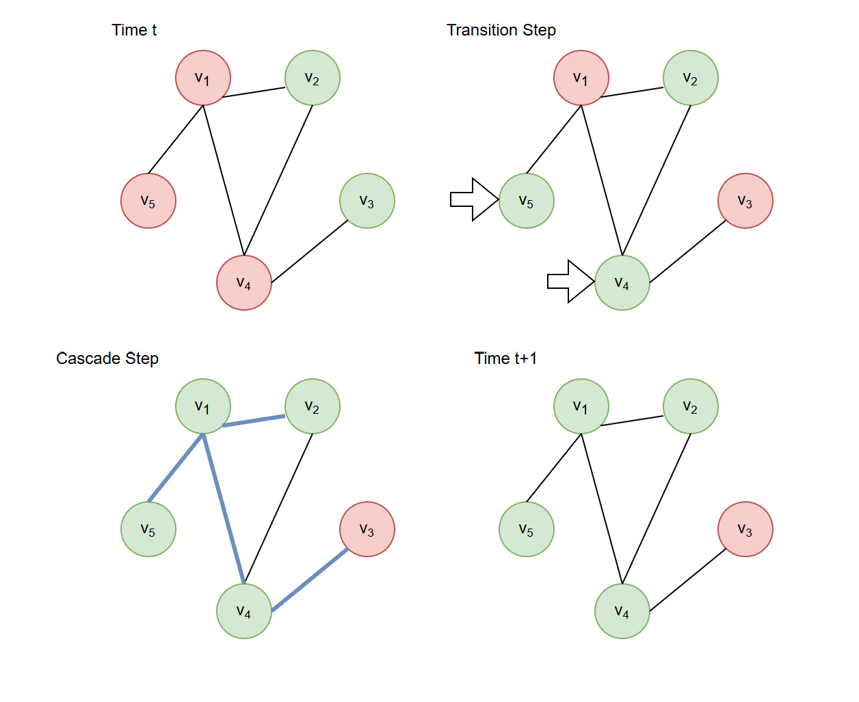
Networked Restless Multi-Arm Bandits with Reinforcement Learning
Hanmo Zhang, Kai Wang
Georgia Institute of Technology
Abstract
Motivation
Methodology
Results
Restless Multi-Armed Bandits (RMABs) are a powerful framework for sequential decision-making, widely applied in public health challenges such as resource allocation and intervention optimization. However, traditional RMABs assume independence among arms, limiting their ability to account for interactions between individuals, which can be common and significant in a real-world environment. This paper introduces Networked RMAB, a novel framework that integrates the RMAB model with the independent cascade model to capture interactions between arms in networked environments. We establish the submodularity of Bellman's Equation for that model, enabling efficient policy design and proposing a Q-learning algorithm to account for the networked setting. Initial experimental results demonstrate that our network-aware approach outperforms a network-blind approach, highlighting the importance of capturing and leveraging network effects where they exist.
Efficient distribution of health resources is crucial during outbreaks, yet traditional static allocation models (ie RMAB) often ignore complex social and contact networks.
Interventions like vaccination or quarantine impact not just targeted individuals but also those in their network, and neglecting these effects can lead to suboptimal resource use and higher transmission.
We propose the Networked Restless Multi-Armed Bandit (NRMAB) framework, integrating the RMAB model with the Independent Cascade model to capture network interactions.
Our approach enables scalable algorithms and reinforcement learning–based solutions that improve resource allocation and health outcomes.
We define Bellman’s Equation to model the value of each state:
Where:
s is the state
a is the action
u is the intermediate state after the transition step given (s,a)
s’ is the final state after the cascade step given u
We develop a Deep Q-Network with Hill Climbing to estimate the Q-value of each individual action a, and then select the top k actions with the highest predicted Q-values.
Fig 2.: A visualization of the performance of DQN using hill climbing, an approximate algorithm, against Tabular Q Learning, a technique that deterministically solves the optimal actions. Although Tabular Q can only be ran for small graph sizes, we see that DQN does not perform worse than 63% of tabular Q.
Networked RMAB
The network RMAB problem is defined on a graph G=(V,E), where each node represents an arm that can be inactive (0) or active (1).
Transition step: a budget constraint allows only k arms to receive active interventions, which yield higher probabilities of transitioning from inactive to active than passive interventions.
Cascade step: active nodes potentially activate their neighbors with edge-specific probabilities.
Objective: choose which k nodes to activate at each timestep in order to maximize the discounted sum of rewards over time, where the immediate reward is determined by the total value of active nodes
Background
Restless Multi-Armed Bandits (RMABs):
Introduced by Whittle (1988), generalize the classic Multi-Armed Bandit framework by allowing each arm to evolve over time, even if it is not selected.
Restless Multi-Armed Bandits (RMABs) are a decision-making framework used when multiple options (called "arms") evolve over time, even when not selected. Each arm can be in different states, and taking an action influences how it transitions between states based on a probability model. These transition probabilities define how likely an arm is to move from one state to another under different actions. A key challenge in RMABs is choosing which arms to act on at each step, given a limited budget, to maximize long-term rewards.
Whittle Index: The Whittle index policy (Whittle, 1988) is a prominent heuristic offering near-optimal solutions under indexability.
Applications: RMABs have been applied in various domains like healthcare for a variety of tasks.
Independent Cascade Model:
Introduced by Kempe et al. (2003) to model probabilistic influence spread in networks.
Activation Process: Active nodes get a single chance to activate each inactive neighbor with a given probability.
Applications: Models real-world phenomena like information diffusion and epidemic propagation.
Influence Maximization: Selecting initial nodes to maximize spread is NP-hard.
Submodularity: The influence function is submodular, enabling efficient approximation algorithms with provable guarantees (Nemhauser et al., 1978).
Q-function Submodularity
Fig 3.: A trial of the performance of DQN against all other algorithms on a real graph from Ou et al. (2021). The graph structure is real data, while node values and transition probabilities are randomly generated. DQN clearly outperforms other algorithms on a graph of this size.
Q(s,a) is submodular with respect to a. Additionally, our problem aligns with the influence maximization problem, which means a greedy hill-climbing strategy can achieve a performance guarantee of 1-1/e, approximately 63% of the optimal solution. Proof is omitted for the sake of brevity.
Next Steps
Experiments
Develop a Graph Neural Network, which may be able to leverage network effect better than DQN and thus find more optimal actions
Prove the convergence and reward value of Bellman’s Equation under action select through hill climbing
Collect data and perform experiments on real data (real action values, transition and cascade probabilities)
To evaluate the effectiveness of our DQN algorithm, we compare it with three other algorithms:
Tabular Q-Learning: Solves the full Bellman's Equation for each state-action pair for small state-action sizes.
1-step look-ahead: performs hill-climbing by calculating the value of activating a node in a state, taking into account network effect but ignoring future states.
Whittle Index: a traditional method for solving RMABs without considering network effects
We perform evaluations on both synthetic and real graph data. We perform multiple simulations consisting of 30 timesteps and take the mean reward per timestep at each timestep t.
We show two main experiments: one showing the submodular performance guarantee of the submodular Q-value function, and another showcasing the performance of DQN against other techniques in a real-world graph
References
Fig. 1: A visual representation of the Networked RMAB problem. We begin with a graph at time t. We enter the transition step, where we select k=2 nodes to perform the activate actions on; those nodes change state based on active transition probabilities. Other nodes change state based on passive transition probabilities. We then enter the cascade step, where each active node has P_{G}(s',u) probability to activate their neighbors. After this step is complete, we enter the state at time t+1.
Whittle, P. (1988). Restless bandits: Activity allocation in a changing world. Journal of Applied Probability, 25, 287–298.
Kempe, D., Kleinberg, J., & Tardos, É. (2003). Maximizing the spread of influence through a social network. In Proceedings of the Ninth ACM SIGKDD International Conference on Knowledge Discovery and Data Mining (KDD-03) (pp. 137–146). ACM. https://doi.org/10.1145/956750.956754
Nemhauser, G. L., Wolsey, L. A., & Fisher, M. L. (1978). An analysis of approximations for maximizing submodular set functions—I. Mathematical Programming, 14(1), 265–294.
Ou, H.-C., Chen, H., Jabbari, S., & Tambe, M. (2021). Active screening for recurrent diseases: A reinforcement learning approach. CoRR, abs/2101.02766. Retrieved from https://arxiv.org/abs/2101.02766.

