Slide 1
Welcome to Bamazon
Please select Appl
1-Shop. 2-View Cart,
3-Checkout
1
SHOP
VIEW CART
CHECKOUT
PRODUCTS
READ PRODUCTS TABLE
2
Prompt Product/unitsadd to Cart
Y
Inventory Available?
N
CART TABLE
Add products to CART TABLE
Product not available, select another
cartSQL
Array
Add UPDATE SQL to cartSQLArray
2
Your Product added to CART
Y
Continue Shopping?
N
2
1

Slide 2
Welcome to Bamazon
Please select Appl
1-Shop. 2-View Cart,
3-Checkout
1
SHOP
VIEW CART
3
CHECKOUT
CART
READ CART TABLE
CART
SQL Array
Read cartSQL Array
CART ITEMS
PRINT CART
PRODUCTS
TABLE
UPDATE
PRODUCTS
TABLE
CART
TABLE
Read CART TABLE
CHECKOUT?
Y
3
N
Order Receipt
PRINT Receipt
1

Slide 3
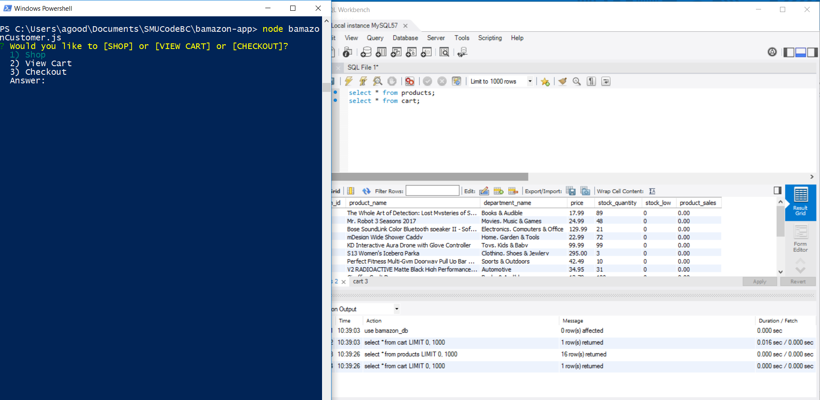
Initial Start Menu: Shop, View Cart, Checkout

Slide 4
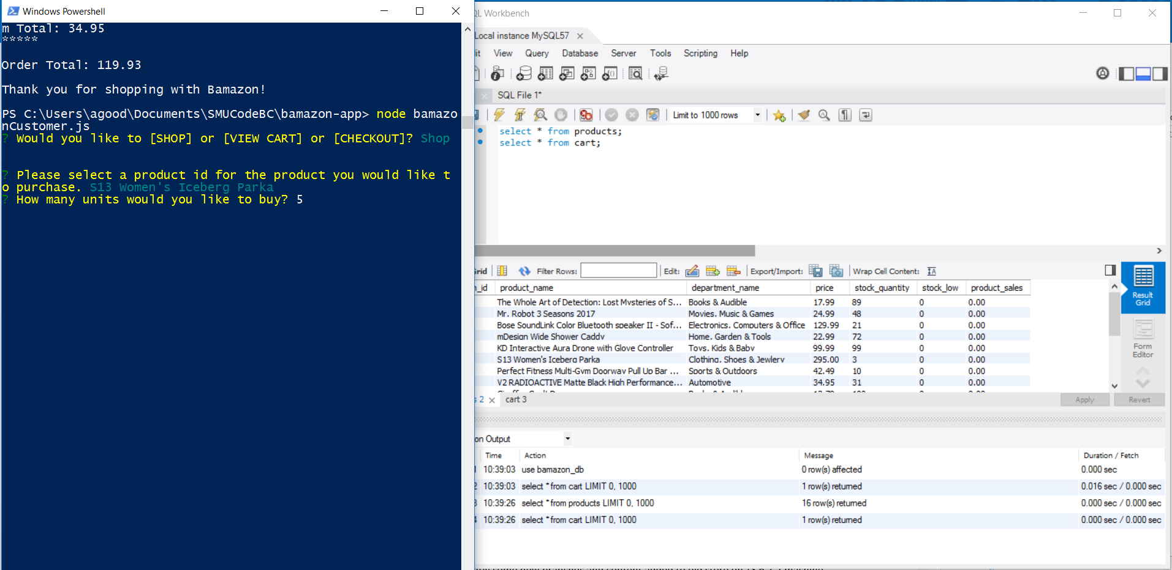
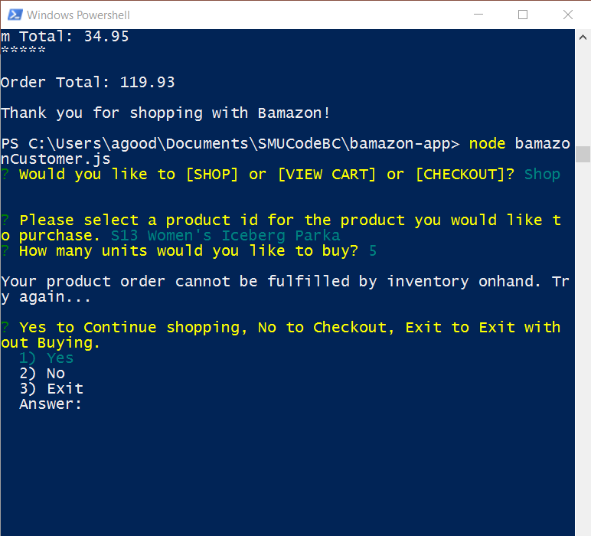
Not enough Product Inventory On-hand Message

Slide 5
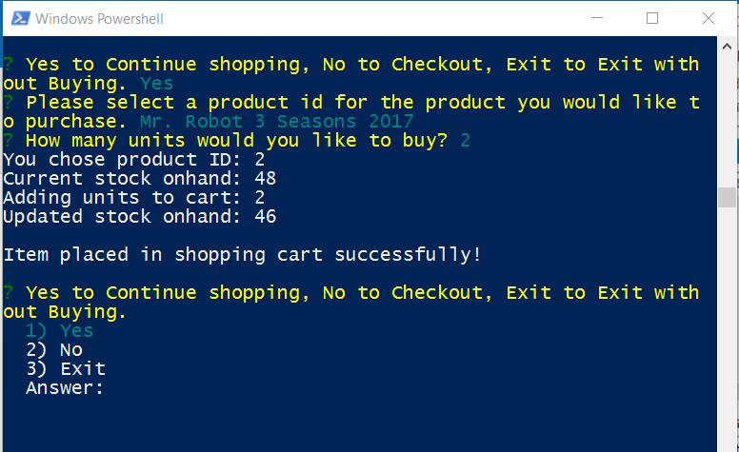
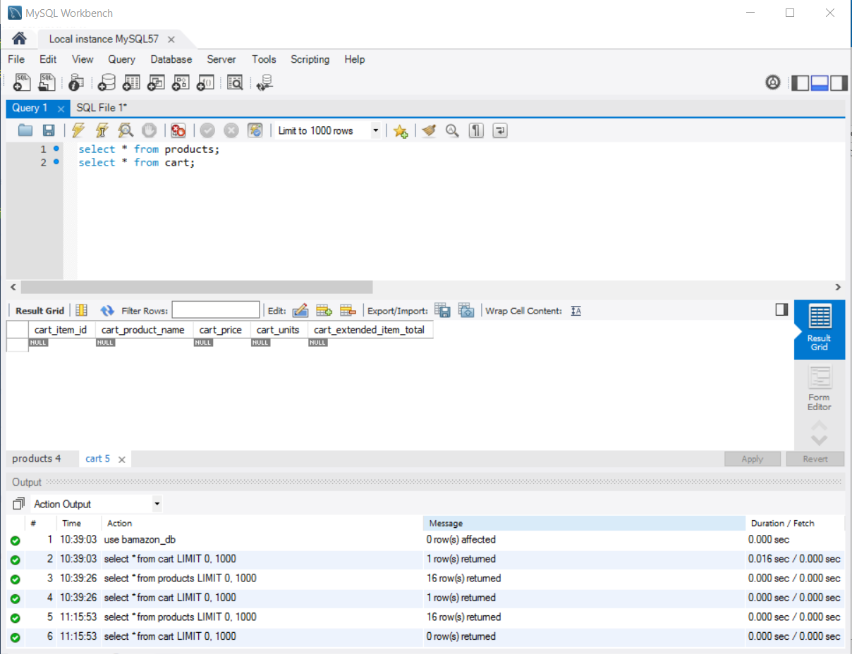
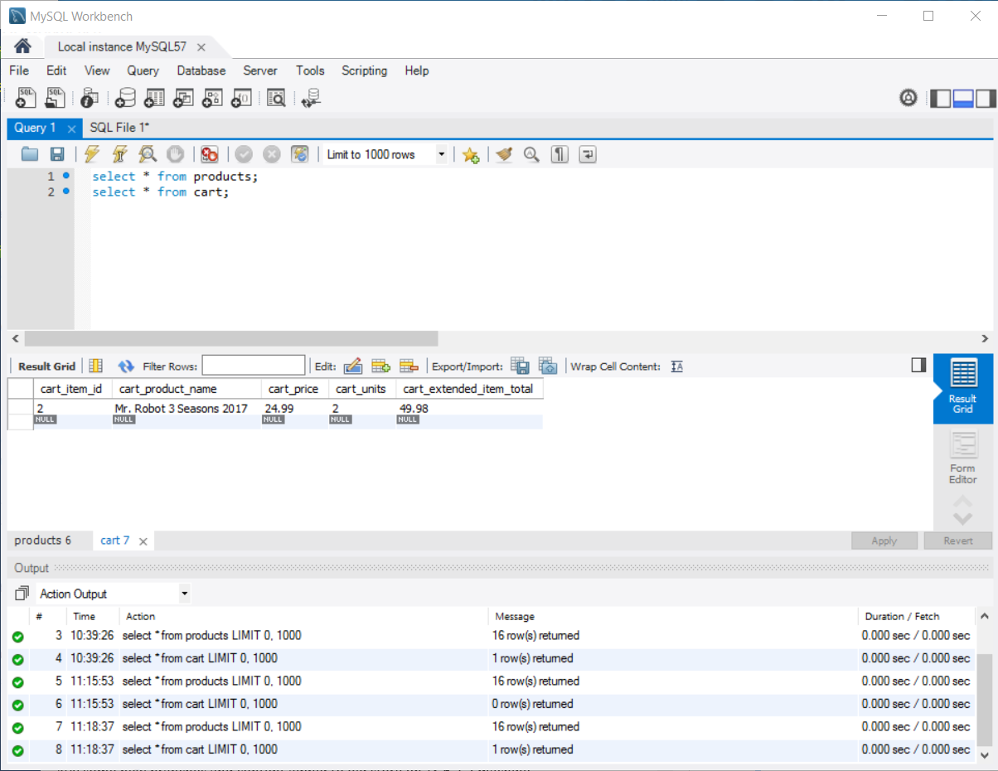
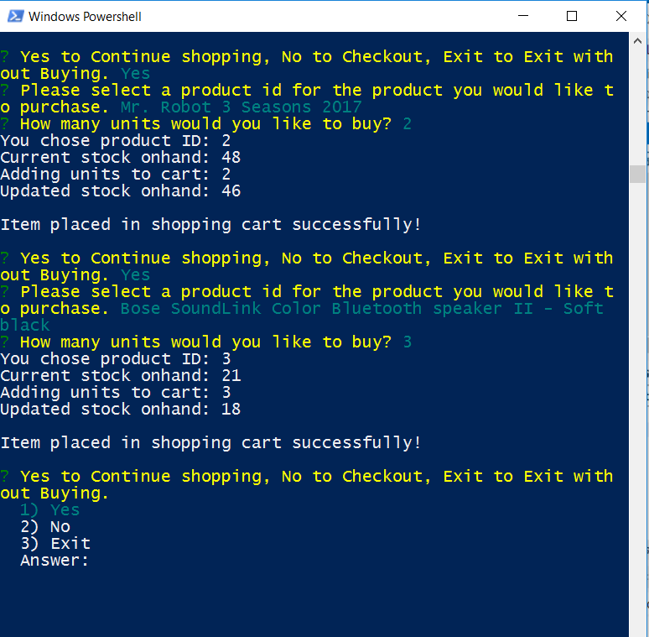
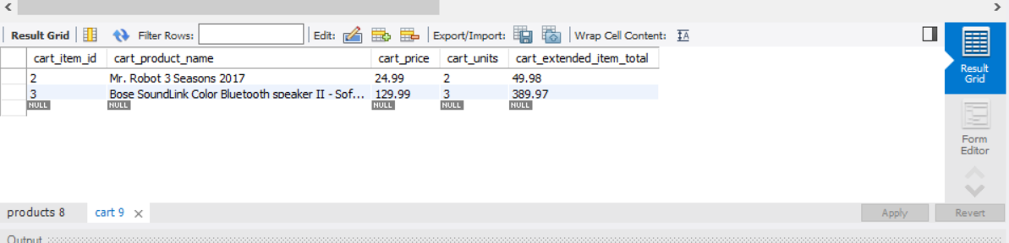
Shopping cart items stored in cart table until checkout

Slide 6
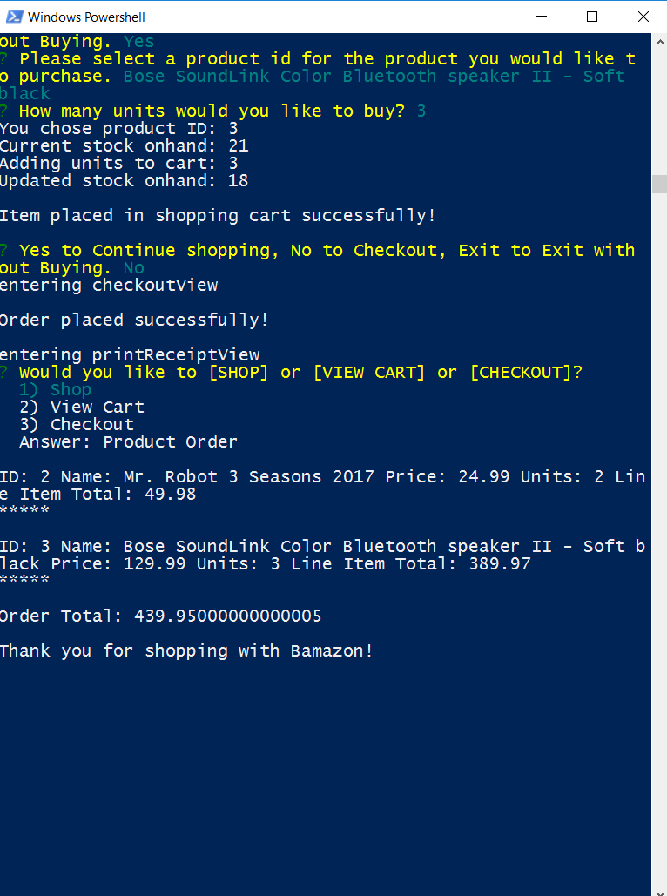
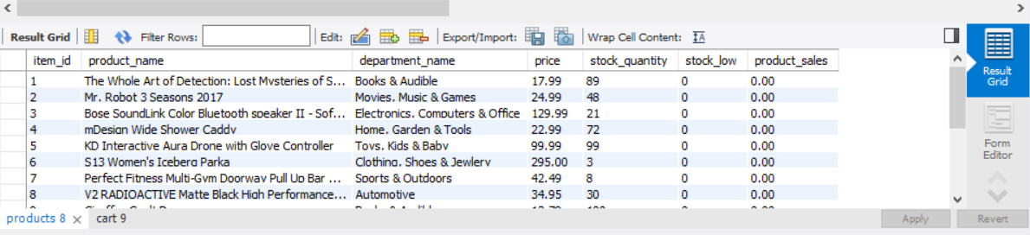
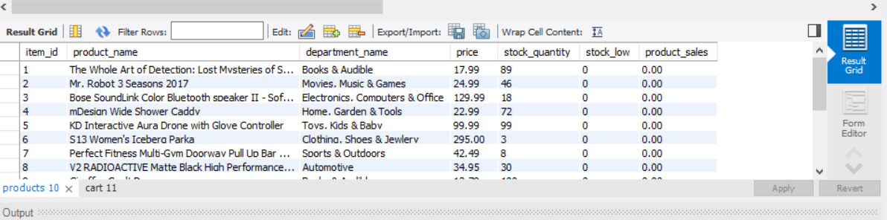
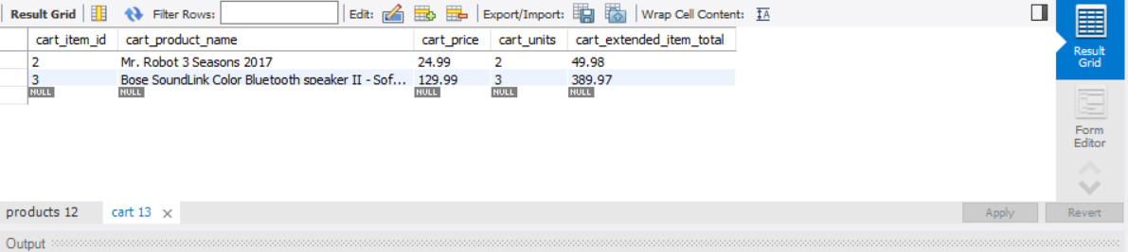
Update to inventory from shopping cart during checkout
Inventory before order placed
Inventory after order placed
Shopping cart items

Slide 7
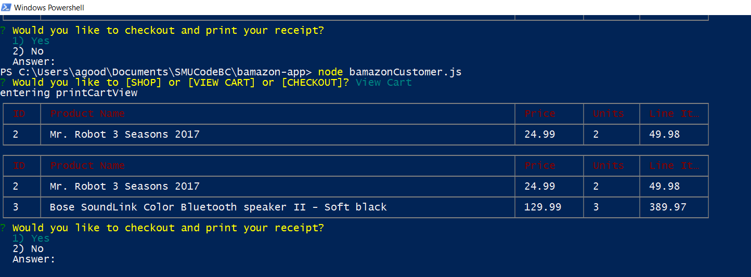
View Shopping Cart

Slide 8
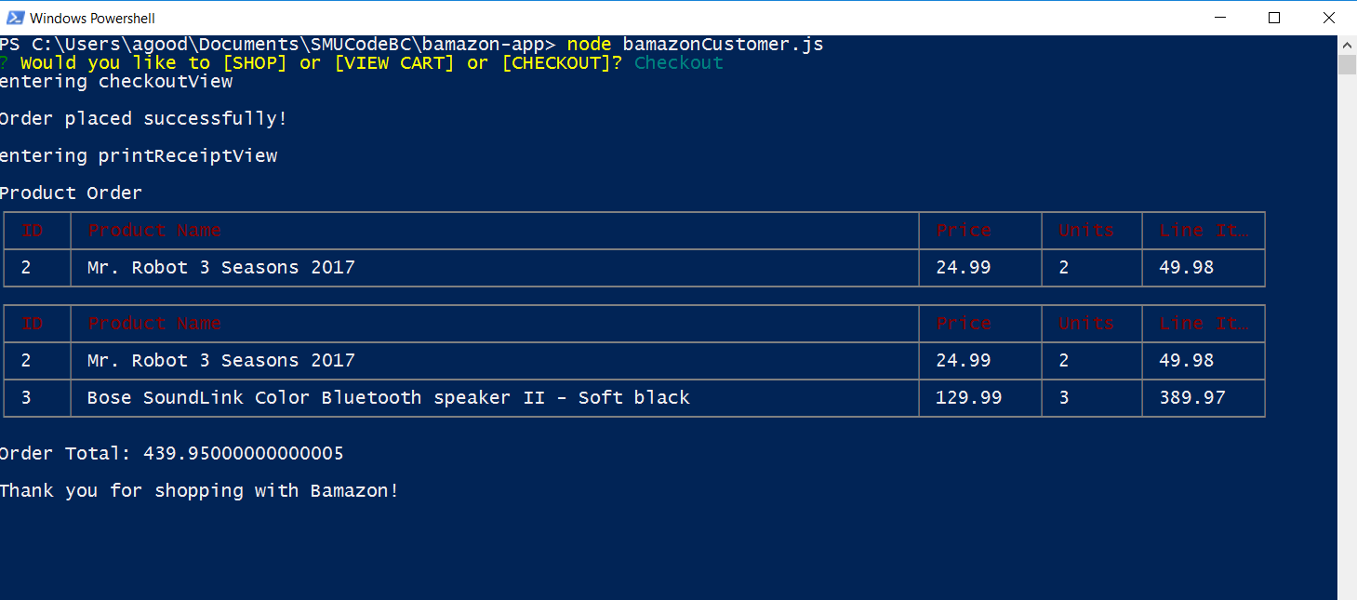
Checkout with Print Receipt

