Slide 1
Automotive Clusters
Passenger Car Motor Oils **
Component Part | Lube Spec | Lube Requirements | Products
 |  |  | Standard | Premium | Supreme
Engine (Petrol Monograde) | Engine oil SAE 10W, 30, 40, 50 | Oxidation resistance Good detergency Good dispersancy Good wear control | PETRONAS Mach 5 SF SAE 40 | - | -
Engine (Petrol Multigrade) | Engine Oil 0W-20, 5W-30, 0W-40, 5W-40, 15W-40, 20W-50 | Oxidation resistance Good detergency Good dispersancy Good wear control Fuel efficiency | PETRONAS M-Plus | PETRONAS Syntium 5000 series | PETRONAS Syntium 7000 Series
Engine (Diesel Monograde) | Engine oil SAE 10W, 30, 40, 50 | Oxidation resistance Detergency Dispersancy Soot handling | PETRONAS Urania CF | - | -
Engine (Diesel Multigrade) | Engine Oil 10W-40, 15W-40 | Cold starting Long idling periods Soot handling | PETRONAS Urania LD 7 | PETRONAS Urania 5000 E 15W40 | PETRONAS Urania 7000 E 10W40
Transmission (automatic) | Dexron series OEM requirement | High viscosity index Oxidation stability Compatibility with friction material | PETRONAS ATF D3 PETRONAS Tutela Transmission GI/A | PETRONAS Tutela Transmission GI/E | PETRONAS Transmission ATF 90 PETRONAS Transmission ATF 120 PETRONAS Transmission CVT PETRONAS ATF MV3
Transmission (manual) | 75W-90, 80W-90, 80W-A, API GL-4, OEM requirement | Oxidation stability Extreme pressure Compatibility with yellow metal components | PETRONAS GL-4 |  | PETRONAS Tutela EG 50 PETRONAS Transmission FE
** Products may vary by region and fuel specification, check with your local PETRONAS representative
Continued on next slide

Slide 2
Automotive Clusters
Passenger Car Motor Oils **
Component Part | Lube Spec | Lube Requirements | Products
 |  |  | Standard | Premium | Supreme
Cooling System | Coolant Fluid | Long periods of work High temperature Multi metal compatibility | PETRONAS Paraflu 11 | PETRONAS Paraflu Up Ready | -
Differentials | SAE 50, SAE 90, 75W-90, 80W-140, GL-5, OEM requirement | Oxidation stability Extreme pressure | PETRONAS GL-5 PETRONAS Tutela | - | PETRONAS Tutela Transmission Stargear AX-ED
Wheel bearing Grease | NLGI GC-LB ASTM D4950 Li-X NLGI 2 / 2.5 EP | High load capability Long life High temperature handling Water washout Oxidation resistance | PETRONAS Tutela WB Grease | - | -
CV Joint | NLGI 2 EP Solid Additives | With solid lubricants Water tolerance High load capability | PETRONAS Tutela SP | - | -
General Grease Points | NLGI 2 EP Lithium EP / Lithium-Calcium EP | OEM approvals Long life Water washout Multipurpose Oxidation stability | PETRONAS Tutela GP | - | -
Assembly & Thread Grease | NLGI 1 Lithium Solid additives | Water washout Prevent swelling of rubber Wear protection | PETRONAS Grease Li AS | -
Emission fluid | ISO 22241 | OEM acceptance | Air 1 AdBlue | - | -
** Products may vary by region and fuel specification, check with your local PETRONAS representative

Slide 3
Automotive Clusters
Commercial Vehicle Lubricants CVL**
Component Part | Lube Spec | Lube Requirements | Products
 |  |  | Standard | Premium | Supreme
Engine (Diesel Monograde) | Engine oil SAE 10W, 30, 40, 50 | Oxidation resistance Detergency Dispersancy Soot handling | PETRONAS Urania CF | - | -
Engine (Diesel Multigrade) | Engine Oil 15W40 / 10W40 | Cold starting Long idling periods Soot handling | PETRONAS Urania LD 7 | PETRONAS Urania 5000 10W40 | PETRONAS Urania 5000 E 10W40
Cooling System | Coolant Fluid | Long periods of work High temperature | PETRONAS Paraflu 11 | PETRONAS Paraflu Up Ready | -
Transmission | 75W-90, 80W-90, 80W-A, API GL-4, OEM requirement | Long drain intervals High temperature handling High load capability | PETRONAS Tutela Transmission Series | PETRONAS Tutela Transmission Series - | PETRONAS Tutela Transmission Series
Hydraulics / Steering | ATF type fluids | Long drain intervals High temperature handling High load capability | PETRONAS Tutela Transmission ATF Series | - | -
Final Drive and differentials | SAE 50, 60, 75W-90, 85W-140, 90, 80W-140 GL-5 | Long drain intervals High temperature handling High load capability |  | - | PETRONAS TUTELA TRANSMISSION STARGEAR AX-ED
** Products may vary by region and fuel specification, check with your local PETRONAS representative
Continued on next slide

Slide 4
Automotive Clusters
Commercial Vehicle Lubricants CVL**
Component Part | Lube Spec | Lube Requirements | Products
 |  |  | Standard | Premium | Supreme
Wheel bearing Grease | NLGI GC-LB ASTM D4950 Li-X NLGI 2 / 2.5 EP OEM requirement | High load capability Long life High temperature handling Water washout Oxidation resistance | PETRONAS Tutela WB Grease | PETRONAS Grease LiX 2/170 | - PETRONAS LiX Syn 2/220
5th Wheel Grease | NLGI 2.5 Lithium Calcium Solid additives | High load capability Long life High solid additive content Water washout Oxidation resistance | PETRONAS Grease LiCa GEP 2.5 | - | -
Centralised Lubrications System / Grease Points / Chassis Grease | NLGI 2 EP Lithium EP / Lithium-Calcium EP OEM requirements | OEM approvals Long life Water washout Multipurpose Oxidation stability | PETRONAS Tutela SP | PETRONAS Grease LiX 2/170 | PETRONAS LiX Syn 2/220
Assembly Grease | NLGI 1 Lithium Solid additives | Water washout Prevent swelling of rubber Wear protection | - |  | -
Thread Grease | NLGI 1 Lithium Solid additives | Anti-seize Anti-rust Oxidation stability | PETRONAS Grease Li AS | -
Pin and Bush Grease | NLGI 2 EP | With solid lubricants Water tolerance High load capability | PETRONAS Grease LiX MEP | PETRONAS Grease LiCa MG HL | PETRONAS Grease LiCa MG XHL
Emission fluid | ISO 22241 | OEM acceptance | Air 1 AdBlue | - | -
** Products may vary by region and fuel specification, check with your local PETRONAS representative

Slide 5
Automotive Clusters
Motor Cycle Oils **
Component Part | Lube Spec | Lube Requirements | Products
 |  |  | Standard | Premium | Supreme
Engine (Petrol) 2 Stroke | API TC JASO ISO EGD | Low carbon deposits Extended spark plug life Excellent miscibility & fluidity | PETRONAS Sprinta 2XT | PETRONAS Syntium Moto 2SP | PETRONAS Syntium Moto RS-2
Engine (Petrol) 4 Stroke | API JASO MA2 | Oxidation resistance Good detergency Good dispersancy Good wear control Fuel efficiency Wet clutch compatibility | PETRONAS Sprinta 4XP | PETRONAS Syntium Moto 4SP | PETRONAS Syntium Moto RS-4
Cooling System | Coolant Fluid | Long periods of work High temperature | PETRONAS Paraflu 11 | PETRONAS Paraflu Up Ready | -
Transmission | OEM requirements | OEM requirements Use same engine oil (wet clutch) | Uses the same engine oil (wet clutch) | Uses the same engine oil (wet clutch) | Uses the same engine oil (wet clutch)
Final Drive | OEM requirements | OEM requirements
Brake / Clutch Fluid | DOT 4 or higher | High boiling point Oxidation resistance Long service life Chemical stability Protects metal and rubbers | - | PETRONAS Tutela Extreme HT | PETRONAS Tutela Dot 5.1
Chain Lubricant | - | Tackiness High water wash Long life | - | PETRONAS Durance Chain Lubricant | -
Fork oil | OEM requirements | Very high VI Anti-foaming Seal compatibility | - | PETRONAS Tutela Fork Oil | -
** Products may vary by region, check with your local PETRONAS representative

Slide 6
Automotive Clusters
Automotive component manufacturing and assembly
Component Part | Lube Spec | Lube Requirements | Products
 |  |  | Standard | Premium | Supreme
Cutting / Grinding fluids | - | High emulsion stability Excellent lubricity and anti-weld Anti-rust, anti-corrosion Anti-sludge Anti-bacterial | Mecafluid SM 59 | Mecafluid S 2006 | -
Grease points | NLGI 2 EP | Water tolerance High load capability | PETRONAS Grease Li EP 2 | PETRONAS Grease LiX 2/170 | PETRONAS Grease LiX Syn 2/220
Hydraulics | ISO VG range HM specification | Good air release Water separability Low foaming tendencies | PETRONAS Hydraulic | PETRONAS Hydraulic HV | PETRONAS Hydraulic ESF
Slide way oils | ISO VG 68 and 220 Cincinnati Machine Spec | Pumpability and sprayability Adhesive characteristics Extreme pressure | PETRONAS Slideway | - | -
Air compressor | 51506-VDL | Oxidation stability Good air release Foam tendencies | PETRONAS Compressor A M2 | PETRONAS Compressor A M4 | PETRONAS Compressor A Syn PAO
Electric Motor Bearings | NLGI 2 | Long life at high temperature Low bleed Medium and high speed | PETRONAS Grease Li 2 | PETRONAS Grease PU | -
Gear oils | AGMA 4-7 EP | Micropitting resistance High load capability Low foaming tendencies Water separability | PETRONAS Gear MEP | PETRONAS Gear FL | PETRONAS Gear Syn PAO
Chain oils | ISO VG 220 Cincinnati Machine Spec | Tackiness Rust and corrosion protection Lubricity | PETRONAS Slideway | - | -
** Products may vary by region, check with your local PETRONAS representative
Continued on next slide

Slide 7
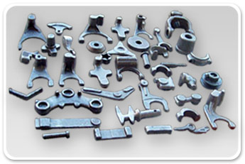
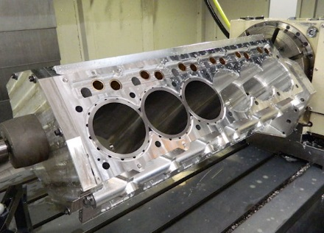
Automotive Clusters
Automotive component manufacturing and assembly
Component Part | Lube Spec | Lube Requirements | Products
 |  |  | Standard | Premium | Supreme
Metal forming fluids | Process dependant | Process dependant | PETRONAS Mecafluid Range | - | -
Assembly grease | NLGI 1 Lithium Solid additives | Water washout Prevent swelling of rubber Wear protection |  | PETRONAS Grease LiX 2/170 | -
Shock absorber fluid | OEM dependant
Air Tool | ISO VG range | corrosion protection resistance to dieseling fog control adhesiveness | PETRONAS ATO | - | -

Slide 8
Automotive Clusters
Rebuild and repair centres
Component Part | Lube Spec | Lube Requirements | Products
 |  |  | Standard | Premium | Supreme
Cutting / Grinding fluids | - | High emulsion stability Excellent lubricity and anti-weld Anti-rust, anti-corrosion Anti-sludge Anti-bacterial | Mecafluid SM 59 | Mecafluid S 2006 | -
Grease points | NLGI 2 EP | Water tolerance High load capability | PETRONAS Grease Li EP 2 | PETRONAS Grease LiX 2/170 | PETRONAS Grease LiX Syn 2/220
Hydraulics | ISO VG range HM specification | Good air release Water separability Low foaming tendencies | PETRONAS Hydraulic | PETRONAS Hydraulic HV | PETRONAS Hydraulic ESF
Slide way oils | ISO VG 68 and 220 Cincinnati Machine Spec | Pumpability and sprayability Adhesive characteristics Extreme pressure | PETRONAS Slideway | - | -
Air compressor | 51506-VDL | Oxidation stability Good air release Foam tendencies | PETRONAS Compressor A M2 | PETRONAS Compressor A M4 | PETRONAS Compressor A Syn PAO
Electric Motor Bearings | NLGI 2 | Long life at high temperature Low bleed Medium and high speed | PETRONAS Grease Li 2 | PETRONAS Grease PU | -
Gear oils | AGMA 4-7 EP | Micropitting resistance High load capability Low foaming tendencies Water separability | PETRONAS Gear MEP | PETRONAS Gear FL | PETRONAS Gear Syn PAO
Assembly grease | NLGI 1 Lithium Solid additives | Water washout Prevent swelling of rubber Wear protection | - | PETRONAS Grease LiX 2/170 | -
Air Tool | ISO VG range | corrosion protection resistance to dieseling fog control adhesiveness | PETRONAS ATO | - | -
** Products may vary by region, check with your local PETRONAS representative

Slide 9
Agricultural Clusters
Agriculture & Construction Lubricants **
Component Part | Lube Spec | Lube Requirements | Products
 |  |  | Standard | Premium | Supreme
Engine (Diesel Monograde) | Engine oil SAE 10W, 30, 40, 50 | Oxidation resistance Detergency Dispersancy Soot handling | PETRONAS Urania CF | - | -
Engine (Diesel Multigrade) | Engine Oil 15W40 / 10W40 STOU | Cold starting Long idling periods Soot handling | PETRONAS Urania LD 7 | PETRONAS Urania 5000 10W40 | PETRONAS Urania 5000 E 10W40
Cooling System | Coolant Fluid | Long periods of work High temperature | PETRONAS Paraflu 11 | PETRONAS Paraflu Up Ready | -
Transmission | SAE 30 TO-4 series UTTO OEM requirements (ZF/Allison) | Long drain intervals High temperature handling High load capability | PETRONAS Powertrans T4 Series | PETRONAS Arbor MTF | -
Hydraulics | UTTO | Long drain intervals High temperature handling High load capability | - | PETRONAS Arbor MTF | -
Wet brakes / Oil immersed brakes | UTTO | Anti-squawk capability Oxidation resistance Anti-wear | - | PETRONAS Arbor MTF | -
** Products may vary by region, check with your local PETRONAS representative
Continued on next slide

Slide 10
Agricultural Clusters
Agriculture & Construction Lubricants **
Component Part | Lube Spec | Lube Requirements | Products
 |  |  | Standard | Premium | Supreme
Final Drive and differentials | SAE 50, 60, 75W-90, 85W-140, 90, 80W-140 GL-5 | Long drain intervals High temperature handling High load capability | - Gearlube EP Series) | - | -
General purpose agricultural grease | NLGI 2 Lithium / Lithium calcium Functional polymer OEM requirements | Water tolerance Long life Centralized lubricant system High load | PETRONAS Tutela SP | PETRONAS Grease LiX 2/170 | PETRONAS Grease LiX Syn 2/220
Wheel bearing Grease | NLGI GC-LB ASTM D4950 Li-X NLGI 2 / 2.5 EP OEM requirement | High load capability Long life High temperature handling Water washout Oxidation resistance | PETRONAS Tutela WB Grease | PETRONAS Grease LiX 2/170 | -
CV Joint | NLGI 2 EP Solid Additives | With solid lubricants Water tolerance High load capability | PETRONAS Tutela SP | PETRONAS Grease LiX MEP | -
Thread Grease | NLGI 1 Lithium Solid additives | Solid lubricants Water tolerance High and low temperature capability Chemical corrosion resistance | PETRONAS Grease LiAS | -
Emission fluid | ISO 22241 | OEM acceptance | Air 1 AdBlue
** Products may vary by region, check with your local PETRONAS representative

Slide 11
Construction Clusters
Agriculture & Construction Lubricants **
Component Part | Lube Spec | Lube Requirements | Products
 |  |  | Standard | Premium | Supreme
Engine (Diesel Monograde) | Engine oil SAE 10W, 30, 40, 50 | Oxidation resistance Detergency Dispersancy Soot handling | PETRONAS Urania CF | - | -
Engine (Diesel Multigrade) | Engine Oil 15W40 / 10W40 | Cold starting Long idling periods Soot handling | PETRONAS Urania LD 7 | PETRONAS Urania 5000 10W40 | PETRONAS Urania 5000 E 10W40
Cooling System | Coolant Fluid | Long periods of work High temperature | PETRONAS Paraflu 11 | PETRONAS Paraflu Up Ready | -
Transmission | SAE 30 TO-4 series UTTO OEM requirements (ZF) | Long drain intervals High temperature handling High load capability | PETRONAS Powertrans T4 Series PETRONAS Arbor MTF | - | -
Hydraulics (Steering) | SAE 10W TO-4 series | Long drain intervals High temperature handling High load capability | PETRONAS Powertrans T4 10W | - | -
Hydraulics | Premium VI High VI | Water Separability Wet and Dry Filterability Multi metal compatibility Rust and corrosion protection | PETRONAS Hydraulic EP | PETRONAS Hydraulic HV | Engen Hydrokin ESF Series
Rockdrill / Air Tool (oil) | Parker Denison Cincinnati Afnor | Corrosion and rust protection Water tolerance Reduced air particulates / fogging (non-toxic) Anti-wear Reduced downtime due to icing | PETRONAS ATO | - | -
** Products may vary by region, check with your local PETRONAS representative
Continued on next slide

Slide 12
Construction Clusters
Agriculture & Construction Lubricants **
Component Part | Lube Spec | Lube Requirements | Products
 |  |  | Standard | Premium | Supreme
Compressor | DIN 51506 VDL | Oxidation stability Reduced deposits Long drain intervals | PETRONAS Compressor A M2 | PETRONAS Compressor A M4 | PETRONAS Compressor A Syn PAO
Gearbox | AGMA 4-7 EP | Micropitting resistance High load capability Low foaming tendencies Water separability | PETRONAS Gear MEP | - | PETRONAS Gear Syn EP Series
Final Drive and differentials | SAE 50, 60, 75W-90, 85W-140, 90, 80W-140 TO-4 series GL-5 | Long drain intervals High temperature handling High load capability | PETRONAS Powertrans T4 Series - | - | -
Wheel bearing Grease | NLGI GC-LB ASTM D4950 Li-X NLGI 2 / 2.5 EP OEM requirement |  | PETRONAS Tutela WB Grease | PETRONAS Grease LiX 2/170 | -
Centralised Lubrications System Grease Points | NLGI 2 EP Lithium EP / Lithium-Calcium EP OEM requirements |  | PETRONAS Tutela SP | - | PETRONAS Grease LiX Syn 2/220
Thread Grease | NLGI 1 Lithium Solid additives |  | PETRONAS Grease Li AS | -
Pin and Bush Grease | NLGI 2 EP | With solid lubricants Water tolerance High load capability | PETRONAS Grease LiX MEP | PETRONAS Grease LiCa MG HL | PETRONAS Grease LiCa MG XHL
Emission fluid |  |  | AdBlue
** Products may vary by region, check with your local PETRONAS representative
Continued on next slide

Slide 13
Construction Clusters
Agriculture & Construction Lubricants **
Component Part | Lube Spec | Lube Requirements | Products
 |  |  | Standard | Premium | Supreme
Slewing gear | NLGI 2 Liebherr, Bell (white solids) | With solid lubricants Water tolerance Extreme high load capability | - | - | PETRONAS Grease LiCa MG XHL
Generator – Electric Motor | NLGI 2 | Long life at high temperature Low bleed Medium and high speed | PETRONAS Grease Li 2 | PETRONAS Grease PU | -
Steel Ropes | OIPEEC | Core penetration Adhesive characteristics Elasticity Rust and corrosion protection | PETRONAS Grease LiCa GEP 2.5 | - | -
Conveyor bearings | NLGI 2 EP | High load capability Water tolerance Long life | PETRONAS Grease Li EP 2 | PETRONAS Grease CaSX | PETRONAS Grease LiX Syn 2/220
** Products may vary by region, check with your local PETRONAS representative

Slide 14
Agriculture & Construction Clusters
Component manufacturing and assembly**
Component Part | Lube Spec | Lube Requirements | Products
 |  |  | Standard | Premium | Supreme
Cutting / Grinding fluids | - | High emulsion stability Excellent lubricity and anti-weld Anti-rust, anti-corrosion Anti-sludge Anti-bacterial | Mecafluid SM 59 | Mecafluid S 2006 | -
Grease points | NLGI 2 EP | Water tolerance High load capability | PETRONAS Grease Li EP 2 | PETRONAS Grease LiX 2/170 | PETRONAS Grease LiX Syn 2/220
Hydraulics | ISO VG range HM specification | Good air release Water separability Low foaming tendencies | PETRONAS Hydraulic | PETRONAS Hydraulic HV | PETRONAS Hydraulic ESF
Slide way oils | ISO VG 68 and 220 Cincinnati Machine Spec | Pumpability and sprayability Adhesive characteristics Extreme pressure | PETRONAS Slideway | - | -
Air compressor | 51506-VDL | Oxidation stability Good air release Foam tendencies | PETRONAS Compressor A M2 | PETRONAS Compressor A M4 | PETRONAS Compressor A Syn PAO
Electric Motor Bearings | NLGI 2 | Long life at high temperature Low bleed Medium and high speed | PETRONAS Grease Li 2 | PETRONAS Grease PU | -
Gear oils | AGMA 4-7 EP | Micropitting resistance High load capability Low foaming tendencies Water separability | PETRONAS Gear MEP | PETRONAS Gear FL | PETRONAS Gear Syn PAO
Chain oils | ISO VG 220 Cincinnati Machine Spec | Tackiness Rust and corrosion protection Lubricity | PETRONAS Slideway | - | -
** Products may vary by region, check with your local PETRONAS representative
Continued on next slide

Slide 15
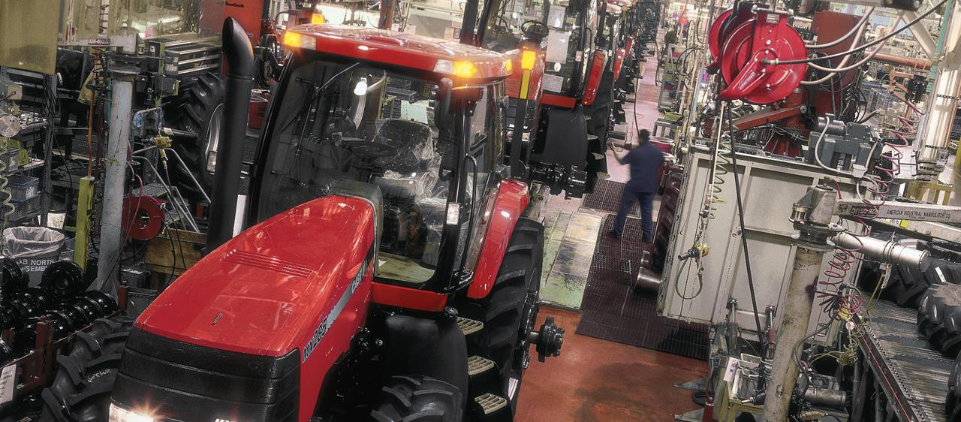
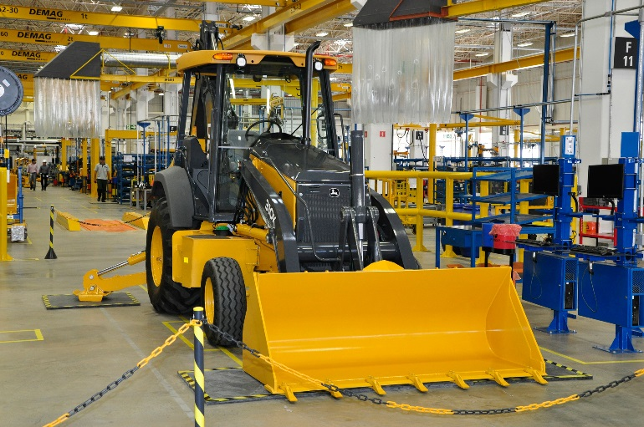
Agriculture & Construction Clusters
Component manufacturing and assembly**
Component Part | Lube Spec | Lube Requirements | Products
 |  |  | Standard | Premium | Supreme
Metal forming fluids | Process dependant | Process dependant | PETRONAS Mecafluid Range | - | -
Assembly grease | NLGI 1 Lithium Solid additives | Water washout Prevent swelling of rubber Wear protection | - | PETRONAS Grease LiX 2/170 | -
Shock absorber fluid | OEM dependant |  | No global product Only in SA
Air Tool | ISO VG range | corrosion protection resistance to dieseling fog control adhesiveness | PETRONAS ATO | - | -
** Products may vary by region, check with your local PETRONAS representative

Slide 16
Agriculture & Construction Clusters
Rebuild and repair centres
Component Part | Lube Spec | Lube Requirements | Products
 |  |  | Standard | Premium | Supreme
Cutting / Grinding fluids | - | High emulsion stability Excellent lubricity and anti-weld Anti-rust, anti-corrosion Anti-sludge Anti-bacterial | Mecafluid SM 59 | Mecafluid S 2006 | -
Grease points | NLGI 2 EP | Water tolerance High load capability | PETRONAS Grease Li EP 2 | PETRONAS Grease LiX 2/170 | PETRONAS Grease LiX Syn 2/220
Hydraulics | ISO VG range HM specification | Good air release Water separability Low foaming tendencies | PETRONAS Hydraulic | PETRONAS Hydraulic HV | PETRONAS Hydraulic ESF
Slide way oils | ISO VG 68 and 220 Cincinnati Machine Spec | Pumpability and sprayability Adhesive characteristics Extreme pressure | PETRONAS Slideway | - | -
Air compressor | 51506-VDL | Oxidation stability Good air release Foam tendencies | PETRONAS Compressor A M2 | PETRONAS Compressor A M4 | PETRONAS Compressor A Syn PAO
Electric Motor Bearings | NLGI 2 | Long life at high temperature Low bleed Medium and high speed | PETRONAS Grease Li 2 | PETRONAS Grease PU | -
Gear oils | AGMA 4-7 EP | Micropitting resistance High load capability Low foaming tendencies Water separability | PETRONAS Gear MEP | PETRONAS Gear FL | PETRONAS Gear Syn PAO
Assembly grease | NLGI 1 Lithium Solid additives | Water washout Prevent swelling of rubber Wear protection | - | PETRONAS Grease LiX 2/170 | -
Air Tool | ISO VG range | corrosion protection resistance to dieseling fog control adhesiveness | PETRONAS ATO | - | -
** Products may vary by region, check with your local PETRONAS representative

Slide 17
General Industry Clusters
Industrial Gearboxes
Component Part | Lube Spec | Lube Requirements | Products
 |  |  | Standard | Premium | Supreme
Generic Gearbox | AGMA 4-7 EP | Micropitting resistance High load capability Low foaming tendencies Water separability | PETRONAS Gear MEP | PETRONAS Gear FL | PETRONAS Gear Syn PAO
Worm gearbox | AGMA 4-7 EP | Micropitting resistance High load capability Low foaming tendencies Water separability | - | - | PETRONAS Gear Syn WI
Winch gearbox | NLGI 1 AGMA CG 1 and 2 | Low oil bleed and resist separation Oxidation stability Anti-wear and extreme pressure | PETRONAS Grease Clay MEP | PETRONAS Grease PE HS
Open gear (Girth gear) | AGMA 251.01 FZG US Steel | Pumpability and sprayability Adhesive characteristics Extreme pressure Low consumption | - | PETRONAS Grease LiCa TMG)
Enclosed open gear (Grease) | NLGI 0.5 Lithium calcium Functionalized polymer | Pumpability and sprayability Adhesive characteristics Extreme pressure Extended life | - | PETRONAS Grease LiCa TMG | -
Machine tool gearboxes | Cincinnati machine specification | Tackiness Oxidation resistance | PETRONAS Slideway PETRONAS Circula | - | PETRONAS Circula SYN

Slide 18
General Industry Clusters
Hydraulic systems
Component Part | Lube Spec | Lube Requirements | Products
 |  |  | Standard | Premium | Supreme
Hydraulics | ISO 15, 32, 46, 68, 100 DIN 51524 Standard to High VI | Water Separability Wet and Dry Filterability Multi metal compatibility Rust and corrosion protection | PETRONAS Hydraulic EP | PETRONAS Hydraulic HV | PETRONAS Hydraulic ESF
Fire Resistant Hydraulics | Fire resistant DIN 51524 Standard to High VI | High temperature Dust | PETRONAS Hydraulic HFC | PETRONAS Hydraulic FR | -
Hydraulic (Zinc free) | ISO 46 DIN 51524 Standard to High VI | Wet and dry filterability Anti-wear Rust and corrosion protection Oxidation stability Fast air release | - | PETRONAS Hydraulic HVZF | -
Machine tool hydraulics | Cincinnati machine specification | Oxidation resistance Rust and corrosion protection | PETRONAS Slideway | - | -

Slide 19
General Industry Clusters
Refrigeration compressors
Component Part | Lube Spec | Lube Requirements | Products
 |  |  | Standard | Premium | Supreme
Compressor (Ammonia) | ISO 68 Naphthenic / Ester | Foam resistance Miscible with Ammonia Low volatility | - | - | PETRONAS Compressor R Syn PAO
Compressor (HFC) | ISO 68 Polyolester Grasso Bitzer | Lubricity EF / Biodegradable Long life Miscible with HFC 134-a Low volatility | - | - | PETRONAS Compressor R Syn POE
Electric Motor Bearings (grease) | NLGI 2 | Long life at high temperature Low bleed Medium and high speed | PETRONAS Grease Li 2 | PETRONAS Grease PU | -
Electric Motor Bearings / Plain Bearings (oil) | ISO VG range | Demulsibity Low foaming tendencies Antiwear properties | PETRONAS Circula | - | PETRONAS Circula Syn

Slide 20
General Industry Clusters
Standby Power Generation
Component Part | Lube Spec | Lube Requirements | Products
 |  |  | Standard | Premium | Supreme
Generator bearings | NLGI 2 EP | High load capability Water tolerance Long life | - | PETRONAS Grease PU | PETRONAS Grease LiX Syn 2/100
Diesel Engine | Engine Oil 15W40 / 10W40 | Cold starting Long idling periods Soot handling OEM requirements | PETRONAS Urania LD 7 ** | PETRONAS Urania 5000 E 15W40 ** | PETRONAS Urania 7000 E 10W40 **
Cooling System | Coolant Fluid | Long periods of work High temperature | PETRONAS Paraflu 11 ** | PETRONAS Paraflu Up Ready ** | -
** Products may vary by region, check with your local PETRONAS representative

Slide 21
General Industry Clusters
Pumps
Component Part | Lube Spec | Lube Requirements | Products
 |  |  | Standard | Premium | Supreme
Bearings (oil) | ISO VG range | Demulsibity Low foaming tendencies Antiwear properties | PETRONAS Circula | - | PETRONAS Circula Syn
Bearings (grease) | NLGI 2 EP | High load capability Water tolerance Long life | PETRONAS Grease Li EP 2 | PETRONAS Grease CaSX | PETRONAS Grease LiX Syn 2/220
Electric Motor Bearings (grease) | NLGI 2 | Long life at high temperature Low bleed Medium and high speed | PETRONAS Grease Li 2 | PETRONAS Grease PU | -

Slide 22
General Industry Clusters
Electric motors
Component Part | Lube Spec | Lube Requirements | Products
 |  |  | Standard | Premium | Supreme
Electric Motor Bearings (grease) | NLGI 2 | Long life at high temperature Low bleed Medium and high speed | PETRONAS Grease Li 2 | PETRONAS Grease PU | PETRONAS Grease LiX Syn 2/100
Electric Motor Bearings / Plain Bearings (oil) | ISO VG range | Demulsibity Low foaming tendencies Antiwear properties | PETRONAS Circula | - | PETRONAS Circula Syn

