Slide 1
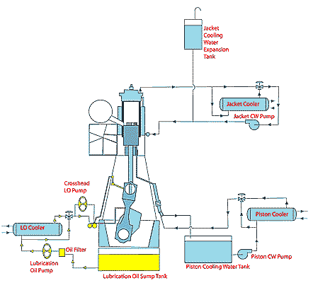
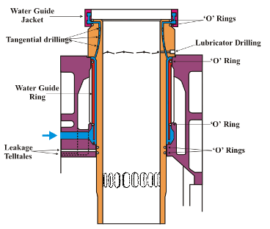
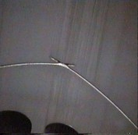
Marine - Shipping
2 Stroke Main propulsion engine system
Component Part | Lube Spec | Lube Requirements | Products
 |  |  | Standard | Premium | Supreme
Crosshead Marine Diesel Engine (Cylinder Oil) | SAE 50 TBN 70 or 100 |  | PETRONAS Silub 50-100LS
Crosshead Marine Diesel Engine (System Oil) | SAE 30 TBN 6 |  | PETRONAS Disrol 6 LS

Slide 2
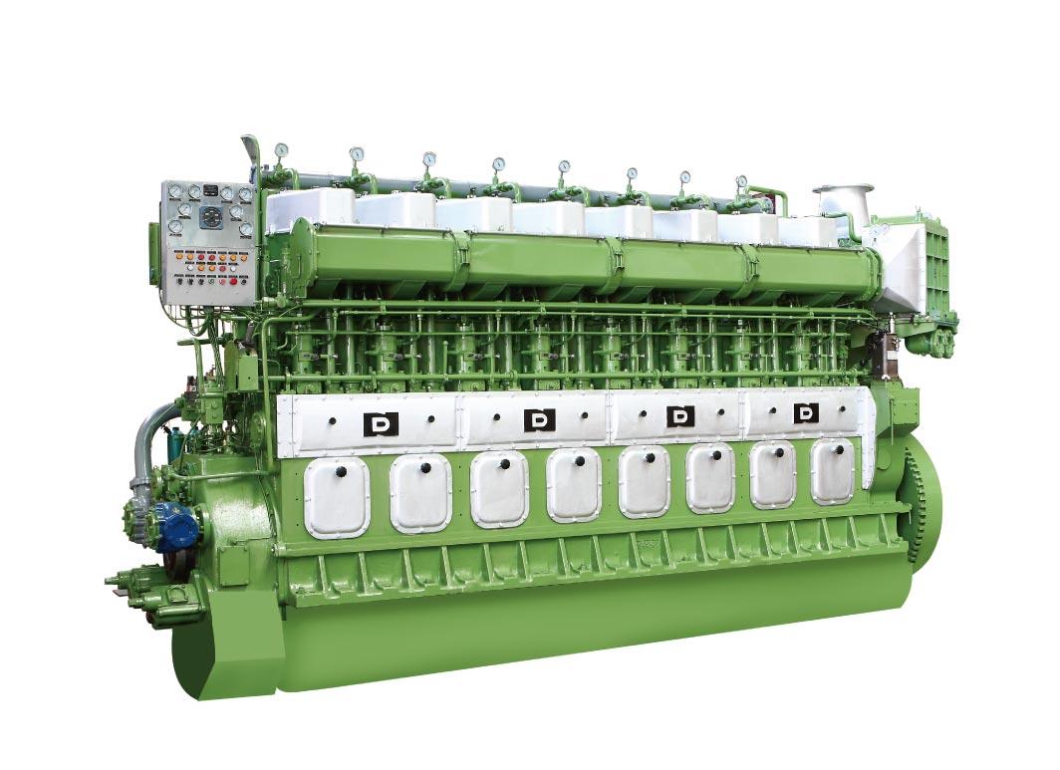
4 Stroke Medium Speed Engines
Component Part | Lube Spec | Lube Requirements | Products
 |  |  | Standard | Premium | Supreme
Trunk Piston Engines (Medium Speed) | SAE 40 TBN 15 Fuel S 1-2% TBN 30 HFO S 2-3% TBN 40 HFO S >3% |  | PETRONAS Disrol 15, 30, 40 50 and 55 MS Series
Trunk Piston Engines (Medium Speed) | SAE 30 TBN 15 Fuel S 1-2% TBN 30 HFO S 2-3% TBN 40 HFO S >3% |  | PETRONAS Disrol 15, 30, 40 MS Series

Slide 3
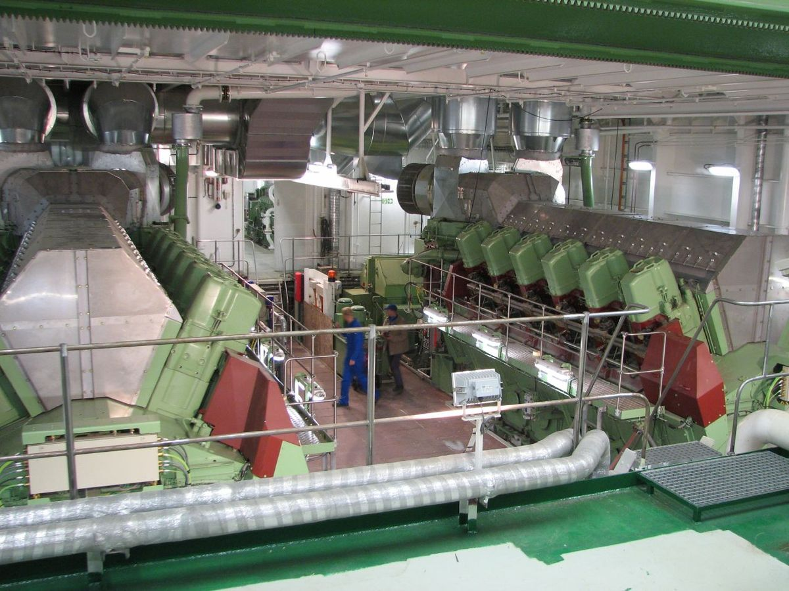
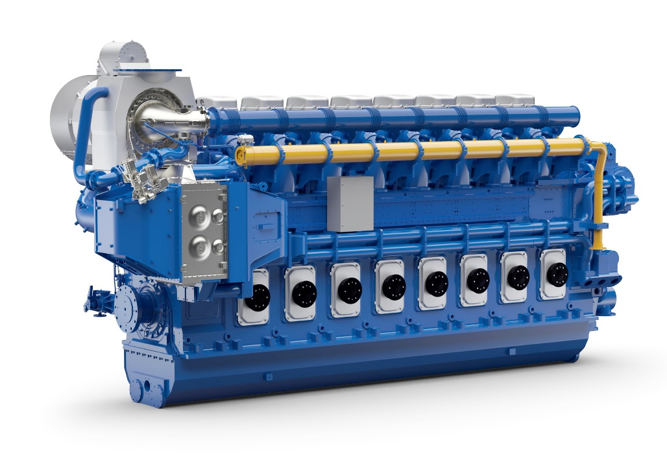
Coastal Marine - Shipping
High Speed Power Generation Engines
Component Part | Lube Spec | Lube Requirements | Products
 |  |  | Standard | Premium | Supreme
Generator bearings | NLGI 2 EP | High load capability Water tolerance Long life | -Petronas Grease Li 2 | PETRONAS Grease PU | PETRONAS Grease LiX Syn 2/220
Diesel Engine | Engine Oil 15W40 / 10W40 | Cold starting Long idling periods Soot handling | Petronas Disrol 12 HS 30/40 Petronas Disrol 10 HS 15W40

Slide 4
Ship Auxillary Equipment
Steering gear and stern tube Equipment
Component Part | Lube Spec | Lube Requirements | Products
 |  |  | Standard | Premium | Supreme
Steering gear | Premium VI High VI | Water separability Wet and Dry Filterability Multi metal compatibility Rust and corrosion protection | PETRONAS Hydraulic Series | PETRONAS Hydraulic HV Series | PETRONAS Hydraulic ESF
Grease points | NLGI 2 EP | High load capability Water tolerance Long life | PETRONAS Grease LiX EP 2/380 | PETRONAS Grease CaSx | PETRONAS Grease LiX Syn 2/460
Stern tube | Emulsion @ 60min Timken salt water test Sea water rust test | Water separability Rust and corrosion protection | Disrol 6 until new product available

Slide 5
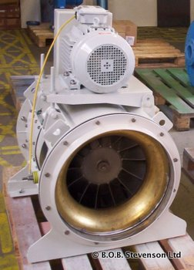
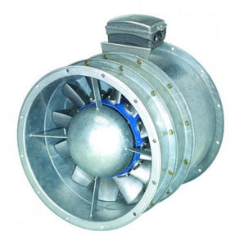
Ship Auxillary Equipment
Fans - Axial Flow Fans, Deck Mounting, Centrifugal Fans
Component Part | Lube Spec | Lube Requirements | Products
 |  |  | Standard | Premium | Supreme
Fans (Grease) | NLGI 2 | Long life at high temperature Low bleed Medium and high speed | PETRONAS Grease Li 2 | PETRONAS Grease PU | -
Electric Motor (Grease) | NLGI 2 | Long life at high temperature Low bleed Medium and high speed | PETRONAS Grease Li 2 | PETRONAS Grease PU | -

Slide 6
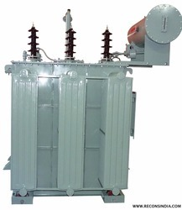
Ship Auxillary Equipment
Transformers
Component Part | Lube Spec | Lube Requirements | Products
 |  |  | Standard | Premium | Supreme
Transformers | Naphthenic Uninhibited | BDV No corrosive sulphur Dry oil (10ppm max) | PETRONAS Elektron | - | -

Slide 7
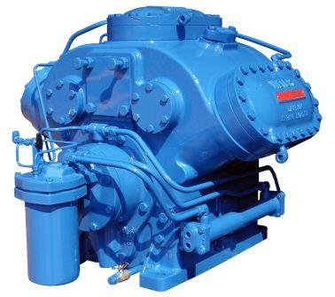
Ship Auxillary Equipment
Refrigeration plants: Provision Storage, Air Conditioner Plants, Control air Dryers, Cargo Refrigeration Plants.
Component Part | Lube Spec | Lube Requirements | Products
 |  |  | Standard | Premium | Supreme
Compressor (Ammonia) | ISO 68 Naphthenic / Ester | Foam resistance Miscible with Ammonia Low volatility |  |  | PETRONAS Compressor R Syn PAO
Compressor (HFC) | ISO 68 Polyolester Grasso Bitzer | Lubricity EF / Biodegradable Long life Miscible with HFC 134-a Low volatility |  |  | PETRONAS Compressor R Syn POE
Electric Motor Bearings (grease) | NLGI 2 | Long life at high temperature Low bleed Medium and high speed | PETRONAS Grease Li 2 | PETRONAS Grease PU | -

Slide 8
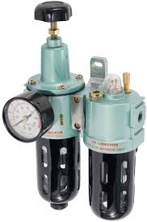
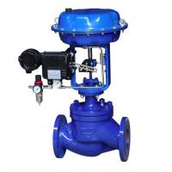
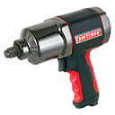
Ship Auxillary Equipment
Compressed Air system – Compressors Air tools and pneumatic control valves
Component Part | Lube Spec | Lube Requirements | Products
 |  |  | Standard | Premium | Supreme
Compressor | DIN 51506 VDL | Oxidation stability Reduced deposits Long drain intervals | PETRONAS Compressor A M2 | PETRONAS Compressor A M4 | PETRONAS Compressor A Syn PAO
Air line Lubricators | ISO 68 | Good water seperability Reduced deposits Oxidation stability | Hydraulic 68
Electric Motor Bearings | NLGI 2 | Long life at high temperature Low bleed Medium and high speed | PETRONAS Grease Li 2 | PETRONAS Grease PU | -
Air dryer (HFC) | ISO 68 Polyolester Grasso Bitzer | Lubricity EF / Biodegradable Long life Miscible with HFC Low volatility | - | - | PETRONAS Compressor R Syn POE

Slide 9
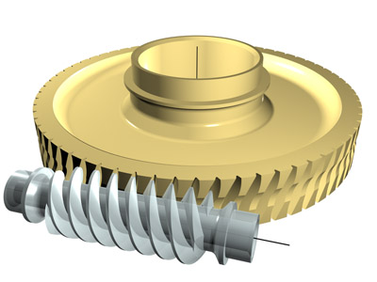
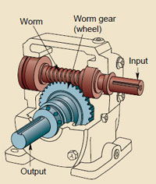
Ship Auxillary Equipment
Fuel and lubricant centrifuges
Component Part | Lube Spec | Lube Requirements | Products
 |  |  | Standard | Premium | Supreme
Electric Motor Bearings | NLGI 2 | Long life at high temperature Low bleed Medium and high speed | PETRONAS Grease Li 2 | PETRONAS Grease PU | -
Worm Gear Drives | AGMA 4 | Excellent lubricity High Load capability Water separability Excellent oxidation stability |  |  | Petronas Gear Syn WI

Slide 10
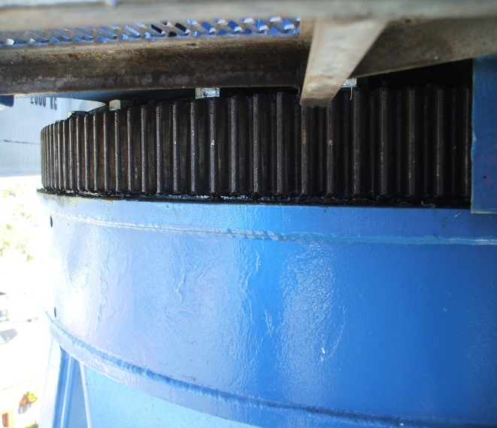
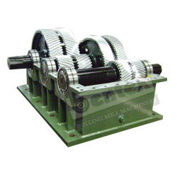
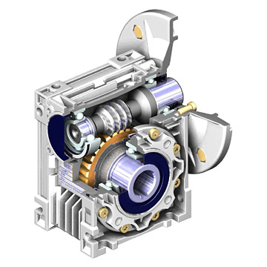
Ship Auxillary Equipment
Gears - Reduction gears, Crane Slewing gears
Component Part | Lube Spec | Lube Requirements | Products
 |  |  | Standard | Premium | Supreme
Gear Drives | AGMA 4-7 EP | Micropitting resistance High load capability Low foaming tendencies Water separability | PETRONAS Gear MEP | PETRONAS Gear FL | PETRONAS Gear Syn PAO PETRONAS Gear Syn PAG
Worm Gear Drives | AGMA 4 | Excellent lubricity High Load capability Water separability |  |  | Petronas Gear Syn WI
Slewing gears | NLGI 2 (white solids) | With solid lubricants Water tolerance Extreme high load capability | - | - | PETRONAS Grease LiCa MG XHL

Slide 11
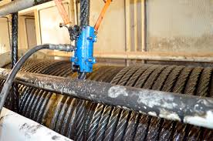
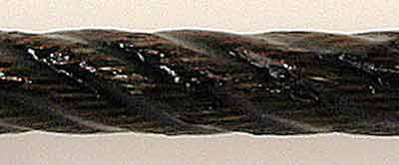
Ship Auxillary Equipment
Cables
Component Part | Lube Spec | Lube Requirements | Products
 |  |  | Standard | Premium | Supreme
Cables | Marine guidelines | Core penetration Adhesive characteristics Elasticity Rust and corrosion protection | - | PETRONAS WR EF | -

Slide 12
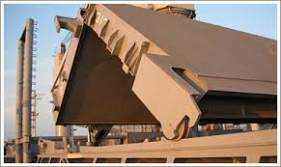
Ship Auxillary Equipment
Hydraulics - Winch and Windlass drives, Deck cranes, tween and lifting decks, Cargo valve control systems, Main Engine control systems, Cargo hatch systems, Controllable pitch propellers, Bow thrusters
Component Part | Lube Spec | Lube Requirements | Products
 |  |  | Standard | Premium | Supreme
Hydraulics | Premium VI High VI | Water separability Wet and Dry Filterability Multi metal compatibility Rust and corrosion protection | PETRONAS Hydraulic | PETRONAS Hydraulic HV | PETRONAS Hydraulic ESF
Electric Motor Bearings | NLGI 2 | Long life at high temperature Low bleed Medium and high speed | PETRONAS Grease Li 2 | PETRONAS Grease PU

Slide 13
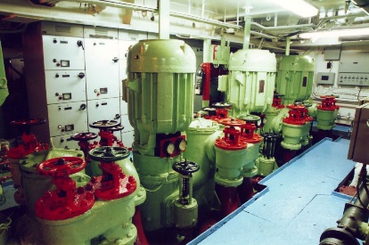
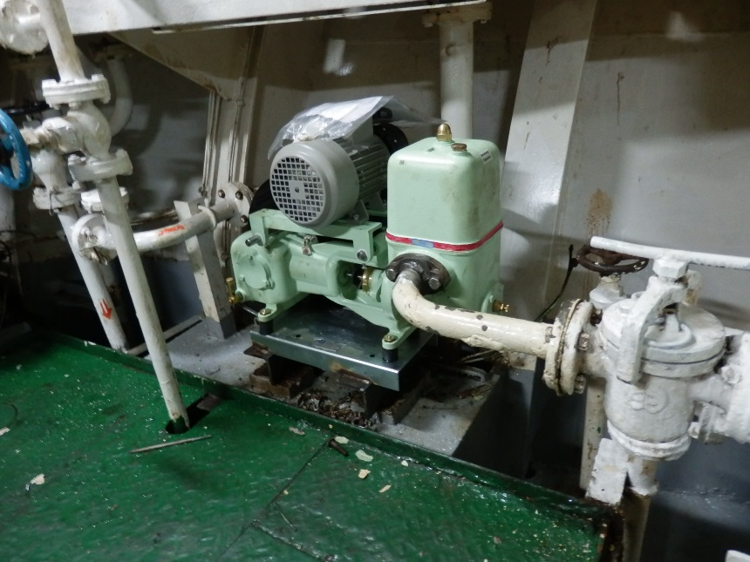
Ship Auxillary Equipment
Fuel transfer, oil, Ballast, Bilge and Cooling Pumps
Component Part | Lube Spec | Lube Requirements | Products
 |  |  | Standard | Premium | Supreme
Bearings (Oil) | ISO VG 68 | Demulsibity Low foaming tendencies Antiwear properties | PETRONAS Hydraulic | PETRONAS Hydraulic HV | PETRONAS Hydraulic ESF
Bearings (Grease) | NLGI 2 EP | High load capability Water tolerance Long life | PETRONAS Grease Li EP 2 | PETRONAS Grease CaSx | PETRONAS Grease LiX Syn 2/220
Electric Motor Bearings | NLGI 2 | Long life at high temperature Low bleed Medium and high speed | PETRONAS Grease Li 2 | PETRONAS Grease PU | -

Slide 14
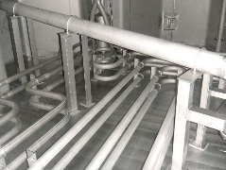
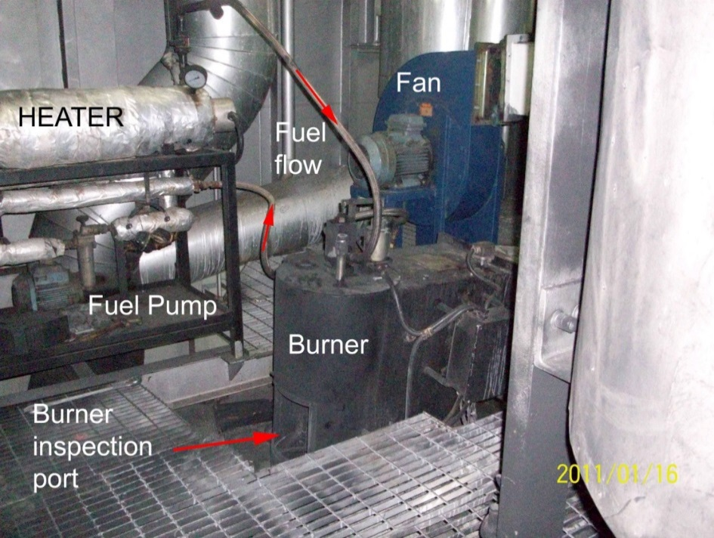
Ship Auxillary Equipment
Heat Transfer Equipment – Thermo Pack and Tank Heating coils
Component Part | Lube Spec | Lube Requirements | Products
 |  |  | Standard | Premium | Supreme
Heat Transfer equipment | ISO 22/32 Mineral | Oxidation stability Flash point Volatility | PETRONAS HTO 22 & 32)

Slide 15
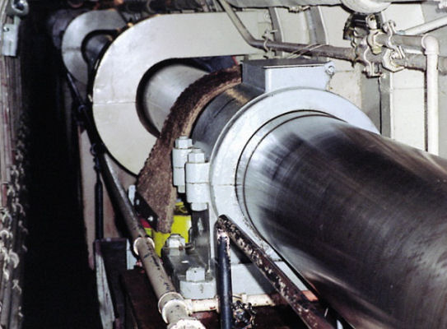
Ship Auxillary Equipment
Ships Tail Shaft
Component Part | Lube Spec | Lube Requirements | Products
 |  |  | Standard | Premium | Supreme
Bearings (Oil) | ISO VG 68 | Demulsibity Low foaming tendencies Antiwear properties | PETRONAS Circula |  | PETRONAS Circula SYN PAO

Slide 16
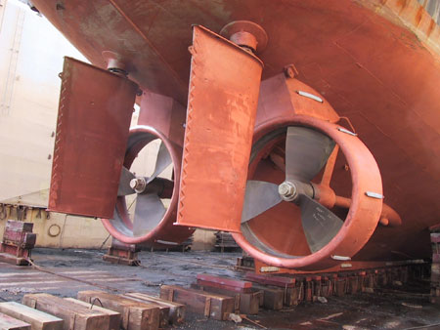
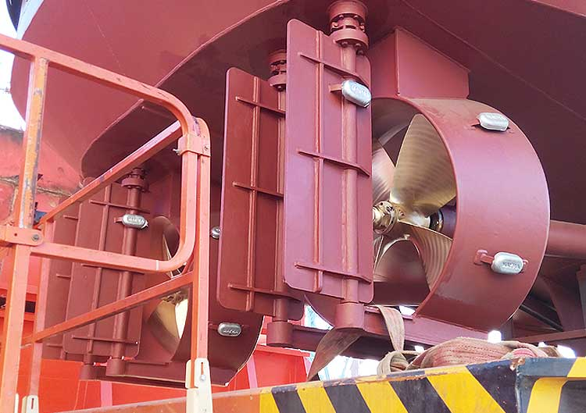
Rudder Stock bearing assembly
Component Part | Lube Spec | Lube Requirements | Products
 |  |  | Standard | Premium | Supreme
Bearings | NLGI 2 | Water resistance High Load Antiwear properties | PETRONAS Grease LiX EP 2/380 |  | PETRONAS Grease LiX Syn 2/460

Slide 17
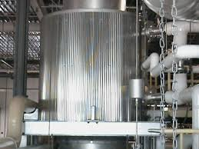
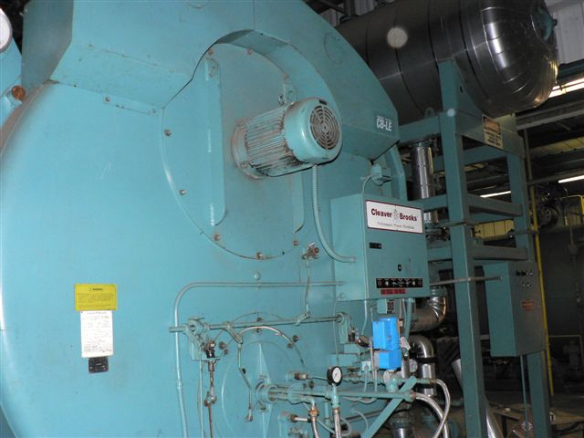
Ship Auxillary Equipment
Fuel Fired boiler and economiser
Component Part | Lube Spec | Lube Requirements | Products
 |  |  | Standard | Premium | Supreme
Pump Bearings (Oil) | ISO VG 68 | Demulsibity Low foaming tendencies Antiwear properties | PETRONAS Hydraulic
Pump Bearings (Grease) | NLGI 2 EP | High load capability Water tolerance Long life | PETRONAS Grease Li EP 2 | PETRONAS Grease CaSx | PETRONAS Grease LiX Syn 2/220
Fan Bearings | NLGI 2 | Long life at high temperature Low bleed Medium and high speed | PETRONAS Grease Li 2 | PETRONAS Grease PU
Electric Motor Bearings | NLGI 2 | Long life at high temperature Low bleed Medium and high speed | PETRONAS Grease Li 2 | PETRONAS Grease PU | -

Slide 18
Coastal Marine Port Services
Cargo Cranes
Component Part | Lube Spec | Lube Requirements | Products
 |  |  | Standard | Premium | Supreme
Cables | Marine guidelines | Core penetration Adhesive characteristics Elasticity Rust and corrosion protection | PETRONAS Grease LiCa GEP 2.5 | PETRONAS WR EF | -
Gearbox | AGMA 4-7 EP | Micropitting resistance High load capability Low foaming tendencies Water separability | PETRONAS Gear MEP | Petronas Gear FL | PETRONAS Gear Syn PAO
Winches (Worm Gear) | AGMA 4-7 EP | Micropitting resistance High load capability Low foaming tendencies Water separability |  | - | PETRONAS Gear Syn WI
Winches (Open Gear) | NLGI 1 AGMA CG 1 and 2 | Low oil bleed and resist separation Oxidation stability Anti-wear and extreme pressure | - | PETRONAS Grease LiCa MGHL | -
Winch bearings | NLGI 2 /2.5 Calcium Sulfonate or Lithium Complex | Water resistance Salt water corrosion protection Extreme load Environmentally friendly (where required) | PETRONAS Tutela WB Grease | PETRONAS Grease CaSX
Electric Motors | NLGI 2 | Long life at high temperature Low bleed Medium and high speed | PETRONAS Grease Li 2 | PETRONAS Grease PU | -
Engine | Engine Oil 15W40 / 10W40 | Cold starting Long idling periods Soot handling | PETRONAS Urania LD 7 | PETRONAS Urania 5000 E 15W40 | PETRONAS Urania 7000 E 10W40 **
Continued on next slide

Slide 19
Coastal Marine Port Services
Cargo Cranes
Component Part | Lube Spec | Lube Requirements | Products
 |  |  | Standard | Premium | Supreme
Cooling System | Coolant Fluid | Long periods of work High temperature | PETRONAS Paraflu 11 ** | PETRONAS Paraflu Up Ready ** | -
Transmission | SAE 50 TO-4 series | Long drain intervals High temperature handling High load capability | PETRONAS Powertrans T4 50W ** | - | -
Grease points | NLGI 2 EP | With solid lubricants Water tolerance High load capability | PETRONAS Grease LiX MEP | PETRONAS Grease LiCa MG HL | PETRONAS Grease LiCa MG XHL
Vertical bearing | NLGI 2 EP | Extreme high load Water tolerance High and low temperature capability | - | PETRONAS Grease CaSX | PETRONAS Grease LiX Syn 2/220
Slewing ring | NLGI 2 EP | Extreme high load capability Water tolerance Solid lubricants | - | - | PETRONAS Grease LiCa MG XHL
Hydraulics | Premium VI High VI | Water Separability Wet and Dry Filterability Multi metal compatibility Rust and corrosion protection | PETRONAS Hydraulic | PETRONAS Hydraulic HV | PETRONAS Hydraulic ESF

Slide 20
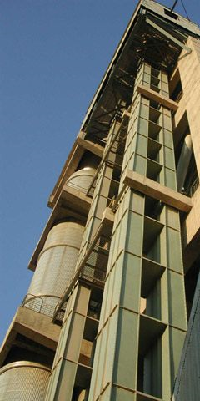
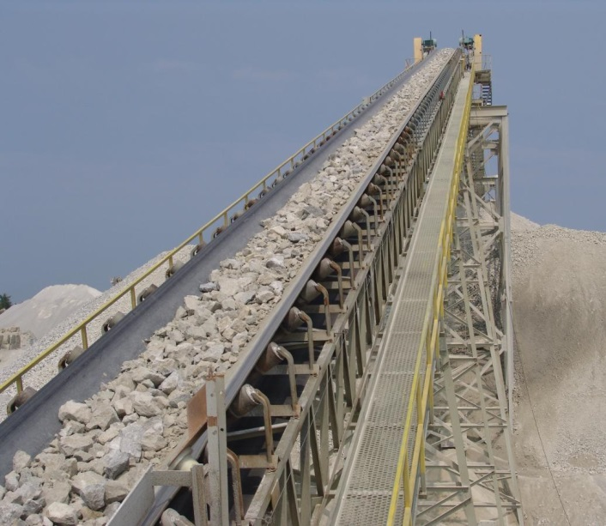
Marine Cargo Services
Conveyors, bucket elevators, screw conveyors
Component Part | Lube Spec | Lube Requirements | Products
 |  |  | Standard | Premium | Supreme
Electric Motor Bearings | NLGI 2 | Long life at high temperature Low bleed Medium and high speed | PETRONAS Grease Li 2 | PETRONAS Grease PU | -
Gearbox / Reducer | AGMA 4-7 EP | Micropitting resistance High load capability Low foaming tendencies Water separability | PETRONAS Gear MEP | PETRONAS Gear FL | PETRONAS Gear Syn PAO
Bearings | NLGI 2 EP | High load capability Water tolerance Long life | PETRONAS Grease Li EP 2 | PETRONAS Grease CaSx | PETRONAS Grease LiX Syn 2/220
Coupling | NLGI 1 AGMA CG 1 and 2 | Low oil bleed Oxidation stability Resistance to centrifugal force | PETRONAS Grease Li 2 | PETRONAS Grease PE HS | -
Idler roller bearings |  |  | Filled for life - special low viscosity grease (contact OEM for initial fill)

