Slide 1
Gas Engines
Power Generation and Combined Heat Process
Component Part | Lube Spec | Lube Requirements | Products
 |  |  | Standard | Premium | Supreme
Gas Engine (Natural Gas) | OEM Approval Gas type SAE40 | Low ash TBN retention Long service life Low deposits | PETRONAS GEO NG 40 |  | -
Gas Engine (BioGas / Landfill Gas / Sewage Gas) | OEM Approval Gas type SAE40 | Low ash TBN retention Long service life Low deposits | PETRONAS GEO BLG 40 |  | -
Gas Engine (Flue Gas) | OEM Approval Gas type SAE40 | Low ash TBN retention Long service life Low deposits | PETRONAS GEO BLG 40 |  | -
Generator bearings | NLGI 2 EP | High load capability Water tolerance Long life | - Petronas Grease Li 2 | PETRONAS Grease PU | PETRONAS Grease LiX Syn 2/100
Cooling System | Coolant Fluid | Long periods of work High temperature | PETRONAS Paraflu 11 | PETRONAS Paraflu Up Ready | -

Slide 2
Gas Engine Industry
Transformers
Component Part | Lube Spec | Lube Requirements | Products
 |  |  | Standard | Premium | Supreme
Transformer | Naphthenic Uninhibited | BDV No corrosive sulphur Dry oil (10ppm max) | PETRONAS Elektron | - | -

Slide 3
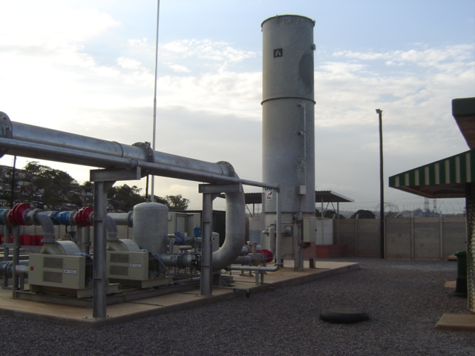
Gas Blower
Component Part | Lube Spec | Lube Requirements | Products
 |  |  | Standard | Premium | Supreme
Bearings (Grease) | NLGI 2 | Long life at high temperature Low bleed Medium and high speed | PETRONAS Grease Li 2 | PETRONAS Grease PU | -PETRONAS Grease LiX Syn 2/100
Electric Motor Bearings | NLGI 2 | Long life at high temperature Low bleed Medium and high speed | PETRONAS Grease Li 2 | PETRONAS Grease PU | -

