Slide 1
Reproducible workflows in Stata
A personal perspective borrowing heavily from Scott Long
Alun Hughes
alun.hughes@ucl.ac.uk
https://github.com/adh30

Slide 2
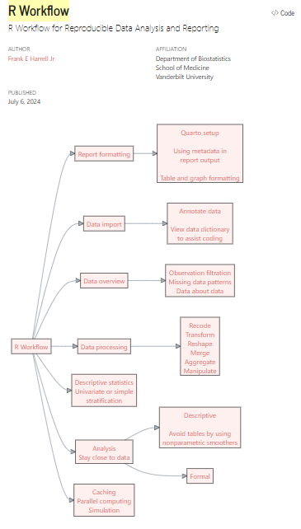
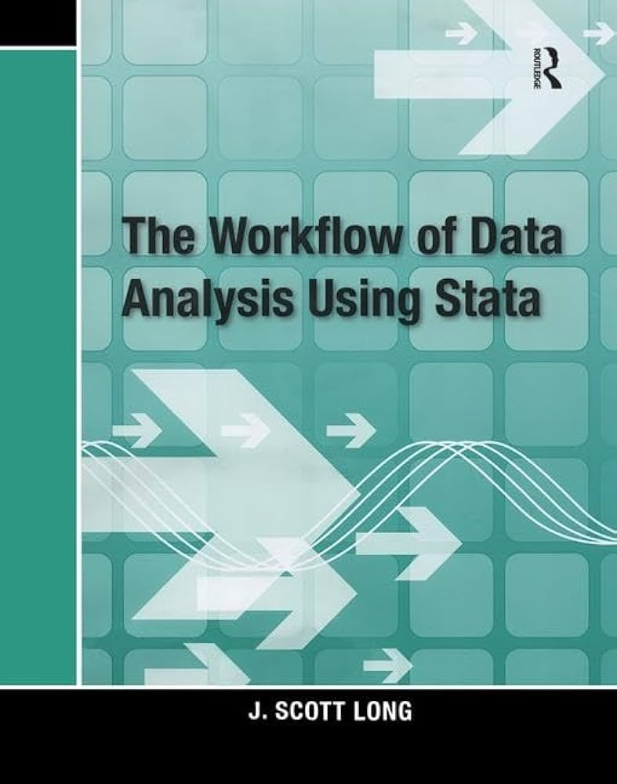
Sources
Frank Harrell
https://hbiostat.org/rflow/

Slide 3
The research process (simplified)
Experimental
Sample size
Randomization
Research question
Study design
Data acquisition
Analysis workflow
Longitudinal
Model choices
Observational
Cross-sectional
Based on https://www.fharrell.com/post/rflow/

Slide 4
The cycle of data analysis
PLAN
ORGANISE
DOCUMENT
COMPUTE
R. Scott Long. The Workflow of Data Analysis Using Stata

Slide 5
Workflow
Workflow is about keeping track of things
An organised workflow enables you to work efficiently, accurately and reproducibly
Steps include
Planning your work
Documenting your activities
Creating and verifying your data
Generating and presenting your statistical analyses reproducibly
Archiving your work
Planning is important - invest time in it
Keep things simple…but not too simple!
There is more than one way to do things – what follows is just my view

Slide 6
Train hard, fight easy – projects & folders
‘Post’ datasets and use structured folders
Original datasets should be ‘posted’ and remain unmodified – you can add to a posted folder, but you should never change anything in posted.
Use a work folder (and subfolders) to develop your analyses and then ‘post’ a snapshot to the relevant posted folder(s) when you think the code is stable. This means that when you need to go back to analysis (e.g., when you revise a manuscript) you have exactly what you did to hand.
Document your decisions (both why you did something and why you did not)
Research log
Codebooks
Dataset documentation
Do file documentation (comments)

Slide 7
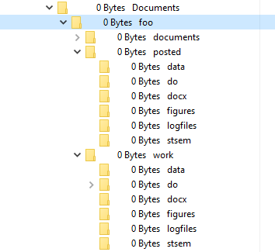
An example folder structure
Posted data and documentation
Working stata data (dta)
do files (including main.do)
Word documents and tables
Figures
Log files
SEM builder files
This example was generated in Stata using the command:
. mkproject foo, dir(C:\Users\rmgpadh\Documents) template(ah)
mkproject is by Maarten Buis (https://github.com/maartenteaches/mkproject) , it can be installed in Stata using:
. net install mkproject, from("https://raw.githubusercontent.com/adh30/mkproject/main")
The template mp_ah.mpp can be found in the fork at https://github.com/adh30/mkproject but you can easily create or modify existing templates to customize the folder structure. The do file to create this folder structure is at https://github.com/adh30/HDRUK_2024 (hdruk_mkproj.do)

Slide 8
Train hard, fight easy – do files
Always use code to do anything (i.e., use ‘do’ files)
It’s fine to use the menus (particularly when you are beginning) but ensure you save the code in a do file and use the do file in future
Use code to open and merge your datasets…use code to clean…use code to analyse…use code to produce tables and figures…
Use comments to describe what you are doing in code
/* …*/ is useful for commenting out blocks of code
Use a main.do file
This allows you to modularize your code (i.e., small components of code). These are easier to write, maintain and debug
Create a log file to keep track of your actions and outputs
Use version control for Stata (e.g., version 18) and for user-written add-ons. Without the latter, others (or you later) may not be able to replicate your analyses
Use datasig to ensure your dataset hasn’t changed (or been changed)

Slide 9
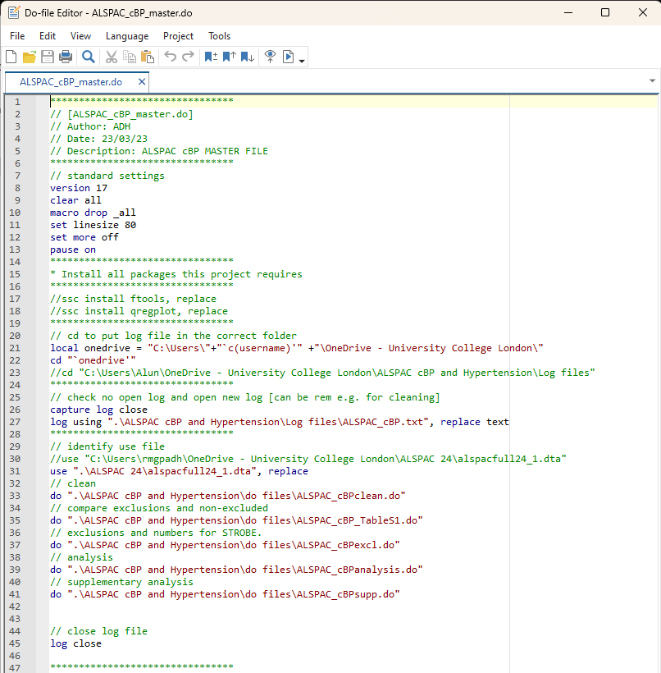
An example main.do file
Ensures version compatibility
Clears any previous data
Drops any existing macros
Sets the linesize so the log file is readable
Stop Stata pausing output (not really necessary but included to be explicit)
Set pause on (useful when writing / debugging can be dropped once coding is complete)
Uses a local macro to identify ‘onedrive’
Sets working directory to ‘onedrive’
Closes any open log files
Opens a new log file with a replace option
Opens the source datafile
Runs submodules to clean, create tables, impose exclusions, analyse etc.
Closes the log file

Slide 10
Train hard, fight easy – do files continued
Use local macros
Use loops (foreach, forvalues, while)
Use code to make tables
dtable, etable, collect*
export to word (docx) [or excel (xlxs)]
a very simple example is available at https://github.com/adh30/HDRUK_2024/blob/main/hdruk_eg1.do
Make figures with code
jpg, tiff, svg - I prefer svg as it’s a vector graphic and therefore rescales nicely
Never type anything that you can obtain from a saved result
return list, ereturn list and matrix list are your friends
* Some examples using collect to make tables can be found at https://github.com/adh30/StataTablesPublic

Slide 11
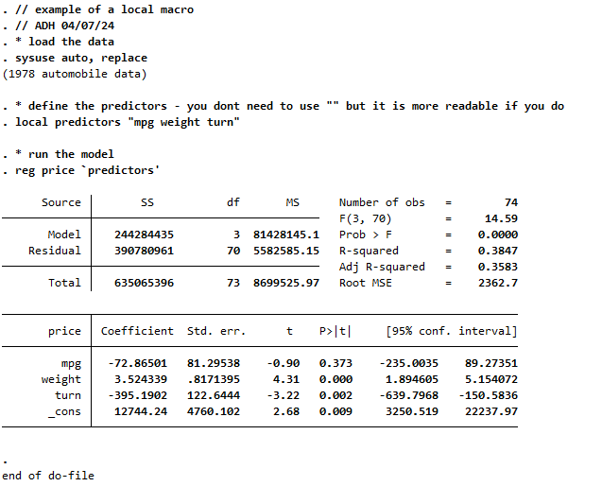
Local macros
This can be useful when you want to make multiple models (model1, model2 ….) - the code is more readable

Slide 12
Sources and useful links (not listed elsewhere)
Workflow
https://jslsoc.sitehost.iu.edu/workflow.htm
https://medium.com/the-stata-guide/the-stata-workflow-guide-52418ce35006
https://www.theanalysisfactor.com/best-practices-organizing-data-analysis/
https://www.theanalysisfactor.com/the-data-analysis-work-flow-strategies-for-keeping-track-of-your-analyses-and-output/
General
https://blog.stata.com/ - The Stata Blog
https://stats.oarc.ucla.edu/stata/ - UCLA statistical methods and data analytics
https://www.statalist.org/ - Statalist
https://stackoverflow.com/ - Stack Overflow
https://git-scm.com/ - Git (a distributed version control system)
https://github.com/ - Github
https://gitlab.com/ - Gitlab

