Slide 1
An Empty Shell of Extra Work

Slide 2
Small things
Faster detection using parallelization.
Fast training: 6 minutes training a 100 strong classifier with 6000 training samples.
Matrix multiplications rather than loops.
Columns are accessed faster than row.

Slide 3
An Attempt at a Cascade!
In stead of a 100 strong classifier use a 10 stage cascade of 20 strong classifiers.
Earlier classifiers have high FPR.
Train them sequentially on the FP samples from the previous one.
Most windows only get evaluated by the first stage. Improves detection speed!

Slide 4
At least it should.
Our cascade took longer to scan through big_one_chris than our 100 strong classifier.
But it should also improve accuracy.

Slide 5
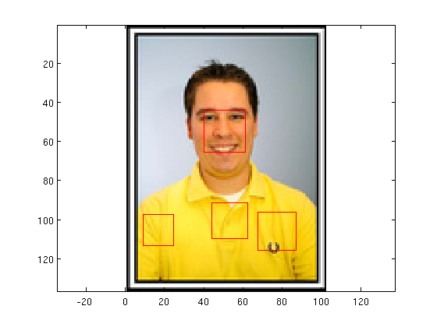
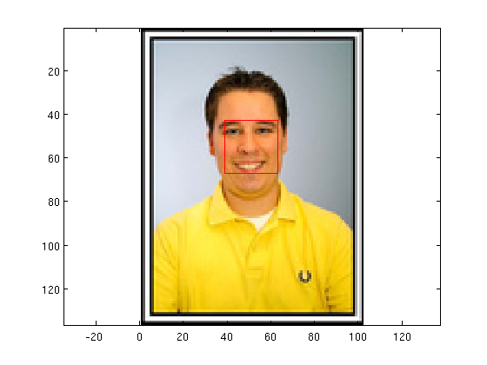
Cascade vs. 100 Strong

Slide 6
New Plan:
Improve Accuracy
Data Augmentation.
Altered contrast.
Added gaussian noise.
Hard negative mining.

Slide 7
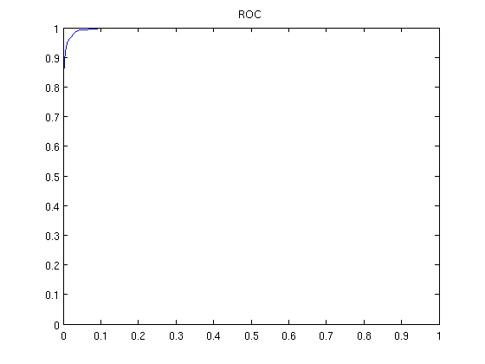
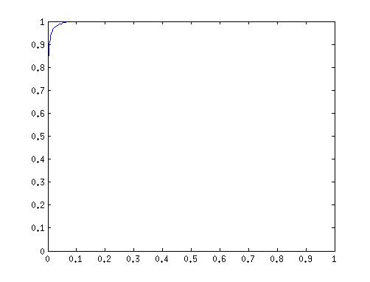
Hard negative mining 8000 images

