Slide 1
distributed camera proposal
topic : Passive learning of scene models
  how long do you have to watch?
  what can you infer about the camera and the scene?
  what can you predict about that which is not viewable?
  how can you validate the result?
What is consistent across cameras?
What is the motivation?

Slide 2
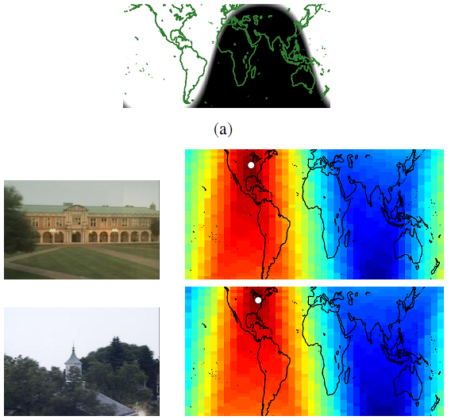
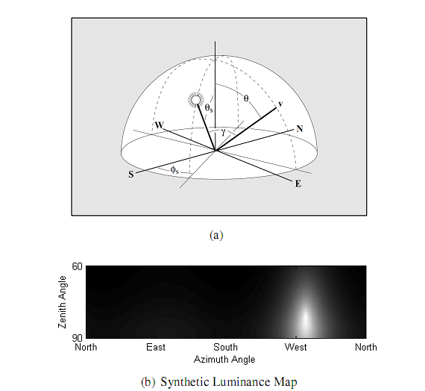
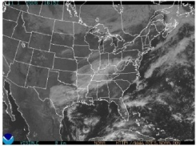
learning about cameras
  geographic location
  geo-orientation
  photometric response
  focal length

Slide 3
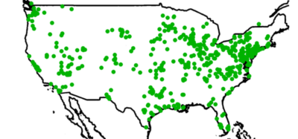
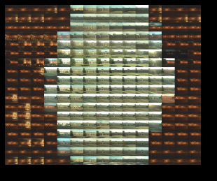
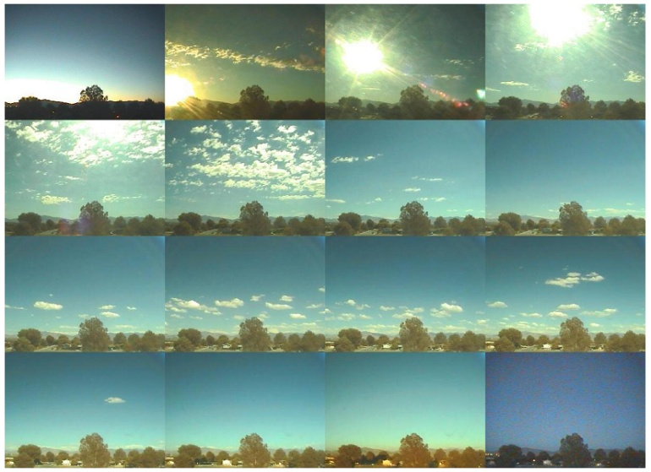
web camera dataset
many images with
timestamps
geolocation
orientation

Slide 4
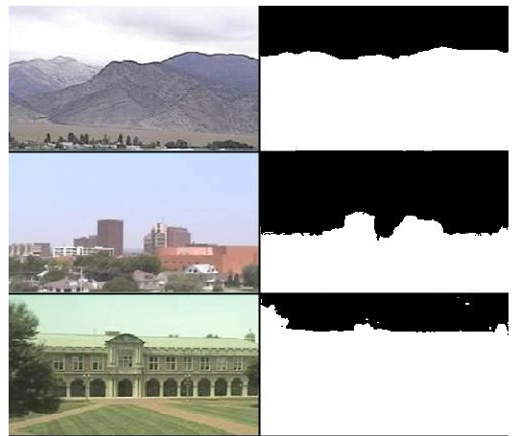
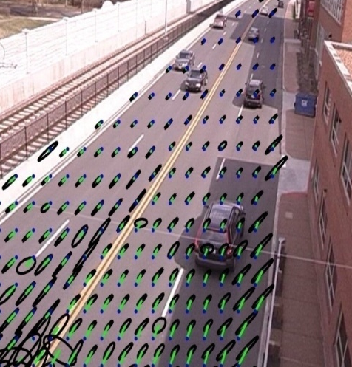
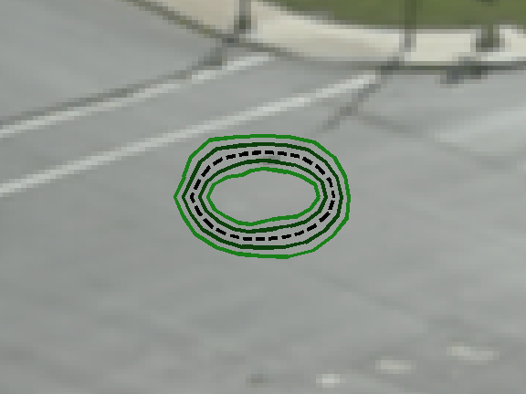
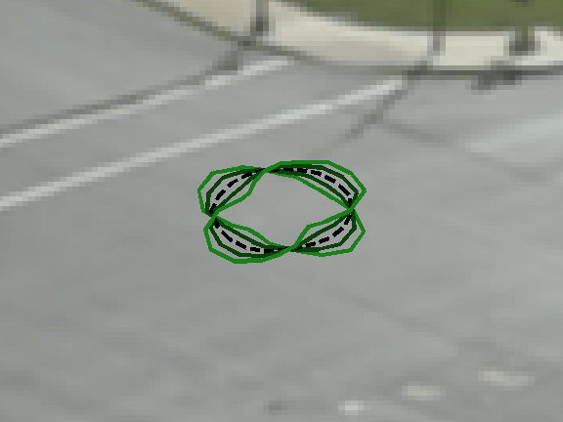
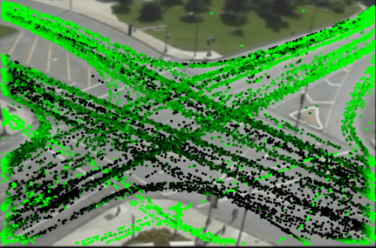
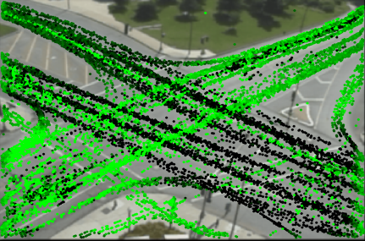
converting images to information
static elements
  structure labeling
dynamic elements
  objects
  weather

Slide 5
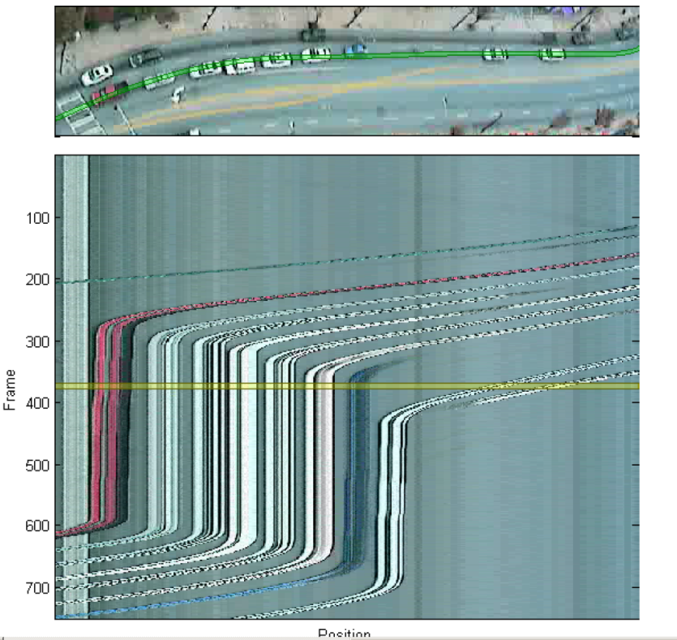
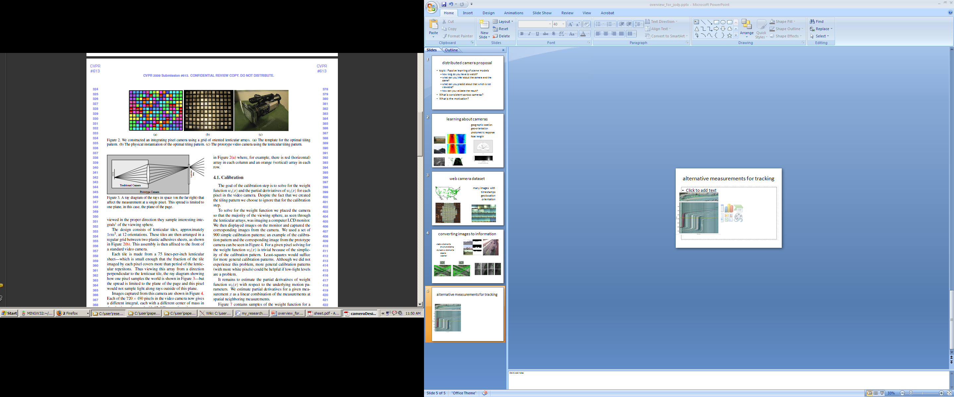
alternative measurements for tracking

