Slide 1
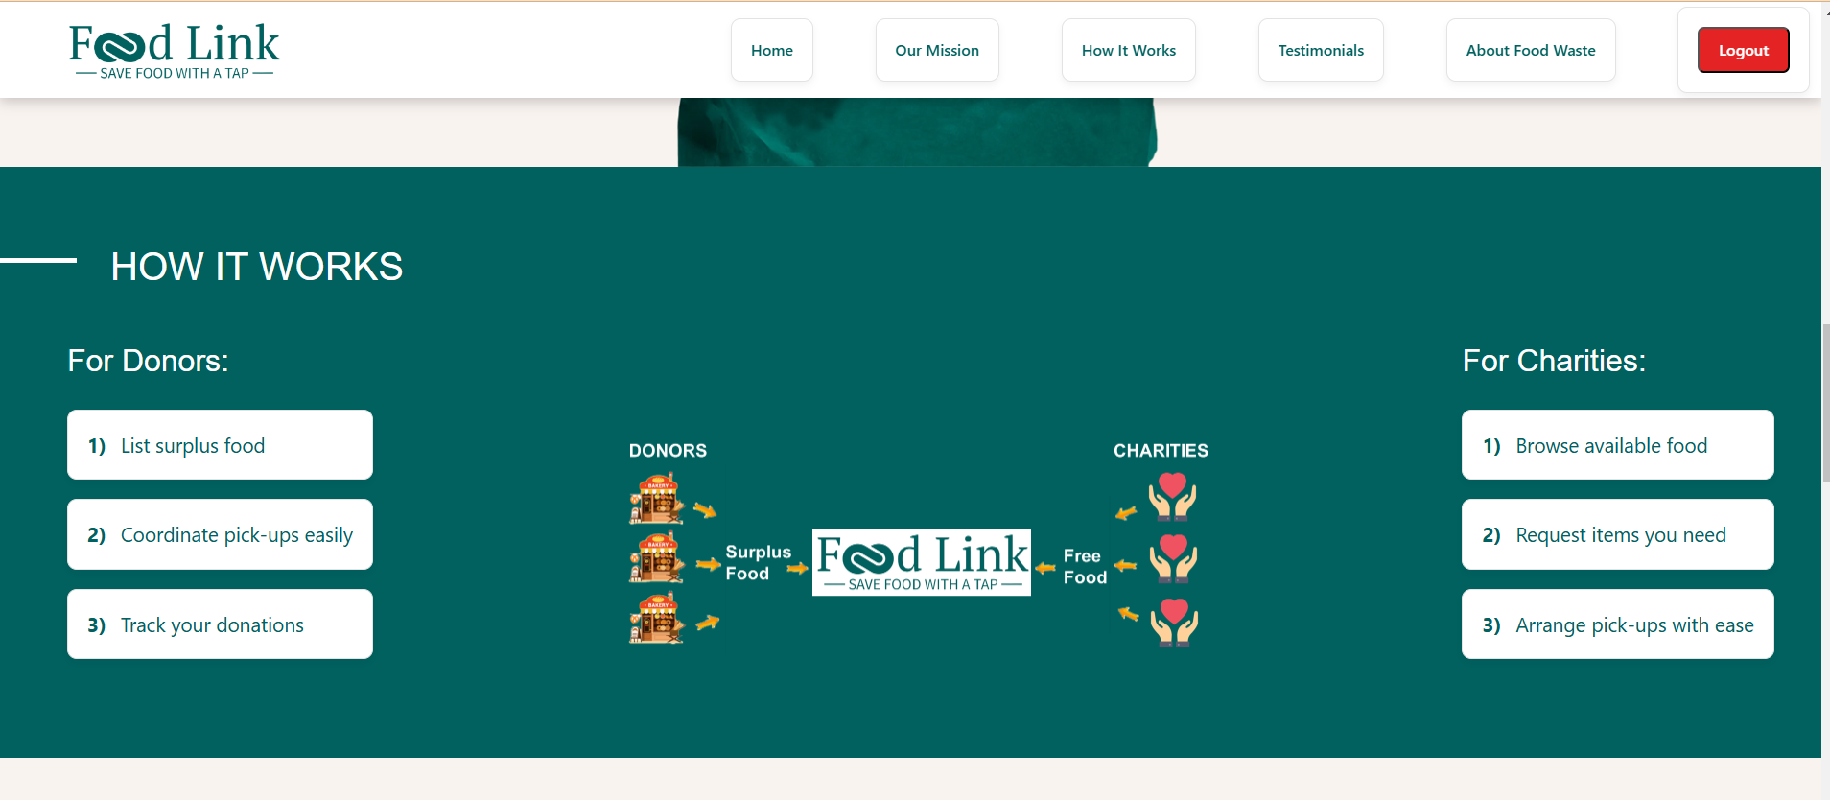
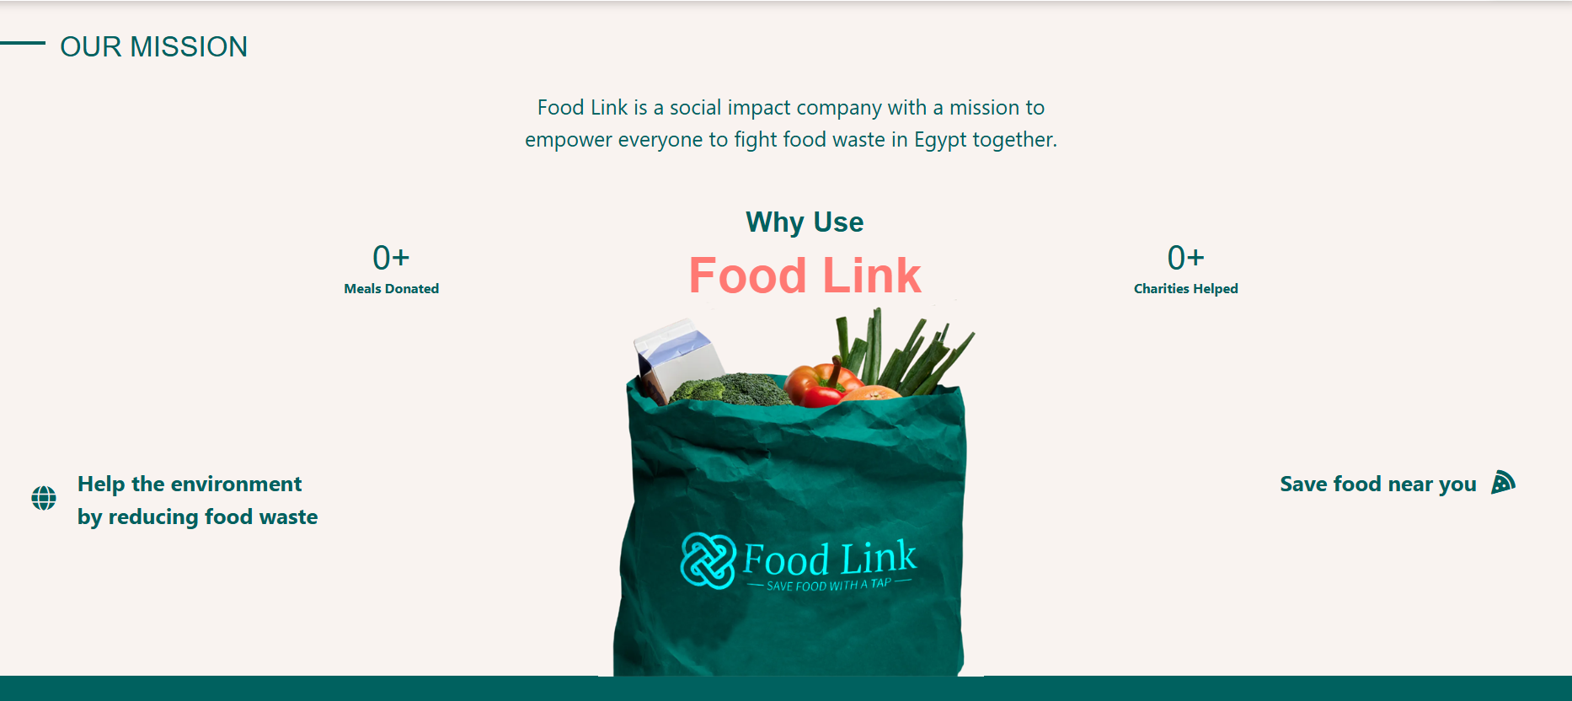

Slide 2
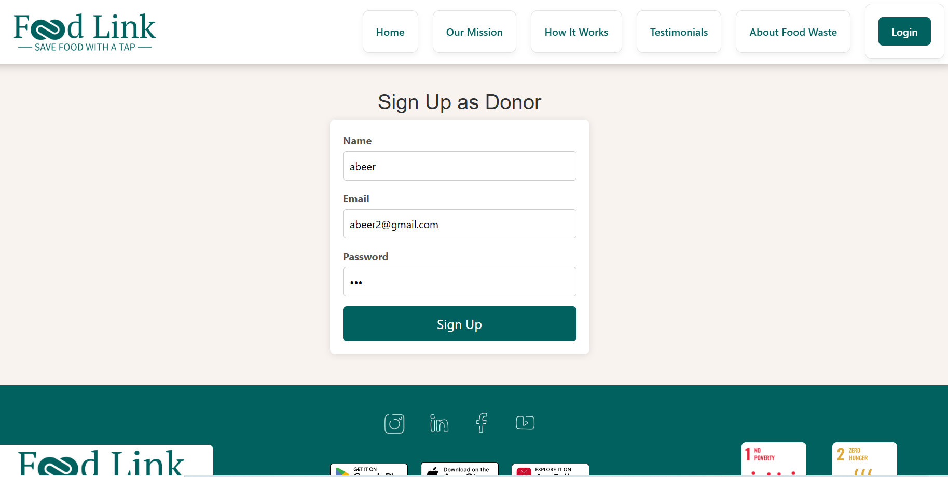
Sign Up/Log In Feature For Donors and Charities

Slide 3
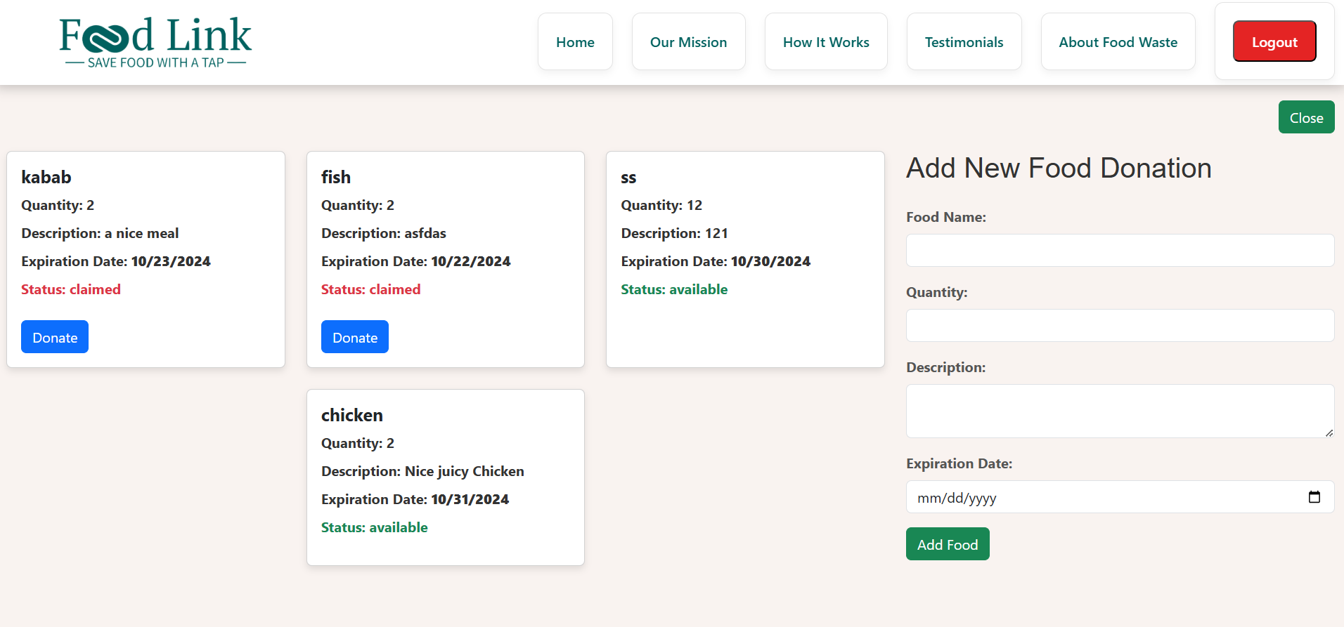
Donor Dashboard – Add Food Items & Review their Status (with Log Out)

Slide 4
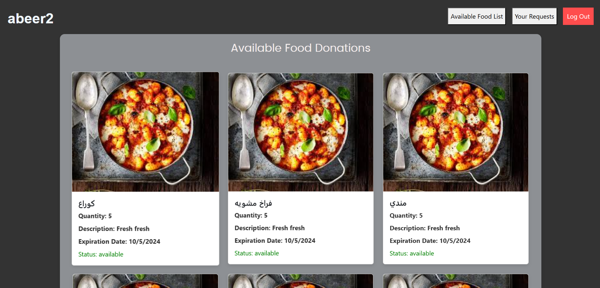
Charity Dashboard

Slide 5
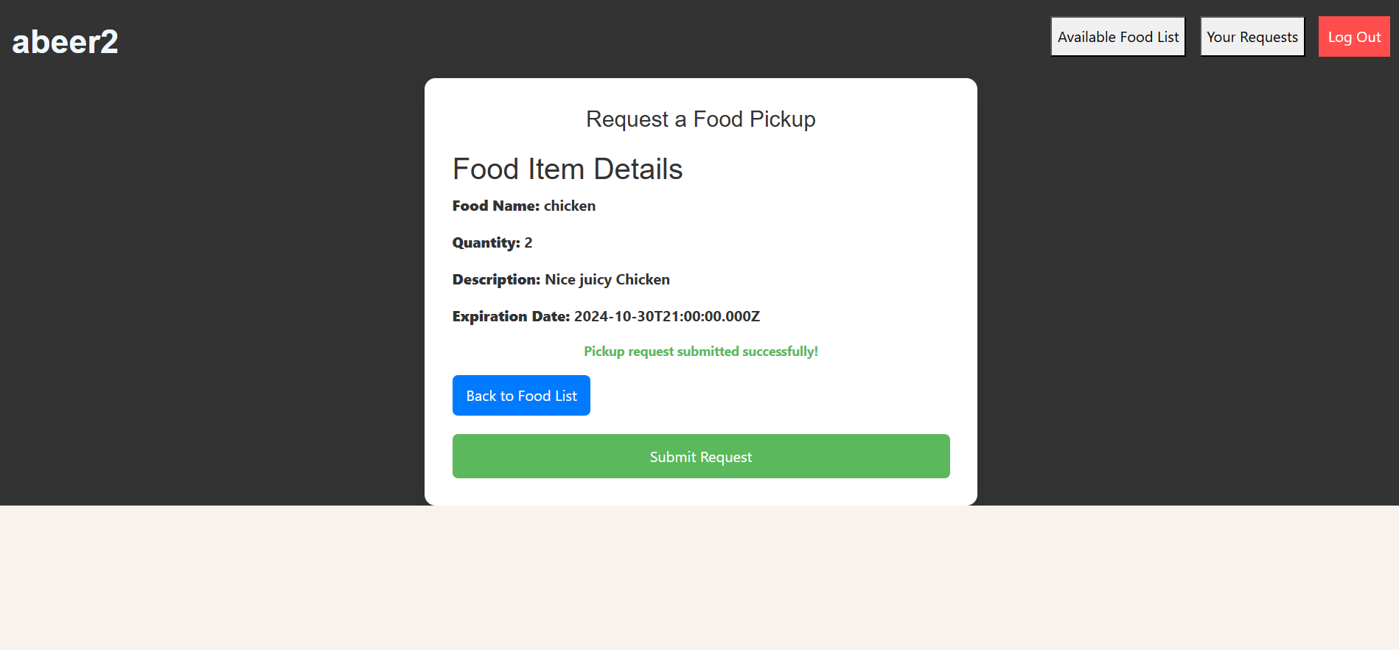
Charity Food Item Request

Slide 6
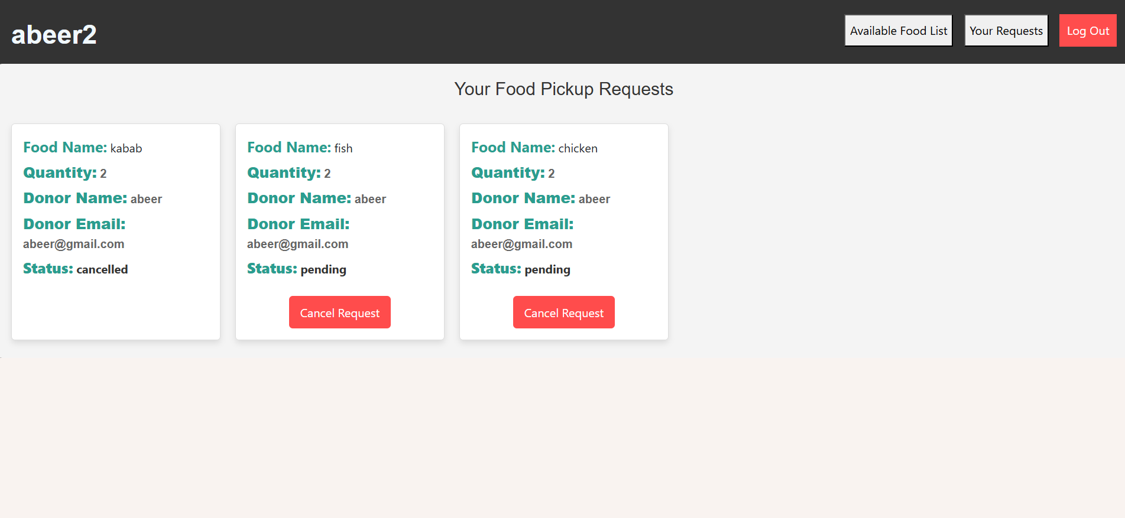
Charity Available Requests Status (Pending, cancelled, fulfilled)

Slide 7
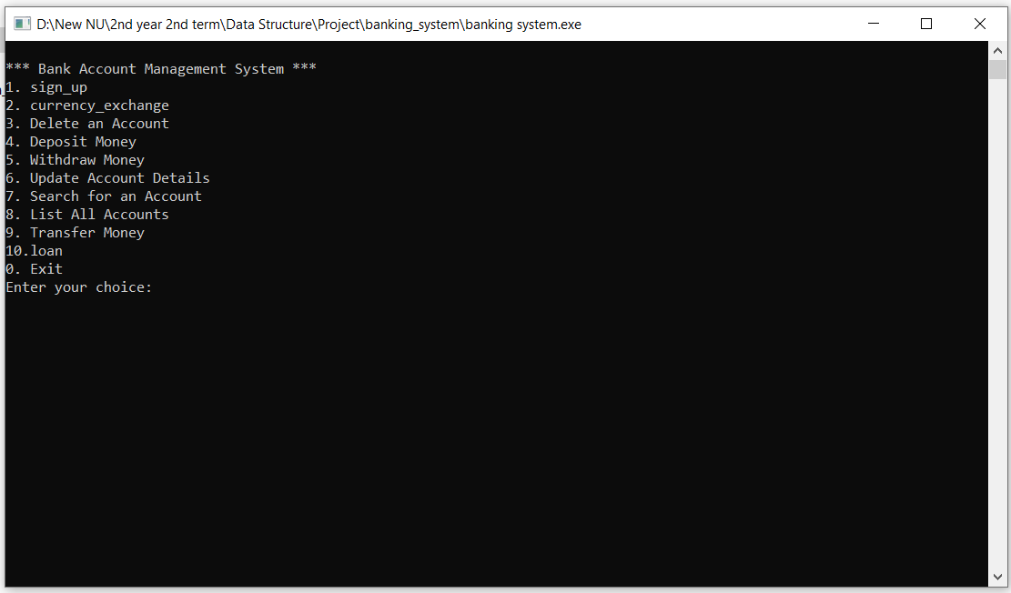
Home Page – 10 Different Functions

Slide 8
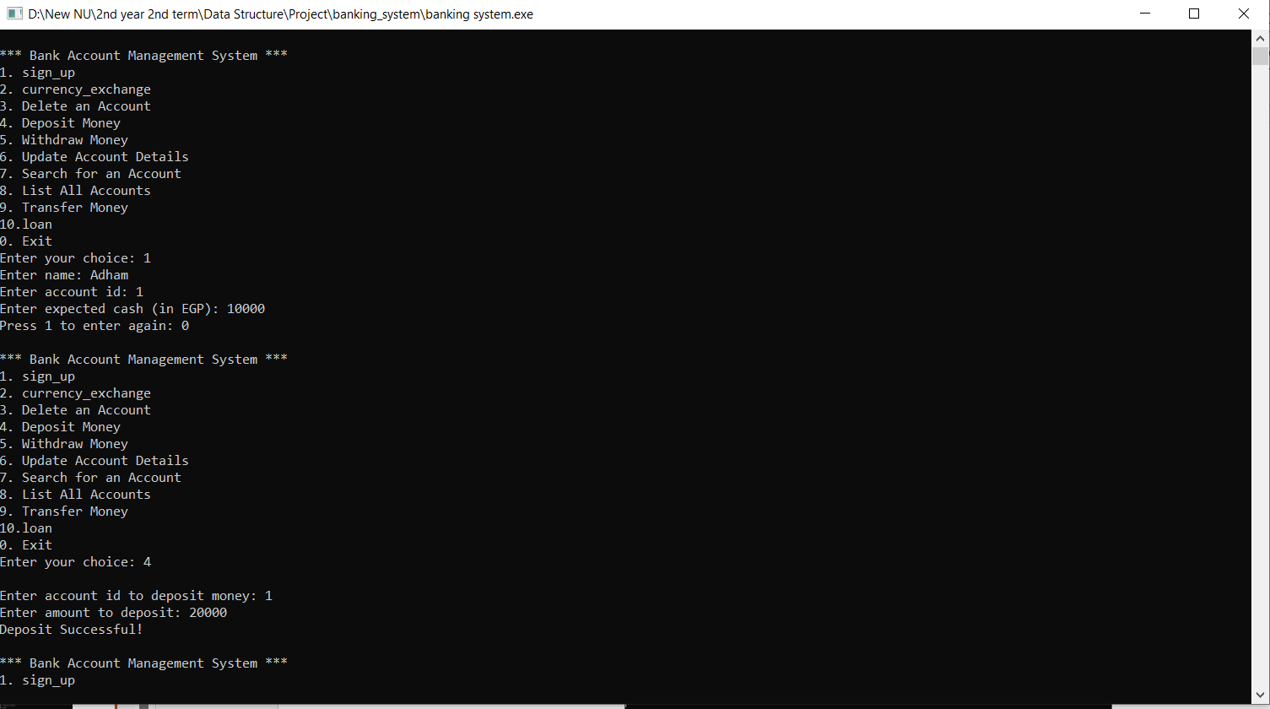
Creating Account and Money Deposit

Slide 9
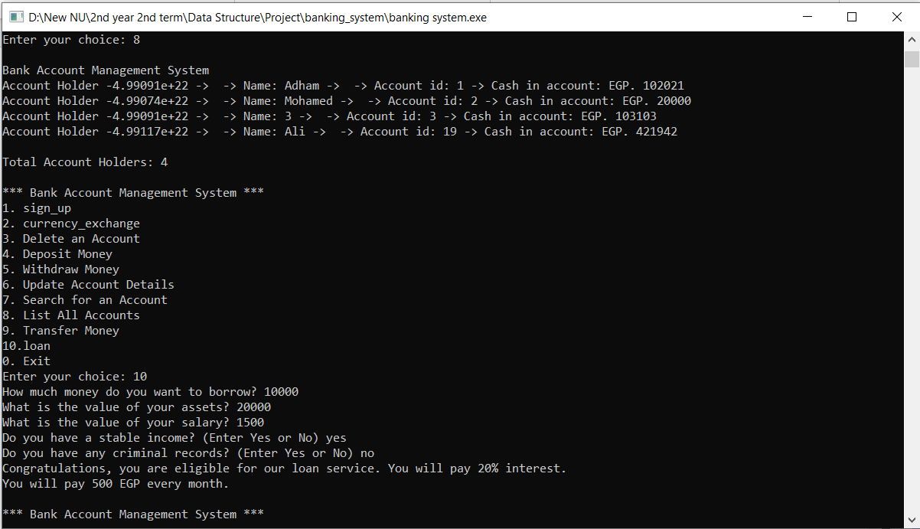
Accounts Listing and Loan Options

