Slide 1
EXECUTIVE PRESENTATION · AIB902 · GROUP 9230 TEAM 1
Where the next EGP of maintenance should go
PMARIS asset reliability: 5,000 observation windows, six sites, twelve months
45%
2.3x
829
of loss in the top 10% of windows
reactive vs predictive downtime
high-risk windows not escalated
Prepared for the Head of Reliability & Maintenance · 11 October 2026
Notes:
This deck answers one question for the Head of Reliability and Maintenance: where should the next Egyptian pound of maintenance budget go? The three numbers at the bottom are the whole story: loss is concentrated, a controllable lever doubles downtime, and the escalation flag misses most of the risk.

Slide 2
THE ANSWER
The answer: fund four levers and widen the escalation list
1
2
3
Loss is concentrated
It tracks controllable levers
The escalation flag misses it
Top 10% of windows carry 44.7% of revenue loss. High-risk windows carry 46.7%.
Strategy, spares, crew skill and PM discipline each split downtime about 2x to 3x, all statistically real.
829 of 960 high-risk windows sit at P3/P4, carrying EGP 723M of exposure.
Source: Group_9230_Team1_PMARIS_Enterprise_Dataset.csv, 5,000 observation windows
2 / 15
Notes:
Lead with the answer, Pyramid style. Everything after this slide is support for these three arguments.

Slide 3
THE HEADLINE NUMBERS
EGP 1.88B lost to 54,938 hours of downtime
1.88B
11.0 h
19.2%
46.7%
EGP revenue loss, all windows
mean unplanned downtime per window
of windows high-risk (failure probability ≥ 50%)
of revenue loss sits in those windows
19% of windows, 47% of the loss. The high-risk slice is small enough to target and large enough to matter.
Source: Group_9230_Team1_PMARIS_Enterprise_Dataset.csv, 5,000 observation windows
3 / 15
Notes:
These are the four KPIs agreed in the scope brief. Totals add overlapping 30-day windows, so compare means per window, not totals.

Slide 4
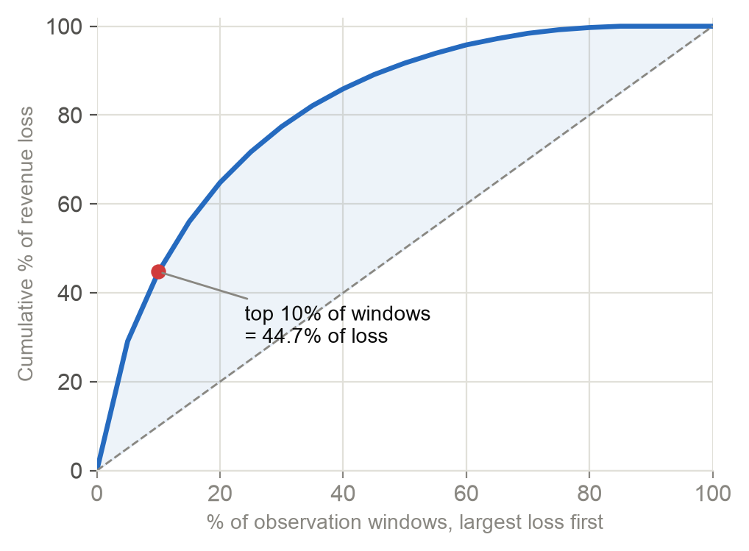
CONCENTRATION
A tenth of the windows carry 45% of the loss
44.7%
of loss in the top 10% of windows
64.8%
in the top 20%
0.63
Gini coefficient of loss
Source: Group_9230_Team1_PMARIS_Enterprise_Dataset.csv, 5,000 observation windows
4 / 15
Notes:
Gini 0.63. The playbook calls this the most decision-relevant number. Effort spread evenly across the fleet is mostly spent where little is lost.

Slide 5
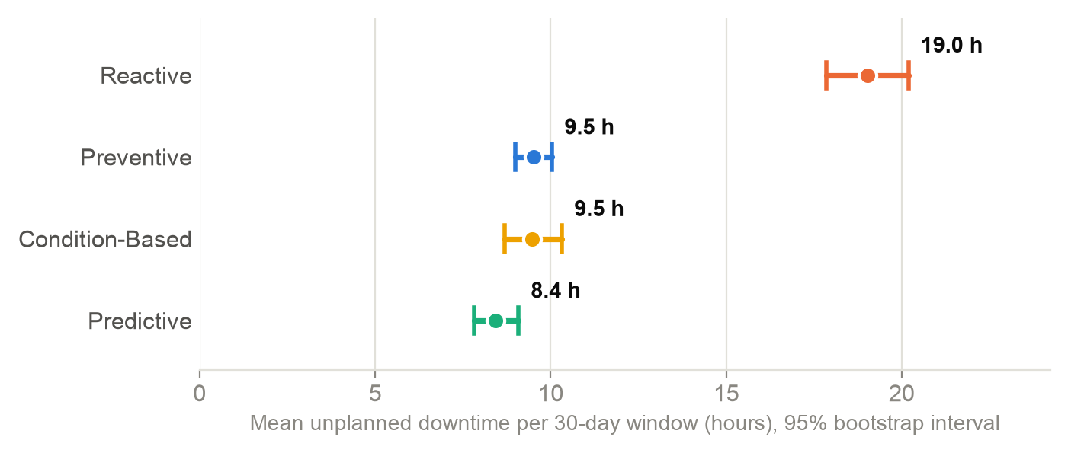
LEVER 1: STRATEGY
Reactive maintenance runs 2.3x the downtime of predictive
SO WHAT
Reactive 19.0 h per window; planned strategies 8.4 to 9.5 h. 906 windows (18%) are still reactive.
Source: Group_9230_Team1_PMARIS_Enterprise_Dataset.csv, 5,000 observation windows
5 / 15
Notes:
Bootstrap 95% intervals. The three planned strategies overlap each other: the step that matters is leaving reactive, not choosing among the planned ones.

Slide 6
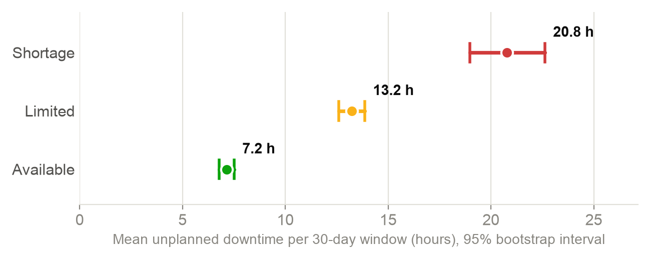
LEVER 2: SPARE PARTS
Parts shortages run 2.9x the downtime of available stock
20.8 h
Shortage · 426 windows
13.2 h
Limited · 2,196 windows
7.2 h
Available · 2,378 windows
Source: Group_9230_Team1_PMARIS_Enterprise_Dataset.csv, 5,000 observation windows
6 / 15
Notes:
A clean staircase with no interval touching the next. Spares status explains 6.5% of revenue-loss variance, five times what site explains.

Slide 7
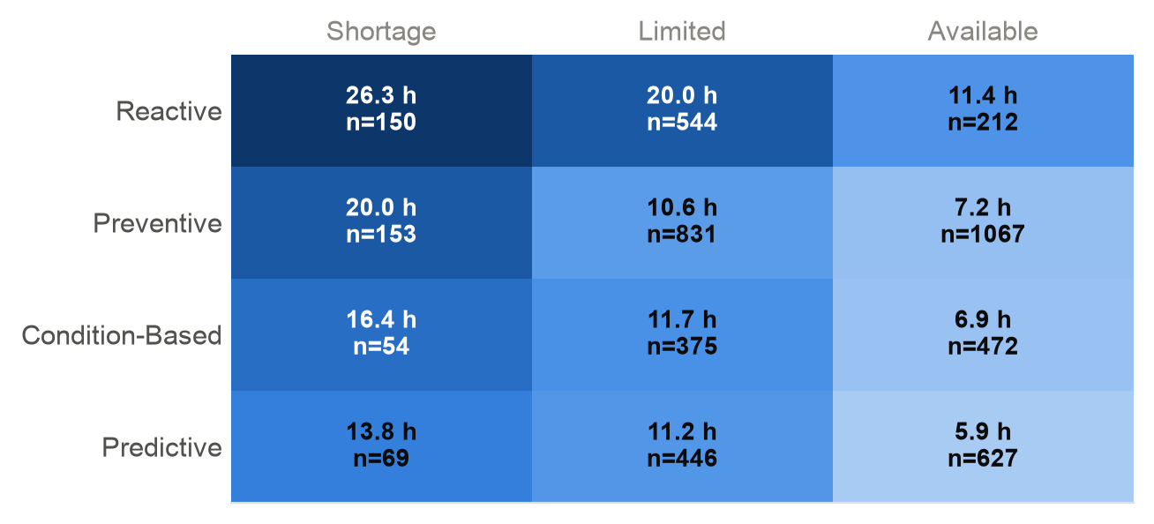
LEVERS 1 + 2 TOGETHER
The levers compound: worst combination 26 h, best 6 h
SO WHAT
A 4.5x spread between the worst and best cell. Even with parts available, reactive runs 11.4 h against 5.9 h for predictive.
Source: Group_9230_Team1_PMARIS_Enterprise_Dataset.csv, 5,000 observation windows
7 / 15
Notes:
Mean downtime by strategy and spares status, with counts. Reactive plus shortage is the cell to empty first; predictive plus available is the target state.

Slide 8
LEVER 3: CREW SKILL
Basic crews run 1.8x the downtime of expert crews
SO WHAT
2,509 windows (50%) are worked by basic or intermediate crews. Pair them with experts on high-risk assets first.
Source: Group_9230_Team1_PMARIS_Enterprise_Dataset.csv, 5,000 observation windows
8 / 15
Notes:
Mean downtime by technician skill level. Basic and intermediate sit clearly above advanced and expert; intervals do not overlap.

Slide 9
LEVER 4: PM DISCIPLINE
Downtime falls steadily as PM compliance rises: 23 h to 7 h
Source: Group_9230_Team1_PMARIS_Enterprise_Dataset.csv, 5,000 observation windows
9 / 15
Notes:
PM compliance deciles, least compliant on the left, median compliance under each bar. A dose-response shape is stronger evidence than a single split.

Slide 10
WHAT THE LEVERS COULD BE WORTH
Upper bound: up to a quarter of downtime is in play
STRATEGY
SPARES
8,621 h
5,800 h
if reactive windows ran at the preventive average (16% of downtime)
if shortage windows ran at the available-stock average (11%)
ESTIMATED, NOT MEASURED. Treat these as the ceiling a pilot would test, not as a forecast. The two overlap where reactive windows also lack parts.
Source: Group_9230_Team1_PMARIS_Enterprise_Dataset.csv, 5,000 observation windows
10 / 15
Notes:
These are estimates, not measurements. They assume the association is fully causal, which it is not: reactive windows also start in worse health. That is why recommendation 6 is a pilot.

Slide 11
D · THE ESCALATION GAP
The escalation flag misses 829 of 960 high-risk windows
Flag received by the 500 largest-loss windows
829
high-risk windows flagged only P3 or P4
EGP 723M
financial exposure sitting in that gap
Source: Group_9230_Team1_PMARIS_Enterprise_Dataset.csv, 5,000 observation windows
11 / 15
Notes:
Executive priority is a fixed banding of an index that correlates only 0.75 with failure probability. P1/P2 cover 26.5% of the loss in the worst 10% of windows. Most of the worst windows were filed as P3 Planned.

Slide 12
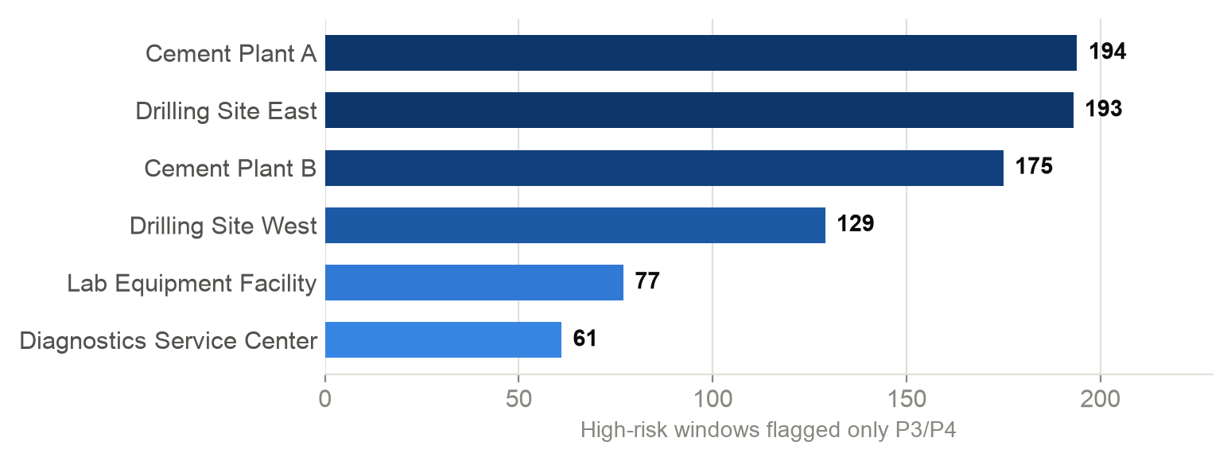
D · THE PROPOSED RULE
Add a second trigger: FP ≥ 50% on High or Critical assets
+433
windows escalated by the rule
EGP 434M
exposure covered (60% of the gap)
134 → 567
escalated windows: check capacity
Source: Group_9230_Team1_PMARIS_Enterprise_Dataset.csv, 5,000 observation windows
12 / 15
Notes:
On this file the rule adds 433 windows and EGP 434M of exposure to the watched list. Escalated count goes from 134 to 567, so confirm crew capacity before switching it on.

Slide 13
CONTEXT
What does not matter, and should not get budget on its own
Site
Manufacturer (OEM)
Operating shift
Calendar month
Real but small: explains 1.3% of loss variance. Heavy-industry sites lose about 1.5x per window, largely through the same levers.
No difference on downtime, loss or failure probability (p ≥ 0.57).
No difference on any measure (downtime p = 0.49).
Flat year, no momentum between months.
Do not run a site-vs-site campaign
No OEM switch on this evidence
No shift restructuring
Plan by condition, not calendar
Source: Group_9230_Team1_PMARIS_Enterprise_Dataset.csv, 5,000 observation windows
13 / 15
Notes:
Site is real but small (η² 0.013 on loss). Manufacturer (p = 0.57) and shift (p = 0.49) show nothing at all.

Slide 14
WHAT TO DO
Seven recommendations
1
Leave reactive maintenance
2
Fund spare-parts availability
critical and high-criticality assets first
for the classes that hit shortage
3
PM at 80%+, backlog under 14 days
4
Upskill basic and intermediate crews
the operating targets
pair with experts on high-risk work
5
Add the second escalation trigger
6
Pilot before scaling
+433 windows, after a capacity check
one site converted, one matched site as control
7
Fix the asset key in the next export
unlocks per-asset history and replacement planning
Source: Group_9230_Team1_PMARIS_Enterprise_Dataset.csv, 5,000 observation windows
14 / 15
Notes:
Ordered by size of effect and ease. Number 6 is what turns these associations into causal, budgetable estimates.

Slide 15
DECISIONS NEEDED
Three decisions for this quarter
1
Approve the reactive-to-planned pilot
One site, one matched control, measured on the live dashboard
2
Approve the second escalation trigger
Subject to a capacity check for 567 escalated windows
3
Request a fixed Asset_ID in the next export
So the next review can plan replacement per asset
Analysis: 02_Analysis/analyze_pmaris.py · Dashboard: 03_Dashboard · Report: PMARIS_Reliability_Assessment.pdf
15 / 15
Notes:
Close on the decisions, not a thank-you slide. The pilot is the most important: it converts the 2x associations into a causal number the budget can rest on. The live dashboard will measure it.

