Slide 1
AIB902 · AGENTIC ANALYTICS · GROUP 9230 TEAM 1
Where the next EGP of maintenance should go
PMARIS asset reliability: 5,000 observation windows, six sites, twelve months
45%
2.3x
829
of loss in the top 10% of windows
reactive vs predictive downtime
high-risk windows not escalated
Prepared for the Head of Reliability & Maintenance · 11 October 2026
Notes:
This deck answers one question for the Head of Reliability and Maintenance: where should the next Egyptian pound of maintenance budget go? The three numbers at the bottom are the whole story: loss is concentrated, a controllable lever doubles downtime, and the escalation flag misses most of the risk.

Slide 2
THE ANSWER
The answer: fund four levers and widen the escalation list
1
2
3
Loss is concentrated
It tracks controllable levers
The escalation flag misses it
Top 10% of windows carry 44.7% of revenue loss. High-risk windows carry 46.7%.
Strategy, spares, crew skill and PM discipline each split downtime about 2x to 3x, all statistically real.
829 of 960 high-risk windows sit at P3/P4, carrying EGP 723M of exposure.
Source: Group_9230_Team1_PMARIS_Enterprise_Dataset.csv, 5,000 observation windows
2 / 30
Notes:
Lead with the answer, Pyramid style. Everything after this slide is support for these three arguments.

Slide 3
CONTENTS
Agenda
A
The data and how we read it
Intake, cleaning, one broken key, the significance gate
B
Where the loss is
Concentration, health, and a flat year
C
The levers
Strategy, spares, crew skill, PM discipline
D
The escalation gap, and what to do
The flag, the proposed rule, the dashboard, recommendations
Source: Group_9230_Team1_PMARIS_Enterprise_Dataset.csv, 5,000 observation windows
3 / 30
Notes:
Four sections. The method section is short but it matters: every number later on survived a test.

Slide 4
A
The data and how we read it
A clean file with real signal, and one key that cannot be trusted
Source: Group_9230_Team1_PMARIS_Enterprise_Dataset.csv, 5,000 observation windows
4 / 30
Notes:
Section A. Before any finding, how the file was handled, and why the findings can be trusted.

Slide 5
THE DATA
One flat file: 5,000 thirty-day windows across six sites
5,000
60
6
12
observation windows (rows)
columns: 41 numeric, 16 categorical
sites across 4 industries
months, Sep 2025 to Aug 2026
Industries covered
■ Cement manufacturing (2 plants)
■ Oil & gas drilling (2 sites)
■ Lab-equipment manufacturing
■ In-vitro diagnostics service
Source: Group_9230_Team1_PMARIS_Enterprise_Dataset.csv, 5,000 observation windows
5 / 30
Notes:
Playbook Stage 0. Path A: one flat table with a date column, so no joins were needed. Each row is one 30-day window of one asset.

Slide 6
HOW WE WORKED
The method: seven stages, two hard gates
0
1
2
3
4
5
6
Intake
Clean
Check meaning
Insights
Significance
Scope brief
Build + verify
What each stage contributed
■ Clean and check meaning: zero defects, but Asset_ID is not an asset key (next slides)
■ Significance: 33 tests, Bonferroni-corrected; only differences that survived became KPIs
■ Scope brief: audience, decision and KPIs agreed with the stakeholder before anything was built
■ Build + verify: six-page live dashboard; save-to-screen refresh timed at 376 ms on average
Source: Group_9230_Team1_PMARIS_Enterprise_Dataset.csv, 5,000 observation windows
6 / 30
Notes:
AIB902 Playbook v4.0. The two gates are the scope brief, approved by the stakeholder before the build, and the timed live-refresh test.

Slide 7
STAGE 1: CLEANING
The file passed every cleaning check with nothing dropped
Check | Result | Action
Missing cells | 0 | None needed
Duplicate rows / IDs | 0 / 0 | None needed
Type errors / bad dates | 0 / 0 | None needed
Revenue loss beyond 3 SD | 113 rows | Kept: real tail
Load factor above 100% | 452 rows | Kept: overload
Rare failure modes (<1%) | 27 rows | Pooled as Other
Efficiency index at cap | 53% at 100 | Treated as capped
300,000
cells checked, zero missing
0
rows dropped or imputed
Source: Group_9230_Team1_PMARIS_Enterprise_Dataset.csv, 5,000 observation windows
7 / 30
Notes:
Nothing was imputed or removed. The heavy tail in revenue loss is real, not error, so it stays in.

Slide 8
STAGE 1B: DOES EACH COLUMN MEAN WHAT IT SAYS?
One key is broken: Asset_ID does not identify an asset
Other column checks
499 / 500
■ Financial exposure ≈ revenue loss (r = 0.999). Never add them.
■ Failure probability mirrors health (r = -0.972). Report one.
■ Executive priority is a formula: fixed bands of the Maintenance Priority Index.
■ Composite scores inter-correlate at 0.7 to 0.99: they describe a formula, not a discovery.
Asset IDs that change site between observations
498 change criticality; for 497, asset age runs backwards in time.
Source: Group_9230_Team1_PMARIS_Enterprise_Dataset.csv, 5,000 observation windows
8 / 30
Notes:
This is the most important limit. Because the ID changes site, type and criticality, we treat every row as an independent window. No per-asset history, replacement or remaining-life plan can be built from this export.

Slide 9
STAGE 3B: THE SIGNIFICANCE GATE
26 of 33 differences are real; OEM and shift are not
READ IT AS
Failure mode, spares and strategy explain the most downtime. Site explains 1.5%. Manufacturer, shift and criticality show no downtime difference.
Source: Group_9230_Team1_PMARIS_Enterprise_Dataset.csv, 5,000 observation windows
9 / 30
Notes:
ANOVA confirmed by Kruskal-Wallis, Bonferroni threshold 0.0015. With 5,000 rows almost anything is detectable, so the bar shows effect size: the share of downtime variance each dimension explains. Grey bars are not significant.

Slide 10
B
Where the loss is
Concentrated in a fifth of the windows, and tied to asset health
Source: Group_9230_Team1_PMARIS_Enterprise_Dataset.csv, 5,000 observation windows
10 / 30
Notes:
Section B. Before levers, where the money actually sits.

Slide 11
THE HEADLINE NUMBERS
EGP 1.88B lost to 54,938 hours of downtime
1.88B
11.0 h
19.2%
46.7%
EGP revenue loss, all windows
mean unplanned downtime per window
of windows high-risk (failure probability ≥ 50%)
of revenue loss sits in those windows
19% of windows, 47% of the loss. The high-risk slice is small enough to target and large enough to matter.
Source: Group_9230_Team1_PMARIS_Enterprise_Dataset.csv, 5,000 observation windows
11 / 30
Notes:
These are the four KPIs agreed in the scope brief. Totals add overlapping 30-day windows, so compare means per window, not totals.

Slide 12
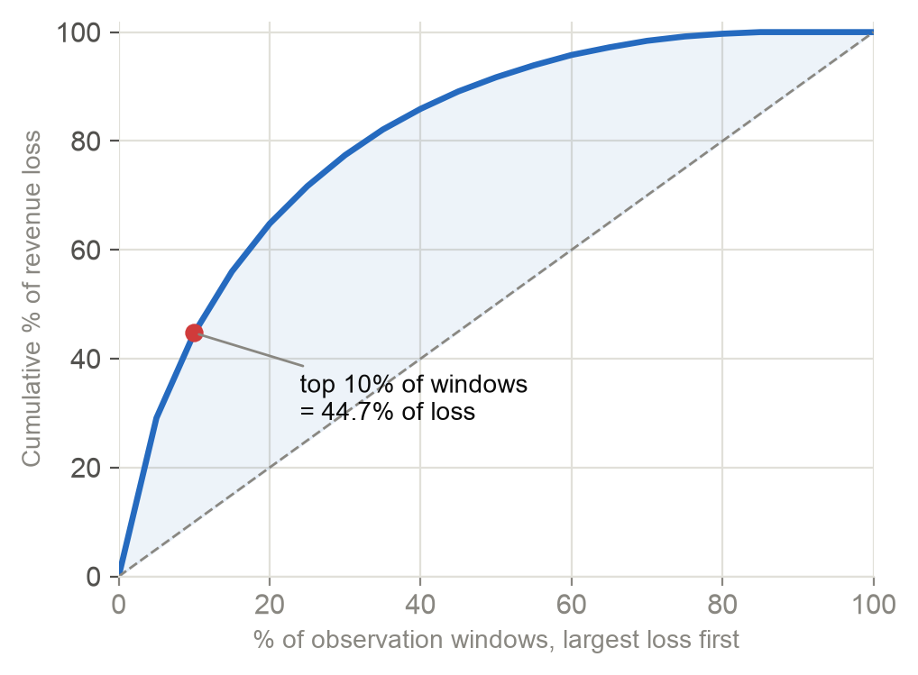
CONCENTRATION
A tenth of the windows carry 45% of the loss
44.7%
of loss in the top 10% of windows
64.8%
in the top 20%
0.63
Gini coefficient of loss
Source: Group_9230_Team1_PMARIS_Enterprise_Dataset.csv, 5,000 observation windows
12 / 30
Notes:
Gini 0.63. The playbook calls this the most decision-relevant number. Effort spread evenly across the fleet is mostly spent where little is lost.

Slide 13
LOSS FOLLOWS HEALTH
Windows under health 70 lose 9x those above 90
SO WHAT
Health under 70: 32 h downtime and 77% failure probability per window. Above 90: 3.9 h and 10%.
Source: Group_9230_Team1_PMARIS_Enterprise_Dataset.csv, 5,000 observation windows
13 / 30
Notes:
Health index bands. The steepness is the case for acting early: each band down roughly doubles the loss.

Slide 14
TIME
The year is flat: no trend or season to schedule against
SO WHAT
Every month averages EGP 340k to 410k per window. Plan by asset condition, not by calendar.
Source: Group_9230_Team1_PMARIS_Enterprise_Dataset.csv, 5,000 observation windows
14 / 30
Notes:
Fitted slope +0.60% of the monthly mean per month; lag-1 autocorrelation -0.17. A bad month does not predict the next one, so timing is not a lever.

Slide 15
C
The levers
Four things management controls, each worth about 2x on downtime
Source: Group_9230_Team1_PMARIS_Enterprise_Dataset.csv, 5,000 observation windows
15 / 30
Notes:
Section C. The core of the recommendation.

Slide 16
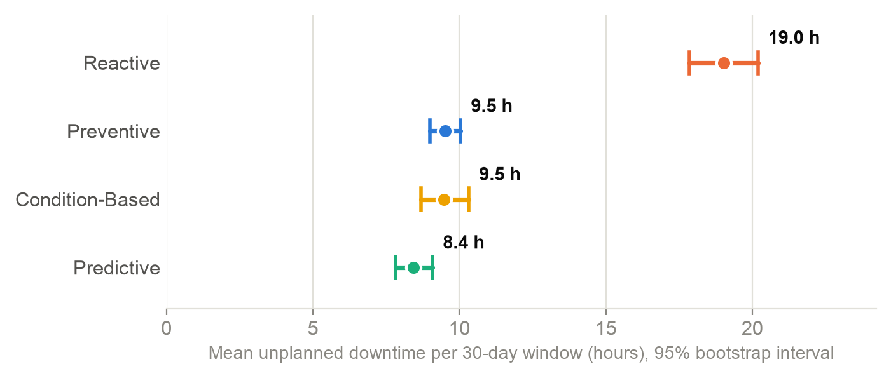
LEVER 1: STRATEGY
Reactive maintenance runs 2.3x the downtime of predictive
SO WHAT
Reactive 19.0 h per window; planned strategies 8.4 to 9.5 h. 906 windows (18%) are still reactive.
Source: Group_9230_Team1_PMARIS_Enterprise_Dataset.csv, 5,000 observation windows
16 / 30
Notes:
Bootstrap 95% intervals. The three planned strategies overlap each other: the step that matters is leaving reactive, not choosing among the planned ones.

Slide 17
LEVER 1: STRATEGY
Reactive windows turn 56% of work orders into emergencies
56%
emergency work orders, reactive
23%
emergency work orders, predictive
Source: Group_9230_Team1_PMARIS_Enterprise_Dataset.csv, 5,000 observation windows
17 / 30
Notes:
Share of work orders that are corrective emergency, by strategy. Emergencies cost labour, parts at premium and production.

Slide 18
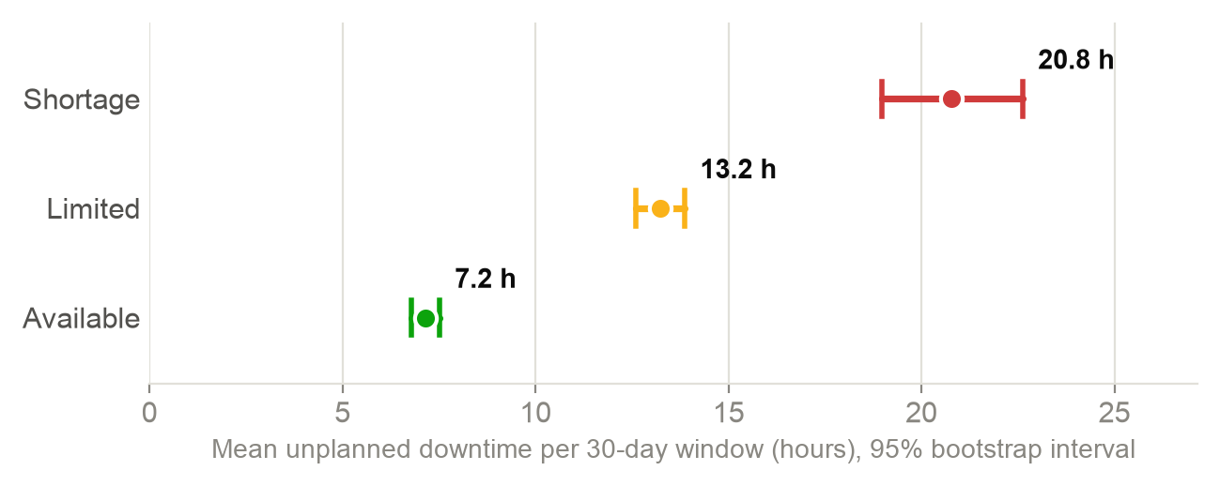
LEVER 2: SPARE PARTS
Parts shortages run 2.9x the downtime of available stock
20.8 h
Shortage · 426 windows
13.2 h
Limited · 2,196 windows
7.2 h
Available · 2,378 windows
Source: Group_9230_Team1_PMARIS_Enterprise_Dataset.csv, 5,000 observation windows
18 / 30
Notes:
A clean staircase with no interval touching the next. Spares status explains 6.5% of revenue-loss variance, five times what site explains.

Slide 19
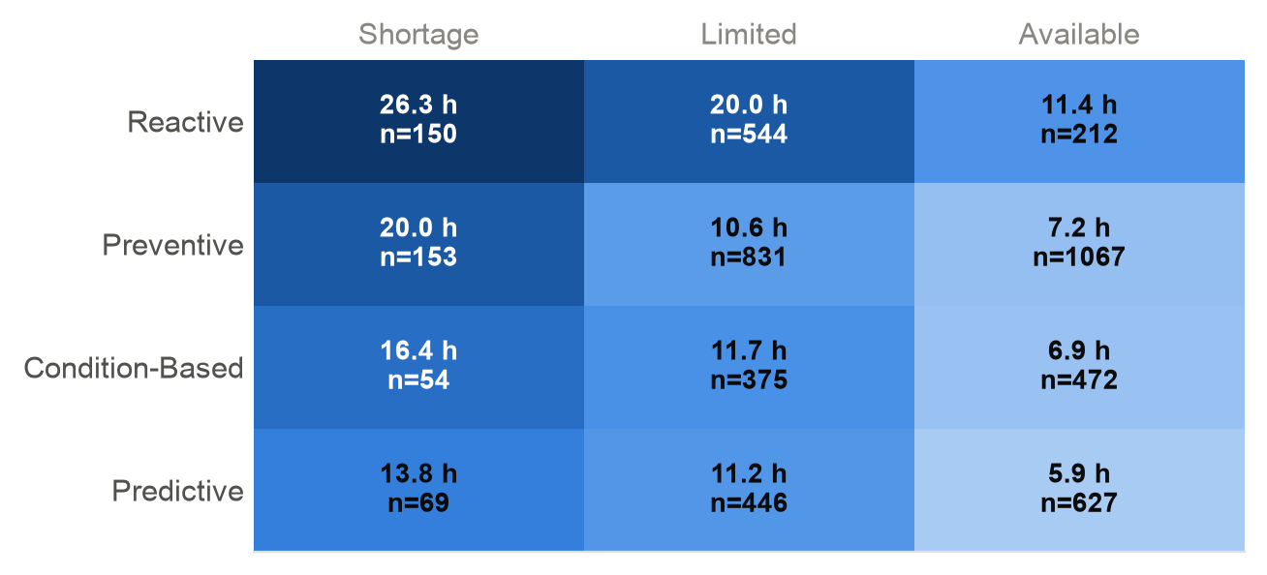
LEVERS 1 + 2 TOGETHER
The levers compound: worst combination 26 h, best 6 h
SO WHAT
A 4.5x spread between the worst and best cell. Even with parts available, reactive runs 11.4 h against 5.9 h for predictive.
Source: Group_9230_Team1_PMARIS_Enterprise_Dataset.csv, 5,000 observation windows
19 / 30
Notes:
Mean downtime by strategy and spares status, with counts. Reactive plus shortage is the cell to empty first; predictive plus available is the target state.

Slide 20
LEVER 3: CREW SKILL
Basic crews run 1.8x the downtime of expert crews
SO WHAT
2,509 windows (50%) are worked by basic or intermediate crews. Pair them with experts on high-risk assets first.
Source: Group_9230_Team1_PMARIS_Enterprise_Dataset.csv, 5,000 observation windows
20 / 30
Notes:
Mean downtime by technician skill level. Basic and intermediate sit clearly above advanced and expert; intervals do not overlap.

Slide 21
LEVER 4: PM DISCIPLINE
Downtime falls steadily as PM compliance rises: 23 h to 7 h
Source: Group_9230_Team1_PMARIS_Enterprise_Dataset.csv, 5,000 observation windows
21 / 30
Notes:
PM compliance deciles, least compliant on the left, median compliance under each bar. A dose-response shape is stronger evidence than a single split.

Slide 22
OPERATING THRESHOLDS
Four operating thresholds each split downtime about 2x
Lever | Worse side | Downtime | Better side | Downtime | Ratio | η²
PM compliance | below 80% | 16.0 h | 80% or more | 7.3 h | 2.2x | 0.097
Days since maintenance | 60+ days | 15.7 h | under 60 days | 8.7 h | 1.8x | 0.056
Lubricant quality | LQI under 50 | 15.8 h | LQI 50+ | 7.9 h | 2.0x | 0.078
Maintenance backlog | backlog 14d+ | 15.5 h | backlog under 14d | 7.7 h | 2.0x | 0.078
OPERATING TARGETS
Targets to manage to: PM compliance at or above 80%, maintenance within 60 days, lubricant quality above 50, backlog under 14 days.
Source: Group_9230_Team1_PMARIS_Enterprise_Dataset.csv, 5,000 observation windows
22 / 30
Notes:
Each lever split at a practical threshold the maintenance team can manage to. All p-values are below 1e-60.

Slide 23
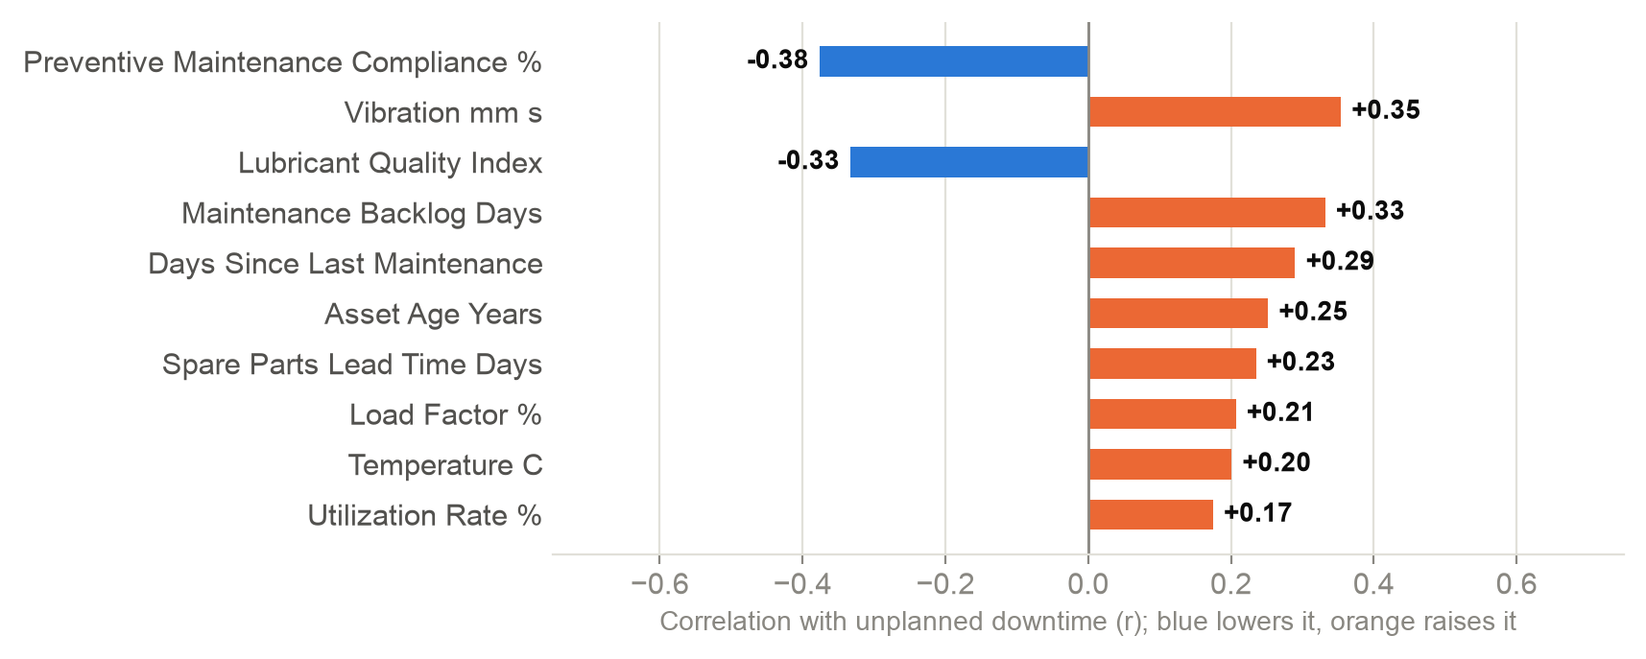
MEASURED INPUTS
PM and lubrication cut downtime; backlog raises it
SO WHAT
The strongest measured inputs are the ones maintenance controls: PM compliance, lubrication and backlog. Vibration is the best early-warning signal.
Source: Group_9230_Team1_PMARIS_Enterprise_Dataset.csv, 5,000 observation windows
23 / 30
Notes:
Correlation of each measured, non-derived input with unplanned downtime. Composite scores are excluded because they are formulas built from these inputs.

Slide 24
WHAT THE LEVERS COULD BE WORTH
Upper bound: up to a quarter of downtime is in play
STRATEGY
SPARES
8,621 h
5,800 h
if reactive windows ran at the preventive average (16% of downtime)
if shortage windows ran at the available-stock average (11%)
ESTIMATED, NOT MEASURED. Treat these as the ceiling a pilot would test, not as a forecast. The two overlap where reactive windows also lack parts.
Source: Group_9230_Team1_PMARIS_Enterprise_Dataset.csv, 5,000 observation windows
24 / 30
Notes:
These are estimates, not measurements. They assume the association is fully causal, which it is not: reactive windows also start in worse health. That is why recommendation 6 is a pilot.

Slide 25
D · THE ESCALATION GAP
The escalation flag misses 829 of 960 high-risk windows
Flag received by the 500 largest-loss windows
829
high-risk windows flagged only P3 or P4
EGP 723M
financial exposure sitting in that gap
Source: Group_9230_Team1_PMARIS_Enterprise_Dataset.csv, 5,000 observation windows
25 / 30
Notes:
Executive priority is a fixed banding of an index that correlates only 0.75 with failure probability. P1/P2 cover 26.5% of the loss in the worst 10% of windows. Most of the worst windows were filed as P3 Planned.

Slide 26
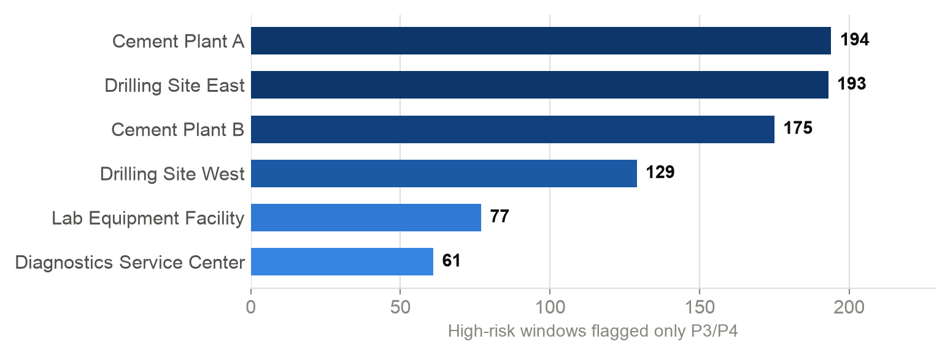
D · THE PROPOSED RULE
Add a second trigger: FP ≥ 50% on High or Critical assets
+433
windows escalated by the rule
EGP 434M
exposure covered (60% of the gap)
134 → 567
escalated windows: check capacity
Source: Group_9230_Team1_PMARIS_Enterprise_Dataset.csv, 5,000 observation windows
26 / 30
Notes:
On this file the rule adds 433 windows and EGP 434M of exposure to the watched list. Escalated count goes from 134 to 567, so confirm crew capacity before switching it on.

Slide 27
CONTEXT
What does not matter, and should not get budget on its own
Site
Manufacturer (OEM)
Operating shift
Calendar month
Real but small: explains 1.3% of loss variance. Heavy-industry sites lose about 1.5x per window, largely through the same levers.
No difference on downtime, loss or failure probability (p ≥ 0.57).
No difference on any measure (downtime p = 0.49).
Flat year, no momentum between months.
Do not run a site-vs-site campaign
No OEM switch on this evidence
No shift restructuring
Plan by condition, not calendar
Source: Group_9230_Team1_PMARIS_Enterprise_Dataset.csv, 5,000 observation windows
27 / 30
Notes:
Site is real but small (η² 0.013 on loss). Manufacturer (p = 0.57) and shift (p = 0.49) show nothing at all.

Slide 28
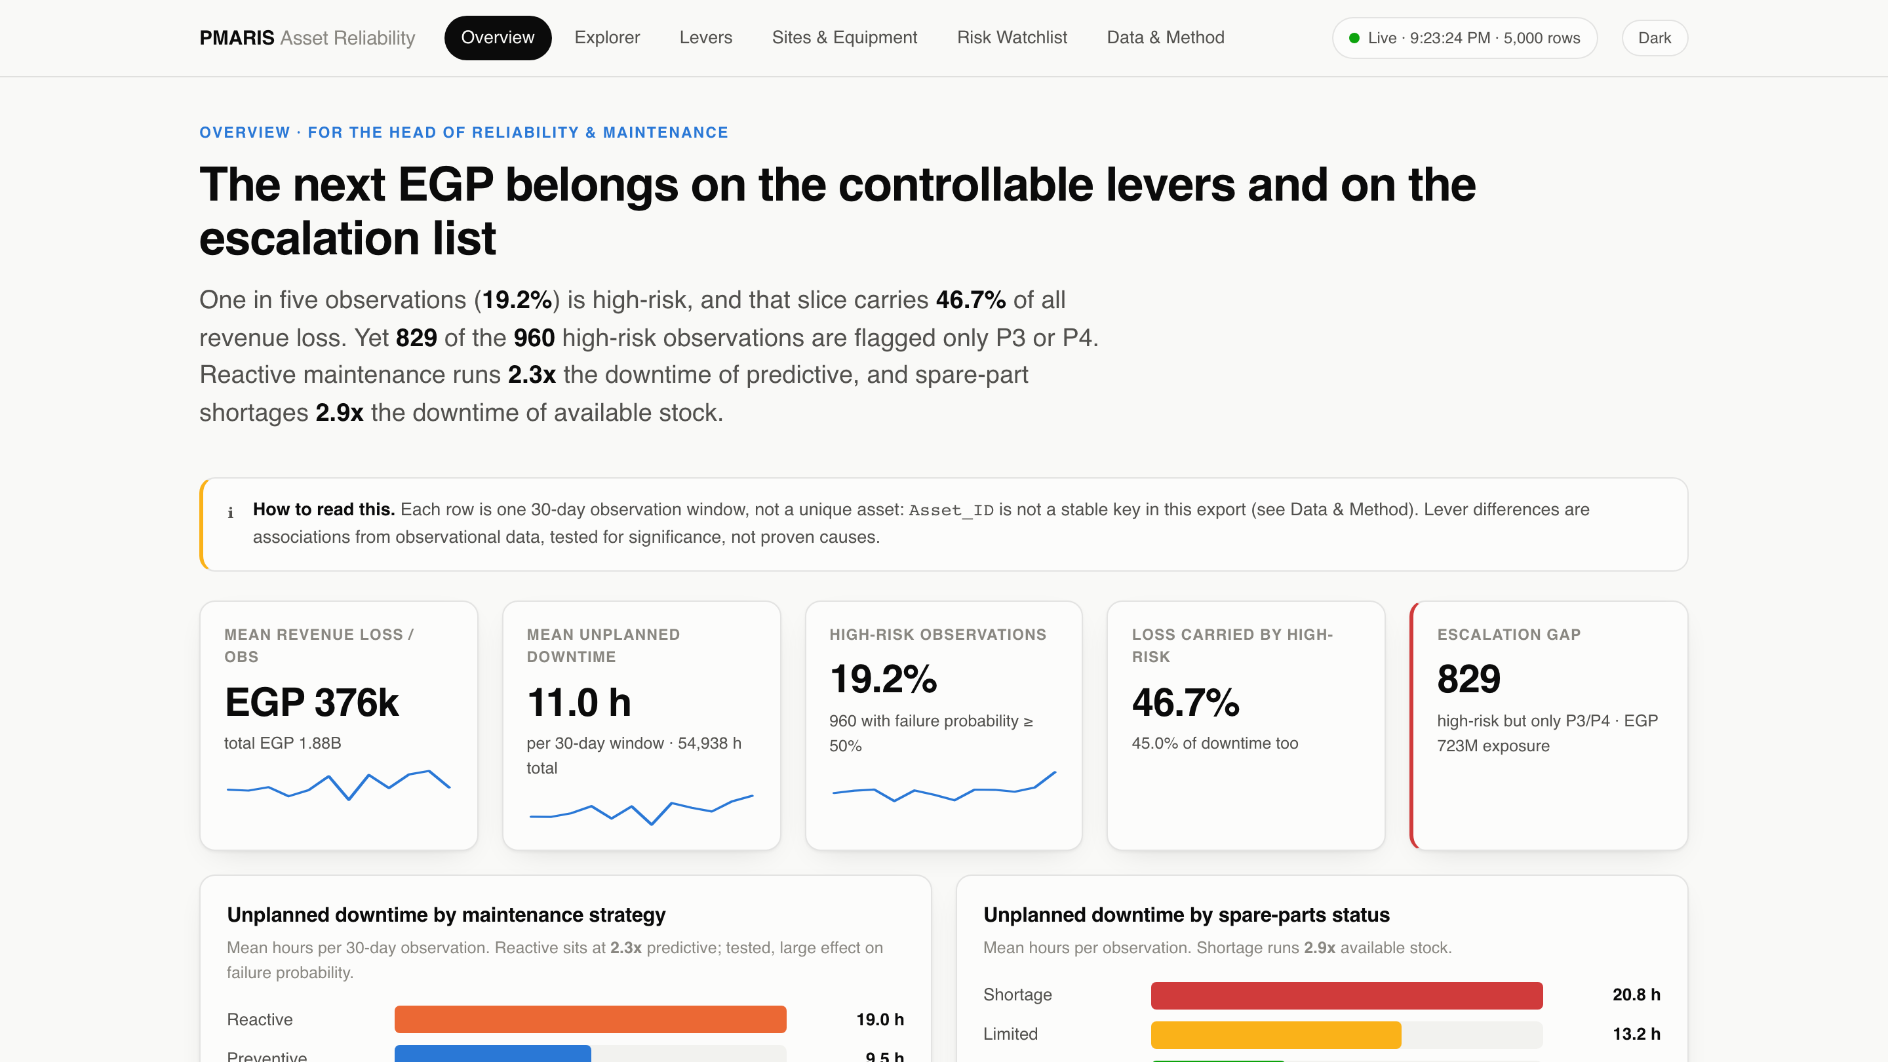
THE BUILD
A live, six-page dashboard keeps these numbers current
376 ms
mean save-to-screen refresh
6
linked pages, light + dark
0
console errors on any page
Source: Group_9230_Team1_PMARIS_Enterprise_Dataset.csv, 5,000 observation windows
28 / 30
Notes:
Overview, Explorer (cross-filtered), Levers, Sites & Equipment, Risk Watchlist, Data & Method. Standard-library Python watcher, plain HTML and SVG, no framework. Verification: 10 timed edits to the source CSV, 376 ms mean, 621 ms max from save to screen.

Slide 29
WHAT TO DO
Seven recommendations
1
Leave reactive maintenance
2
Fund spare-parts availability
critical and high-criticality assets first
for the classes that hit shortage
3
PM at 80%+, backlog under 14 days
4
Upskill basic and intermediate crews
the operating targets
pair with experts on high-risk work
5
Add the second escalation trigger
6
Pilot before scaling
+433 windows, after a capacity check
one site converted, one matched site as control
7
Fix the asset key in the next export
unlocks per-asset history and replacement planning
Source: Group_9230_Team1_PMARIS_Enterprise_Dataset.csv, 5,000 observation windows
29 / 30
Notes:
Ordered by size of effect and ease. Number 6 is what turns these associations into causal, budgetable estimates.

Slide 30
DECISIONS NEEDED
Three decisions for this quarter
1
Approve the reactive-to-planned pilot
One site, one matched control, measured on the live dashboard
2
Approve the second escalation trigger
Subject to a capacity check for 567 escalated windows
3
Request a fixed Asset_ID in the next export
So the next review can plan replacement per asset
Analysis: 02_Analysis/analyze_pmaris.py · Dashboard: 03_Dashboard · Report: PMARIS_Reliability_Assessment.pdf
30 / 30
Notes:
Close on the decisions, not a thank-you slide. The pilot is the most important: it converts the 2x associations into a causal number the budget can rest on. The live dashboard will measure it.

