Slide 1








End-to-End Property Data Solutions: From Acquisition to Visualization and Insights
vps: ubuntu server
PostgreSQL Database
PropertyLinkUpdater.py
Retrieve new link daily updated using crontab
check availability
table: property_link
Insert new link
request
response
PropertyDetilUpdater.py
Retrieve all detailed data (price, address, etc) from each link and store into table
Insert data
https://properti123.com/
table: property_detil
get address
AddressMatching.py
Convert property address into standard Indonesian Address using Fuzzy String Matching
Insert standard address
table: property_address
Line Bot:
Send Message to User
LineNotificationSender.py
Select new and filtered data and send using Line API
Select new and filtered data

Slide 2
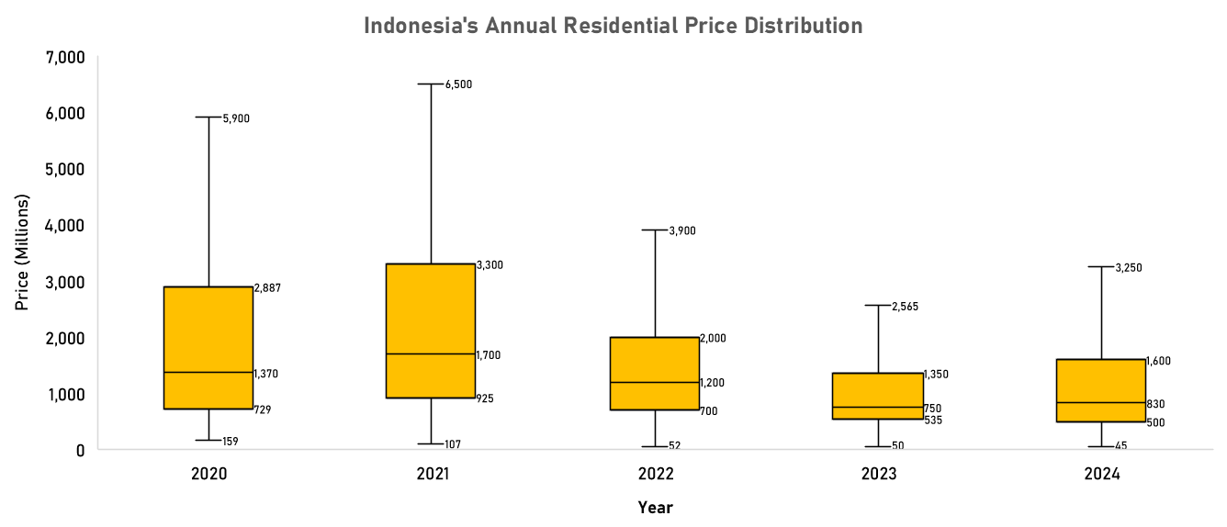
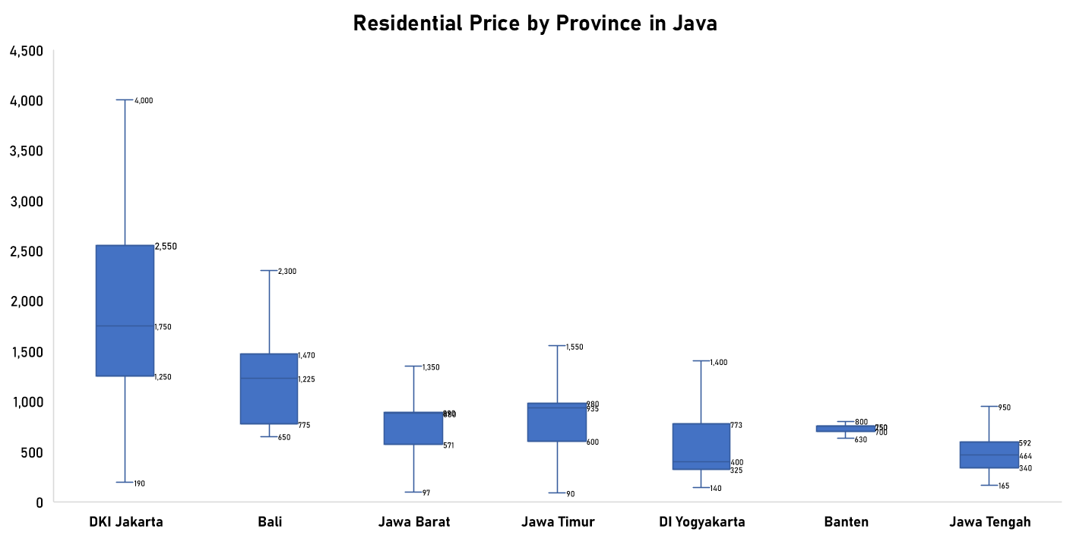
End-to-End Property Data Solutions: From Acquisition to Visualization and Insights
Summary of Residential Price
Over the past five years, we have observed a significant decline in residential property prices in Indonesia. Specifically, the median residential price, which was IDR 1.370 million five years ago, has decreased to IDR 830 million in 2024. This represents a decrease of approximately 39.42%.
With prices significantly lower, this may be an opportune time to purchase residential property, potentially securing a good deal before prices stabilize or increase
Residential Price In Java
Province | Mean | Rank | Q1 | Q2 | Q3
DKI Jakarta | Rp 2,026,530,485 | 1 | Rp 1,250,000,000 | Rp 1,750,000,000 | Rp 2,550,000,128
Bali | Rp 1,308,709,675 | 2 | Rp 775,000,000 | Rp 1,225,000,000 | Rp 1,470,000,000
Jawa Barat | Rp 966,376,064 | 3 | Rp 571,000,000 | Rp 880,000,000 | Rp 890,000,000
Jawa Timur | Rp 962,122,434 | 4 | Rp 600,000,000 | Rp 935,000,000 | Rp 980,000,000
DI Yogyakarta | Rp 959,525,414 | 5 | Rp 325,000,000 | Rp 400,000,000 | Rp 773,000,000
Banten | Rp 766,546,297 | 6 | Rp 700,000,000 | Rp 750,000,000 | Rp 750,000,000
Jawa Tengah | Rp 569,098,641 | 7 | Rp 340,000,096 | Rp 463,800,000 | Rp 592,000,128
Grand Total | Rp 943,003,228 | - | Rp 630,000,000 | Rp 750,000,000 | Rp 880,000,000
DKI Jakarta has the highest residential property prices among the provinces in Java. The high mean price and quartile values indicate a significant demand and higher cost of living in the capital city. Bali ranks second with relatively high property prices, reflecting its status as a popular tourist destination and desirable place to live.
Jawa Barat, Jawa Timur, and DI Yogyakarta have moderate residential prices, with Jawa Barat and Jawa Timur having similar price ranges, while DI Yogyakarta has lower quartile values, indicating more affordable options within the province.
Banten and Jawa Tengah offer the most affordable residential properties among the provinces in Java, with Jawa Tengah having the lowest mean and quartile values, making it a potential market for cost-sensitive buyers.
The overall mean residential price across all listed provinces is approximately Rp943 million. Provinces like DKI Jakarta and Bali exceed this average, while Banten and Jawa Tengah fall below it.

Slide 3

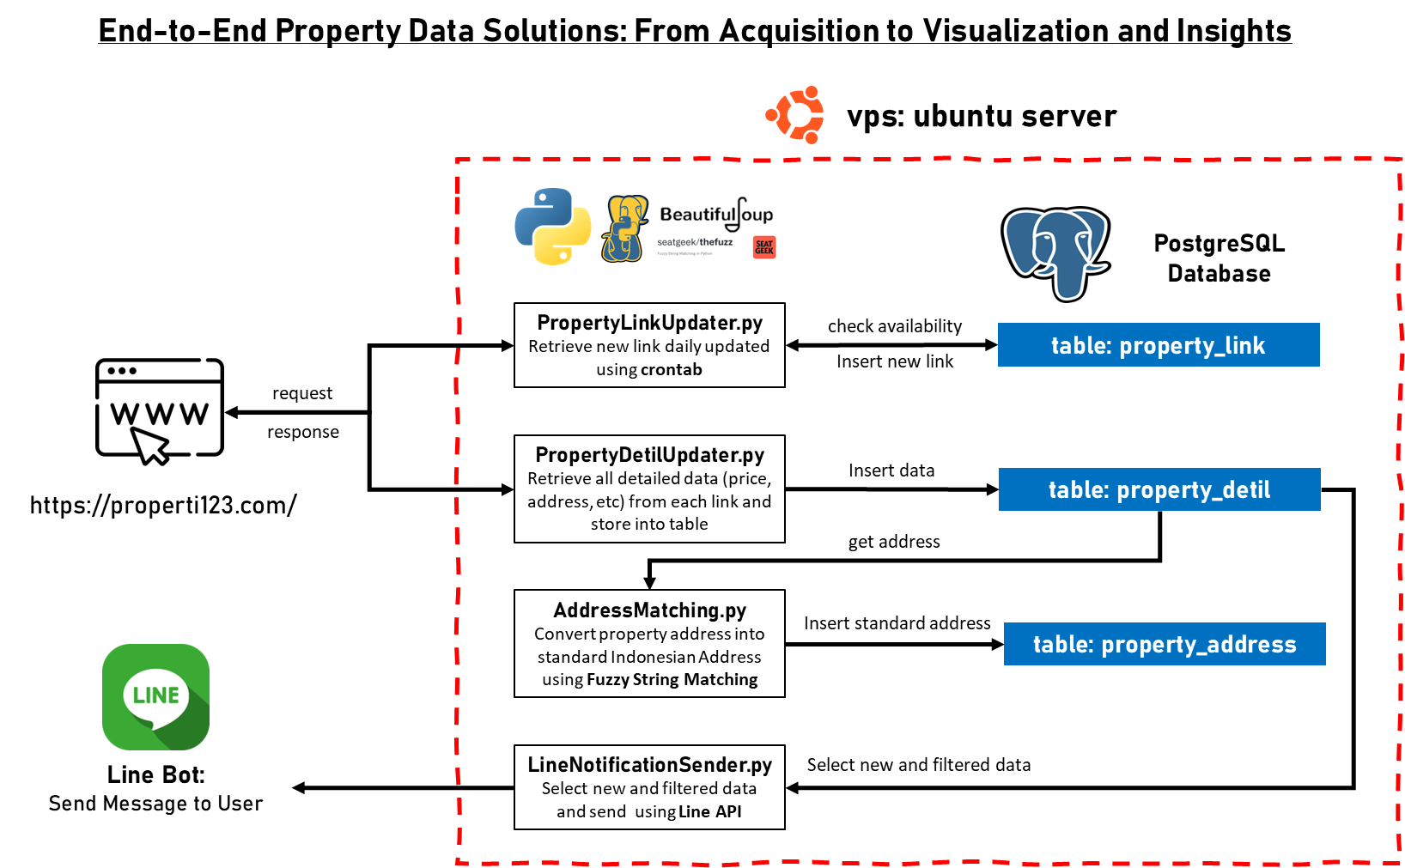
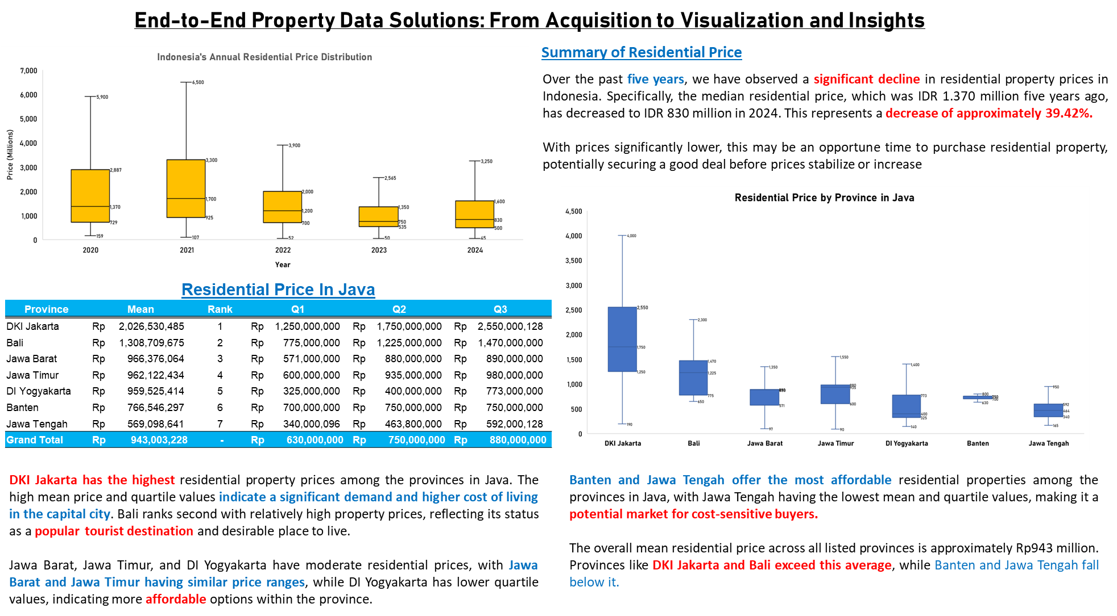
End-to-End Property Data Solutions: From Acquisition to Visualization and Insights

