Slide 1





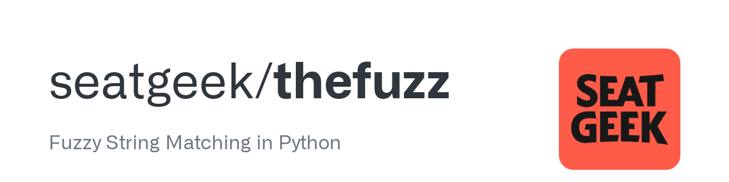


End-to-End Property Data Solutions: From Acquisition to Visualization and Insights
vps: ubuntu server
PostgreSQL Database
PropertyLinkUpdater.py
Retrieve new link daily updated using crontab
check availability
table: property_link
Insert new link
request
response
PropertyDetilUpdater.py
Retrieve all detailed data (price, address, etc) from each link and store into table
Insert data
https://properti123.com/
table: property_detil
get address
AddressMatching.py
Convert property address into standard Indonesian Address using Fuzzy String Matching
Insert standard address
table: property_address
Line Bot:
Send Message to User
LineNotificationSender.py
Select new and filtered data and send using Line API
Select new and filtered data

