Slide 1

Heap Memory Manager By: Adham Khaled
Advanced System Programming under Linux training at STMicroelectronics.
Instructor: Eng. Reda Maher.

Slide 2
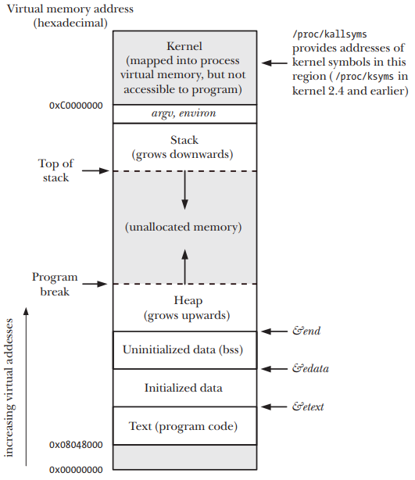
introduction
Heap management is an essential aspect of programming in the C language, particularly in Linux environments.
The heap is a region of memory used for dynamic memory allocation, allowing programs to request and release memory at runtime.
Key goals include dynamic memory allocation, deallocation, implementing various memory management policies, optimizing performance, and integrating error handling mechanisms.
This project offers essential heap functionalities such as malloc, calloc, realloc, and free.

Slide 3
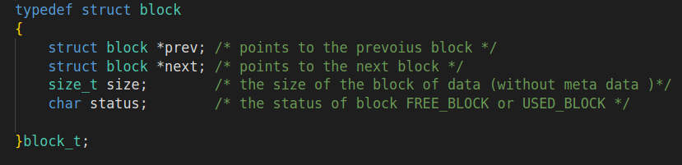
Design
We store the free and used blocks in a double linked list
Each block contains :
pointer to next block
pointer to previous block
size of the data the block can hold
status of the block free or used

Slide 4
Memory allocation Algorithm
First Fit:
Assigns the first available block of memory that is large enough to accommodate the request.
Advantages:
Simple
easy to implement.
Faster than Best Fit.
Disadvantages:
Fragmentation

Slide 5
functions
void *HmmAlloc(size_t size)
Std_ReturnType init(block_t **list,size_t size)
void split(block_t *fitting,size_t size)
Std_ReturnType new_alloc(block_t *list,size_t size)
void HmmFree(void *ptr)
void merge(block_t* block,size_t decSize)
static Std_ReturnType moveBrkDown(block_t *lastBlock,size_t decSize)
void *HmmCalloc(size_t nmemb, size_t size)
void *HmmRealloc(void *ptr, size_t size)

Slide 6
hmmalloc
Description: function allocates bytes in heap and returns a pointer to the allocated memory The memory is not initialized.
Parameters:
size: number of bytes to be allocated
Return: pointer to the allocated memory, return NULL if the request is failed

Slide 7
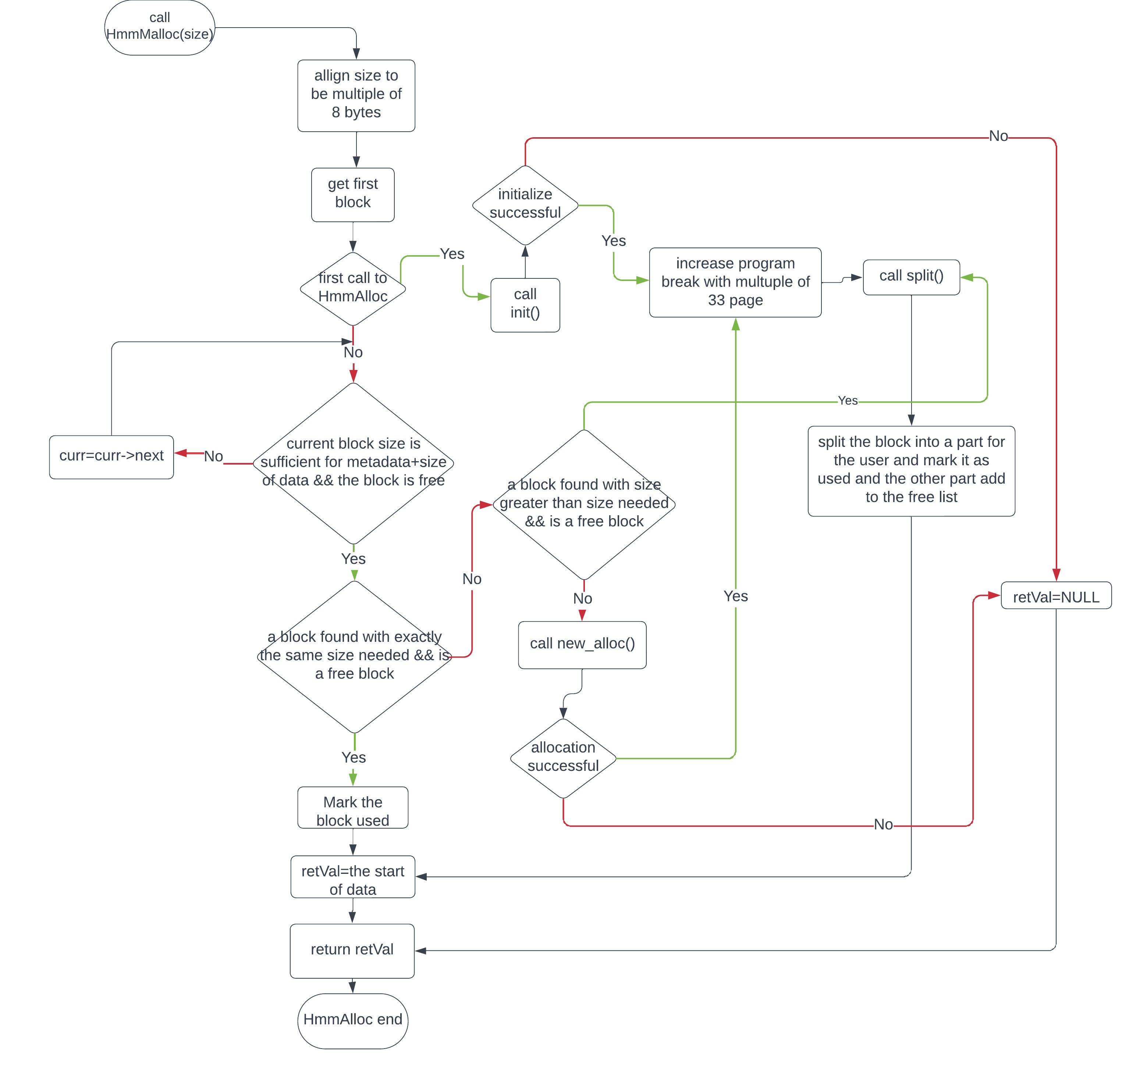
hmMalloc
Scenarios:
First time
Same size block found
Bigger block found
No block found

Slide 8
Init
Description: initialize the list if there's is no allocation before
Parameters:
list: pointer to the first entry of the list
size: the size to be allocated at the beginning
Return: status of the process

Slide 9
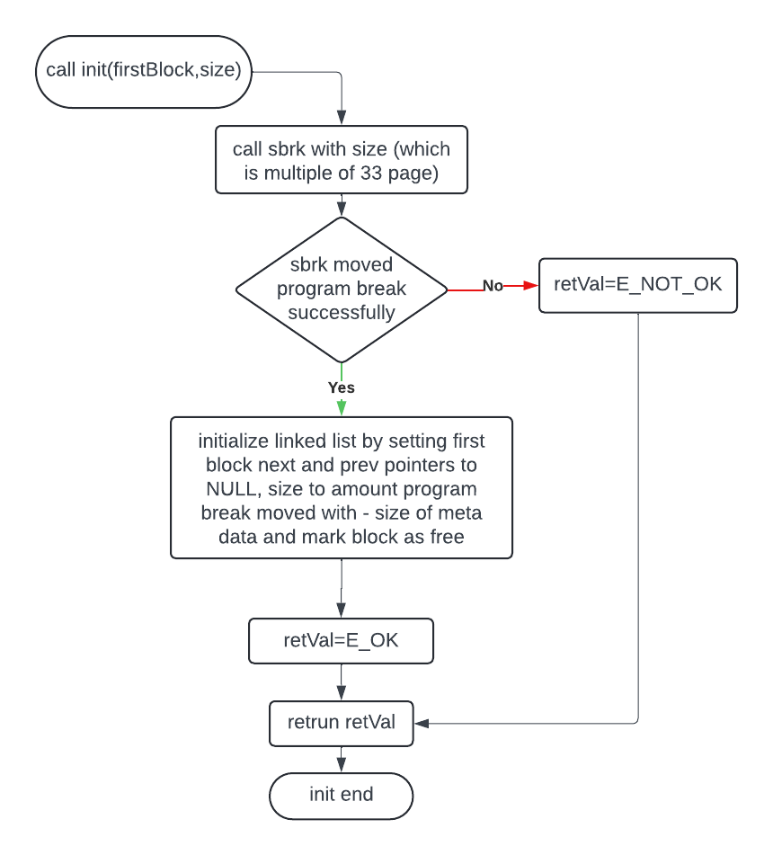
Init

Slide 10
split
Description: used to split a block of data into two blocks t's used in case of finding a block which is bigger than block needed
Parameters:
fitting: pointer to the block which will be split
size: the size of the block after splitting
Return: no return

Slide 11
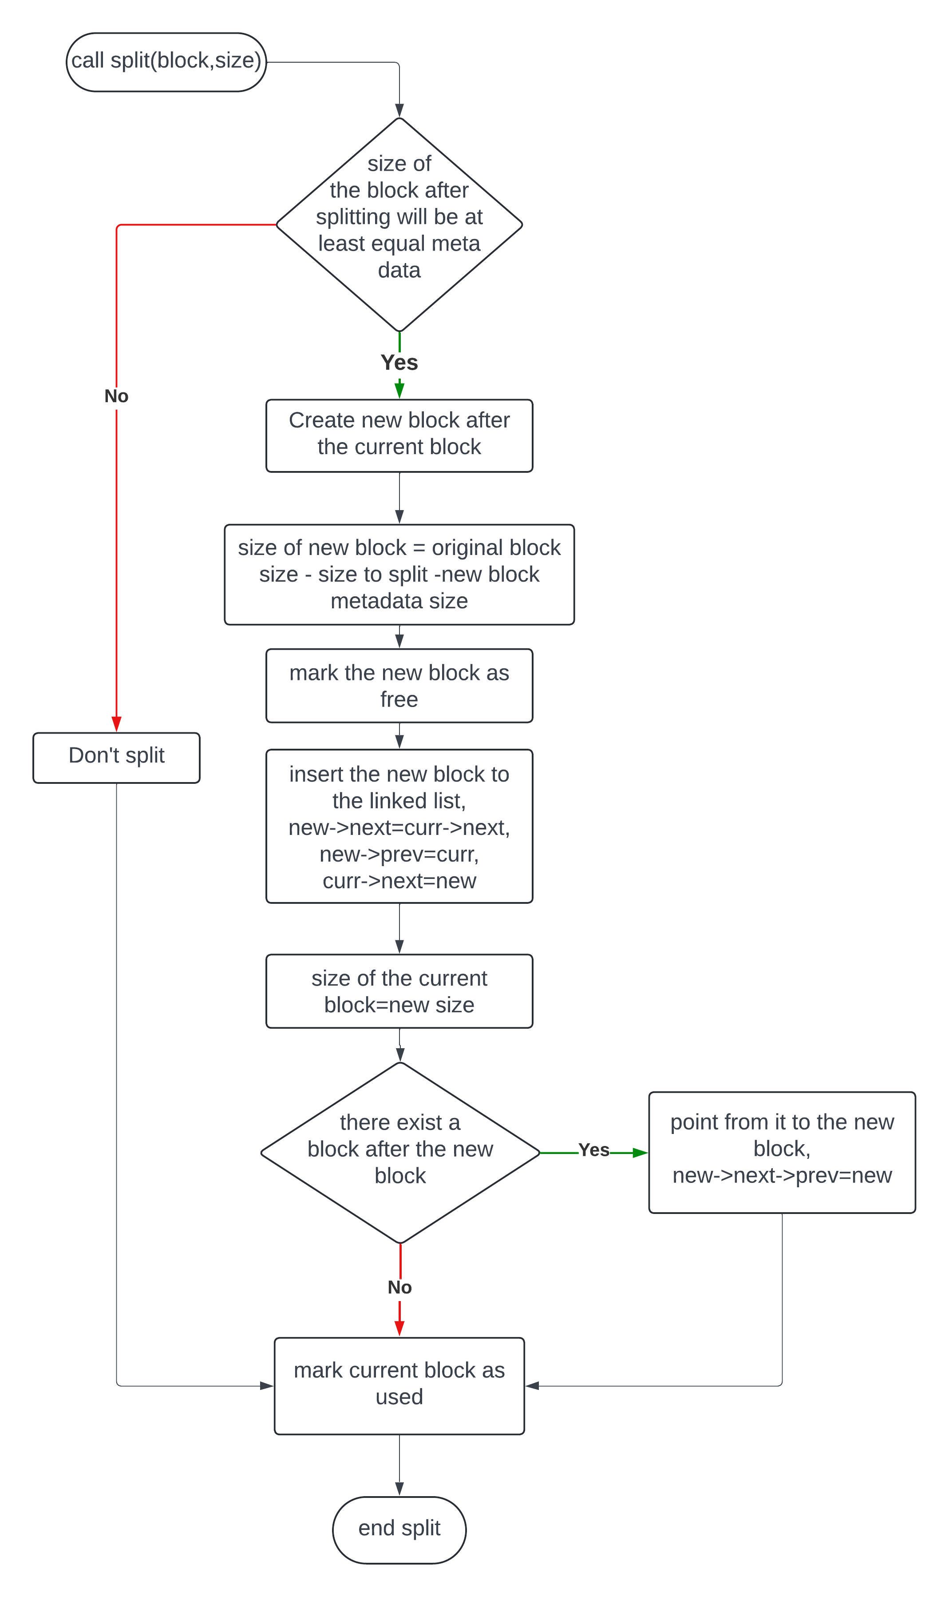
SPLIT

Slide 12
New_alloc
Description: used to allocate new space in heap if the current allocated space isn't enough first check if the block is free then extend it, if used then allocate new space
Parameters:
list: pointer to the last block in the current free list
size: the size to be allocated
Return: status of the process

Slide 13
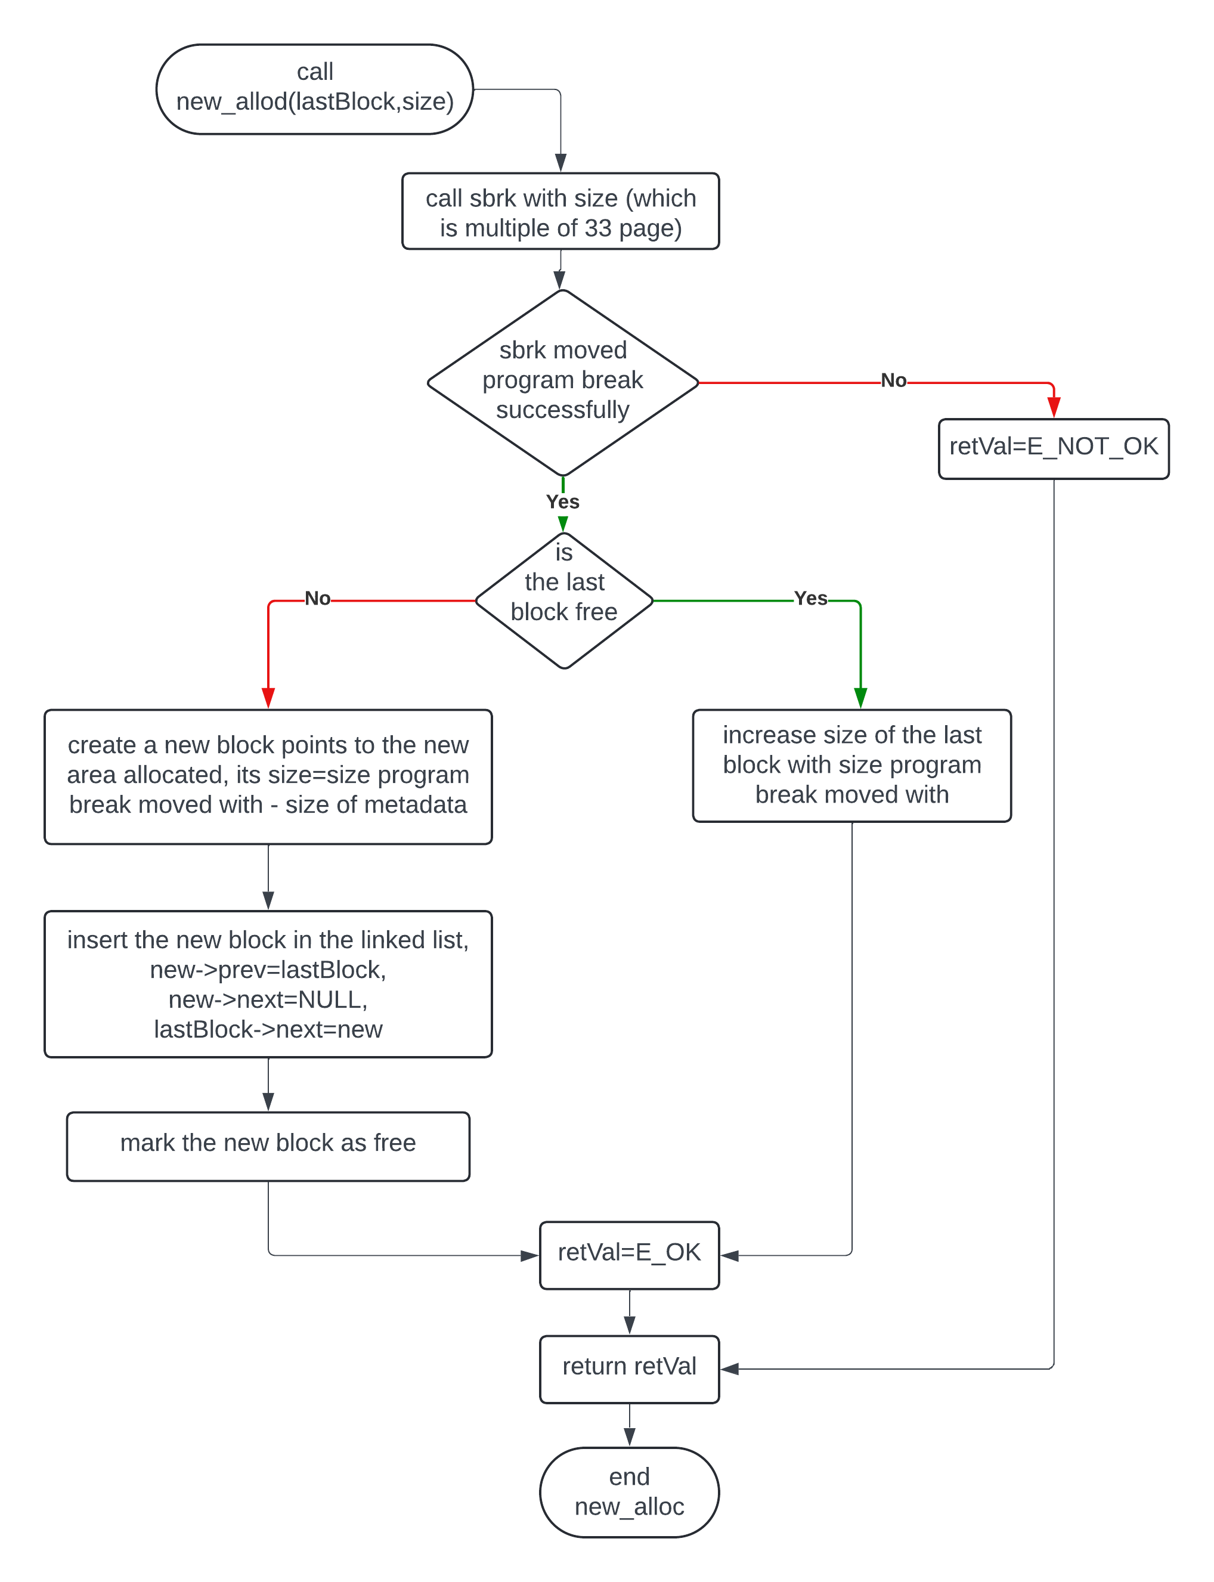
New_Alloc
Scenarios:
Last block is free
Last block is used

Slide 14
HMMFREE
Description: Frees the memory space pointed to by ptr, which must have been returned by a previous call to malloc(), calloc(), or realloc(). Otherwise, or if HmmFree(ptr) has already been called before, undefined behavior occurs. If ptr is NULL, no operation is performed.
Parameters:
ptr: pointer to the space to be freed
Return: no return

Slide 15
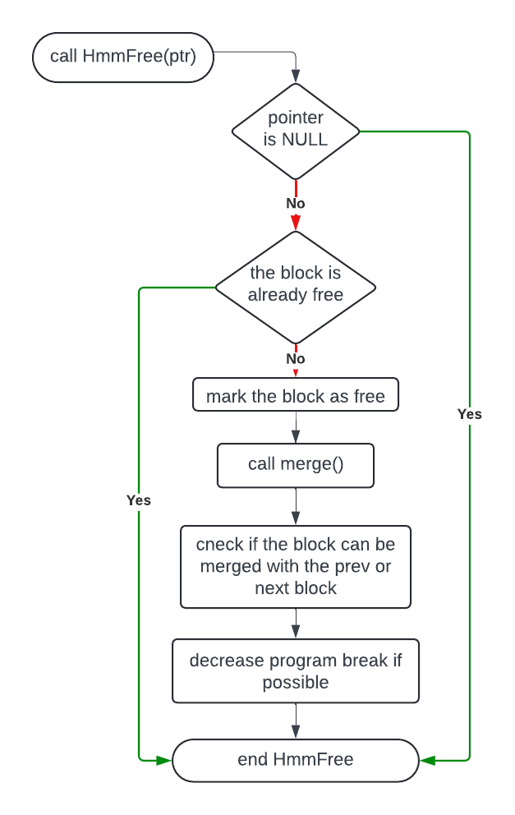
Hmmfree

Slide 16
merge
Description: checks if the free block can be merged with the next or previous free block (if there exist) it's also responsible for decreasing the program break if that can be done
Parameters:
block: pointer to the block to check on
decSize: the minimum size of the free block needed to decrease the program break
Return: no return

Slide 17
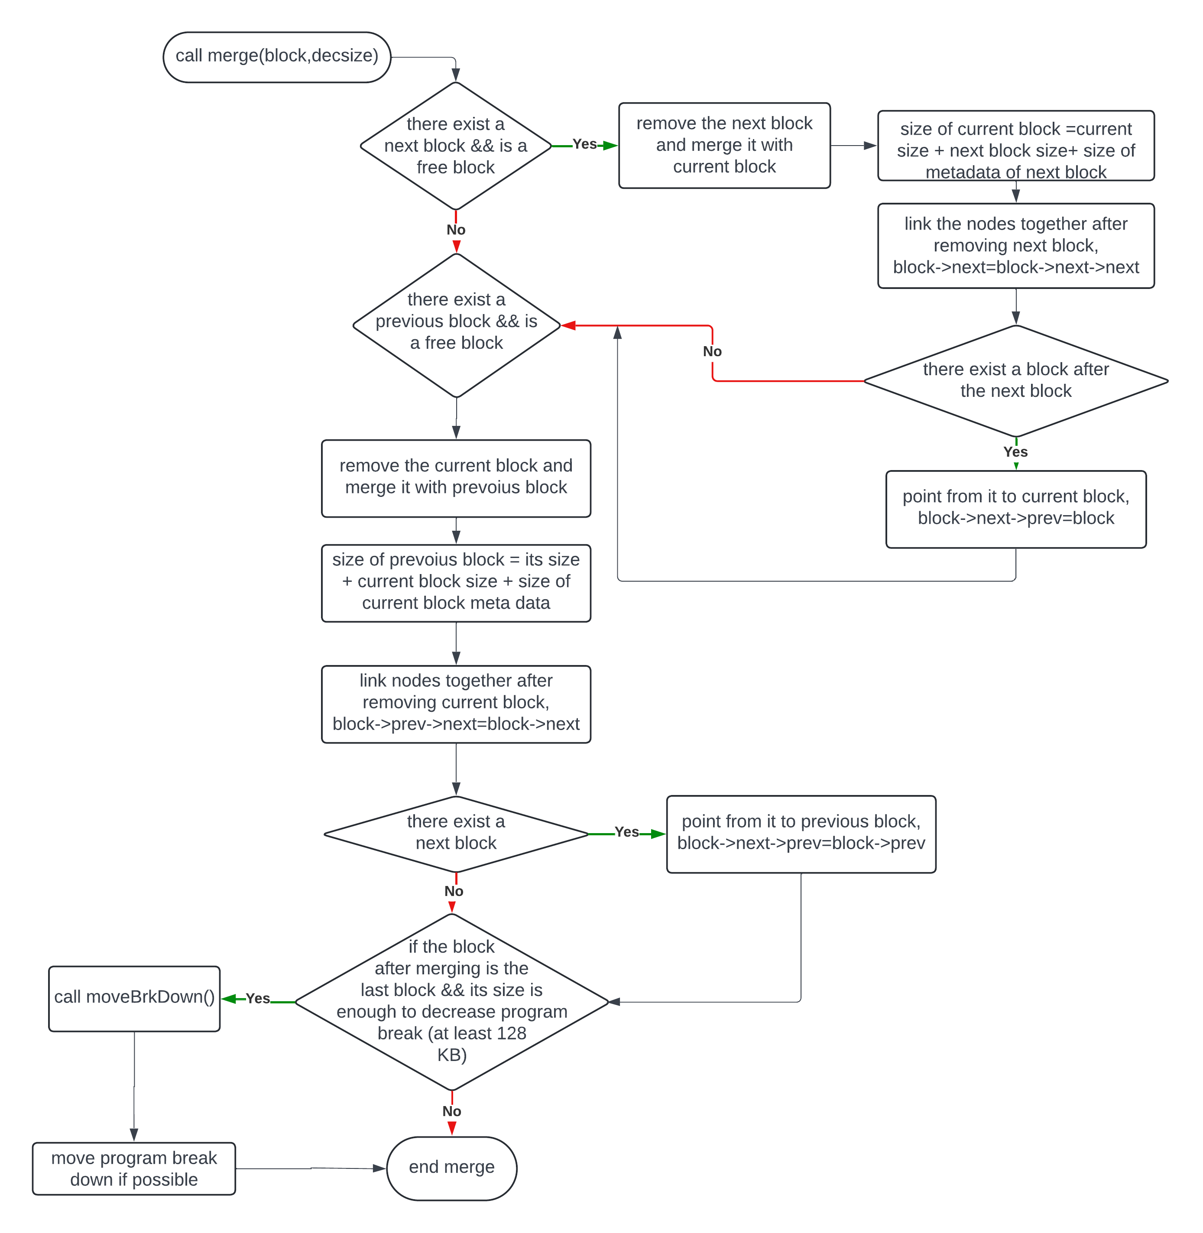
merge
Scenarios:
Next block is free
Prev block is free
Both are free (no problem)

Slide 18
moveBrkDown
Description: helper function to decrease the program break
Parameters:
block: pointer to the block to check on
decSize: the minimum size of the free block needed to decrease the program break
Return: status of the process

Slide 19
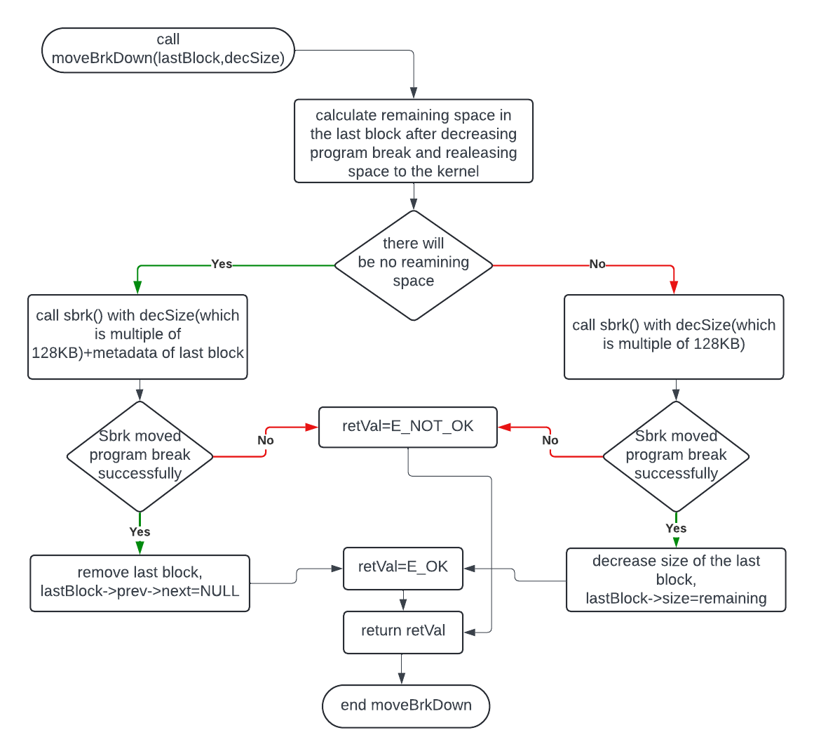
movebrkdown
Scenarios:
There be remaining space
There will be NO remaining space

Slide 20
hmmcalloc
Description: allocates memory for an array of nmemb elements of size bytes each and returns a pointer to the allocated memory.The memory is set to zero. If nmemb or size is 0 then returns NULL.
Parameters:
nmemb: number of memory spaces want to allocate
size: the size of each memory space to allocate
Return: pointer to the allocated memory, return NULL if the request is failed

Slide 21
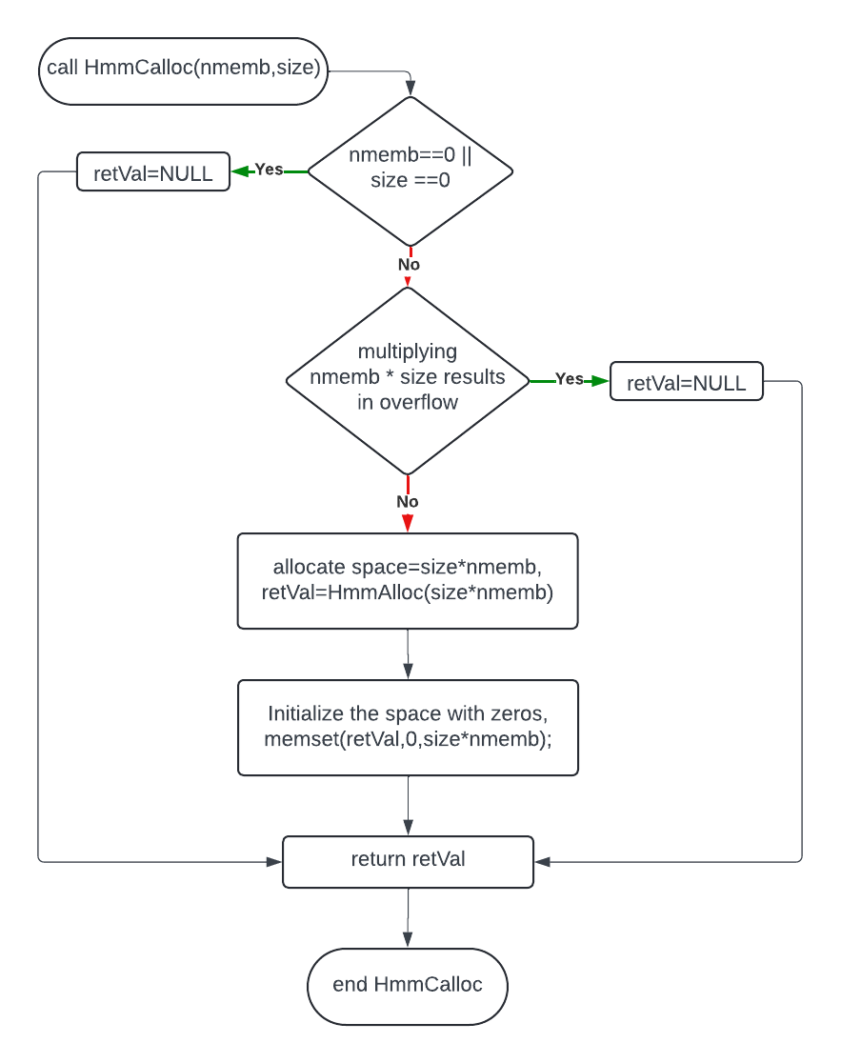
hmmcalloc

Slide 22
Hmmrealloc
Description: changes the size of the memory block pointed to by ptr to size bytes. The contents will be unchanged in the range from the start of the region up to the minimum of the old and new sizes.
Parameters:
ptr: pointer to the memory block to change its size
size: the new size wanted
Return: pointer to the new allocated memory, return NULL if the request is failed

Slide 23
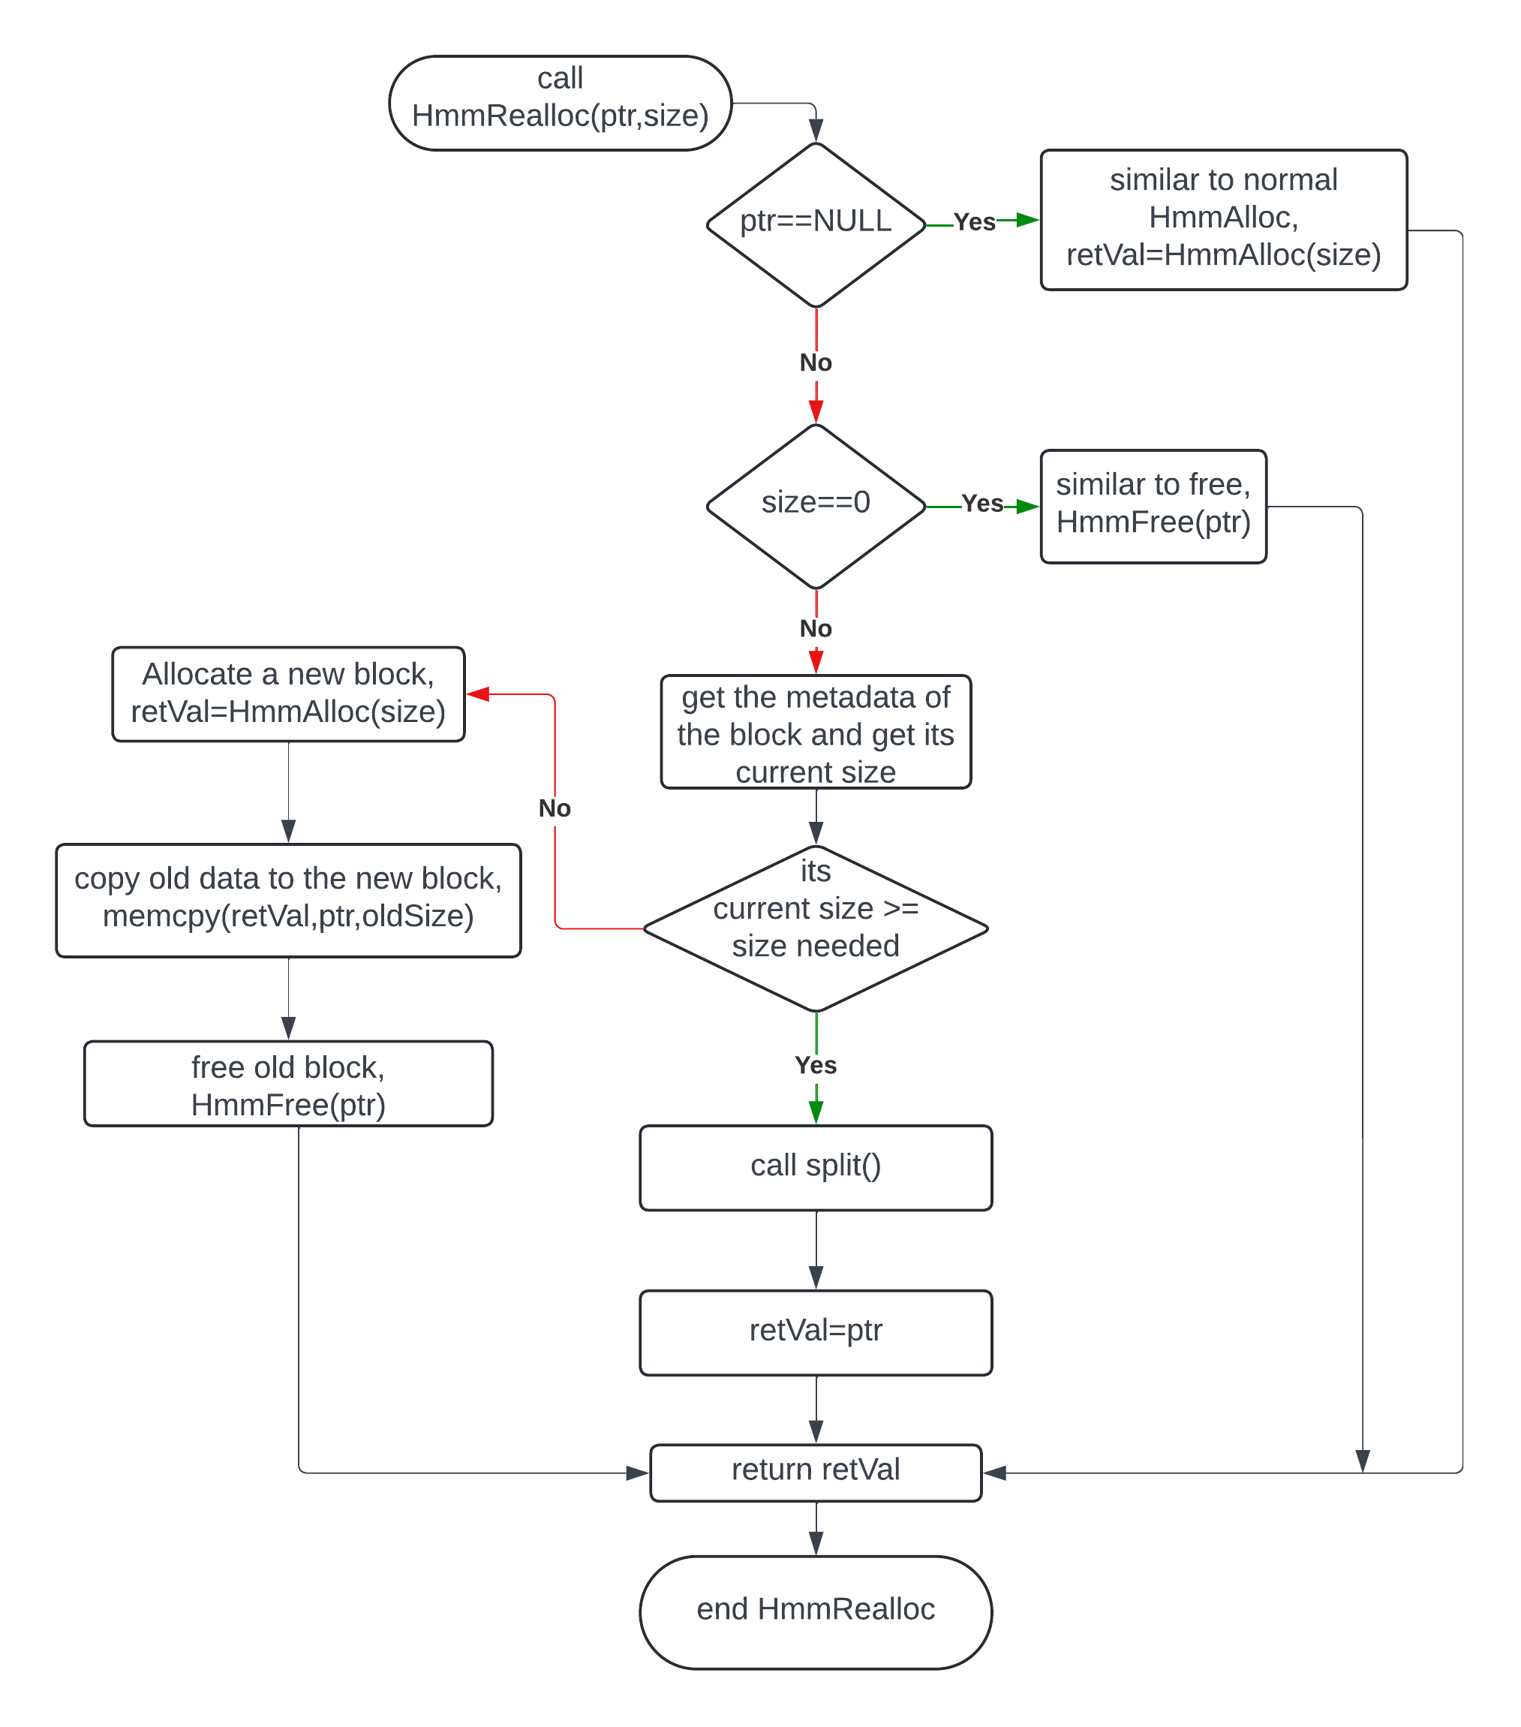
hmmrealloc

Slide 24
Implementation points
Time complexity
HmmAlloc: O(n)
Not always because of first fit
TBD: pointer to the first free block
HmmFree: O(1) , that’s why I don’t check if the pointer is in the list
Minimizing number of sbrk() calls
Memory alignment
Error handling
Always checking on return of sbrk()
Covering corner cases

Slide 25
Testing methodology
Unit testing to test each block of code separately to make sure it does its job good and trace the linked list.
Allocating blocks in a row and freeing them again.
Run some scenarios to check if data stored in heap corrupted or not.
After testing all scenarios each one alone used a randomized test to stress test my HMM.
After everything is good replaced my HMM with glibc HMM and tested many commands and programs like bash and vim.

Slide 26
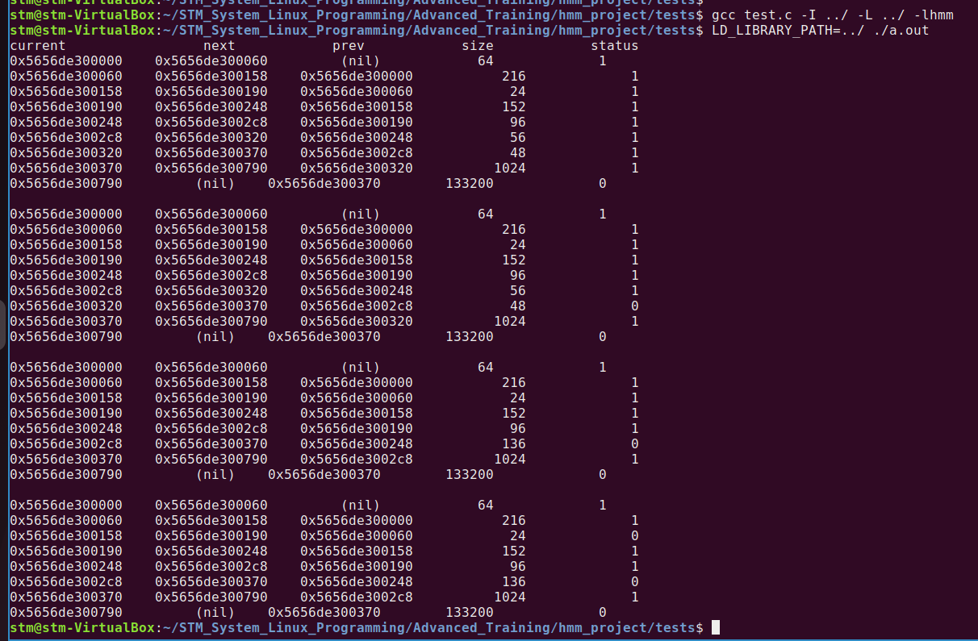
Merging test

Slide 27
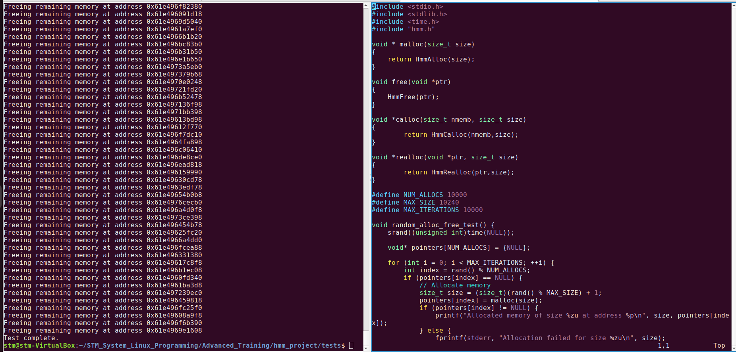
Stress test

Slide 28
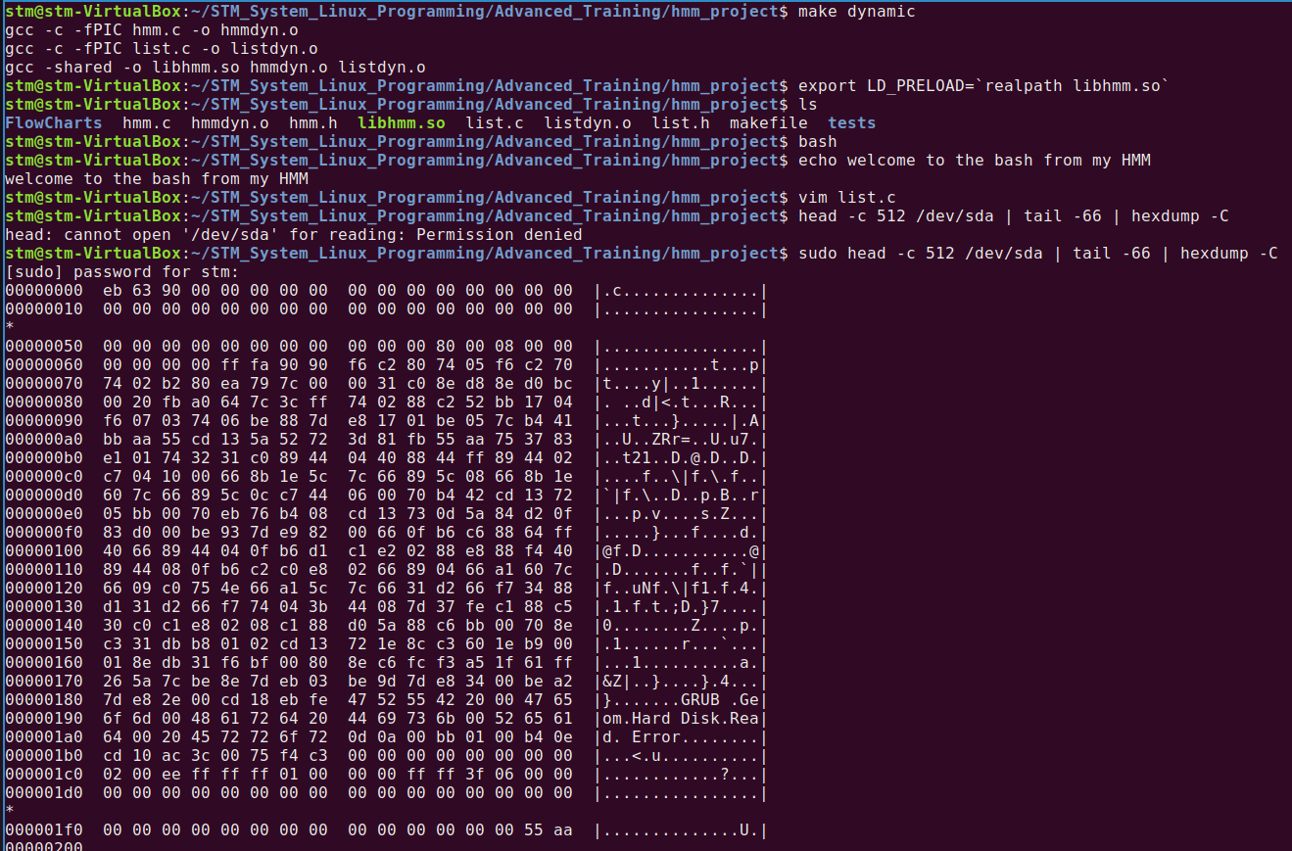
Replacing glibc

Slide 29

THANK YOU

