Slide 1
Introduction to android Activity and Basic Layout

Slide 2
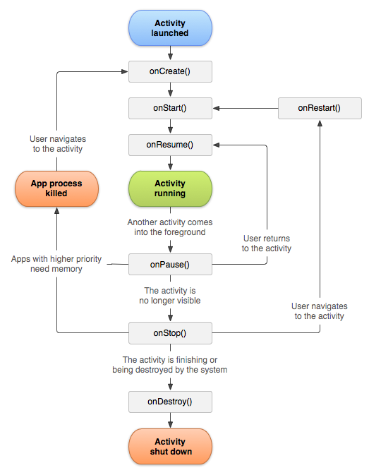
Activity

Slide 3
Activity
Activity Life cycle
Activity navigations
Activity for result

Slide 4
Layouts and Views
Linear layouts
Relative Layout
Scroll View
Text View
Image View
Button
Radio Button
Check box
Switcher

Slide 5
Layouts and Views

Slide 6
Activity part

