Slide 1
Introduction to mobile android application
prepared by Eng. Adham khwaldeh

Slide 2
W3 Questions ?
Who ?
Why ?
How ?

Slide 3
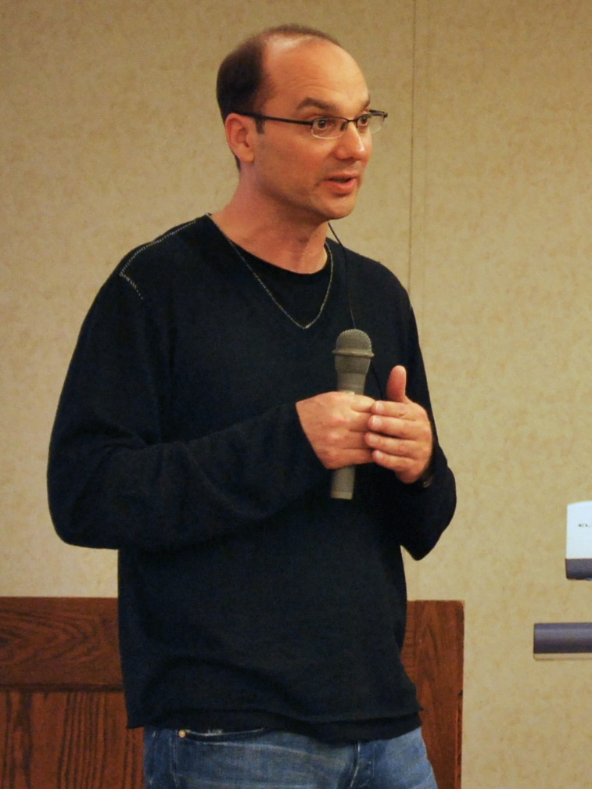
Founder

Slide 4
Startup
Founder (Andy Rubin)
Started in California, United States at October, 2003
Originally intended for camera but shifted to smart phones later because of low market for camera only
In 17th August 2005, Google acquired android Incorporation.
In 2007, Google announces the development of android OS

Slide 5
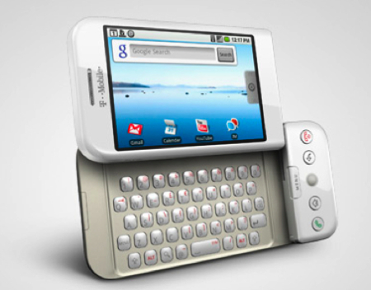
T-Mobile G1
In October 2008, HTC launched the first android mobile (T-Mobile G1)
Android 1.6 (Donut)
Price About 290 EUR

Slide 6
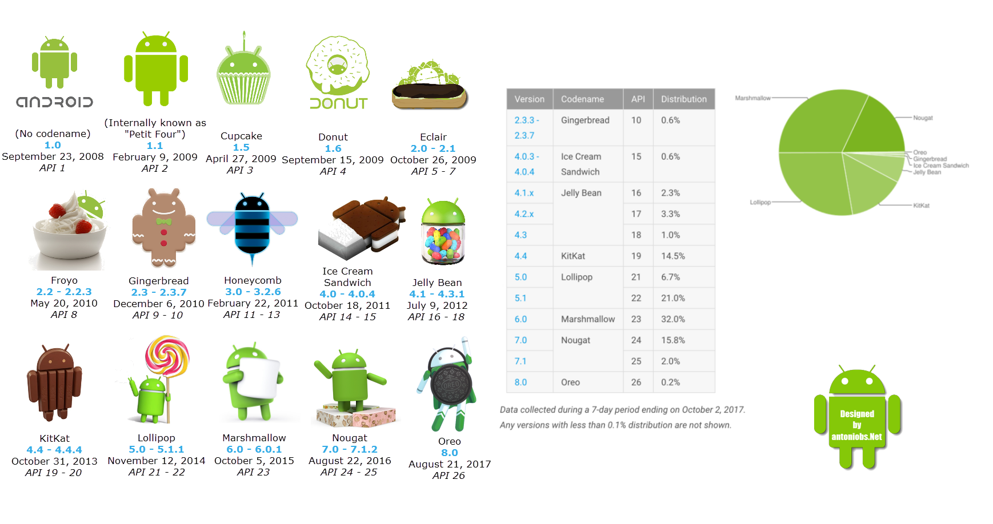
Android versions

Slide 7
Android versions
Version code:
major and minor numbers { major.minor }
Version Rule:
Each new version of Android is named after a dessert, going in alphabetical order

Slide 8
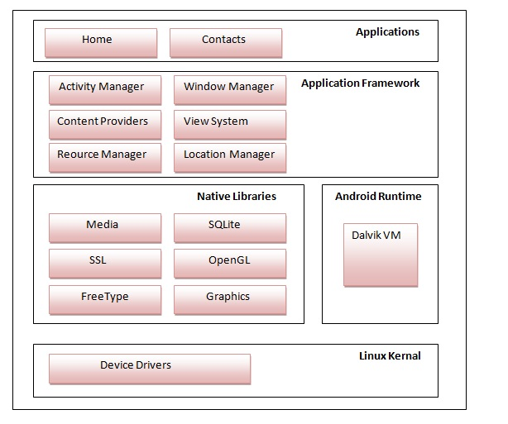
Android hierarchy

Slide 9
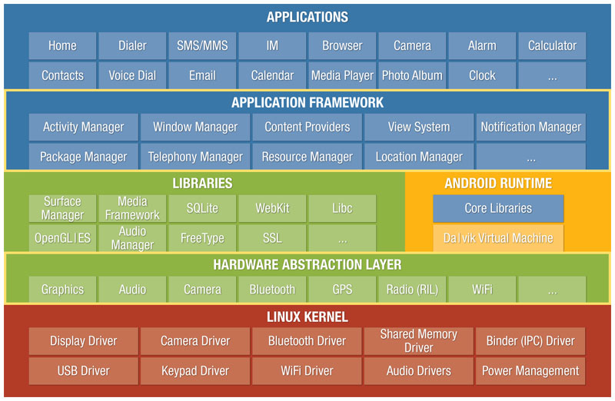
Android hierarchy

Slide 10
Why
Talking about Android importance is deprecated
Cell phones become interface of technologies
Android usage statistic
Android business statistic

Slide 11
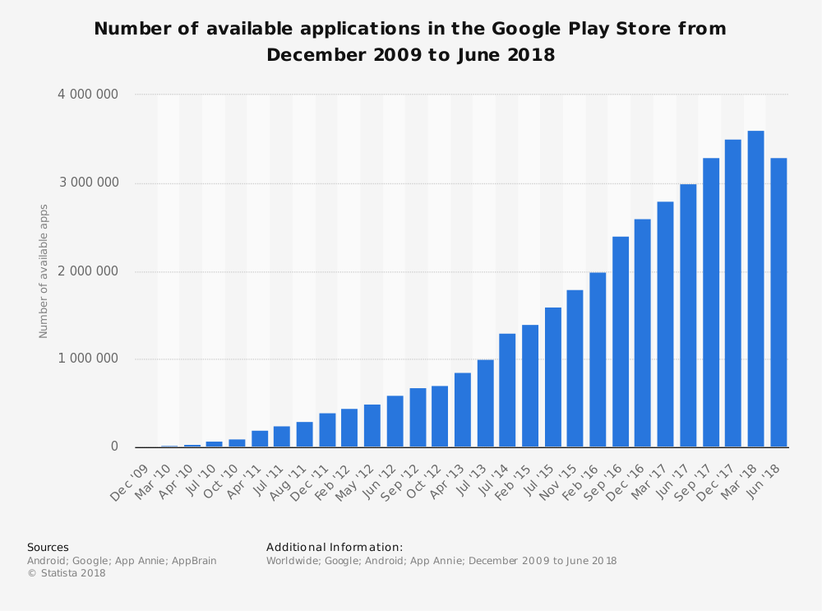

Slide 12
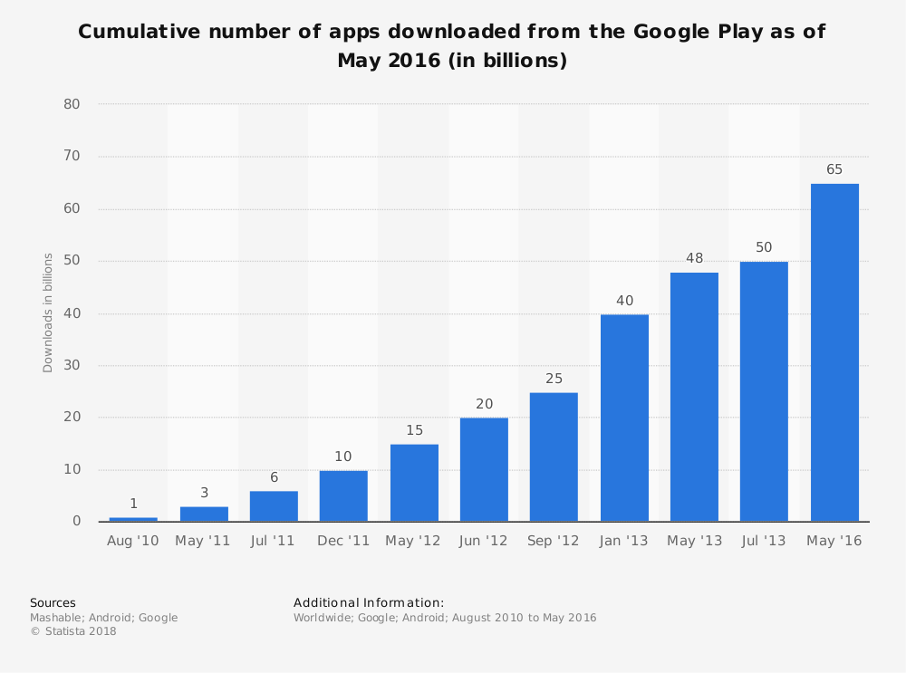

Slide 13
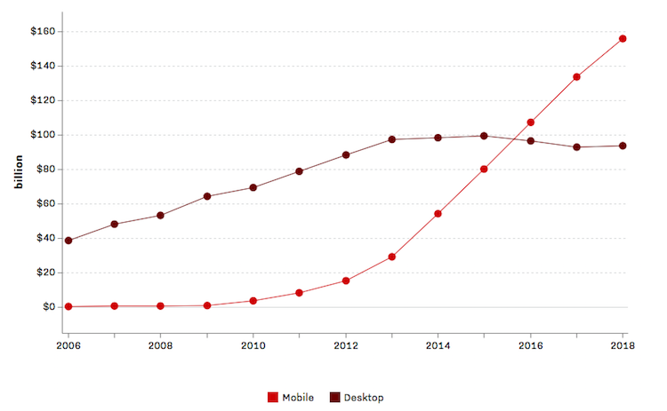

Slide 14
How
Android studio IDE (Environment Development Equipment's )
Developed by Intellij Company
Powered by google.

Slide 15
Why android studio via java or kotlin
Standard (support by google)
Big community
Native platform

Slide 16
Target
The course consist of 12 lectures (1.5 hour)
Include Basic and intermediate levels
good introduction for junior and senior university projects.

Slide 17
References
Founder
https://en.wikipedia.org/wiki/Andy_Rubin
Statistics
https://www.statista.com/statistics/281106/number-of-android-app-downloads-from-google-play/
Platforms
https://www.jetbrains.com/
https://developer.android.com/studio/

Slide 18
Thank you for your attention

