Slide 1
Android tutorial lecture 01

Slide 2
Outlines
Android Hierarchical .
Main components
Android life cycle

Slide 3
Hierarchical
JVM (Java Virtual Machine)
DVM (Dalvik Virtual Machine)
Main Files (R.java file , manifests )

Slide 4
JVM (Java Virtual Machine)
JVM is a part of JRE(Java Run Environment)
When we compile a .java file, a .class file(contains byte-code) with the same filename is generated by the Java compiler.
a .class file goes into various steps when we run it. These steps together describe the whole JVM

Slide 5
DVM (Dalvik Virtual Machine)
DVM is an android virtual machine optimized for mobile devices.
It optimizes the virtual machine for memory, battery life and performance.
The Dex compiler converts the class files into the .dex file that run on the Dalvik VM. Multiple class files are converted into one dex file
Dalvik is a name of a town in Iceland. The Dalvik VM was written by Dan Bornstein.

Slide 6
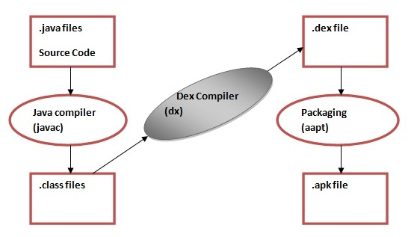
Let's see the compiling and packaging process from the source file:

Slide 7
DVM (Dalvik Virtual Machine )
The javac tool compiles the java source file into the class file
The dx tool takes all the class files of your application and generates a single .dex file. It is a platform-specific tool.
The Android Assets Packaging Tool (aapt) handles the packaging process.

Slide 8
Main Files
R.java file
manifests

Slide 9
R.java
It is the auto-generated file that contains IDs for all the resources of res directory.
It is generated by aapt(Android Asset Packaging Tool).
Whenever you create any component on activity_main, a corresponding ID is created in the R.java file which can be used in the Java Source file later.
aapt regenerate R file on every Build

Slide 10
Manifest.xml
It also declares the android api that the application is going to use
It is responsible to protect the application to access any protected parts by providing the permissions
It lists the instrumentation classes. The instrumentation classes provides profiling and other information. These information are removed just before the application is published
contains information of your package, including components of the application such as activities, services, broadcast receivers, content providers etc.

Slide 11
Main components
Activity
View
Service
Content Provider
Intent
Storage

Slide 12
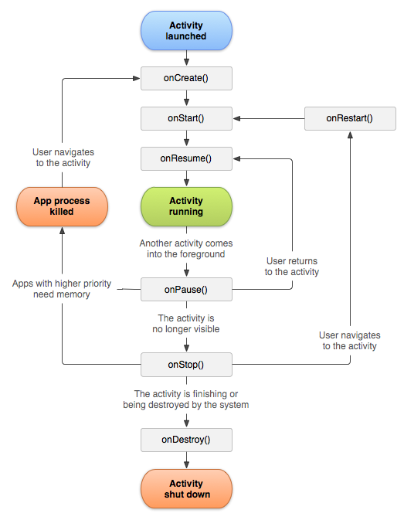
Activity

Slide 13
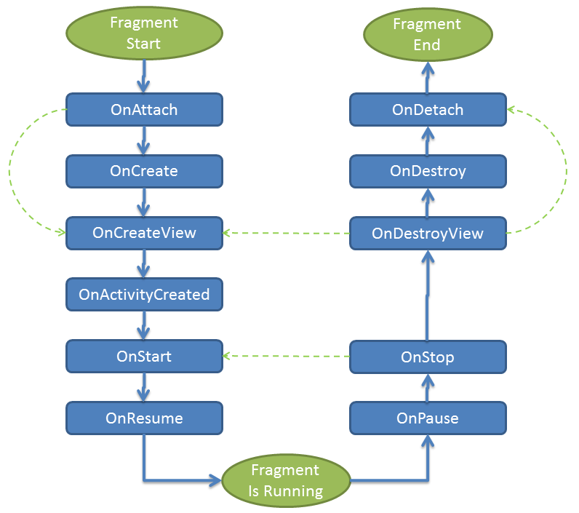
Fragment

Slide 14
View
Layout types
Standard Views
Listing (List View –Recycler View)
Material Design (Support +Design) Library
Custom View

Slide 15
Service
Bind Service
Unbind Service
Job scheduler
Broadcast Receivers
AIDL
Bus Event

Slide 16
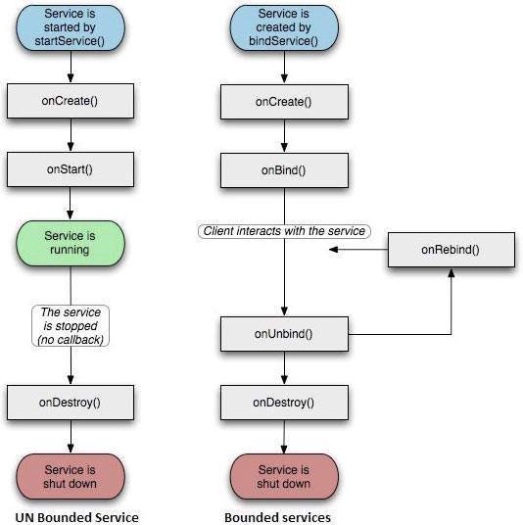
Service

Slide 17
Job scheduler

