Slide 1
Introduction to android Activity and Basic Layout

Slide 2
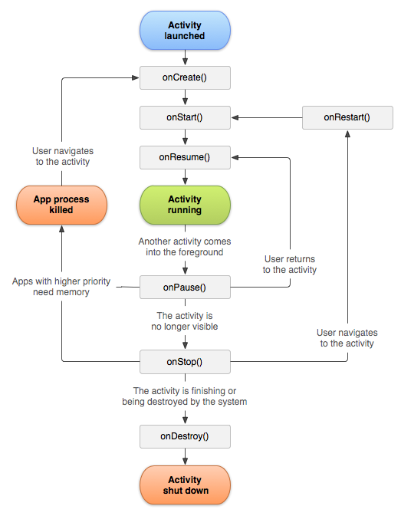
Activity

Slide 3
Activity
Activity Life cycle
Activity navigations
Activity for result

Slide 4
Layouts
Linear layouts
Relative Layout
Frame Layout
Scroll View

Slide 5
Views
Text View
Edit Text
Image View
Button
Radio Button
Radio Group
Check box
Switcher
Toggle Button
Rating View

Slide 6
Resource files
Strings
Drawable
Dimensions
Styles

