Slide 1
Introduction to mobile android application
prepared by Eng. Adham khwaldeh

Slide 2
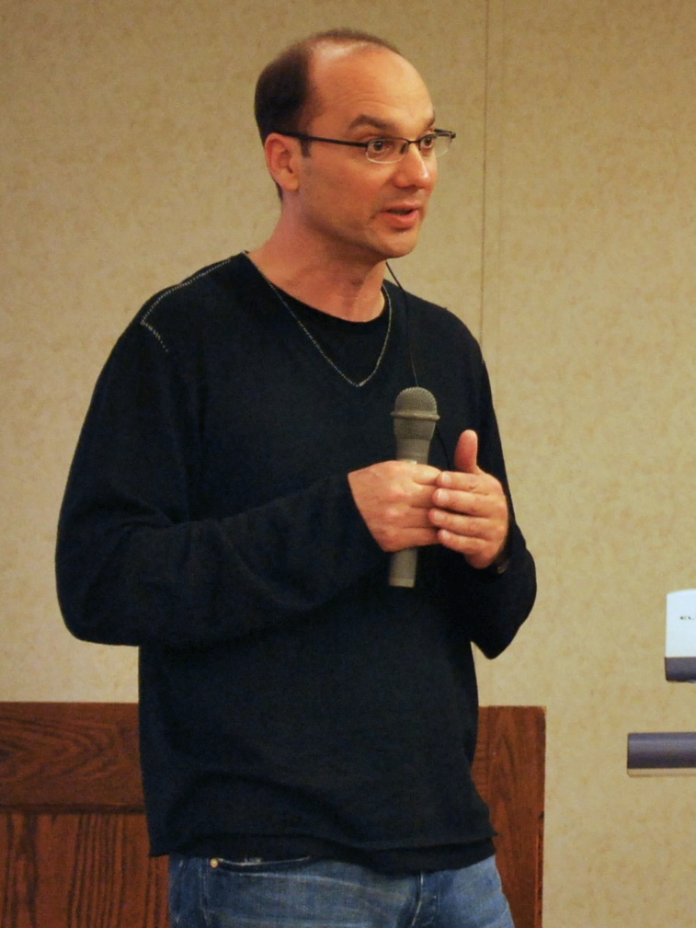
Founder

Slide 3
Startup
Founder (Andy Rubin)
Started in California, United States at October, 2003
Originally intended for camera but shifted to smart phones later because of low market for camera only
In 17th August 2005, Google acquired android Incorporation.
In 2007, Google announces the development of android OS

Slide 4
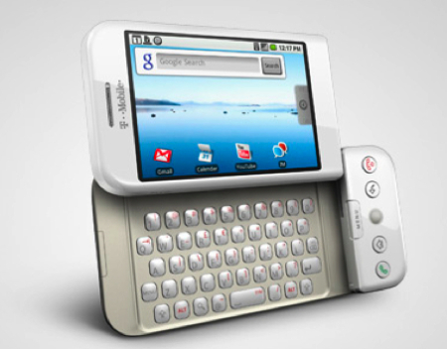
T-Mobile G1
In October 2008, HTC launched the first android mobile (T-Mobile G1)
Android 1.6 (Donut)
Price About 290 EUR

Slide 5
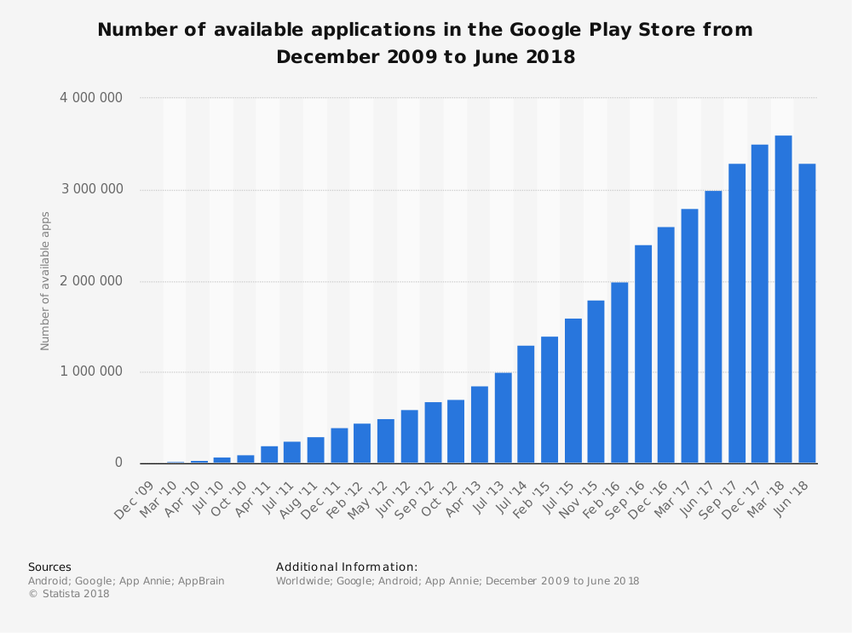

Slide 6
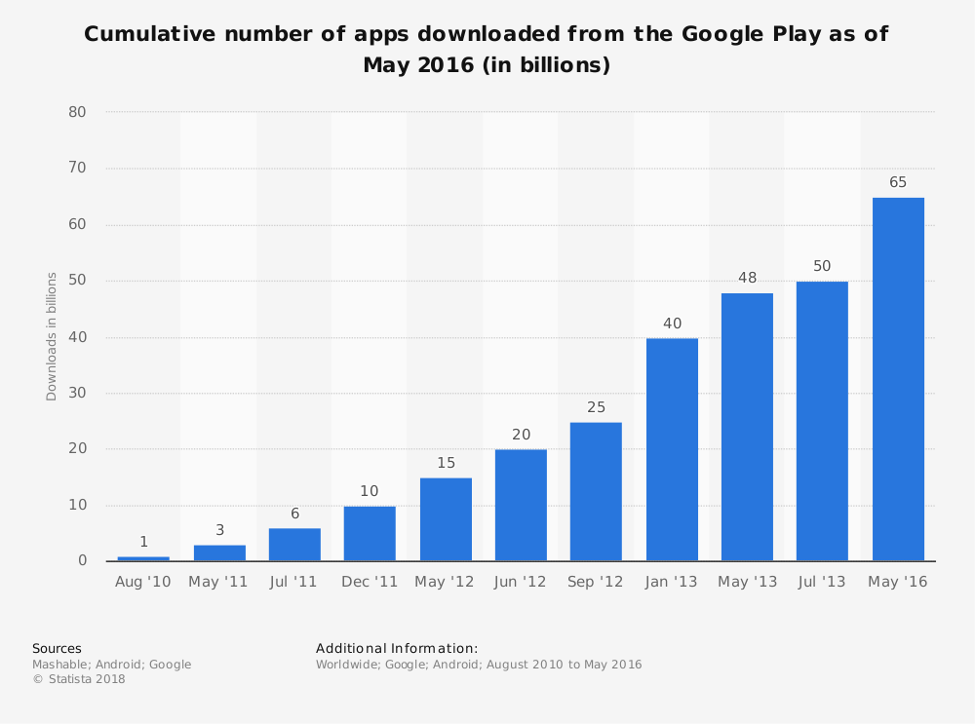

Slide 7
Target
The course consist of 20 lectures (1.5 hour)
Include Basic and intermediate levels
good introduction for junior and senior university projects.

Slide 8
What’s java language
It is intended to let application developers "write once, run anywhere" (WORA)
Portable : Don’t depend on hardware layer
Object oriented language

Slide 9
Android studio IDE
Android studio IDE (Environment Development Equipment's )
Developed by Intellij Company
Powered by google.

Slide 10
Android studio IDE
JDK (Java Development Kit)
SDK (Software Development Kit)
IDE (Integrated Development Environment)

Slide 11
Setup steps
Add JAVA_HOME to environment variables “C:\Program Files\Java\jdk1.8.0_20”
Android Studio IDE portable
SDK portable
Gradle configuration
Open java4android project

Slide 12
Java language
Variables:
Data Types:
Operations:
Relational Operations:
Statements: (if , switch)
Loops: (for , while , do while)
Array and List
Functions:

Slide 13
Variables
Start with letters or ($ , _) and can contain digits.
Represent information
Variable types

Slide 14
Operations
Multiple
Divide
Add
Subtract
Increment
Decrement

Slide 15
Statements
If else statement
Switch case

Slide 16
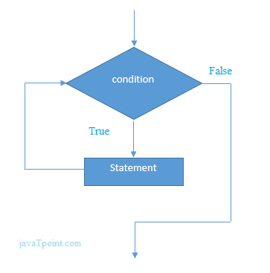
Loops
For loop
While loop
Do while loop

Slide 17
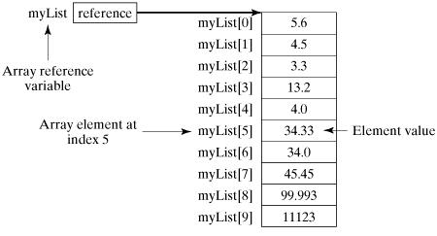
Array

Slide 18
Practice
Write program enter first name and last name then print full name
Write program print maximum number between x and y
Write program print enter student degree then print pass or fail
Write program print 10 stars.
White program print odd number below 10

Slide 19
Tips
Each new version of Android is named after a dessert, going in alphabetical order.

Slide 20
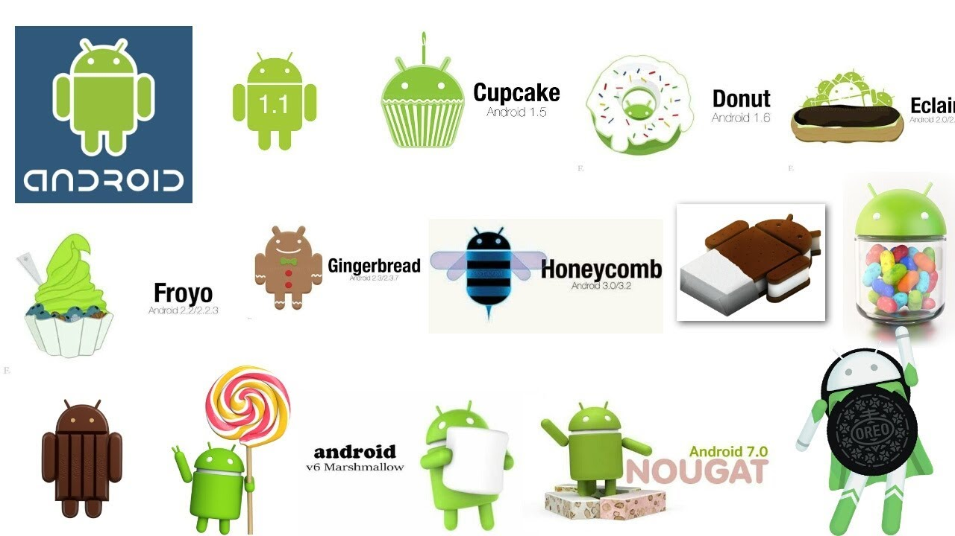

Slide 21

Next version P

Slide 22
Thank you for your attention

