Slide 1

BUSSY
AI-powered Business Manager
Turkiston jamoasi

Slide 2


Muammo
Kichik va o‘rta biznes (KOB) tadbirkorlarida moliyaviy bilim va amaliy ko‘nikmalar yetishmasligi sabab:
Biznes-reja tuzish murakkab
Kredit olish jarayoni tushunarsiz
Soliq va majburiy to‘lovlar bo‘yicha noaniqlik
Bozor haqida yetarli ma’lumot yo‘q
BUSSY · AI-powered Business Manager
02

Slide 3
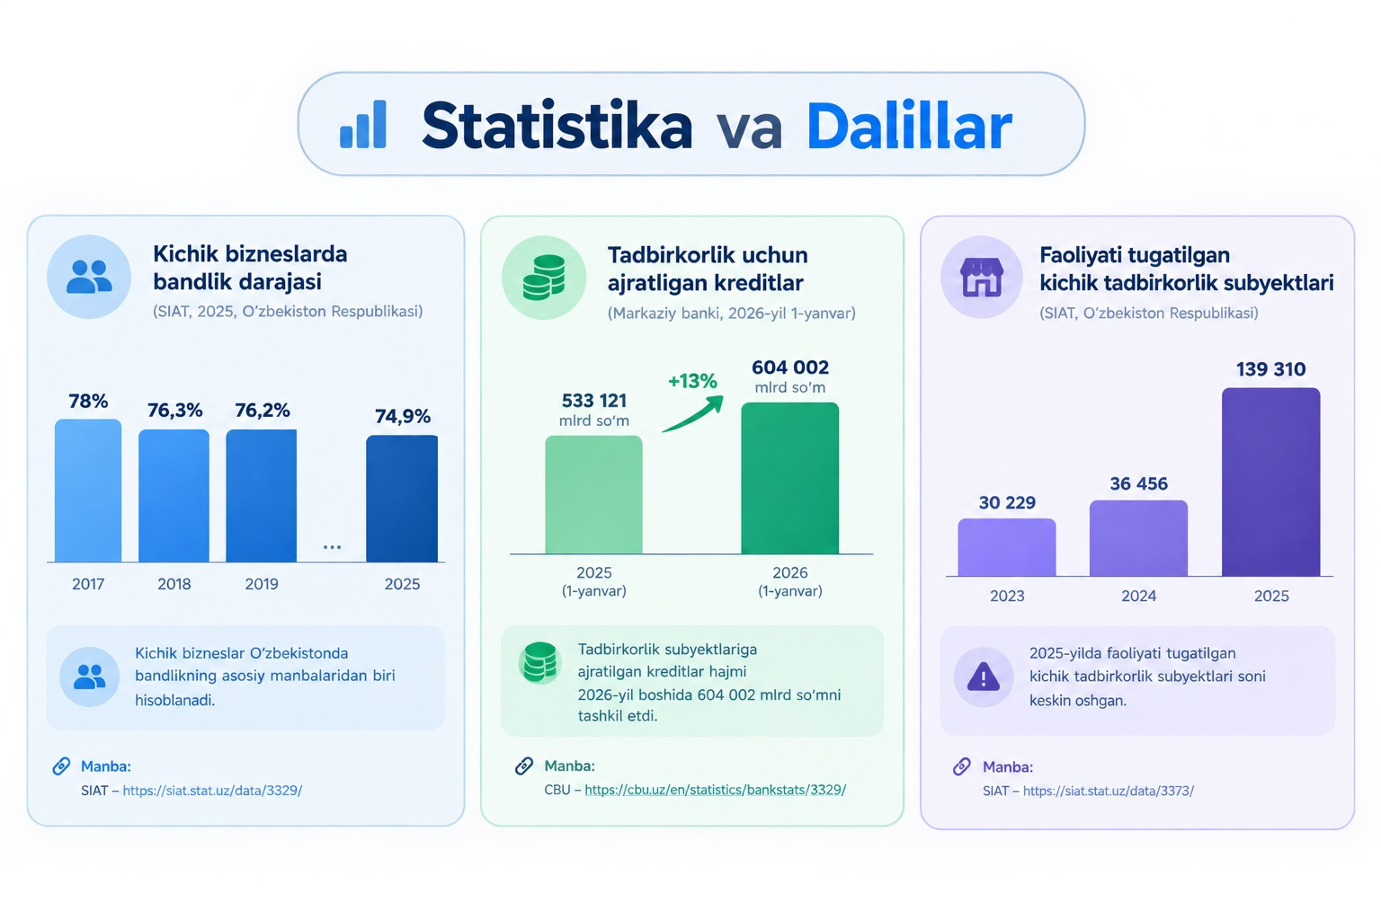
Statistika va dalillar
BUSSY · AI-powered Business Manager
03

Slide 4
Bizning innovative yechim
O‘zbekistonning kichik va o‘rta bizneslari uchun moliyaviy tahlil, soliq, kredit va sug‘urta masalalarini AI yordamida soddalashtirib, biznes uchun to‘g‘ri qarorlar qabul qilishga yordam berish.
BUSSY
AI · Moliya · Soliq · Kredit · Sug‘urta
BUSSY · AI-powered Business Manager
04

Slide 5
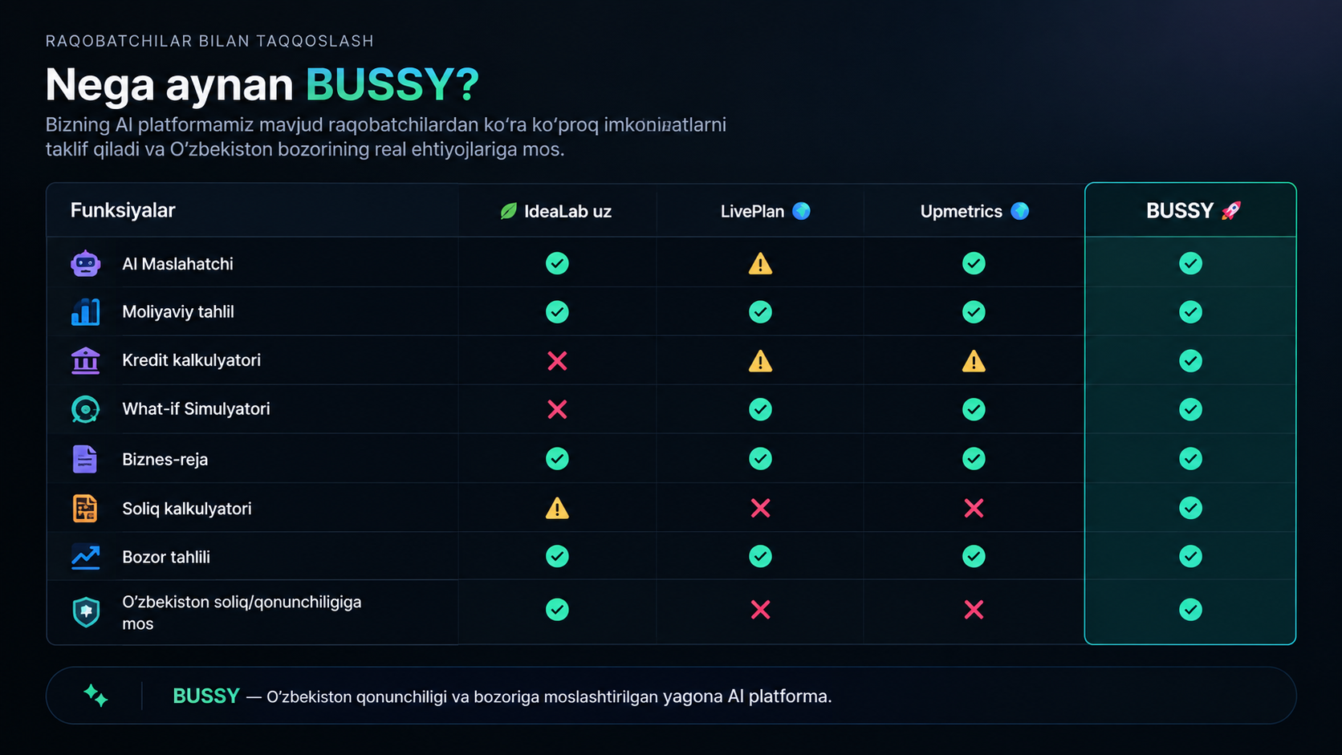
Bizning afzalliklarimiz
Bizning boshqalardan asosiy farqimiz — O‘zbekiston bozori va qonunchiligiga moslashtirilgan AI platforma bo‘lib, biznes ma’lumotlarini tahlil qilib, mahalliy soliq, moliya va bozor sharoitiga mos individual tavsiyalar beradi.
BUSSY · AI-powered Business Manager
05

Slide 6
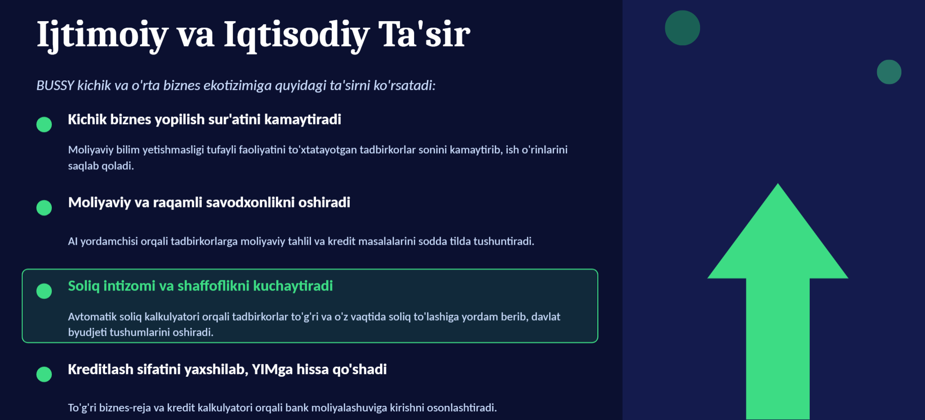
Ijtimoiy va iqtisodiy ta’sir
BUSSY · AI-powered Business Manager
06

Slide 7
Bozor hajmi: TAM · SAM · SOM
TAM
KOB subyektlari: 1.2 M · standart oylik to‘lov $20/oy × 12 = $240/yil
TAM
TAM = 1.2M × $240 ≈ $296,7 mln/yil
SAM
SAM
Yosh tadbirkorlar va biznesmenlar: ~430 000 ta (KOB ~35%)
SAM = 430 000 × $240 ≈ $103,2 mln/yil
SOM
SOM
Dastlabki bozor: ~3 000 ta mijoz
SOM = 3 000 × $240 = $720 000/yil
BUSSY · AI-powered Business Manager
07

Slide 8
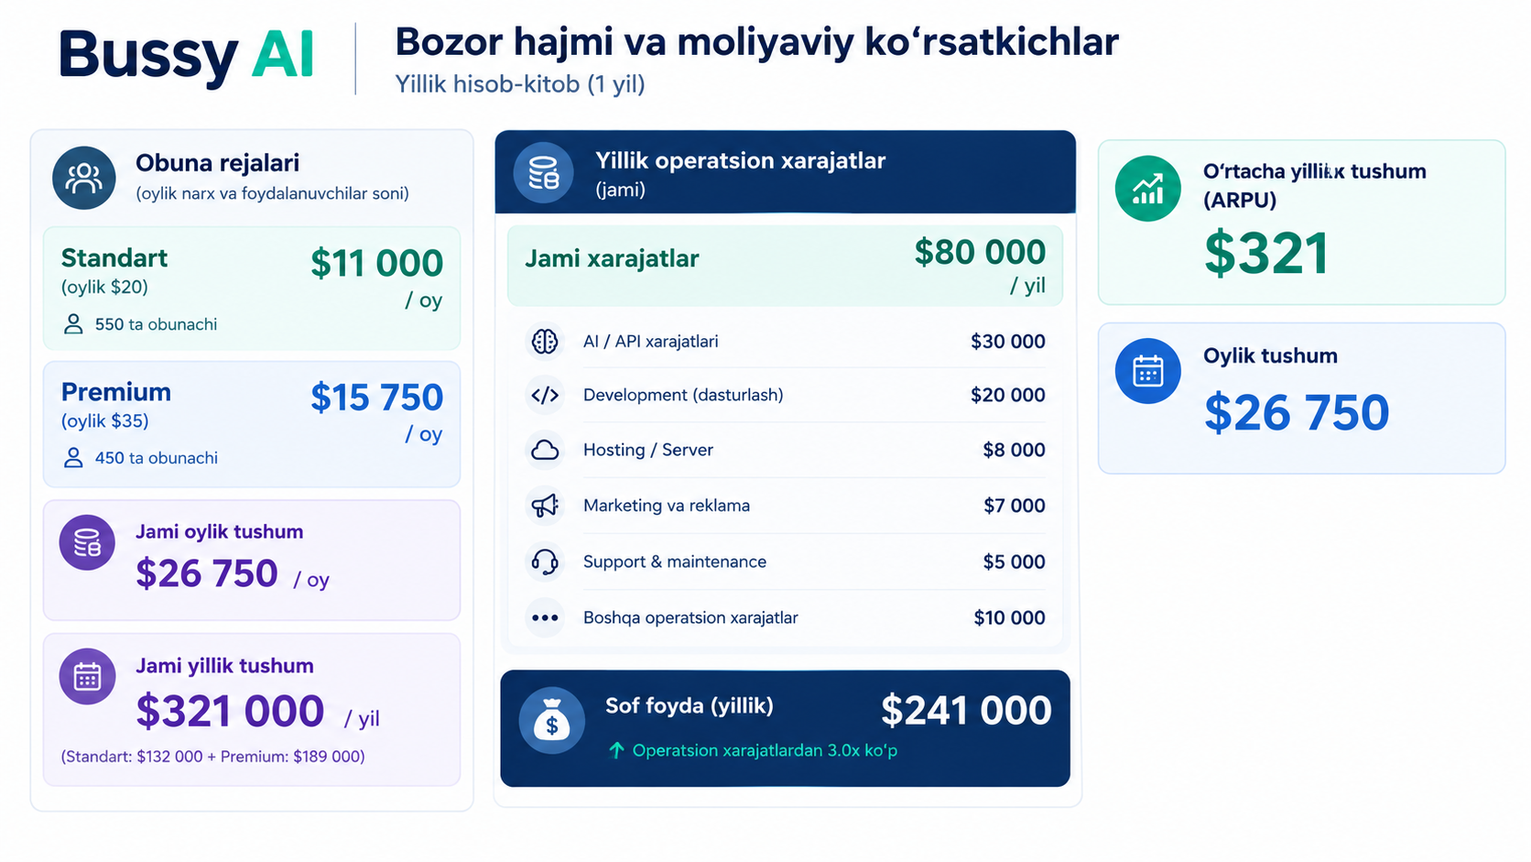
Bozor hajmi va moliyaviy ko‘rsatkichlar
BUSSY · AI-powered Business Manager
08

Slide 9
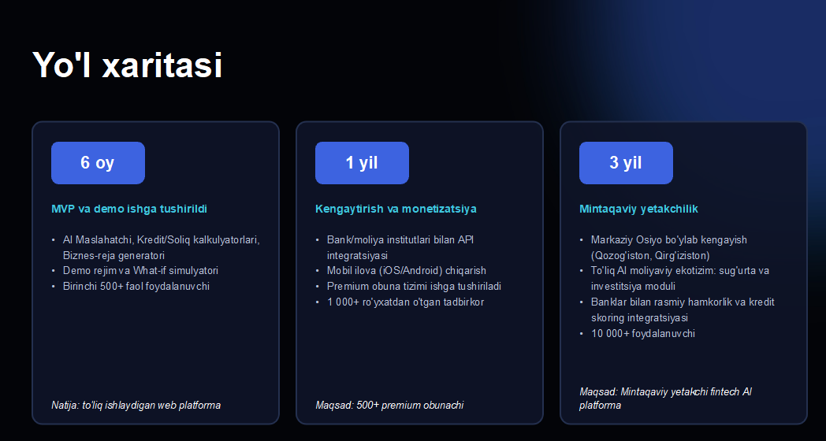
Yo‘l xaritasi
BUSSY · AI-powered Business Manager
09

Slide 10
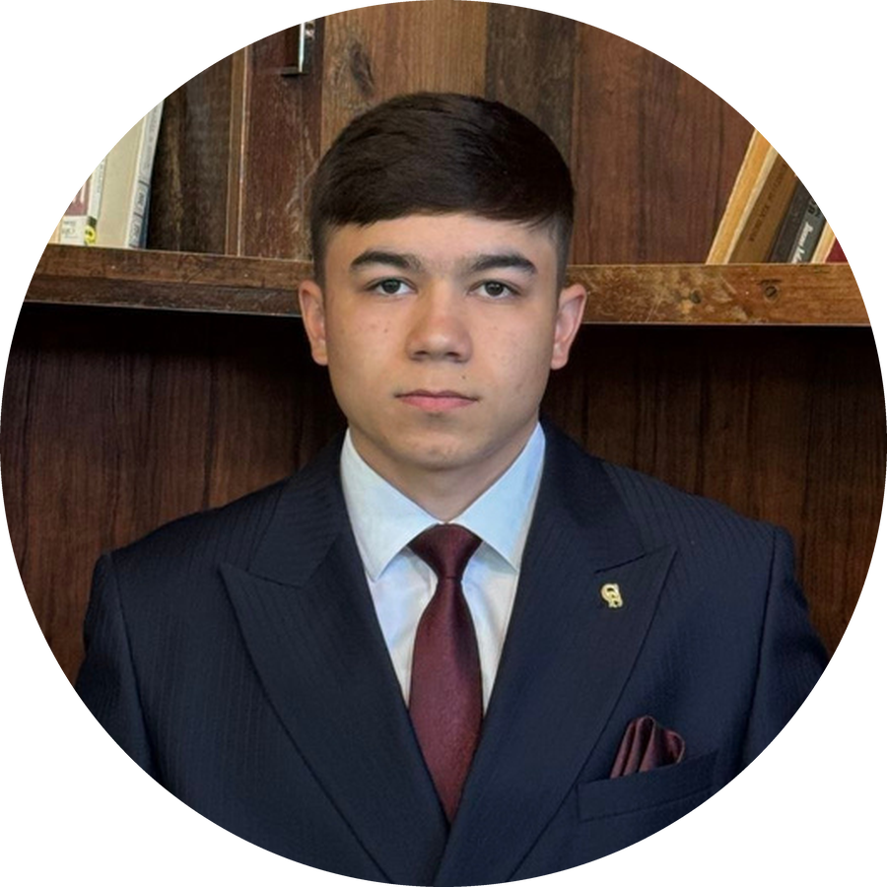


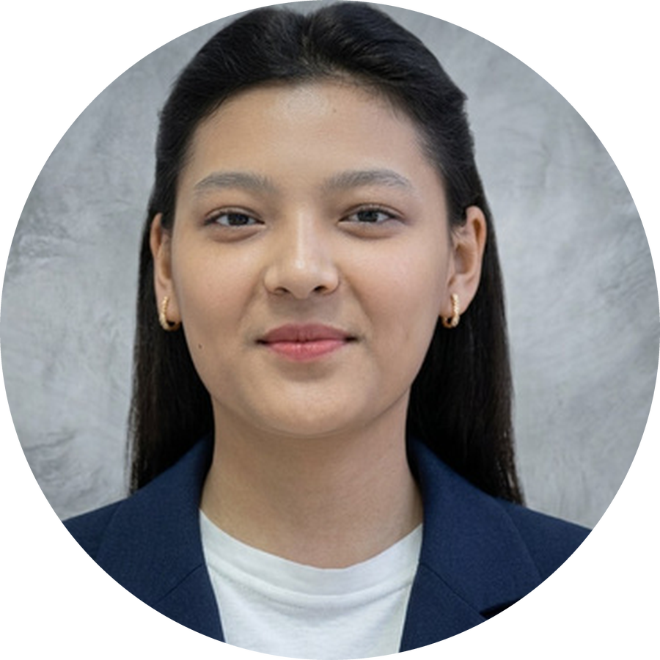
Bizning jamoa
Ollonazarov Adhamjon
Doniyorbek Xasanov
Ergasheva Marjona
Omonboyeva Asaloy
dasturchi, 2 yil
agent engeener
Faunder of Delivro
ML engineer
bussiness va moliya analytik
marketolog
graffik designer
field expert
speaker
BUSSY · AI-powered Business Manager
10

Slide 11

BUSSY bilan qoling!
AI-powered Business Manager · Turkiston jamoasi

