Slide 1

Commerce
Compass
DEPI | DATA ANALYTICS PROJECT
Amazon Sales Analytics | 2020 – 2024
Turning Data into Smarter Business Decisions
100,000
43,233
50
5
5 Years
Orders
Customers
Products
Markets
2020 – 2024

Slide 2





Team Members
THE TEAM
Adham Wael
Alaa Mansour Abdel Halim Alwan
Roqa Ahmed Abdallah
Youssef Hassan
Omar Khaled Abdel Zahir
Team Leader & Power BI Dashboard
DAX Specialist
Data Cleaning Specialist
Data Modeling Specialist
Business Analysis & Documentation
Coordination, Architecture & Layout Design
Measures Formulation, KPIs & Data Validation
Power Query Preprocessing & Quality Audit
Grain Definition, Fact & Star Schema Architecture
Workflow Documentation & Strategic Insights

Slide 3




Project Idea: Commerce Compass
PROJECT IDEA
A Power BI project analyzing 100,000 e-commerce orders (2020 – 2024) to uncover what drives revenue, where value is lost, and how discount decisions affect performance.
Executive Performance
How is the business performing overall?
Revenue Drivers
What drives revenue across categories, products, and price bands?
Value Leakage & Growth
100,000
43,233
50
How can the business mitigate lost / in-progress sales and achieve sustainable growth?
Orders
Customers
Products
Discount Impact & Viability
Do discounts increase sales enough to justify their cost?
5
5 Years
Customer & Market Dynamics
Markets
2020 – 2024
Who are the customers, and where are they located?

Slide 4






Data Pipeline Cleaning
01 · DATA CLEANING
Raw Data
Trim & Clean
Fix Data Types
Product Mapping
Exclude Columns
Orders_Clean
100,000 rows | 20 columns
Remove spaces, standardize text
Date, Fixed Decimal
Merge adds the correct Category; old one removed
Brand, CustomerName, City, State
Cleaned central table
Why Product Mapping? The raw data had 50 products, each repeated across different categories. We merged it with an external Product Mapping file, appended the correct Category, and removed the old one.
Vital calculated columns
01
GrossAmount
02
DiscountAmount
03
NetSales
04
PriceBand
05
Product Mapping

Slide 5



Star Schema: The Central Data Model
02 · DATA MODELING
Why Star Schema was chosen?
Dim_Customer
Superior Performance
Dim_Date
1
Dim_Geography
Faster queries and simpler joins.
*
1
Fact_Orders
(Beating Heart)
1
*
*
Prevent Redundancy
Store customer and product attributes only once.
*
*
1
1
Dim_Product
*
Dim_OrderStatus
Flexibility
1
Smooth flow of filters towards the fact table.
Dim_Payment

Slide 6






Data Anatomy
02 · DATA MODELING
How do we analyze? Dimension Tables
What do we measure? Fact Table
Who are our customers?
KEY COLUMNS
Dim_Customer
When did they buy?
Dim_Date
Quantity
NetSales
Units per order
Revenue after discounts
Where are they located?
Dim_Geography
What do we sell?
Dim_Product
Discount
Tax
How do they pay?
Dim_Payment
Discount amounts
Taxes charged

Slide 7

DAX and Measures
03 · DAX & MEASURES
Basic Paths
SUM(Fact_Orders[NetSales])
Total Net Sales
1
Advanced Indicators
Growth and Cancellation Calculations
Sales Growth %
Cancel Rate
Repeat Customers
2
↑ 1.15%
↓ 0.87%
30K
Dynamic Intelligence
Automatically update titles based on filter
Commerce Compass | 2023 | Canada | Electronics
3

Slide 8
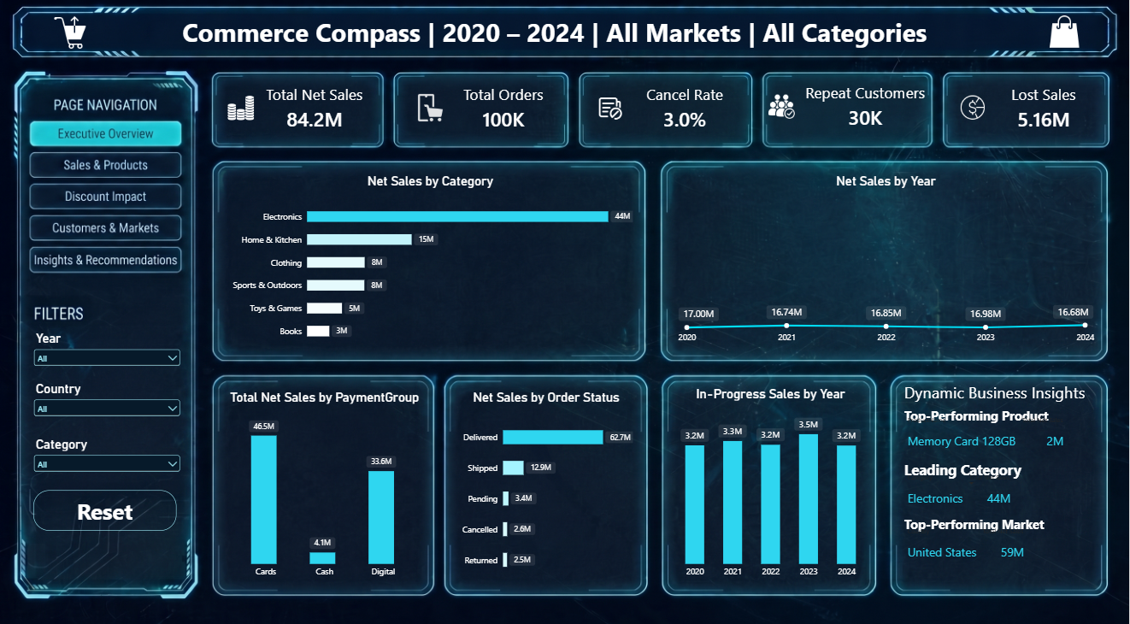
Dashboard: Executive Overview
04 · DASHBOARD · PAGE 1
$1.77M
Top product: Memory Card 128GB
$44M
Electronics — the leading category
$59M
United States — the top market
Page 1 of 5 | Interactive filters: Year · Country · Category · Reset

Slide 9

Overall Executive Performance
04 · DASHBOARD · PAGE 1
$84.2M
100,000
3.0%
$5.16M
Total Sales
Total Orders
Cancellation Rate
Financial Leakage (Losses)
Annual revenue stability, 2020 – 2024 (net sales, $M)
Revenue is stable at an average of $17 million annually. There is no significant growth, which calls for new growth drivers.

Slide 10
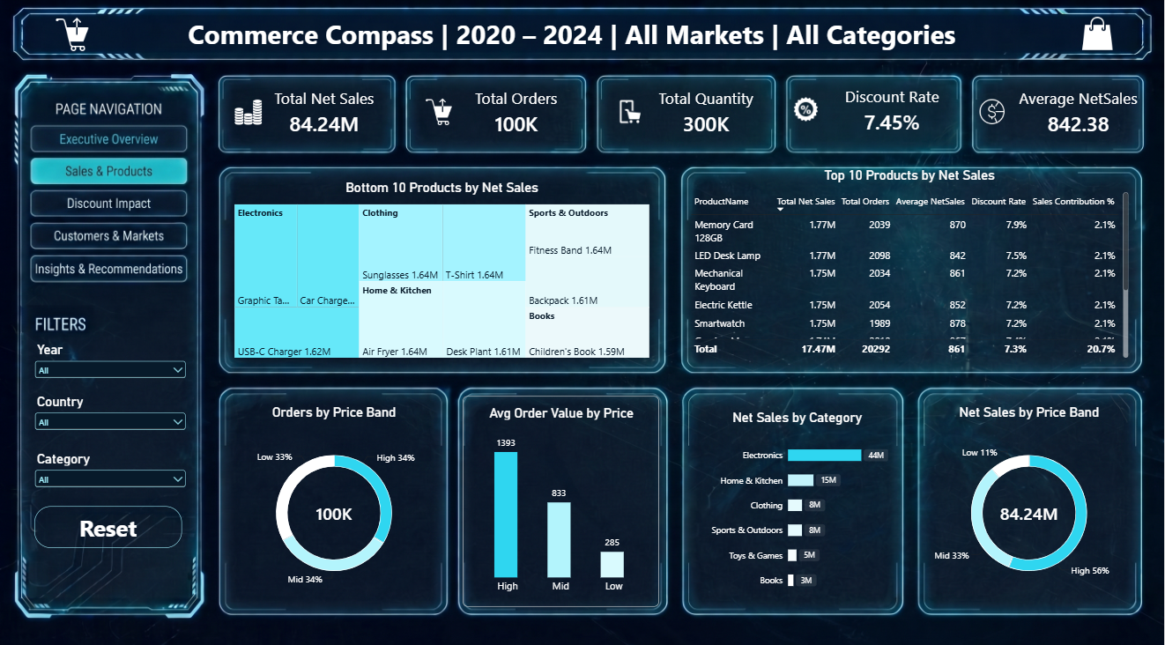
Dashboard: Sales & Products
04 · DASHBOARD · PAGE 2
55.7%
of net sales come from the High price band
$1,393
High-band average order value (Low band: $285)
7.45%
overall discount rate across 300K units sold
Page 2 of 5 | Interactive filters: Year · Country · Category · Reset

Slide 11
Product & Price Band Analysis
04 · DASHBOARD · PAGE 2
Product Sales Distribution
High Price Band Dominance
Top 5 vs. selected bottom-10 products, net sales ($M)
Net sales share
High 56%
Mid 33%
55.7%
High band
Low 11%
Average order value
High $1,393
Low $285
No “hero product” exists: the top and bottom products are very close in sales.
About a third of orders, yet 55.7% of total revenue.

Slide 12
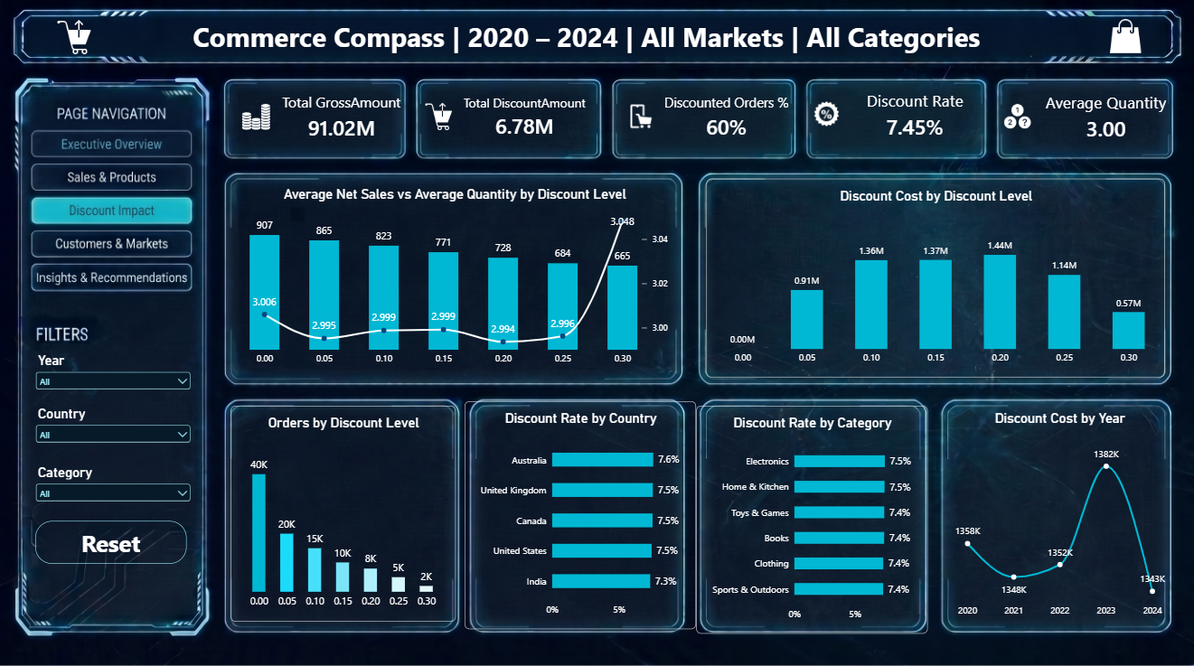
Dashboard: Discount Impact
04 · DASHBOARD · PAGE 3
$6.78M
total discount amount on $91.02M gross sales
60%
of orders carry a discount
3.00
average quantity — flat across discount levels
Page 3 of 5 | Interactive filters: Year · Country · Category · Reset

Slide 13
The Discount Paradox
04 · DASHBOARD · PAGE 3
Average order value by discount level ($)
Cost of Discounts
$6.78M
Represents 7.45% of total sales, without any real increase in the quantities sold.
60% of orders discounted
Average units per order stay at ≈ 3.0 at every discount level.
$907 → $665 AOV

Slide 14
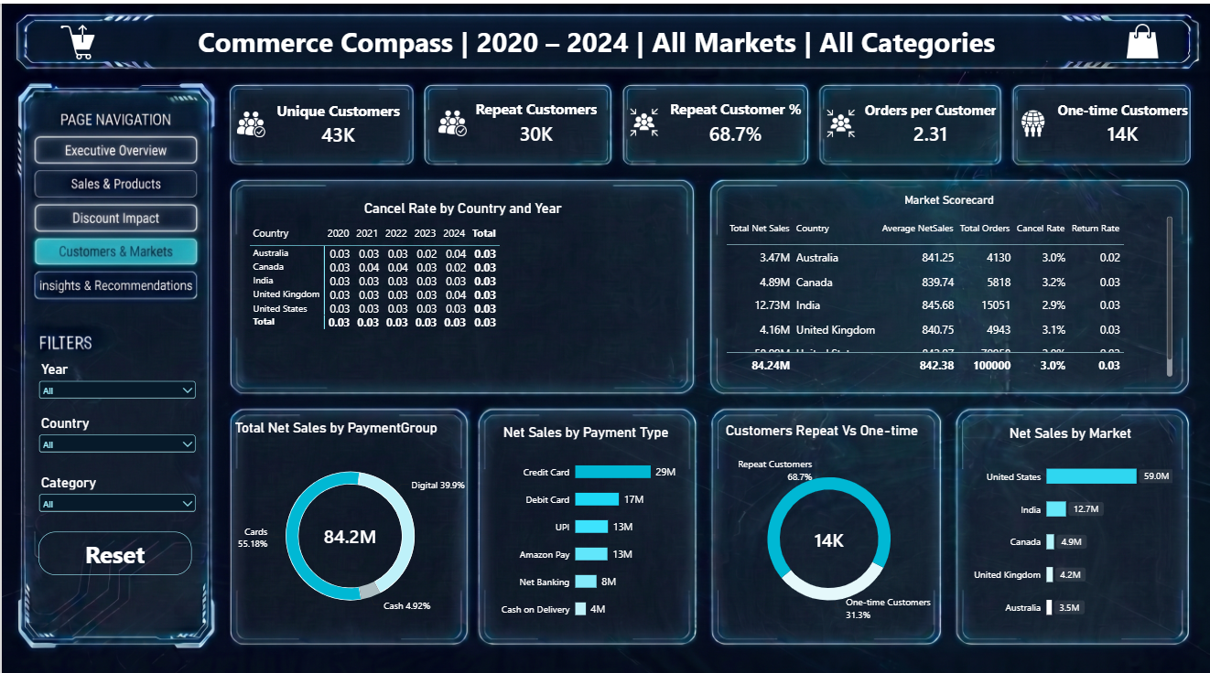
Dashboard: Customers & Markets
04 · DASHBOARD · PAGE 4
68.7%
repeat customer rate: 30K repeat vs. 14K one-time customers
2.31
orders per customer, across 43K unique customers
$59.0M
United States — top market (India: $12.7M)
Page 4 of 5 | Interactive filters: Year · Country · Category · Reset

Slide 15
Customers and Geographical Dominance
04 · DASHBOARD · PAGE 4
Geographical Wealth Concentration
Customer Loyalty Power
70%
68.7%
of total sales come from the US market
of customers are repeat customers
US
68.7%
86.4%
$59M out of $84.2M
of total revenue generated by them

Slide 16
Business Questions Answered
05 · BUSINESS QUESTIONS
Executive Performance
Executive Overview: sales, orders and cancel rate at a glance, plus the 2020 – 2024 revenue trend.
How is the business performing overall?
PAGE 1
Revenue Drivers
Sales & Products: category leaders, product distribution and net sales share by price band.
What drives revenue across categories, products, and price bands?
PAGE 2
Value Leakage & Growth
Lost and in-progress sales on Executive Overview; cancel rate by market on Customers & Markets.
How can the business mitigate lost sales and achieve growth?
PAGE 1+4
Discount Impact & Viability
Discount Impact: discount cost, order value and quantity at every discount level.
Do discounts increase sales enough to justify their cost?
PAGE 3
Customer & Market Dynamics
Customers & Markets: repeat vs. one-time customers, market scorecard and net sales by market.
Who are the customers, and where are they located?
PAGE 4

Slide 17

Strategic Insights and Recommendations
06 · INSIGHTS & RECOMMENDATIONS
EVIDENCE
DECISION
Systematic cancellations (3% in all markets)
Address imbalance at the comprehensive operations level, not individual channels.
Discounts reduce value and do not increase quantity
Set a maximum cap for discounts (Cap) and test it on a small segment.
Revenue stability, with 70% concentration in one market
Geographic diversification and search for new growth drivers outside America.
Repeat customers and luxury products drive profits
Direct marketing to loyalty programs and focus on high-price segments.

Slide 18
Thank
You
DEPI | DATA ANALYTICS PROJECT
Commerce Compass | Questions?
Turning Data into Smarter Business Decisions

