Slide 1
Coexistence of LTE and Wi-Fi for Next Generation
Wireless Communication
MEMBERS:
Sree Hari M Nair – 16BEC0157
Anuvind Ashok – 16BEC0790
Adheik Dominic – 16BEC0620
PROJECT GUIDE:
Kishore V Krishnan, Associate Professor, ECE

Slide 2
INTRODUCTION
The cellular traffic demand has increased significantly in recent years.
Emerging technologies like Internet of Things (IOT) will add further stress to the communication infrastructure.
Spectrum used for these technologies are scarce.
Solution
Utilizing Unlicensed band reserved for scientific and medical (ISM bands) purposes at 5GHZ
Coexisting of LTE Unlicensed (LTE-U) spectrum to share LTE and Wi-Fi

Slide 3
CURRENT STATUS AND MOTIVATION
Efficiently assigning channel between LTE and Wi-Fi devices is a key challenge
LTE-Wi-Fi coexisting strategies
Duty Cycle
Listen Before Talk (LBT)
These approaches assumes that Wi-Fi has undisturbed channel access.
But, there is practical impacts on the coexistence
Coexistence impact Wi-Fi (degradation) whereas no impact on LTE.

Slide 4
LITERATURE REVIEW
CATEGORY | AUTHOR | APPROACH
DUTY CYCLE | E. Almeida A.M Cavalcante | Enabling LTE/WiFi coexistence by LTE blank subframe allocation
 | Hongyu Sun Zhiyi Fang | Enabling LTE and WiFi coesxistence in 5GHz using LASI
LBT | T. Tao F. Han | Enhanced LBT algorithm for LTE-LAA in unlicensed band

Slide 5
OBJECTIVE
Seamless coexistence of Wi-Fi and LTE in the LTE Unlicensed (LTE-U) band
Self configuration of Wi-Fi nodes into Wi-Fi direct groups acting as forwarding relay
Packet success rate is considered as the selection metric.
To develop an optimization algorithm for the formation of Wi-Fi direct groups.
Hungarian Algorithm
To find the optimum PSR threshold value.
To Evaluate the system.

Slide 6
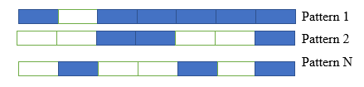
Almost blank subframes
ABS carry neither control nor data.
Primarily aimed for the interference management.
Allows Wi-Fi to gain access to channel for a short time-frequency window
The figure represents various ABS patterns
The blue colored window represents transmission by LTE
White window represents the ABS windows.

Slide 7
METHODOLOGY
The usage of Almost Blank Subframes (ABS)
Even the ABS is not interference free.
Pilots signals impacts the Wi-Fi Signal
We send the Wi-Fi signals through the ABS by grouping them based on the observed Packer Success Ratio (PSR)
These groups are formed using via Wi-Fi Direct which emulates the Wi-Fi AP
We categorize the nodes into different zones.
The categorized nodes are then grouped together to form a Wi-Fi direct group.
Using Hungarian Algorithm
A Group owner (relaying node) is selected for each group, which then forwards the traffic to the AP.

Slide 8
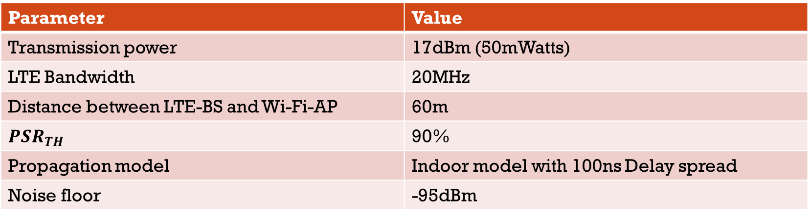
Simulation parameters
Parameter | Value
Transmission power | 17dBm (50mWatts)
LTE Bandwidth | 20MHz
Distance between LTE-BS and Wi-Fi-AP | 60m
$$PSR_{TH}$$ | 90%
Propagation model | Indoor model with 100ns Delay spread
Noise floor | -95dBm

Slide 9
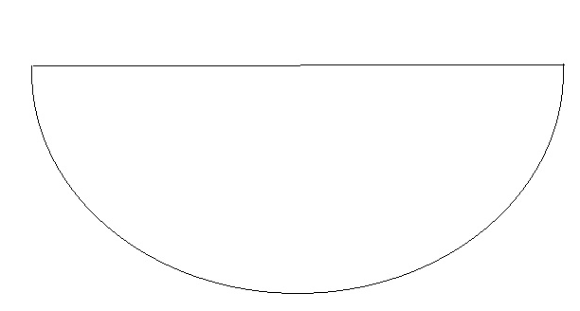


SYSTEM MODEL
BS
AP
The black stars, m_{i} (i=1,2,..) represents the nodes in the safe zone
The white stars, n_{i} (i=1,2,..) represents the nodes in the non-safe zone
The red star represents the relaying node (i.e Group Owner)
n₁
m₁
m₂
n₂
m₄
m₃
n₃

Slide 10
categorization of nodes and grouping of nodes
An initial PSR threshold is decided for node categorization into Safe zone and Non-Safe zone.
We assume initial PSR threshold to be 90%
If a node has its PSR greater than the threshold then it is in the Safe zone. Else, it is in the Non-safe zone.
Each node in Safe zone is a potential relay.
We group nodes in Non-Safe node to relays to maximize the PSR.
Grouping is done by using Hungarian Algorithm.
The Hungarian Algorithm assigns a non-safe zone node to a single relay to maximize the PSR of the network.

Slide 11
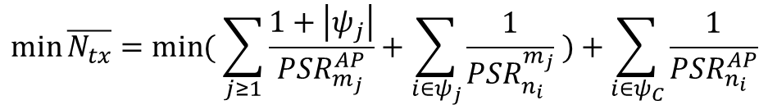
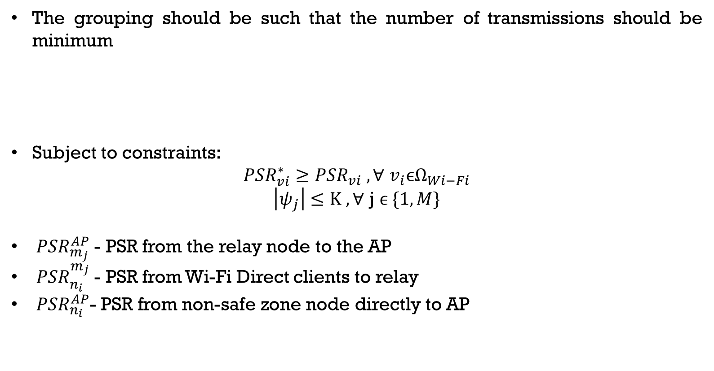
problem definition
The grouping should be such that the number of transmissions should be minimum
Subject to constraints:
$${PSR}_{vi}^{∗}≥{PSR}_{vi} ,\text{∀} v_{i}\text{ϵ}{\text{Ω}}_{Wi−Fi}$$
$$\left|ψ_{j}\right|≤K ,\text{∀} \text{j} ϵ \{1,M\}$$
${PSR}_{m_{j}}^{AP}$ - PSR from the relay node to the AP
${PSR}_{n_{i}}^{m_{j}}$ - PSR from Wi-Fi Direct clients to relay
${PSR}_{n_{i}}^{AP}$- PSR from non-safe zone node directly to AP
$$\min{\overline{N_{tx}}=\min{( \sum_{j≥1}{\frac{1+\left|ψ_{j}\right|}{PSR_{m_{j}}^{AP}}}+\sum_{i∈ψ_{j}}{\frac{1}{{PSR}_{n_{i}}^{m_{j}}} )+\sum_{i∈ψ_{C}}{\frac{1}{PSR_{n_{i}}^{AP}}}}}}$$

Slide 12
HUNGARIAN ALGORITHM:
The Hungarian method is a optimization algorithm that solves the assignment problem
AIM
Nodes connect to only 1 relay
Distribute nodes uniformly to maximize the PSR
It finds the optimal matching to return the maximum PSR for the entire network.

Slide 13
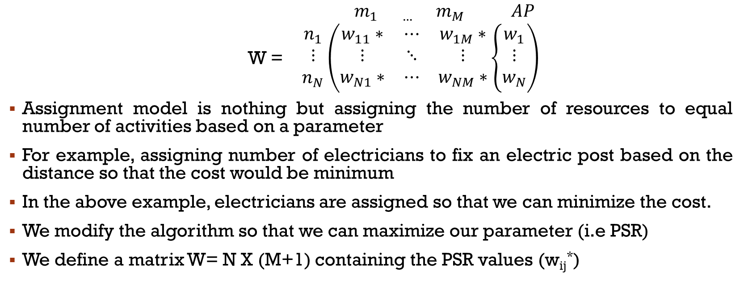
Hungarian ALGORITHM working:
$m_{1 …}$ $m_{M}$ $AP$
W = $\begin{matrix}n_{1} \\ ⋮ \\ n_{N}\end{matrix}\left(\begin{matrix}w_{11}∗ & ⋯ & w_{1M}∗ \\ ⋮ & ⋱ & ⋮ \\ w_{N1}∗ & ⋯ & w_{NM}∗\end{matrix}\left\{\begin{aligned}w_{1} \\ ⋮ \\ w_{N}\end{aligned}\right.\right)$
Assignment model is nothing but assigning the number of resources to equal number of activities based on a parameter
For example, assigning number of electricians to fix an electric post based on the distance so that the cost would be minimum
In the above example, electricians are assigned so that we can minimize the cost.
We modify the algorithm so that we can maximize our parameter (i.e PSR)
We define a matrix W= N X (M+1) containing the PSR values (w_{ij}*)

Slide 14
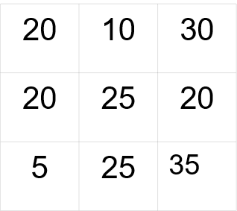
EXAMPLE:
The given matrix has 3 rows and 3 columns.
That means 3 non-safe zone nodes and 3 relays.
The content of the matrix denote the connectivity between them.
Out goal is to group a safe-zone node with a relay based on the connectivity to yield maximum average PSR

Slide 15

EXAMPLE:
Step 1-Row Reduction
Subtract the row maximum from each row.
Here the row maximum are 30,25 and 35
The new matrix will look like this.

Slide 16

EXAMPLE:
Step 2-Column Reduction
Subtract the column maximum from each column.
Here the column maximum are -5,0 and 0
The new matrix will look like this.

Slide 17
EXAMPLE:
Step 3-Test for an optimal assignment
Draw straight lines on matrix to cover all 0s.
If number of lines is less than number of rows and columns then we need to go to step 4
Here the number of lines are less than number of rows and columns.
We must go to step 4. otherwise we can jump to step 5.

Slide 18
EXAMPLE:
Step 4-Shift zeros
Find maximum of the uncovered values.
Here it is -5
Subtract that value from all uncovered values and add to values that are intersected by the lines.
-5 | -20 | 0
0 | 0 | -5
-25 | -10 | 0
0 | -15 | 0
0 | 0 | -5
-20 | -5 | 0
0 | -15 | 0
0 | 0 | -10
-20 | -5 | 0
Subtracting
Adding

Slide 19
EXAMPLE:
Step 5-Making final assignment
After step 4 do step 3 again to get the adjacent matrix.
Now we have 3 lines. Equal to number of rows and columns.
Mark any zero with stars. Only one star for one row.
0 | -15 | 0
0 | 0 | -10
-20 | -5 | 0
0 | -15 | 0
0 | 0 | -10
-20 | -5 | 0
0 | -15 | 0*
0 | 0* | -10
-20 | -5 | 0*

Slide 20
EXAMPLE:
Looking at this matrix the following assignment can be made
Non-safe node 1 with relay 3
Non-safe node 2 with relay 2
Non-safe node 3 with relay 3
0 | -15 | 0*
0 | 0* | -10
-20 | -5 | 0*

Slide 21
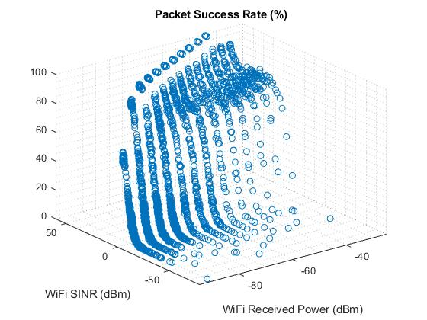
RESULTs
Wi-Fi degradation on abs
The nodes with high power and high SINR value has a higher Packer Success Rate (>PSR_{Th})
The nodes with low power and SINR value does not have the required PSR to transmit.
This shows that there is a degradation of WiFi signals.

Slide 22
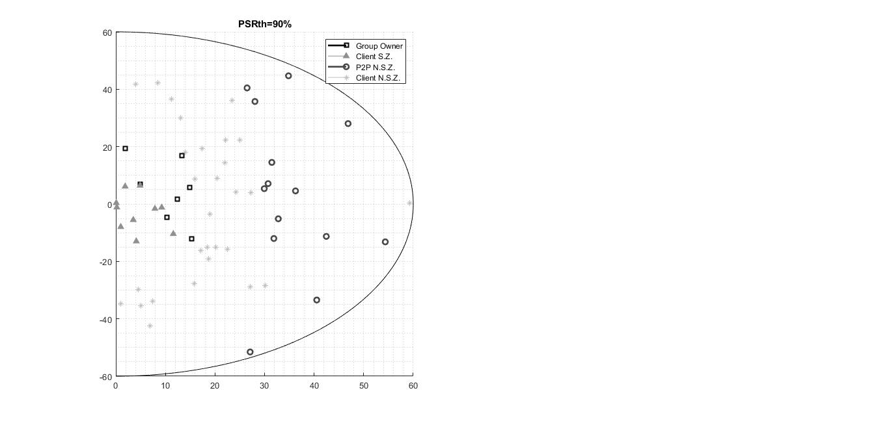
Node categorization
Nodes are categorized into different zones under the threshold PSR value, PSR_{Th} =90%
Triangles and squares represent the nodes in the safe zone
The square represent the Group Owners
Stars and circles represent the nodes in the non-safe zone nodes
The circle represents the Wi-Fi Direct Clients

Slide 23
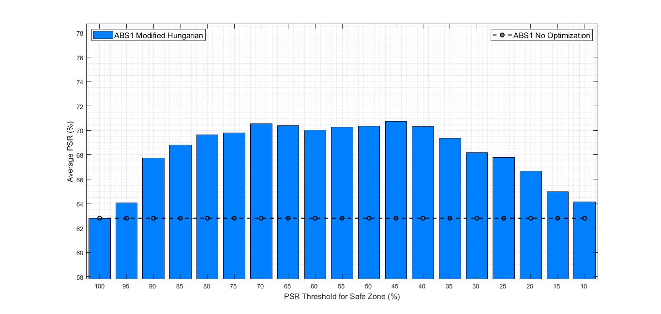
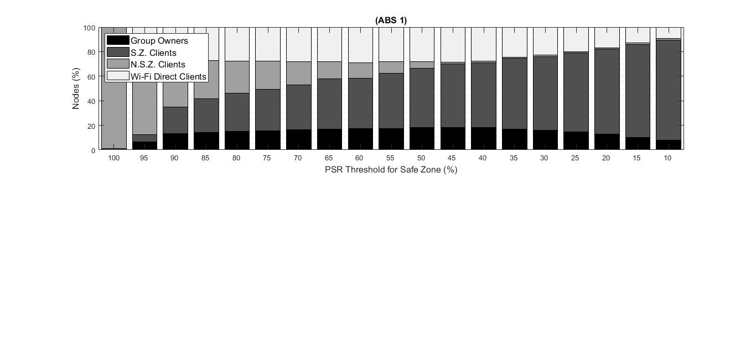
OPTIMIZED VS NON-OPTIMIZED
Non-optimized system Average PSR is obtained at 100% PSR threshold
Average PSR at PSR_{Th} = 100% is less than that for all other PSR_{Th} values
Average PSR of optimized system is better than the non-optimized
Hence, proposed system is better

Slide 24
OPTIMAL PSR THRESHOLD SELECTION
1st Figure – Average PSR for different PSR_{Th}
The graph helps us in selecting the optimal threshold PST value.
Optimum range – Maximum Average PSR
Maximum Average PSR is obtained within the range of 45-70%
2nd Figure - Node distribution
Enough nodes as group owner and Wi-Fi direct client for 45-70% threshold
Almost no nodes in safe zone for 100% PSR – non-optimized system

Slide 25
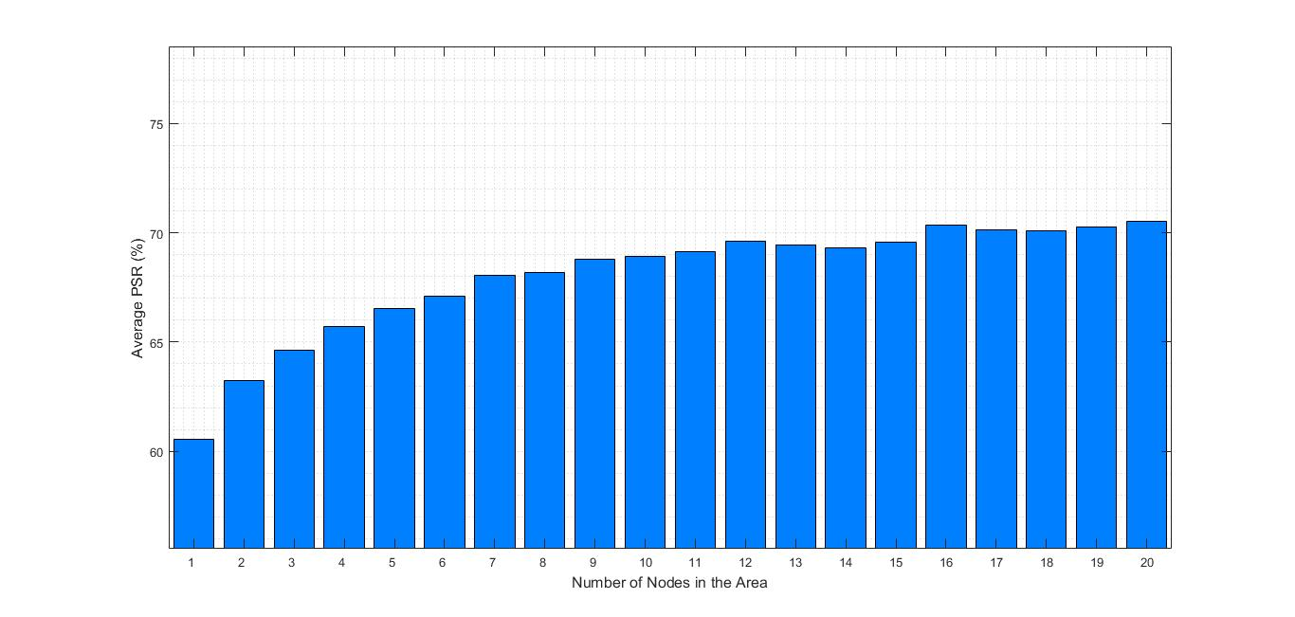
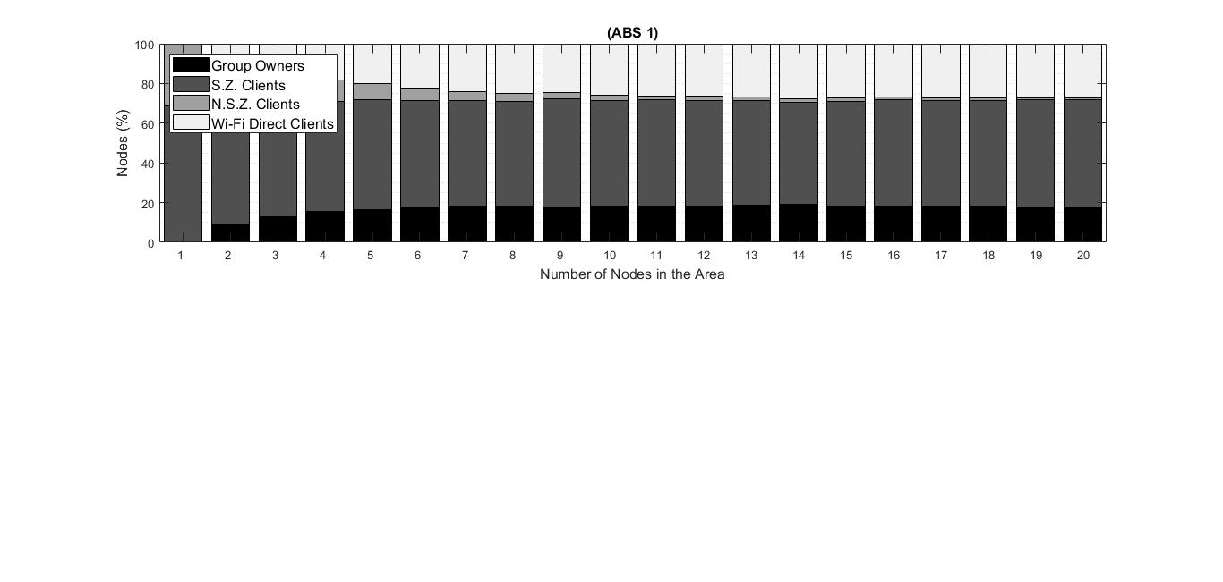
impact of number of nodes on average psr
System depends on the nodes that can perceive high PSR
1st Figure
increase in Average PSR.
2nd Figure
Increase in number of nodes that can become relays
Increase in number of nodes that can become Wi-Fi direct groups.
More one-hop connections
Better Average PSR

Slide 26
SUMMARY
Proposed a system that allows Wi-Fi devices to survive uncoordinated LTE transmission.
Wi-Fi can intelligently adapt to handle high Packet Error Rates and lack of channel opportunities through the use of ABS
Showed that Wi-Fi signals are degraded due to interferences in the ABS
Nodes were successfully categorized in order to find the possible relays and Wi-Fi Direct Clients
Proposed Hungarian Algorithm in order to group the non-safe zone nodes to relays
Evaluated the system for the optimum value of PSR threshold.
Evaluated the system to find the effects of number of nodes on Average PSR.

Slide 27
REFERENCE
Hongyu Sun, Zhiyi Fang, Qun Liu, Zheng Lu, and Ting Zhu. 2017. Enabling LTE and WiFi Coexisting in 5 GHz for Efficient Spectrum Utilization. J. Comput. Netw. Commun. 2017 (February 2017)
A. M. Cavalcante, E. Almeida, R. D. Vieira, S. Choudhury, E. Tuomaala, K. Doppler, F. Chaves, R. C. Paiva, and F. Abinader, “Performance evaluation of LTE and Wi-Fi coexistence in unlicensed bands,”
Yi Cao (2020). Munkres Assignment Algorithm, MATLAB Central File Exchange. Retrieved Feb 02, 2020.
Zhang H, Chu X, Guo W, Wang S (2015) Coexistence of WiFi and heterogeneous small cell networks sharing unlicensed spectrum. IEEE Commun Mag
S S. Chatterjee, M. J. Abdel-Rahman and A. B. MacKenzie, "Optimal distributed allocation of almost blank subframes for LTE/WiFi coexistence," 2017 15th International Symposium on Modeling and Optimization in Mobile, Ad Hoc, and Wireless Networks (WiOpt), Paris, 2017
J. Xiao and J. Zheng, "An adaptive channel access mechanism for LTE-U and WiFi coexistence in an unlicensed spectrum", Proceedings of the IEEE ICC Conference, pp. 1-6, 2016.
Abinader Junior, Fuad & Almeida, Erika & Chaves, Fabiano & Cavalcante, André & Vieira, Robson & Paiva, Rafael & Muniz Sobrinho, Angilberto & Choudhury, Sayantan & Tuomaala, Esa & Doppler, K. & Jr, Vicente. (2014). Enabling the Coexistence of LTE and Wi-Fi in Unlicensed Bands. IEEE Communications Magazine
Aliasghar Keyhanian, Aris Leivadeas, Ioannis Lambadaris, and Ioannis Marmokos. 2018. Analyzing the Coexistence of Wi-Fi and LAA-LTE Towards a Proportional Throughput Fairness. In Proceedings of the 16th ACM International Symposium on Mobility Management and Wireless Access (MobiWac’18).

