Slide 1

Optional semester project – Motion estimation
Dherse Alexandre

Slide 2
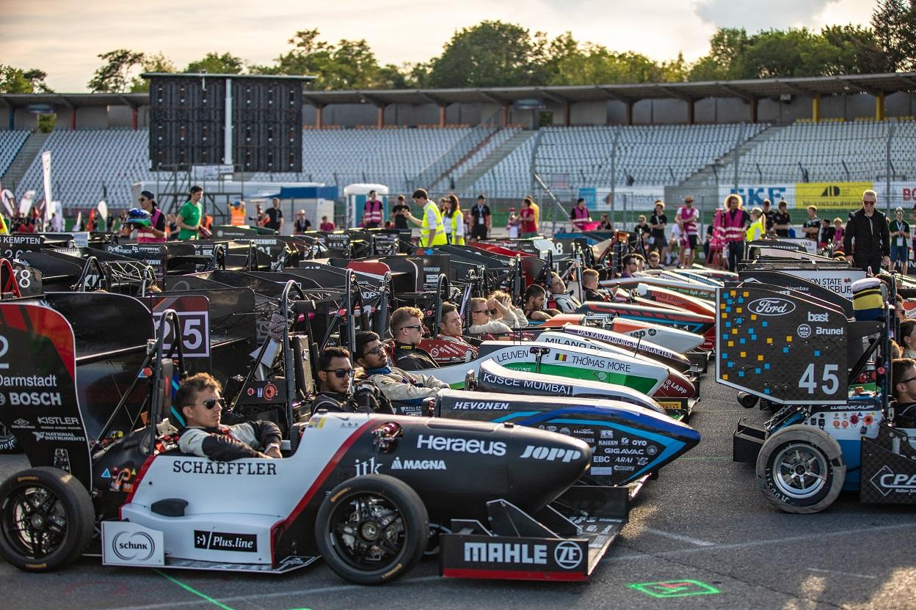
Formula Student
Worldwide race car championship between universities
10 competitions
Multiple driverless events
Our focus : straight line acceleration, skidpad and trackdrive

Slide 3
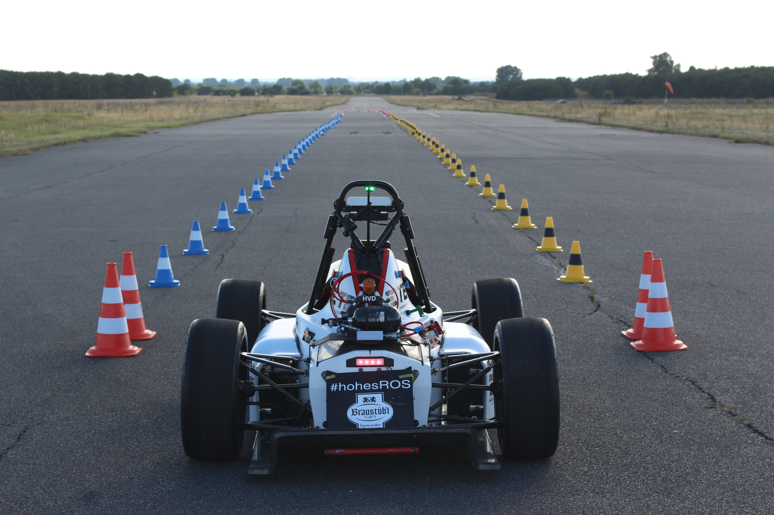
Types of events
Straight line acceleration / skidpad :
  Circuit is known
Trackdrive :
  Circuit is not known in advance
  First lap is recongnition lap

Slide 4
Goals of project
Using the sensors on the car, compute a reliable and accurate estimate of its state.
Position, speed, acceleration, heading and yaw rate of the car.
Useful for other modules :
  SLAM algorithm
  Motion control

Slide 5
Inputs and motivation
Using sensors already on racecar :
  Inertial Navigation System containing accelerometers, gyroscopes and a GNSS receiver
  Wheel Speed Sensors on front wheels
Issues :
  INS can suffer from accumulated errors
  Wheel sensors inaccurate at low speeds, can lock up when driving at the limit
  Need to have coherent output in case of sensor failure

Slide 6
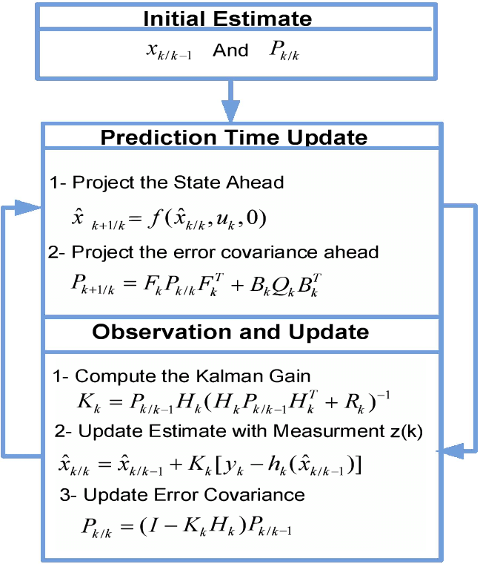
Proposed method : Extended Kalman Filter
2 states : predict and correct
Recursive, fast (<2ms on my pc)
Can be updated asynchronously
Will be computed on the sbRIO’s cpu, already on the car

Slide 7
Proposed method
Kinematic model : not taking into account the dynamics of racecar
  CTRA model (constant turn rate and acceleration)
Need to deal with outliers from sensor failure
  For now, simple check if value is feasible.

Slide 8
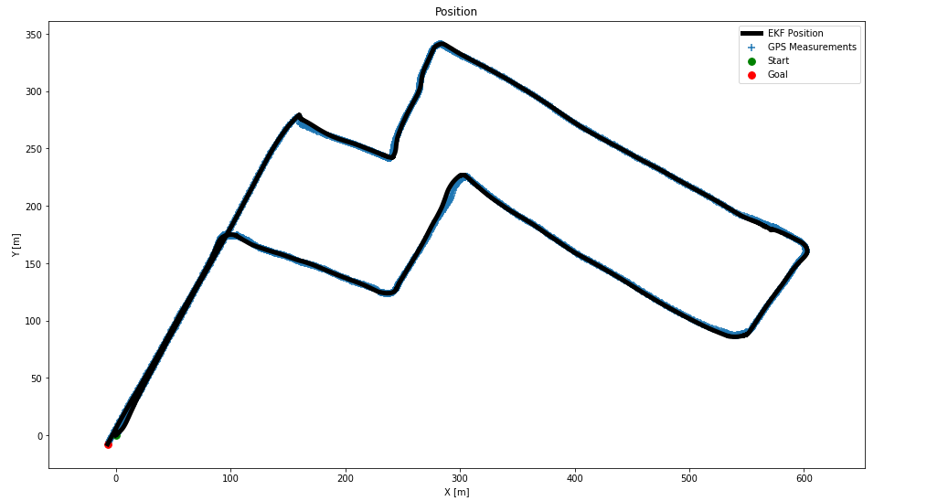
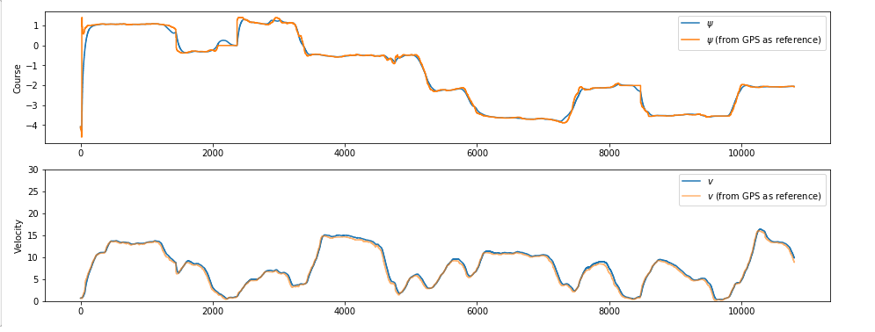
Results
No dataset found with the combination of sensors we have
Tests on dataset with IMU + GPS
Qualitative results

Slide 9
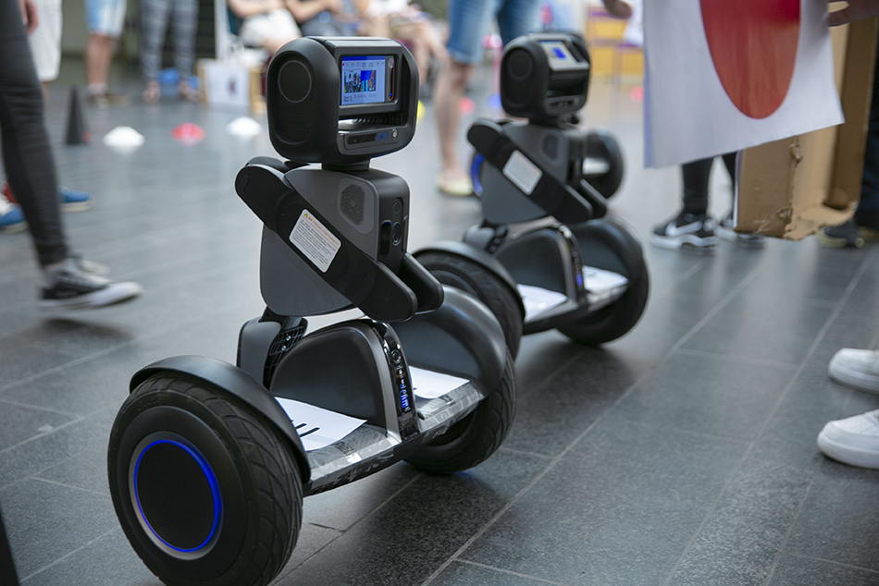
Testing
Also briefly tested with VITA lab robots
  No data fusion / already using KF
Simulation testing next semester

Slide 10
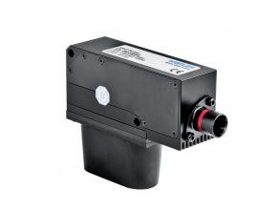
Next steps
Improve results for performance driving
New optical sensor : Correvit SFII
  Measures speed & slip angle
  Lightweight, suited for racing applications
  Sponsoring deal in the works
Visual odometry
  Use data from SLAM
  Projection onto feasible space

