Slide 1
Predicting Tax Refund or Tax Owed Outcomes
Using Financial Activity Patterns
Adhilingam Adiswaran | DSC 680
Bellevue University | Final Project
Notes:
Hello, my name is Adhilingam Adiswaran. My final project is Predicting Tax Refund or Tax Owed Outcomes Using Financial Activity Patterns. The goal of this project is to explore whether common financial and tax-related indicators can provide an early signal of whether an individual is trending toward a federal tax refund or an additional tax payment. This is an educational machine-learning prototype and is not intended to calculate an official tax return or provide tax advice.

Slide 2
Business Problem & Research Questions
Can financial activity provide a useful early warning before tax filing?
Many taxpayers do not know their likely tax direction until late in the year.
An early estimate could support withholding review, cash-flow planning, and financial education.
RQ1: Which variables are most predictive?
RQ2: How accurately can models classify Refund vs. Tax Owed?
RQ3: Does Random Forest outperform Logistic Regression?
RQ4: Does performance vary across income or filing-status groups?
Notes:
The business problem is uncertainty. Many taxpayers do not know whether their withholding and estimated payments are aligned with their eventual tax liability until late in the year. An early estimate could help users review withholding and prepare their cash flow. I focused on four research questions: which variables are most strongly associated with the outcome, how accurately supervised models can predict it, whether Random Forest materially improves on Logistic Regression, and whether performance changes across income or filing-status groups.

Slide 3
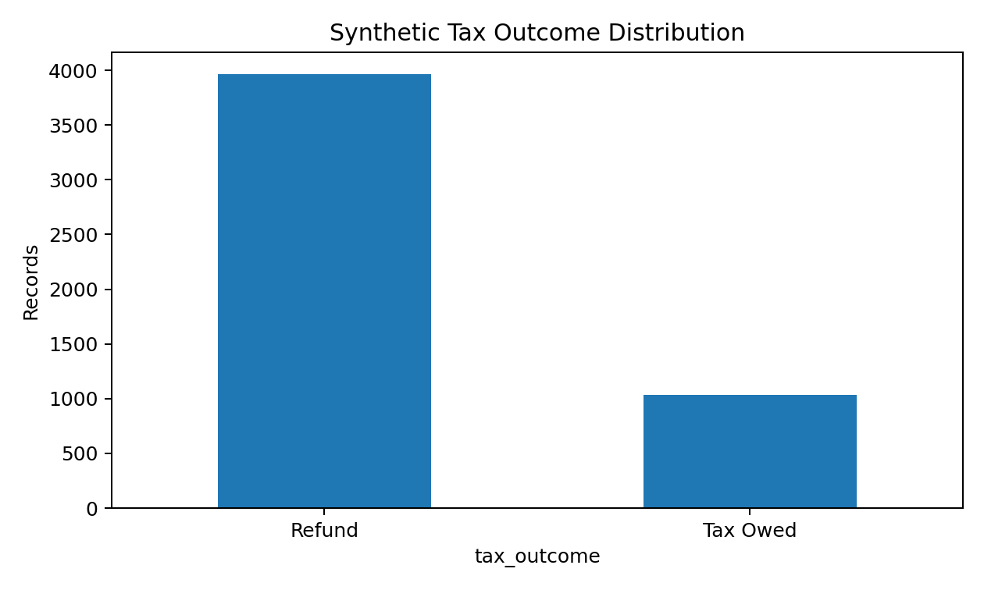
Data & Feature Engineering
Privacy-preserving synthetic experiment
5,000 synthetic taxpayer profiles; fixed seed = 680
No names, SSNs, account numbers, addresses, or real transactions
Inputs: income, filing status, dependents, deductions, credits, withholding, estimated payments, expenses, savings
Engineered ratios: withholding/income, payment/income, income/expense, tax payments/liability
Target: Refund or Tax Owed
Outcome mix: 79.3% Refund / 20.7% Tax Owed
Notes:
Because real linked banking and tax-return data are sensitive, I used 5,000 synthetic profiles generated with a fixed seed. The data contain no direct identifiers or real transactions. The profiles include income, filing status, dependents, deductions, credits, withholding, estimated payments, expenses, and savings behavior. I also engineered ratios such as withholding to income and total tax payments relative to estimated liability. The target is binary: Refund or Tax Owed. The generated sample is imbalanced, with about 79.3 percent Refund and 20.7 percent Tax Owed, so I did not rely on accuracy alone.

Slide 4
Modeling Approach
Three classifiers + held-out testing + cross-validation
Logistic Regression - interpretable baseline
Decision Tree - readable nonlinear rules
Random Forest - nonlinear ensemble
75% training / 25% held-out testing, stratified
5-fold stratified cross-validation
Metrics: accuracy, precision, recall, F1, ROC-AUC, confusion matrix
Permutation importance + subgroup evaluation
Notes:
I compared three supervised classification approaches. Logistic Regression is the interpretable baseline. A Decision Tree can capture nonlinear thresholds as readable rules. Random Forest combines many trees to capture more complex interactions while reducing the instability of a single tree. I used a stratified 75-25 train-test split and five-fold stratified cross-validation. Evaluation included accuracy, precision, recall, F1, ROC-AUC, confusion matrices, permutation importance, and subgroup metrics.

Slide 5
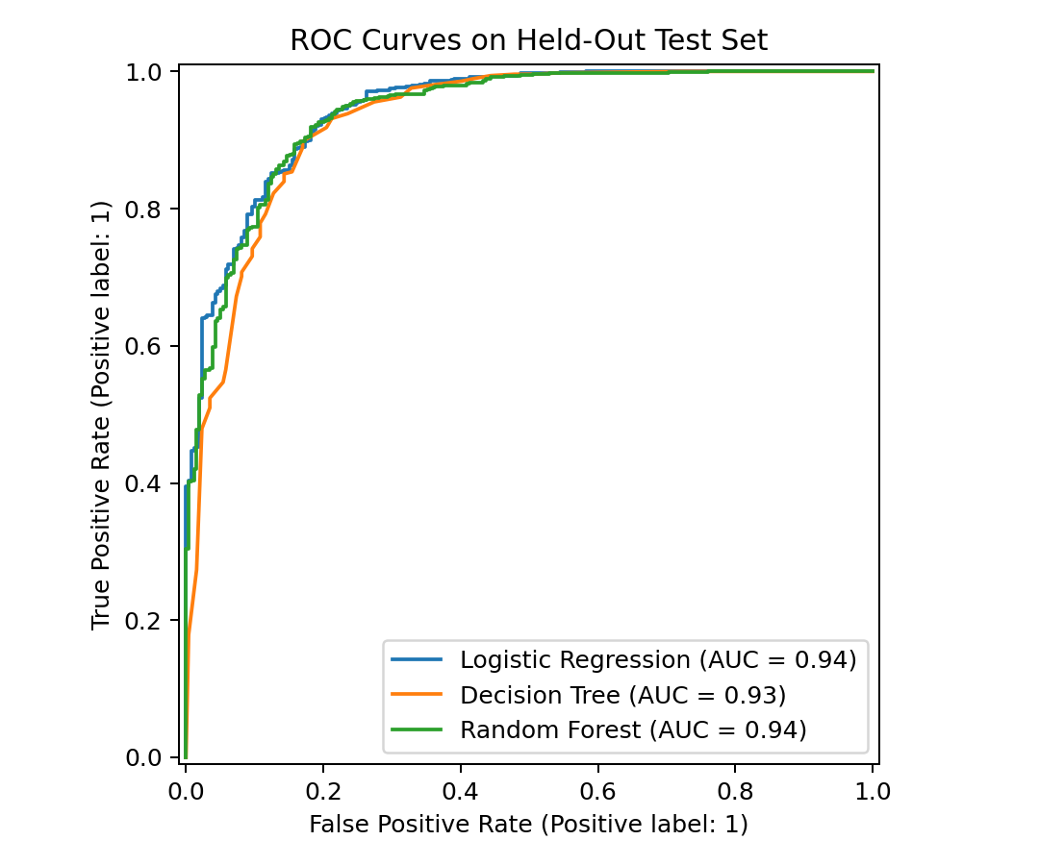
Model Performance
Random Forest leads accuracy and F1; Logistic Regression leads ROC-AUC
Logistic Regression
Accuracy: 87.84%
F1: 0.921
ROC-AUC: 0.945
Decision Tree
Accuracy: 85.20%
F1: 0.901
ROC-AUC: 0.929
Random Forest
Accuracy: 90.16%
F1: 0.938
ROC-AUC: 0.940
Notes:
The results show that no single model dominates every metric. Random Forest achieved the highest accuracy at 90.16 percent and the highest F1 score at 0.938. Logistic Regression achieved 87.84 percent accuracy but had the highest ROC-AUC at 0.945, slightly above Random Forest at 0.940. The Decision Tree was the weakest overall. This means the nonlinear model improved classification accuracy and F1, but the simpler Logistic Regression remained highly competitive and actually ranked cases slightly better by ROC-AUC.

Slide 6
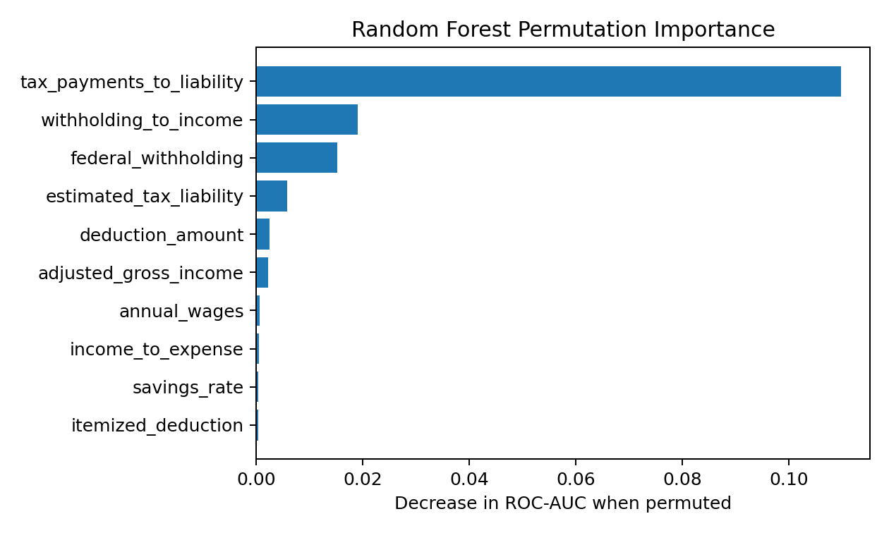
What Drove the Predictions?
RQ1: taxes already paid relative to estimated liability dominate
#1 tax_payments_to_liability
Next: withholding_to_income
Then: federal_withholding
Interpret as association, not causation
Strong signal is expected because the synthetic target uses related tax-payment logic
Notes:
For the first research question, permutation importance gives a very clear result. The tax-payments-to-liability ratio is by far the strongest predictor. Withholding to income and federal withholding follow, but at much lower importance. This makes domain sense because a refund or balance due depends heavily on the relationship between estimated liability and taxes already paid. However, this finding needs caution: the synthetic target is generated from related tax-payment logic, so feature importance should be treated as association within this experiment, not causation.

Slide 7
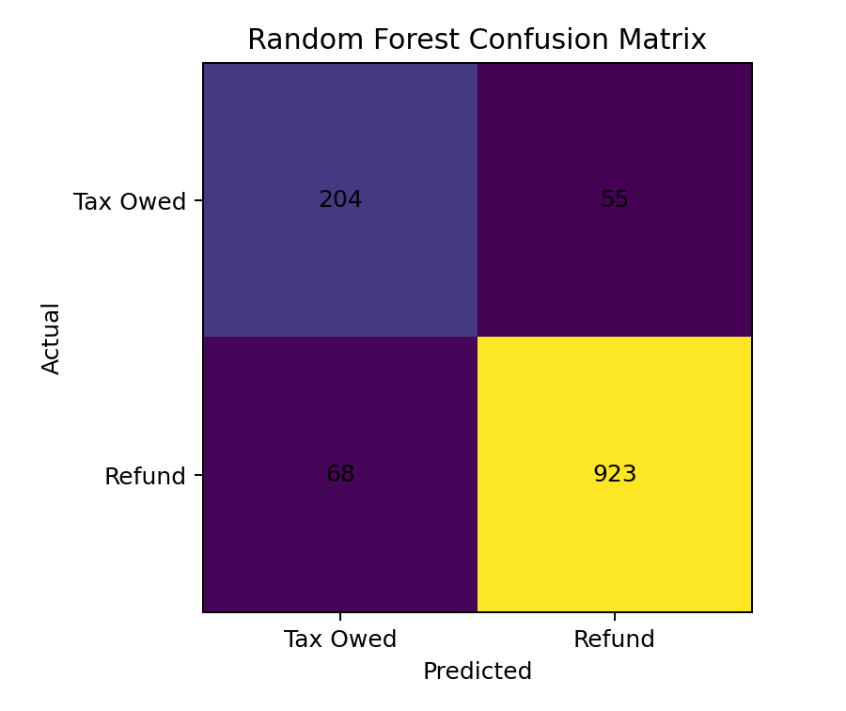
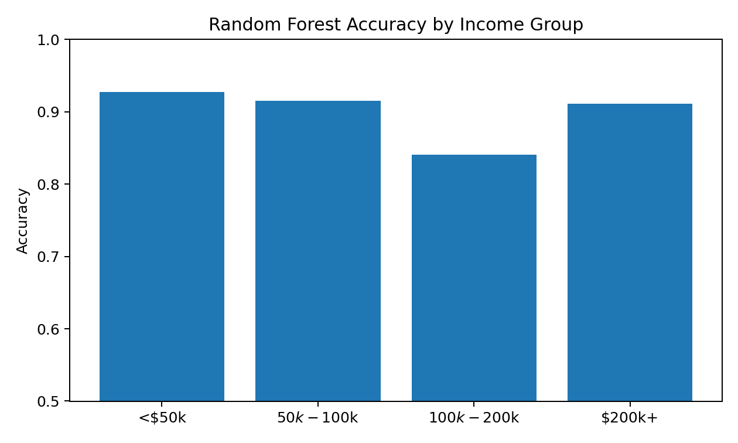
Errors & Subgroup Performance
RQ4: performance is not uniform across groups
55 Tax Owed cases were predicted as Refund
Income-group accuracy: 84.08% to 92.75%
Filing-status accuracy: 87.31% to 93.22%
Small $200k+ subgroup makes its recall estimate unstable
Notes:
The confusion matrix helps explain the errors. Random Forest correctly identified 204 Tax Owed records and 923 Refund records. It incorrectly predicted Refund for 55 people who were actually labeled Tax Owed, and predicted Tax Owed for 68 Refund records. For an early-warning application, the first error is especially important because a user could be financially unprepared. Subgroup performance also varied. Accuracy ranged from about 84.1 to 92.8 percent across income groups and from 87.3 to 93.2 percent across filing statuses. The highest-income subgroup was very small, so its recall estimate is unstable. These results show why fairness metrics must be reported with sample size.

Slide 8
Ethics, Limitations & Responsible Use
Privacy: synthetic data avoids exposing real financial/tax records
Fairness: subgroup error rates differ and require monitoring
External validity: synthetic performance does not prove real-world performance
Leakage risk: final refund/balance fields were excluded
Tax rules change; models require tax-year-specific review
Output must be labeled as an educational estimate - not tax advice
Notes:
Ethics and limitations are central to this project. Using synthetic data greatly reduces privacy risk, but it creates an external-validity limitation because performance on generated profiles cannot prove performance on real taxpayers. Subgroup differences also mean fairness must be monitored. I excluded final refund and balance-due fields to reduce target leakage, but the engineered payment-to-liability ratio is still closely related to the target logic. Tax rules also change over time. Any real application would need annual review, privacy controls, subgroup testing, governance, and clear labeling that the output is only an educational estimate.

Slide 9
Conclusions & Recommendations
A useful screening signal - not an official tax determination
RQ1: Payment-to-liability relationship is the strongest predictor.
RQ2: Random Forest reached 90.16% test accuracy.
RQ3: Random Forest improved accuracy/F1, but Logistic Regression had slightly higher ROC-AUC.
RQ4: Performance varied across income and filing-status groups.
Recommended use: probability band + explanation + prompt to review withholding.
Before production: real-data validation, privacy controls, fairness monitoring, governance, annual tax-rule review.
Best use: early educational warning that directs users to official IRS guidance.
Notes:
In conclusion, the research questions can be answered within the limits of the synthetic experiment. Payment relative to estimated liability is the strongest predictor. Random Forest produced the best accuracy and F1, while Logistic Regression produced the slightly higher ROC-AUC and remains attractive when interpretability matters. Performance was not uniform across subgroups. The appropriate use of this work is an educational screening signal, perhaps a probability band with a simple explanation that encourages the user to review withholding. Before any production use, the model would need validation on legally obtained de-identified data, privacy controls, fairness monitoring, governance, annual tax-rule review, and a clear route to official IRS tools or a qualified tax professional. Thank you.

