Slide 1

GARAGE MANAGEMENT SYSTEM
ADITHYA DAS M P
MES24MCA-2002
Department of Computer Applications
MES College of Engineering, Kuttippuram
20/08/2025

Slide 2
PRODUCT OWNER MR.HYDERALI K HOD DEPARTMENT OF COMPUTER APPLICATIONS MES COLLEGE OF ENGINEERING, KUTTIPPURAM

Slide 3
TABLE OF CONTENTS
Introduction
Objective
Existing System
Proposed System
Motivation
Functionalities
Module Description
Developing Environment
Sprint Backlog
Product Backlog
User Story
Project Plans
Data Flow Diagrams
ER Diagram

Slide 4
GARAGE MANAGEMENT SYSTEM
The Garage Management System is a web-based application designed to streamline all activities within a garage, offering role-based access for users such as Managers, Supervisors, Mechanics and Customers.
It aims to solve common issues in traditional garages, such as poor data storage, lack of worker coordination, and inefficient service tracking, by providing a centralized and systematic platform.

Slide 5
GARAGE MANAGEMENT SYSTEM
Features:
User login & authentication
Spare parts inventory management
Service tracking
Mechanic work hours
Appointment booking
Job assignment
Sales tracking

Slide 6
OBJECTIVES
To automate and streamline garage operations using a centralized web-based system.
To reduce manual errors and paperwork by digitizing service records and inventory.
To allow customers to book services online and track the status of their vehicles.
To provide role-based access for admin, manager, supervisor, mechanic and customer.

Slide 7
OBJECTIVES
To improve service through better task allocation and tracking of mechanic work hours.
To manage spare part inventory efficiently and track sales.
To enable secure and transparent payment processing for completed services.

Slide 8
EXISTING SYSTEM
Manual data entry makes operations slow and time-consuming.
High dependency on manpower for basic tasks.
Lack of proper service history and maintenance tracking.
Inaccurate and slow inventory management.
Delays in service due to poor communication and coordination.
No real-time updates or notifications for customers.
High risk of data loss or manipulation due to lack of security.Low overall efficiency with increased chances of errors.

Slide 9
PROPOSED SYSTEM
Real-time inventory management for spare parts, reducing shortages and excess stock.
Reduced manpower and operational costs through digital automation.
Enhanced customer service with online updates, payment options, and notifications.
Role-based access control ensuring secure and accountable operations.
Faster and more accurate data entry via form-based input, minimizing errors.
High security with restricted data access only for authorized users.
Increased efficiency and reliability of garage operations through centralized data storage.

Slide 10
MOTIVATIONS
To centralize and automate all garage operations for better efficiency.
To reduce manual errors in booking, inventory, and billing processes.
To improve customer satisfaction with faster service and transparency.
To provide accurate reports and insights for better decision-making.

Slide 11
FUNCTIONALITIES
User Login and Authentication-Enables secure access for all user roles by validating credentials and assigning role-based access.
Spare Parts Inventory Management-Allows admin or supervisor to manage spare part stock by validating and updating stock records in the database.
Vehicle Service Appointment Booking-Lets customers book service slots by checking availability and saving the appointment details.

Slide 12
FUNCTIONALITIES
Job Assignment to Mechanics-Assigns repair tasks to mechanics based on their specialization and updates the job status in the system.
Billing and Payment Handling-Issues service bills and manages payment details by calculating the bill and storing payment information.
Reports and Analytics-Generates insights on garage operations by fetching and analyzing stored data.

Slide 13
MODULE DESCRIPTION
Manager Module:
. Generate bills for customer appointments.
. Manage spare parts inventory.
. View and analyze reports.
. Update customer information.
2. Supervisor Module:
. Review customer appointments.
. Assign jobs to mechanics.
. View assigned jobs for monitoring.

Slide 14
MODULE DESCRIPTION
4. Customer Module:
. Book service appointments.
. View vehicle service status.
. Pay bills online.
4. Mechanic Module:
. View jobs assigned by supervisor.
. Update status of ongoing jobs.
. Request spare parts for repairs

Slide 15
DEVELOPING ENVIRONMENT
Operating System: Windows 11 / Ubuntu Linux
Frontend: HTML,CSS,JAVASCRIPT
Backend: PHP
Database: MySQL
Web Browser :Google Chrome/Firefox
IDEs: Visual Studio Code
Version Control: GitHub (optional for code management)

Slide 16
SPRINT BACKLOG
Backlog tem | Status And Completion Date | Original Estimation in Hours | Day 1 hrs | Day 2 hrs | Day 3 hrs | Day 4 hrs | Day 5 hrs | Day 6 hrs | Day 7 hrs | Day 8 hrs | Day 9 hrs | Day 10 hrs
SPRINT1
Database Design | 06/08/2025 | 3 | 1 | 1 | 1 | 0 | 0 | 0 | 0 | 0 | 0 | 0
UI/UX Wireframing | 12/08/2025 | 4 | 1 | 1 | 1 | 1 | 0 | 0 | 0 | 0 | 0 | 0
User Authentication Setup | 18/08/2025 | 5 | 1 | 1 | 1 | 1 | 1 | 0 | 0 | 0 | 0 | 0
SPRINT 2
Role Management | 24/08/2025 | 6 | 1 | 1 | 1 | 1 | 1 | 1 | 0 | 0 | 0 | 0
Supervisor Module | 30/08/2025 | 7 | 1 | 1 | 1 | 1 | 1 | 1 | 1 | 0 | 0 | 0

Slide 17
SPRINT BACKLOG
Backlog tem | Status And Completion Date | Original Estimation in Hours | Day 1 hrs | Day 2 hrs | Day 3 hrs | Day 4 hrs | Day 5 hrs | Day 6 hrs | Day 7 hrs | Day 8 hrs | Day 9 hrs | Day 10 hrs
SPRINT3
Mechanic work hours tracking | 05/09/2025 | 6 | 1 | 1 | 1 | 1 | 1 | 1 | 0 | 0 | 0 | 0
Payment & Billing integration | 10/09/2025 | 7 | 1 | 1 | 1 | 1 | 1 | 1 | 1 | 0 | 0 | 0
SPRINT 4
Reports & Analytics | 15/09/2025 | 1 | 1 | 1 | 1 | 1 | 1 | 1 | 1 | 1 | 0 | 0
Final Testing & Deployment | 20/09/2025 | 8 | 1 | 1 | 1 | 1 | 1 | 1 | 1 | 1 | 0 | 0
TOTAL |  | 50 | 9 | 9 | 8 | 6 | 5 | 4 | 2 | 1
The table given above is for reference only. Update/create a table with your data.

Slide 18
PRODUCT BACKLOG
ID | NAME | PRIORITY | ESTIMATE | STATUS
1 | User Registration / Login | High | 5 | IN PROGRESS
2 | Vehicle Entry & Exit Logging | High | 8 | IN PROGRESS
3 | Spare Parts Inventory System | High | 10 | IN PROGRESS
4 | Service Request Management | High | 12 | IN PROGRESS
5 | Mechanic Job Assignment | Medium | 8 | IN PROGRESS

Slide 19
PRODUCT BACKLOG
ID | NAME | PRIORITY | ESTIMATE | STATUS
6 | Customer Billing & Invoices | High | 9 | IN PROGRESS
7 | Real-Time Service Tracking | Medium | 6 | IN PROGRESS
8 | Payment Integration | High | 7 | IN PROGRESS
9 | Admin Dashboard & Reports | High | 10 | IN PROGRESS
10 | Notifications | Medium | 5 | IN PROGRESS

Slide 20
USER STORY
User Story ID | As a type of User | I want to | So that i can
1 | User | Register | Create an account and access garage services
2 | User | Login | Securely access my account with correct credentials
3 | User | Book Vehicle Services | Schedule my vehicle service online without visiting manually
4 | User | View Service Status | Track the progress of my vehicle being serviced
5 | Supervisor | Monitor Spare Parts Inventory | Ensure required parts are available for repairs

Slide 21
USER STORY
User Story ID | As a type of User | I want to | So that i can
6 | Supervisor | Assign Work to Mechanics | Distribute work efficiently among available mechanics
7 | Mechanic | Update Job Status | Mark service tasks as in-progress or completed
8 | Admin | Generate Reports | View overall garage activities, revenue, and service history
9 | Customer | Make Payment | Pay for services via cash, UPI, or card

Slide 22
PROJECT PLAN
User StoryID | Task Name | Start Date | End Date | Days | Status
1 | Sprint 1 | 06/08/2025 | 11/08/2025 | 22 | In Progress
 |  |  |  |  | In Progress
2 |  | 12/08/2025 | 18/08/2025 |  | Completed
 |  |  |  |  | In Progress
3 |  | 19/08/2025 | 22/08/2022 |  | Completed
4 | Sprint 2 | 28/09/2025 | 05/09/2025 | 18 | In Prpgress
5 |  | 06/09/2025 | 15/09/2025 |  | In Progress

Slide 23
PROJECT PLAN
User StoryID | Task Name | Start Date | End Date | Days | Status
3 | SPRINT 3 | 16/09/2025 | 21/09/2025 | 14 | In Progress
6 |  | 22/09/2025 | 28/09/2025 |  | In Progress
14 | SPRINT 4 | 29/09/2025 | 05/10/2025 | 14 | In Progress
9 |  | 06/10/2025 | 12/10/2025 |  | In Progress

Slide 24
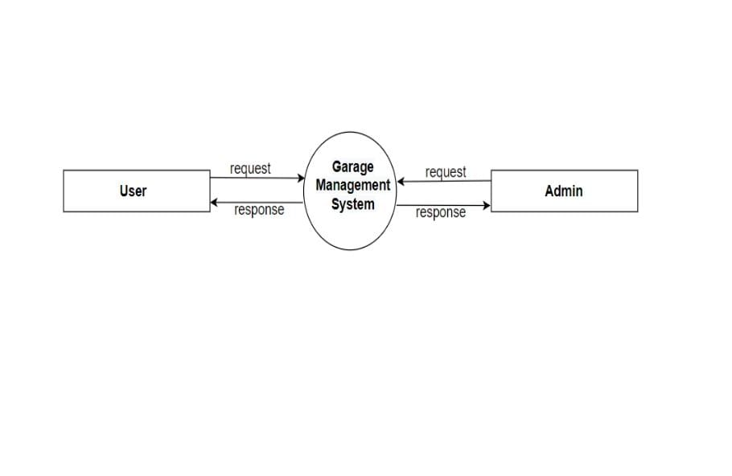
DATA FLOW DIAGRAM
LEVEL 1

Slide 25
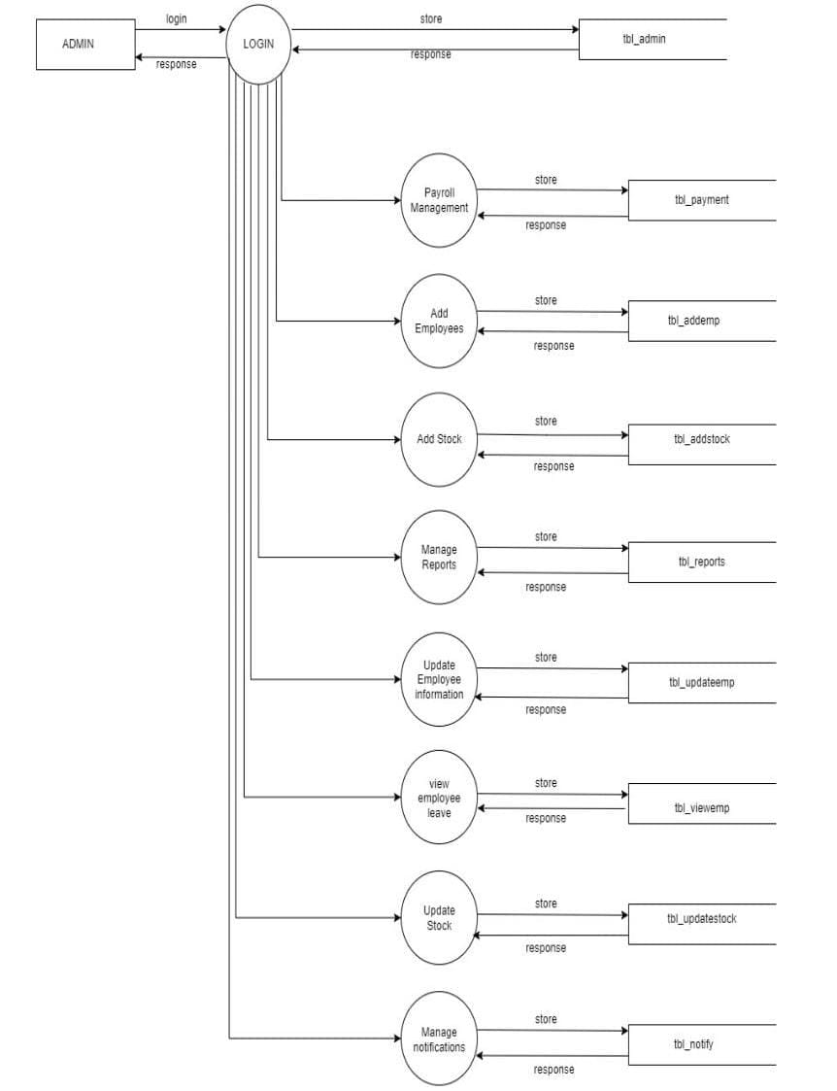
DATA FLOW DIAGRAM
Level 0

Slide 26
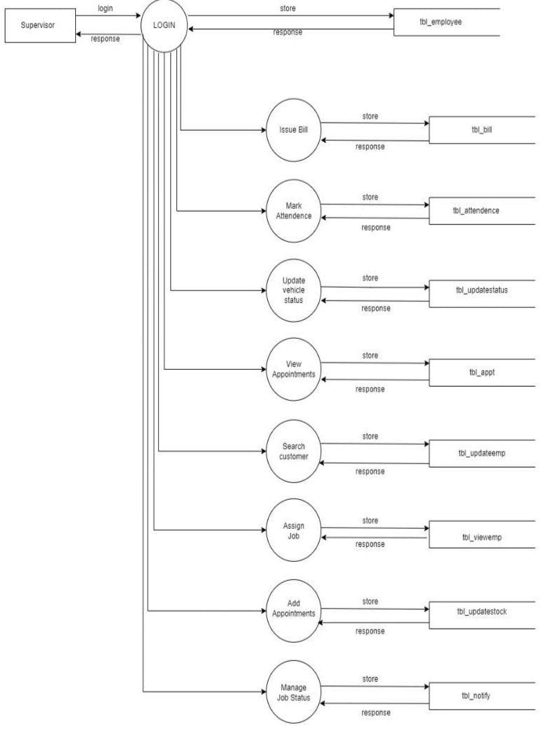
DATA FLOW DIAGRAM
Level 1

Slide 27
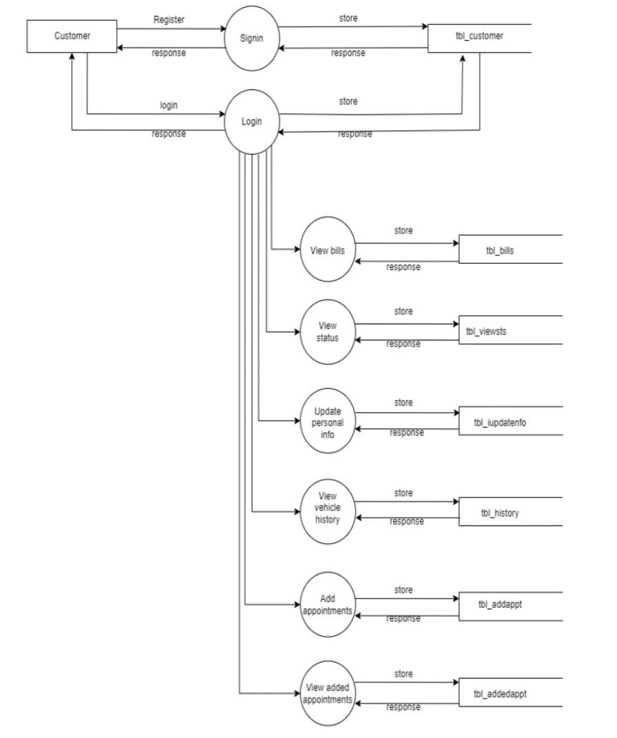
DATA FLOW DIAGRAM
Level 2

Slide 28
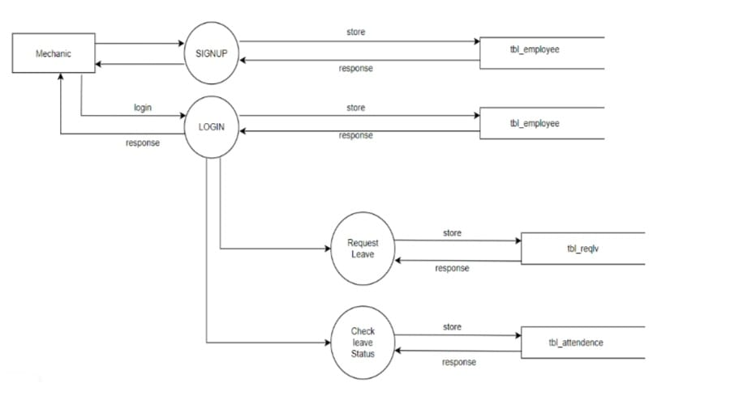
DATA FLOW DIAGRAM
Level 3

Slide 29
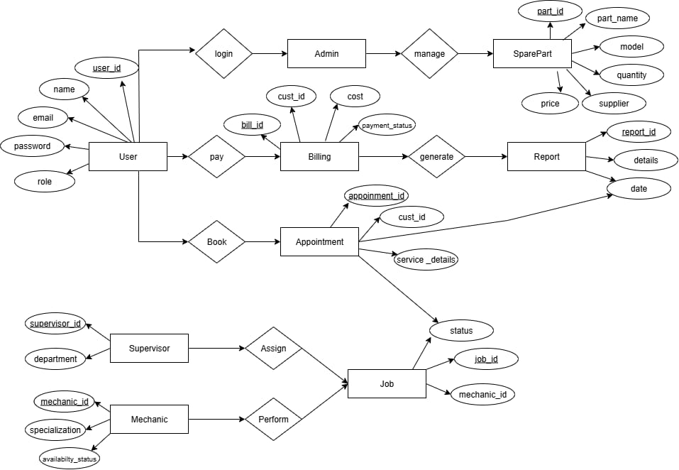
ER DIAGRAM

Slide 30
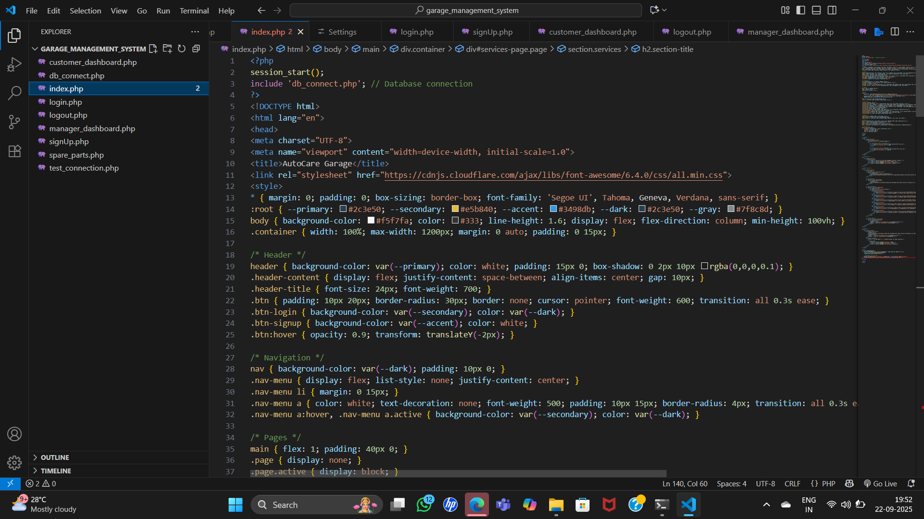
FUNCTIONALITIES

Slide 31
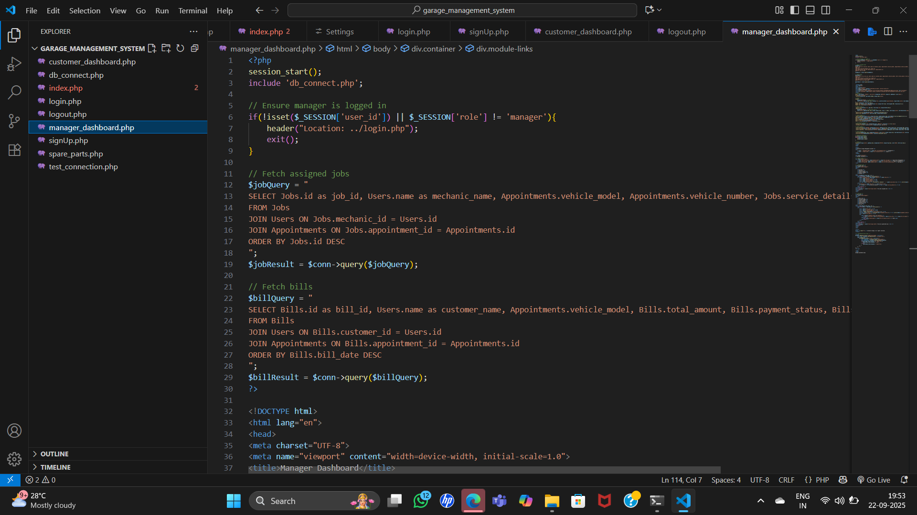
FUNCTIONALITIES

Slide 32
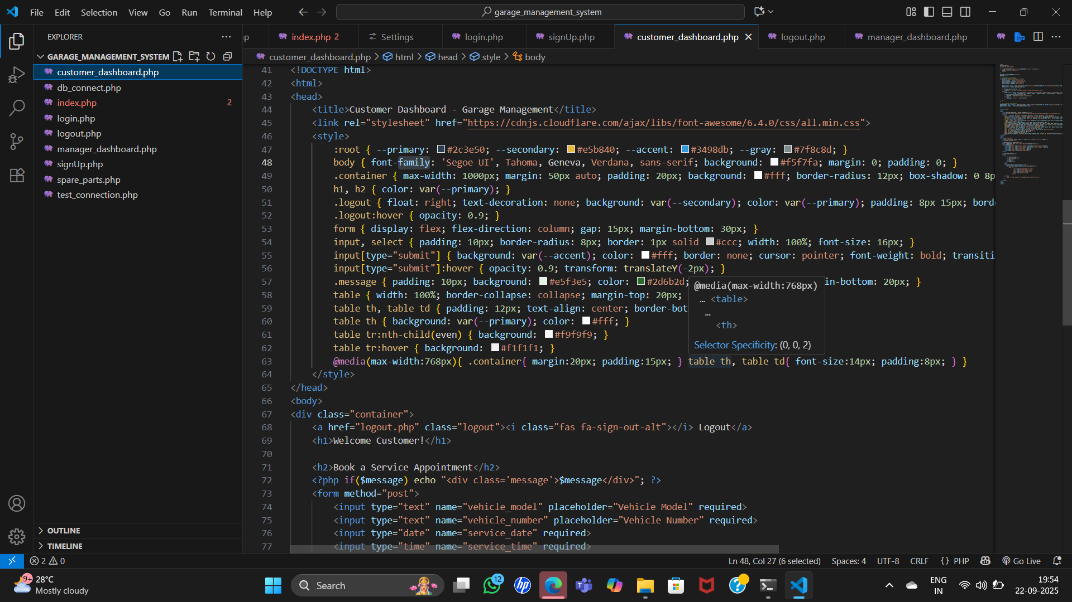
FUNCTIONALITIES

Slide 33
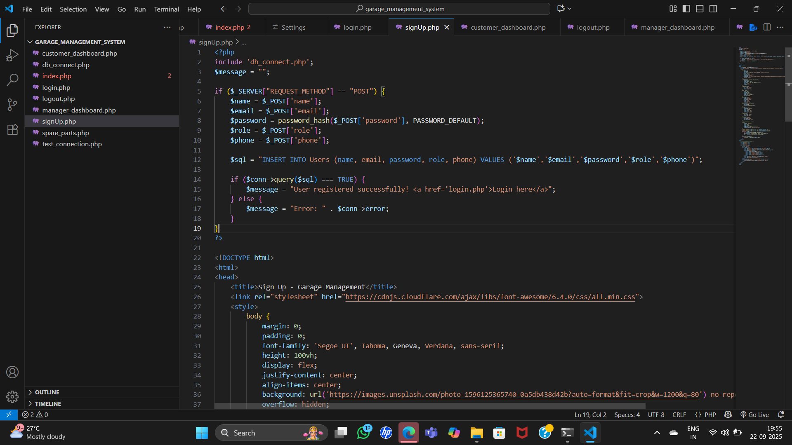
FUNCTIONALITIES

Slide 34
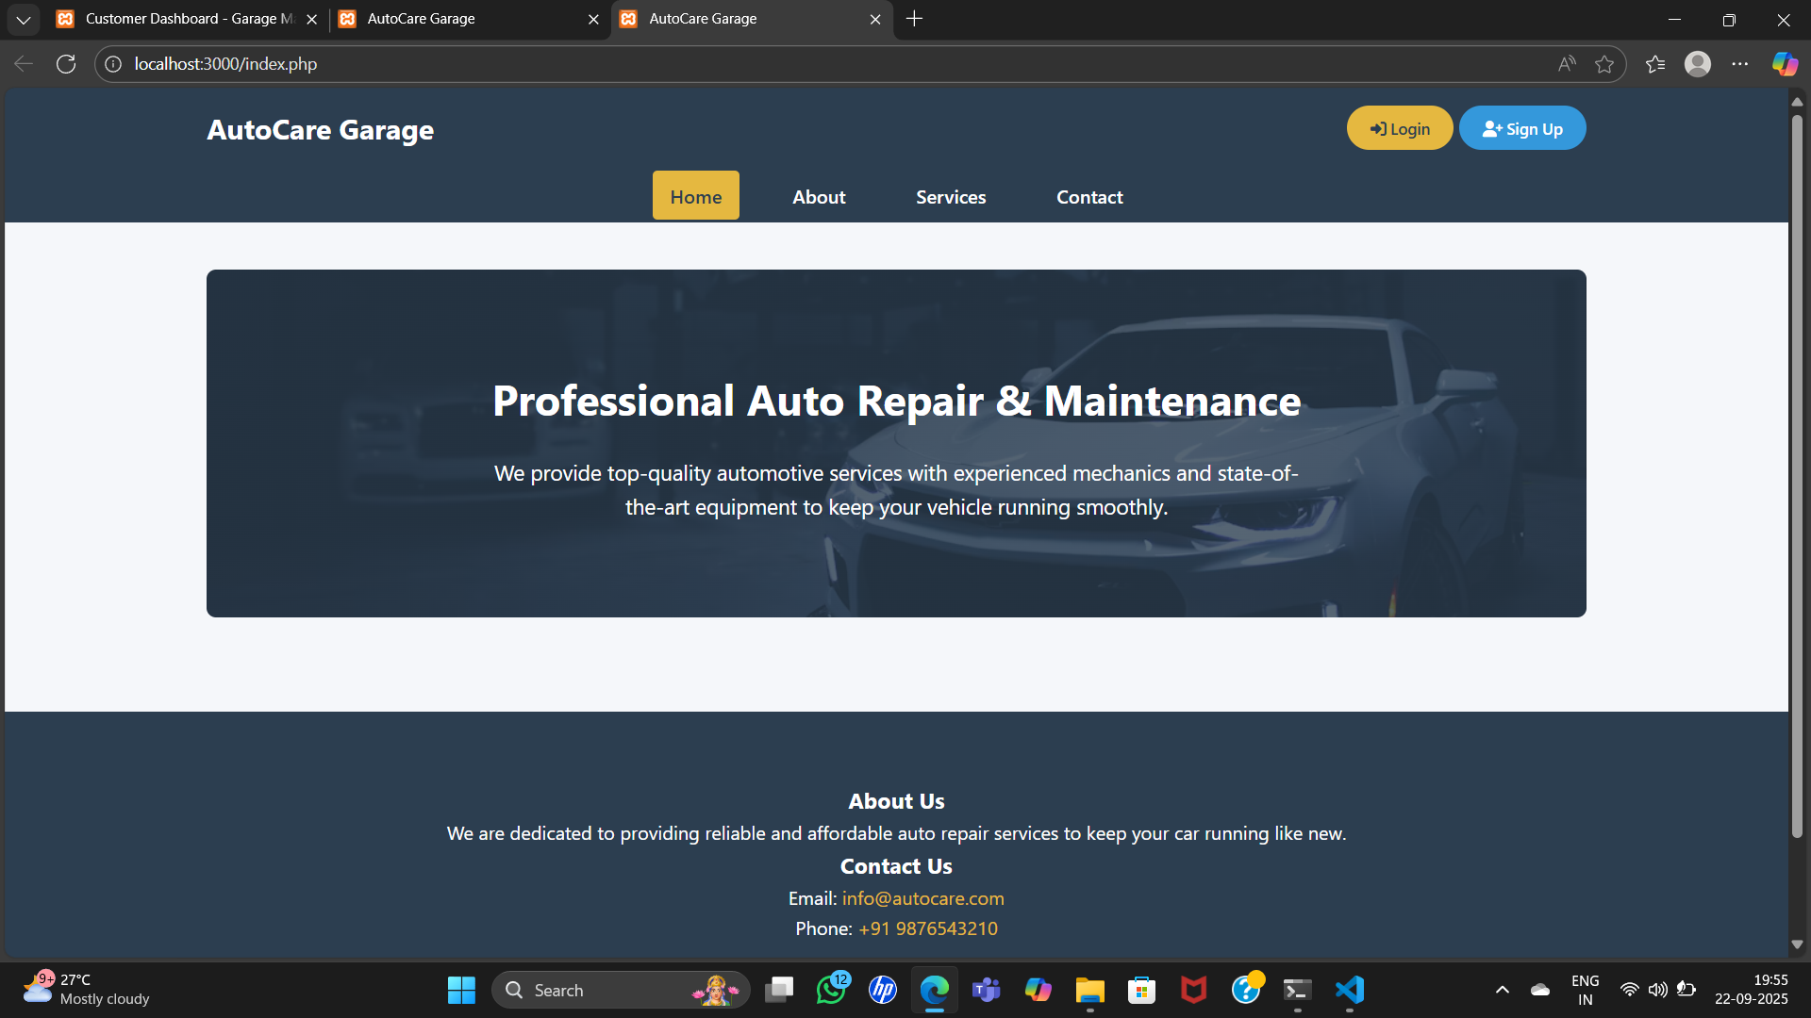
INTERFACE

Slide 35
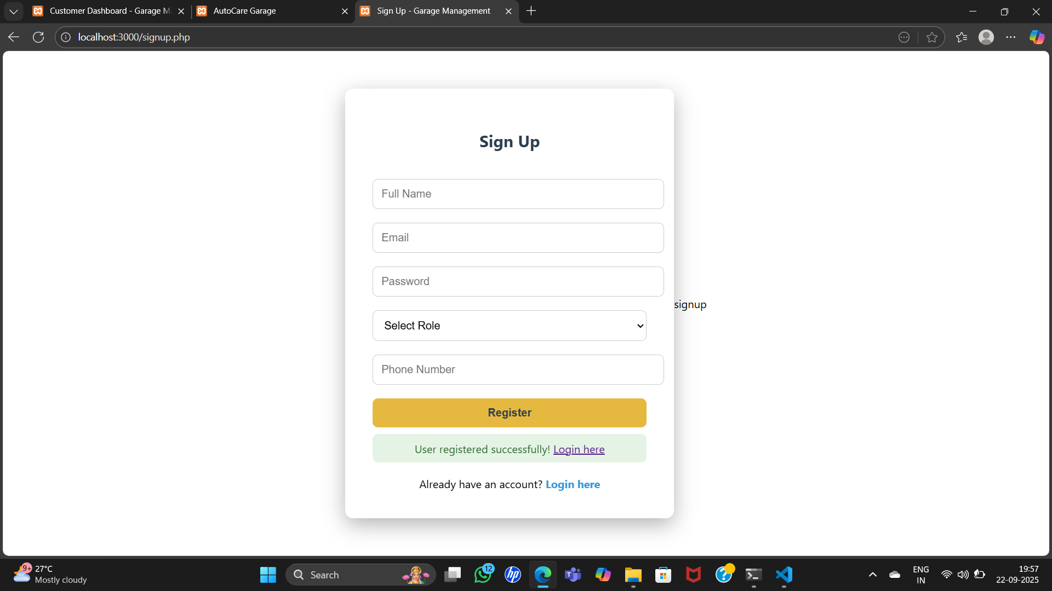
INTERFACE

Slide 36
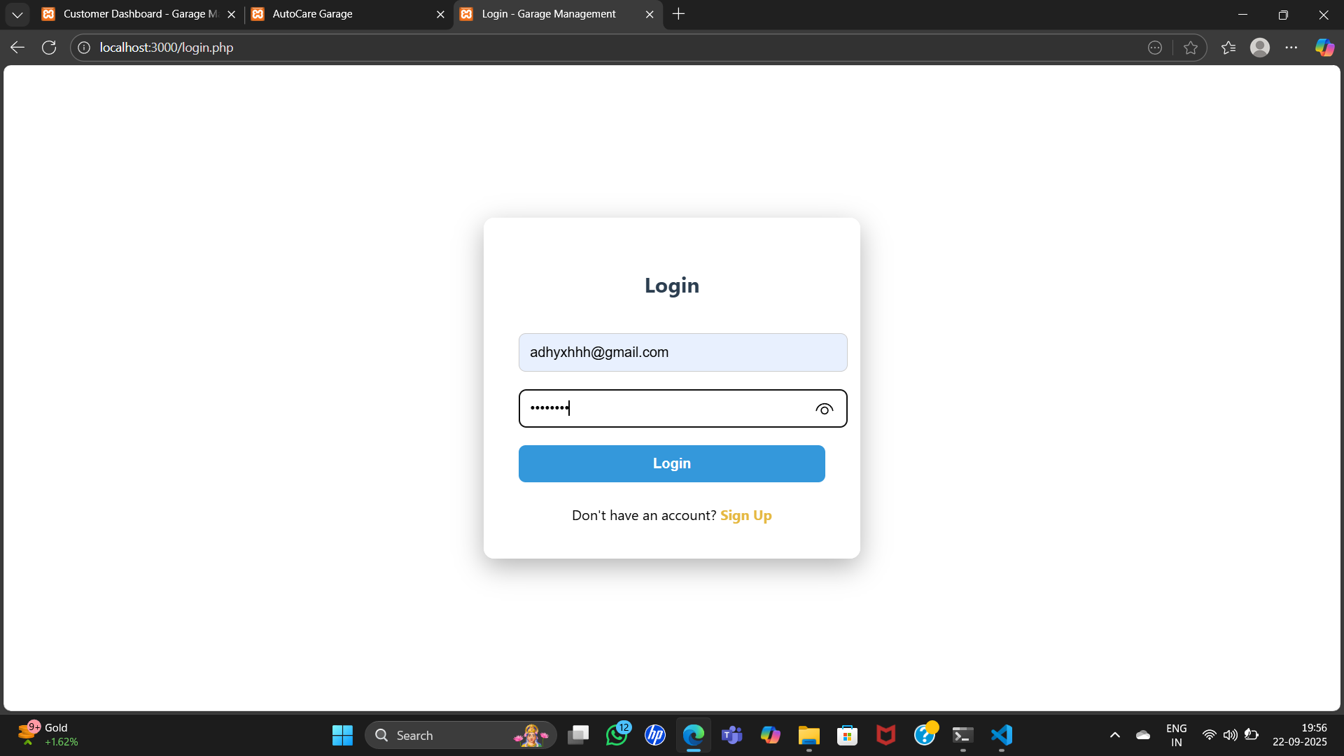
INTERFACE

Slide 37
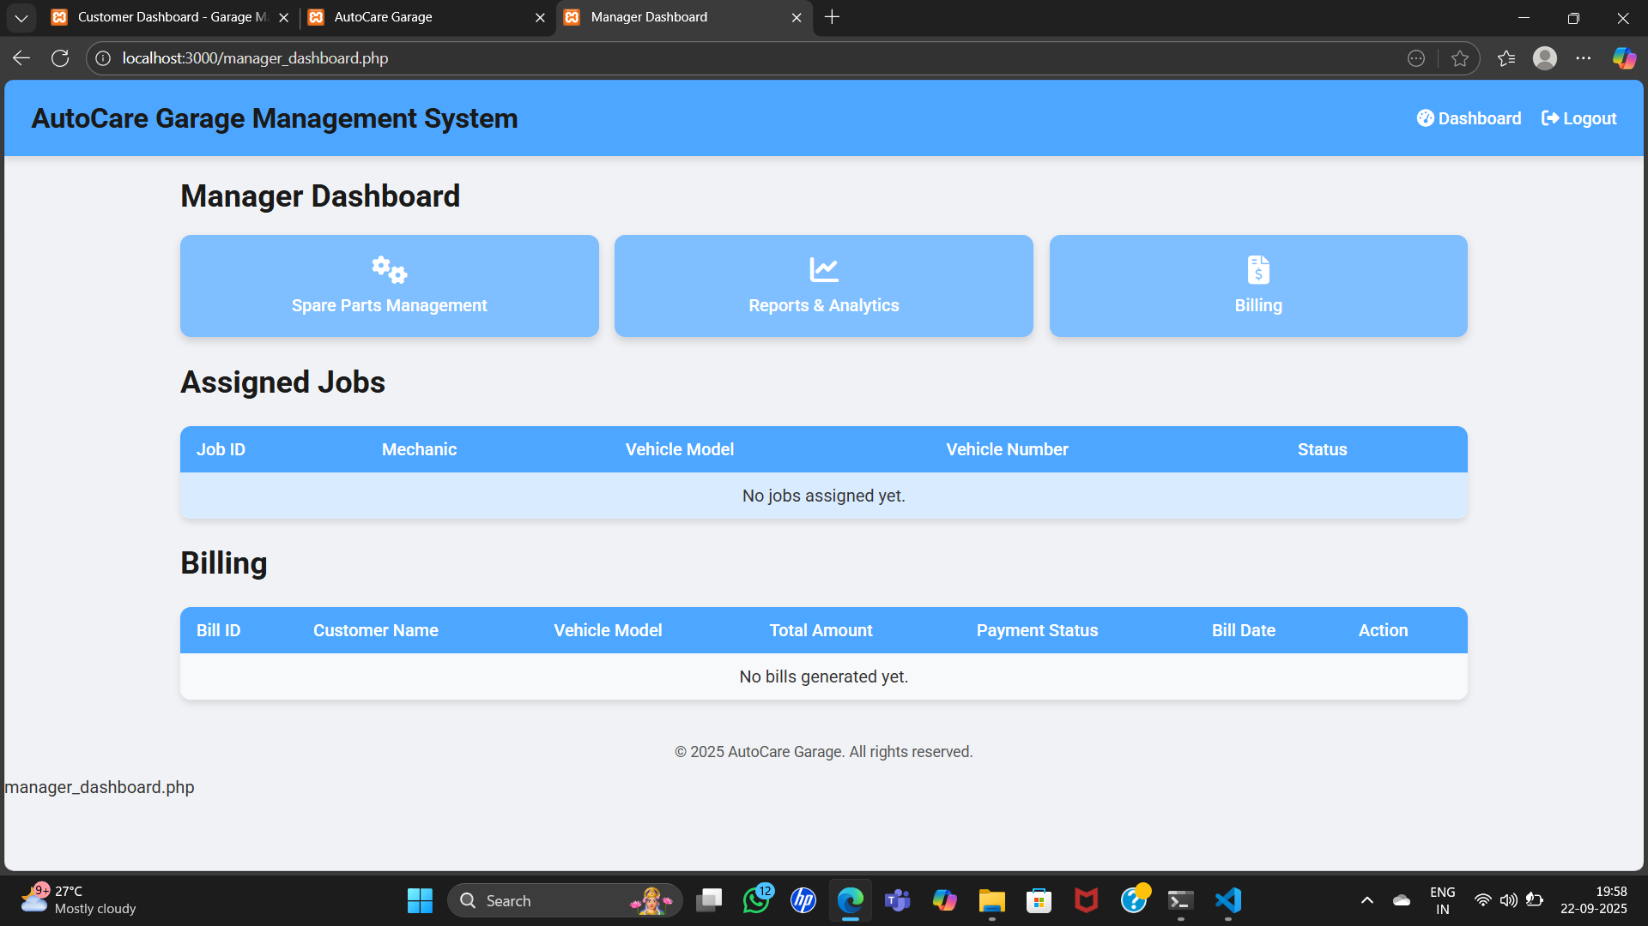
INTERFACE

Slide 38
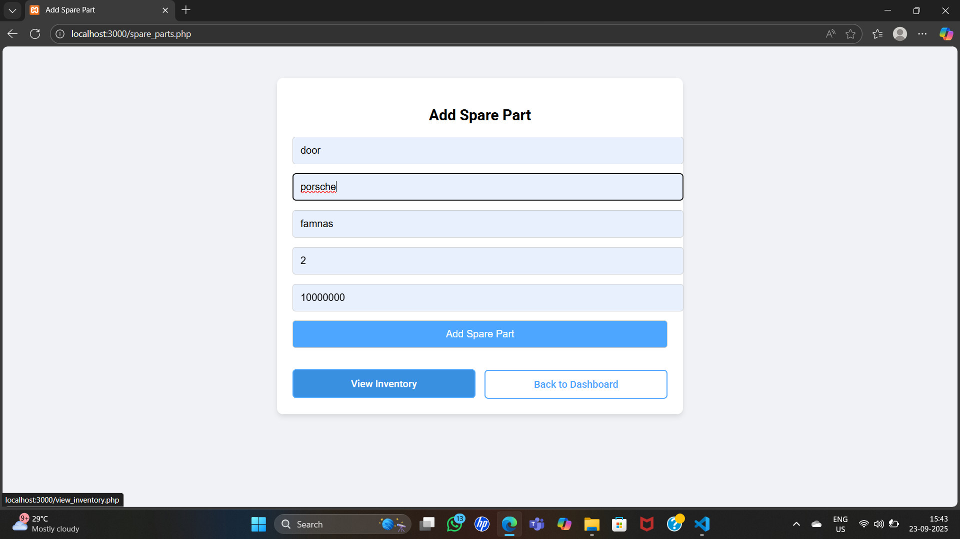
INTERFACE

Slide 39
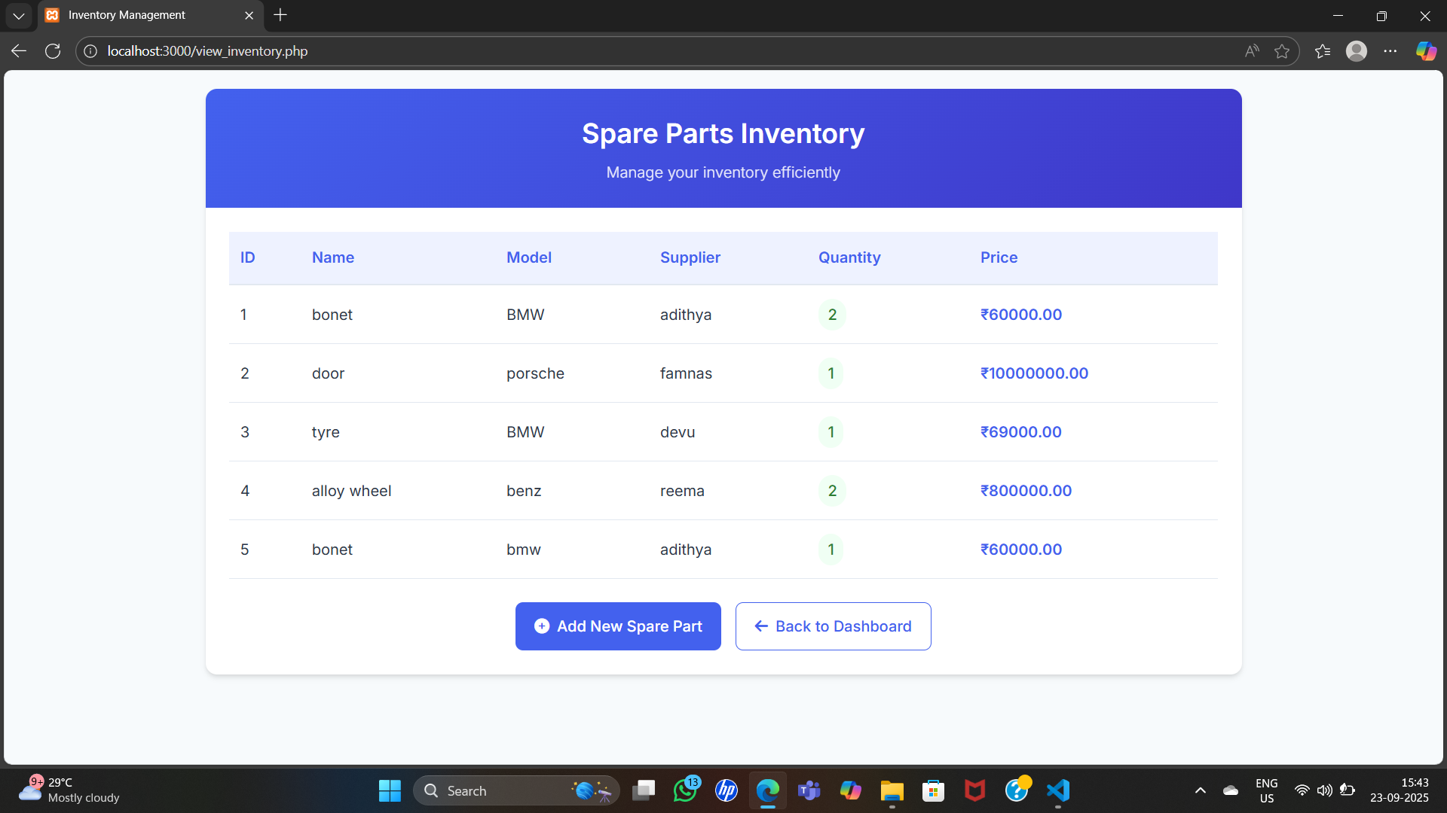
INTERFACE

Slide 40
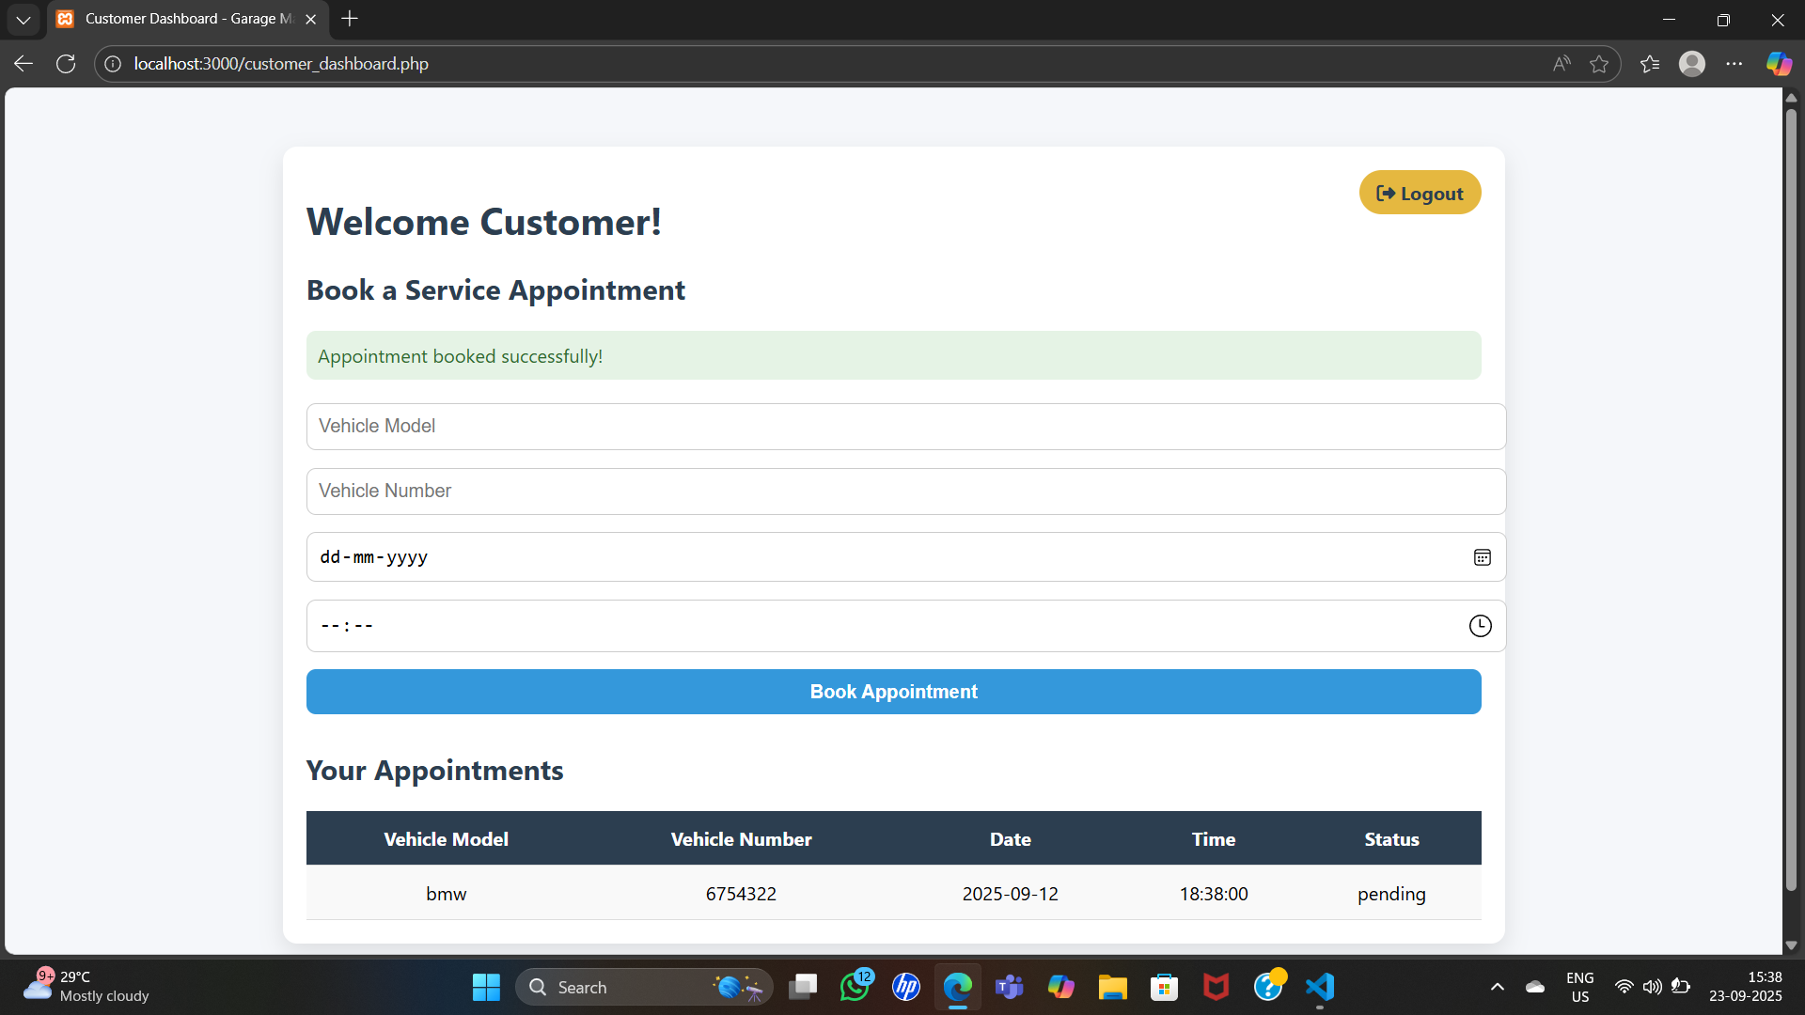
INTERFACE

Slide 41
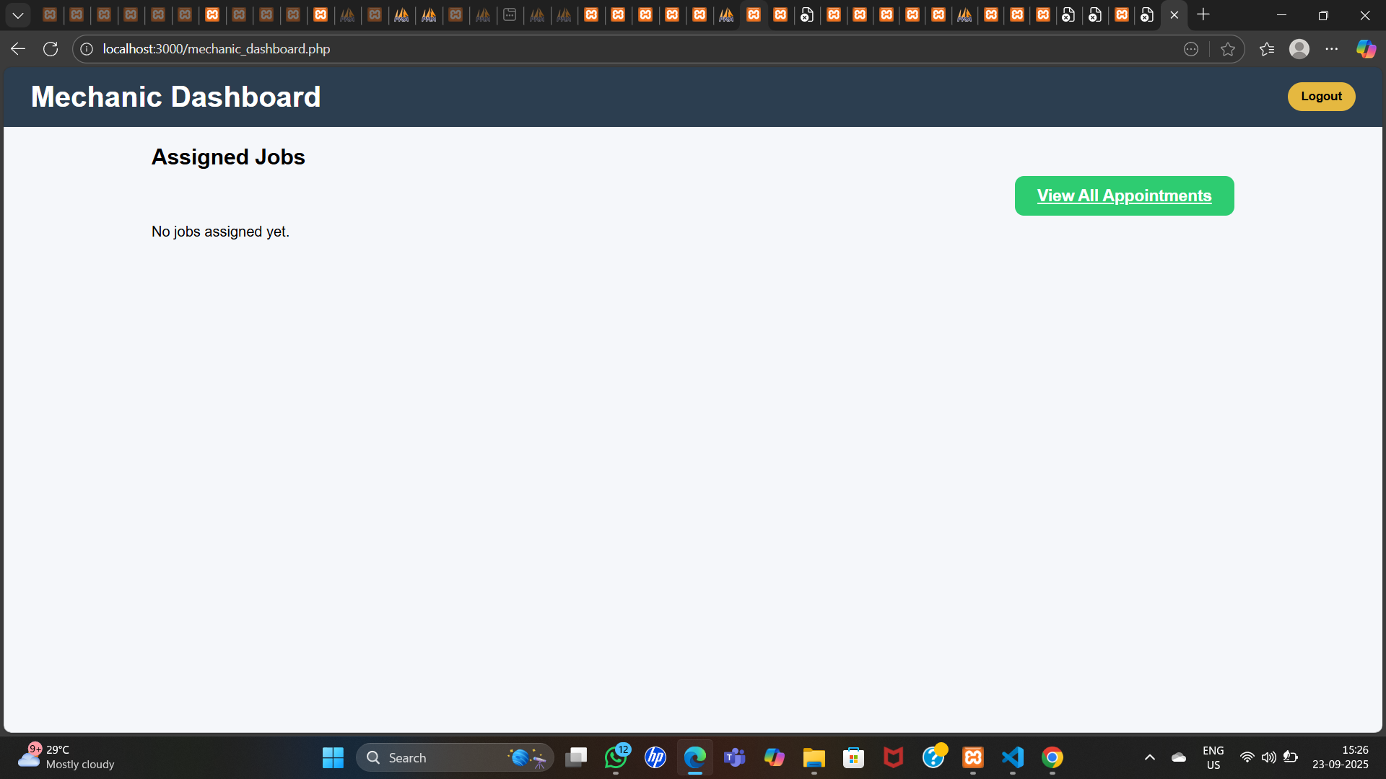
INTERFACE

Slide 42
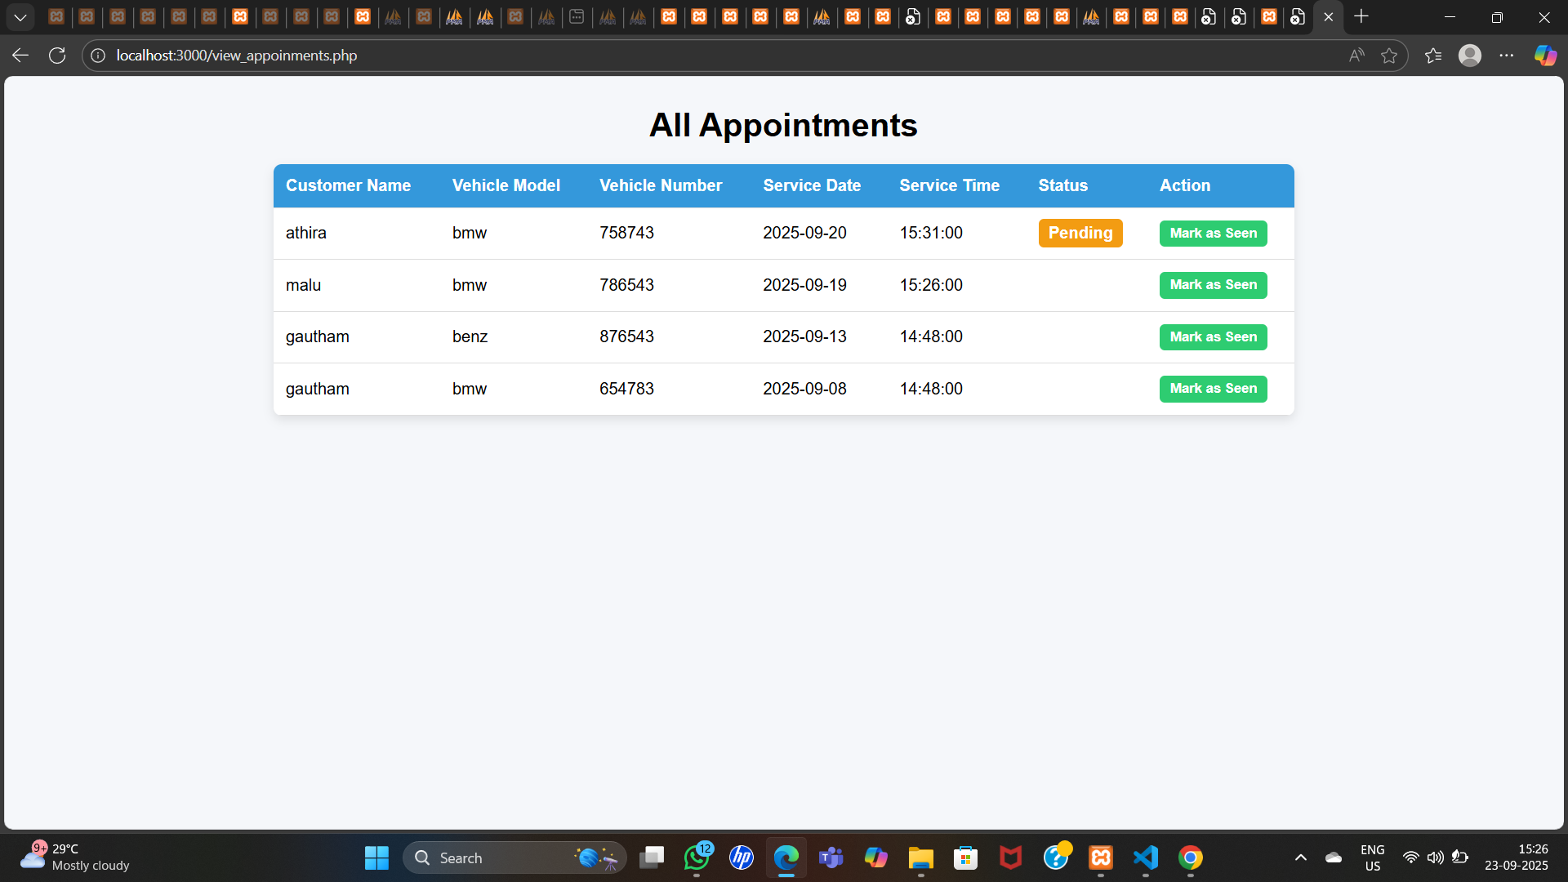
INTERFACE

Slide 43
THANK YOU

