Slide 1
Online Mental Health Platform for Youth in Nepal
Presented By: Team Iterators
17th Sept,2024

Slide 2
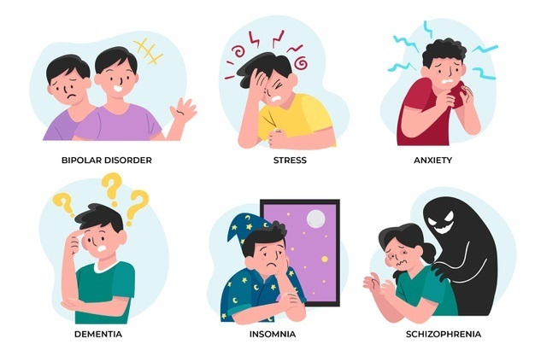
Problem Statement
Mental Health Crisis Among Youth in Nepal
1.Growing Issue: Youth in Nepal face rising mental health challenges, including depression, anxiety, and social isolation, yet there is limited access to support. 2.Stigma and Taboo: Many youth avoid seeking help due to social stigma, fear of judgment, and. lack of affordable services, leading to unaddressed issues that affect their personal and professional lives. 3.High Risk: Unaddressed mental health issues lead to severe consequences such as substance abuse, self-harm, and even suicide. 4.Our Solution: We aim to create an accessible and safe space for mental health support, specifically targeting Nepalese youth.

Slide 3
Objective of the Platform
• Create a virtual support system for Nepalese youth dealing with mental health challenges.
• Connect users with mental health professionals and provide peer support and resources to foster mental wellness.
• To Provide the educational resources that reliefs the stress.
• Reduce the stigma surrounding mental health by providing a safe, inclusive, and culturally
sensitive space for users.

Slide 4


Key features:
2.Access to Mental Health Professionals/ Counsellor
1.Chat System

Slide 5


3.Educational Resources
4.Simple Mental Health Test
5.Crisis Support

Slide 6

Chat System
i) Private Chat with Counsellor
• Secure, one-on-one chats with certified mental health professionals.
ii) Community Forums & Group Chat
Engage with peers who have similar experiences.
Option for anonymous discussions, group
chats, and open forums to foster peer support.

Slide 7

Access to Mental Health Professionals
i)Budget-Friendly Options:
• Affordable mental health services, making help accessible to youth.
ii) Personalized Match:
• Match users with professionals based on personal preferences such as
language, gender, and comfort level.

Slide 8


Educational Resources
i) Articles:
• Regularly updated mental health articles on topics such as depression, anxiety, stress
management, and more.
ii) Videos:
Engaging visual content, including motivational videos, awareness talks,
Expert advice on coping mechanisms.

Slide 9
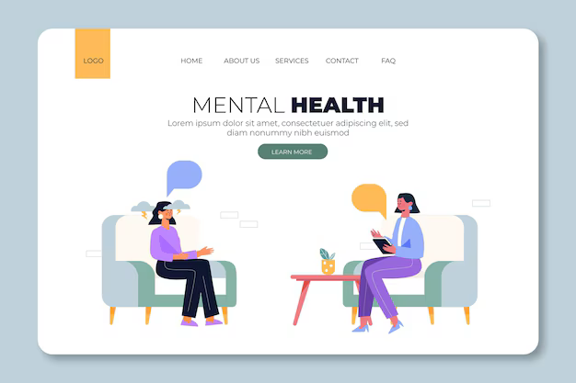
Simple Mental Health Test
i)Self-Assessment:
• Regularly updated mental health articles on topics such as depression, anxiety, stress
management, and more.
ii)Score Calculation:
• A score is calculated based on the answers, providing a mental health
snapshot.
iii)Recommendations:
• Tailored feedback and recommendations based on the user’s score, with the
option to retake the test or reset answers.

Slide 10

Crisis Support
Emergency Services:
• Display important emergency contacts, including hotlines for suicide prevention and immediate
mental health support.
•Direct calling to hospitals for immediate actions

Slide 11



Tech Stack:
1.Frontend:
HTML, CSS, JavaScript (React.js for user interface).
2.Backend:
Node.js and Express.js for secure API development.
3.Database:
MongoDB for managing user data and resources.
4.Authentication & Security
SSL encryption to ensure user data privacy.

Slide 12
Impacts:
How Our Platform Will Make a Difference?
• Reduce Mental Health Stigma: Create a safe and open space to talk about mental health,
reducing the stigma attached to it in Nepalese culture.
• Provide Immediate Support: Offering both peer and professional support can help youth tackle mental health issues before they become severe.
• Enable Personal Development: By providing mental health care, we enable youth to thrive in personal, academic, and professional areas.
• Tackle Mental Health Crisis: Our platform aims to decrease rates of untreated mental health conditions, ultimately reducing incidents of self-harm, suicide, and isolation.

Slide 13
Business Model:
• Freemium Model:
o Free access to community forums, educational resources, and basic mental health tests.
o Paid subscription for private consultations with psychiatrists and premium educational
content.
• Partnerships & Sponsorships:
o Partner with NGOs, mental health organizations, and governmental bodies for
awareness campaigns and sponsorship.
o Collaborate with educational institutions for early access to students.
• Advertising & Affiliate Marketing:
o Monetize with mental health-related products and services like therapy apps, books, and
wellness programs.
Business Model:
Business Model:
Business Model:

Slide 14

Why Should You Select Us?
• Focused on an Urgent Problem: Mental health, especially among youth, is a critical issue in
Nepal, and our platform addresses it head-on.
• Targeted Approach: Our platform is designed specifically for Nepalese youth, combining cultural
sensitivity with modern solutions.
• Innovative and Scalable: The platform not only offers immediate solutions but is designed to be
scalable, with potential expansion to cover the broader South Asian market.
• Community Impact: We focus on community-building and fostering peer support, along with
professional help. We believe in creating a cultural shift in how mental health is perceived.
• Our Commitment: We are passionate about making mental health resources accessible,
affordable, and destigmatized for the youth of Nepal.

