Slide 1
Appointment Mgmt System
Suman Adhikari

Slide 2
The Problem
Need to manage appointments.
Office admin need to confirm appointments.
Patient can request appointment provided they don’t have any bills pending.
Dentist can do at most 5 appointment in a week.

Slide 3
The Features
Appointment Management
Authentication Management
Payment Management
Dentist and Patient Registration Management

Slide 4
The Solution
REST API using:
Backend: Java Spring Boot Web app
Database: PostgreSQL

Slide 5
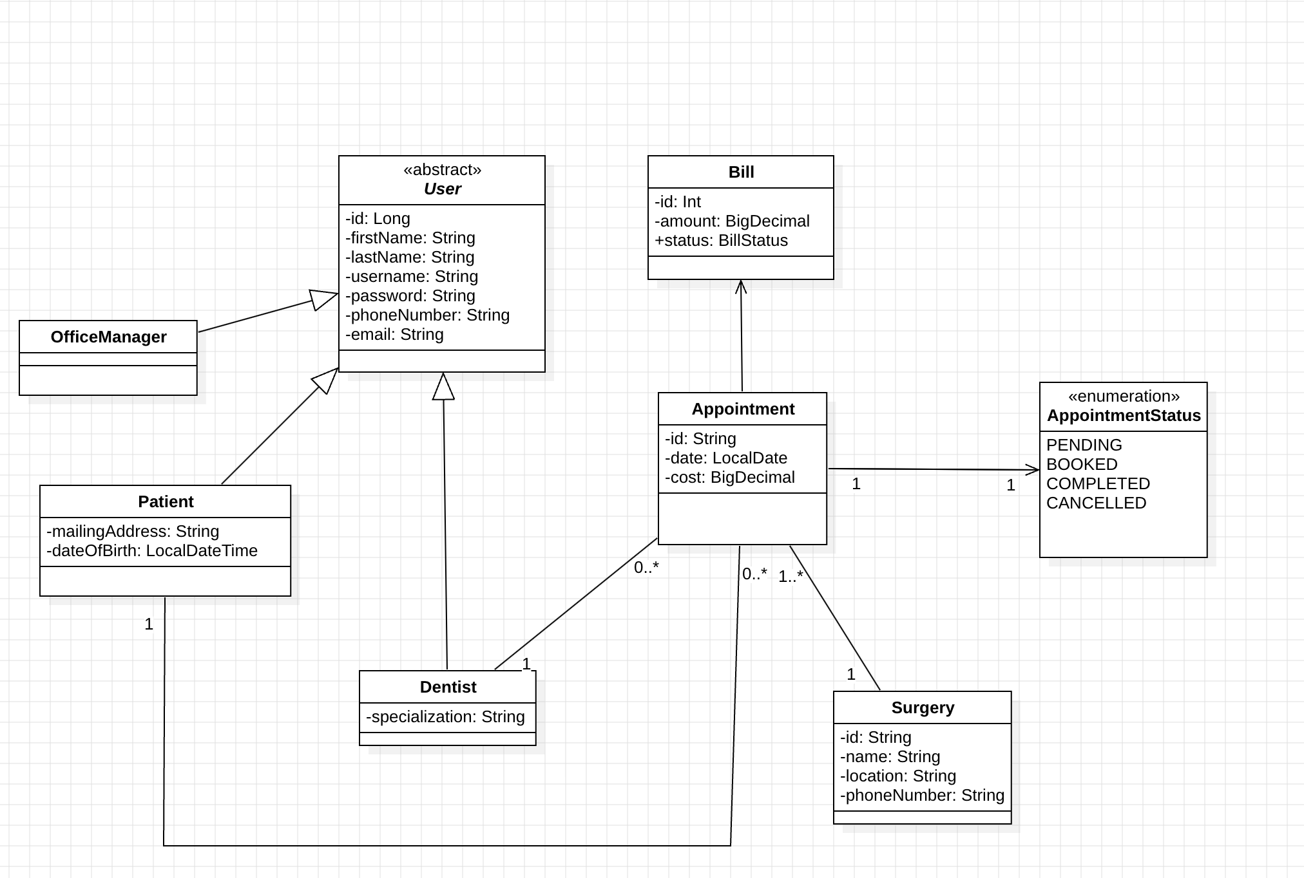
Domain Modeling

Slide 6
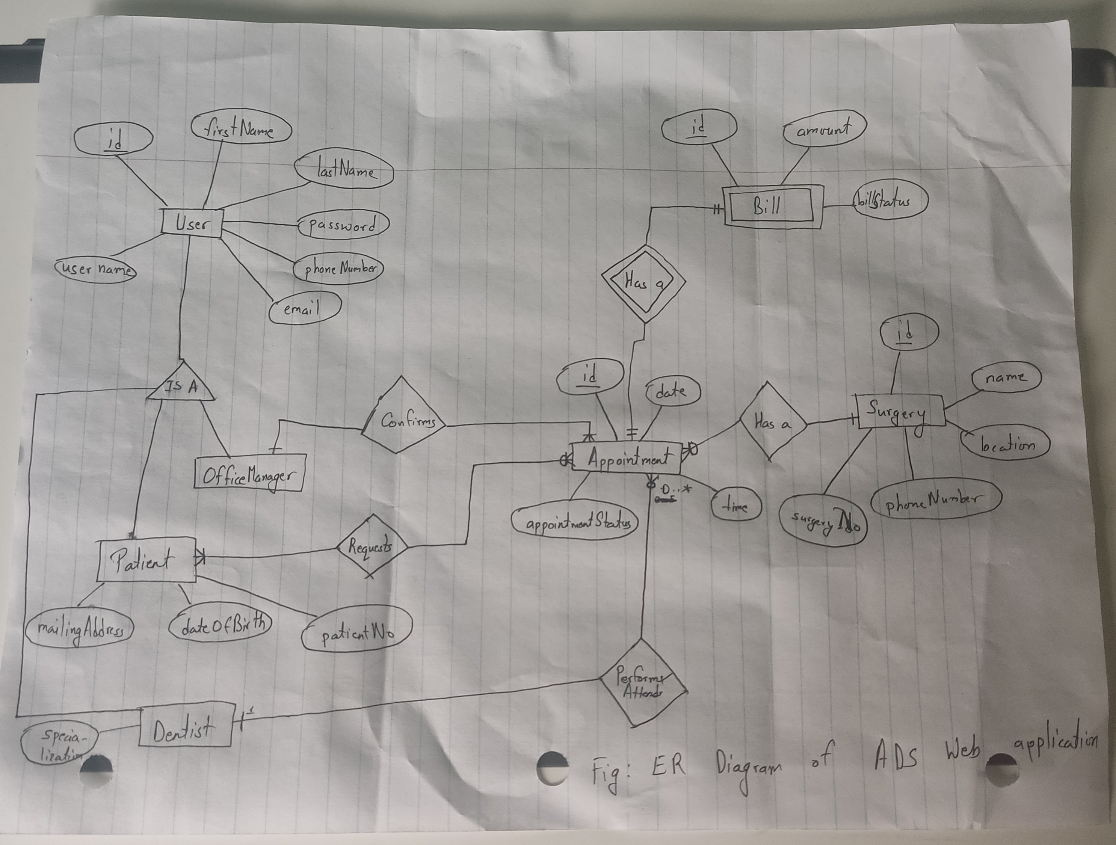
ER Diagram

Slide 7
Time For demo – See you at postman
Thank You!

