Slide 1


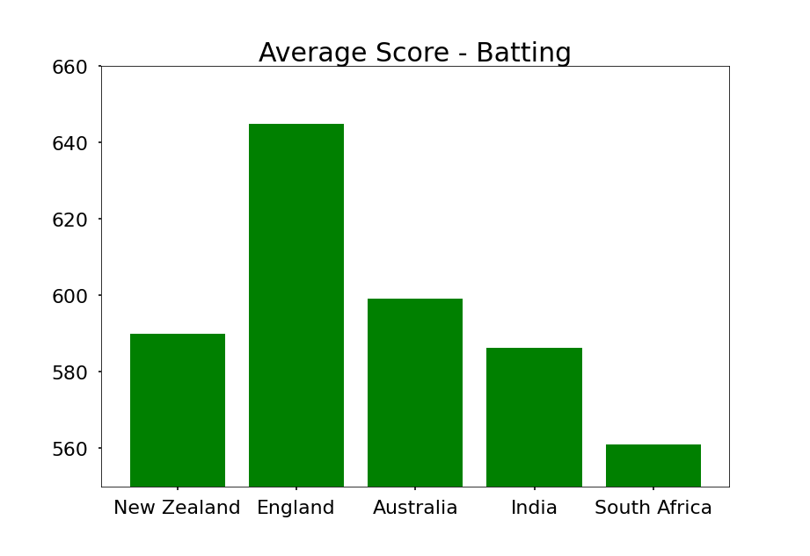
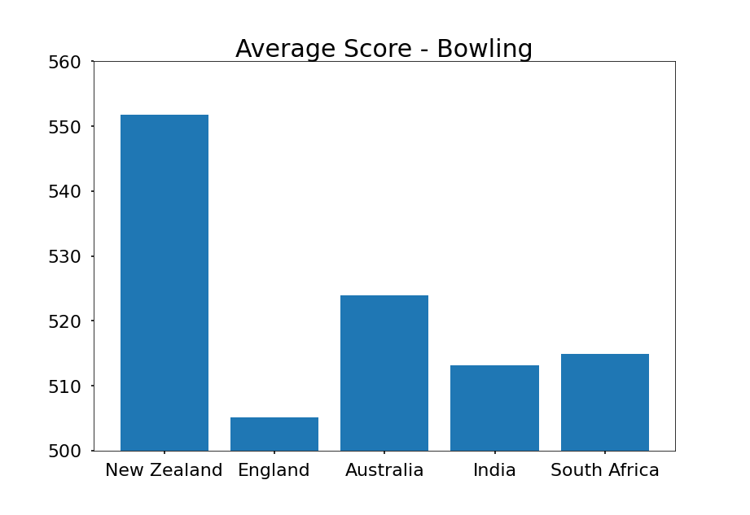
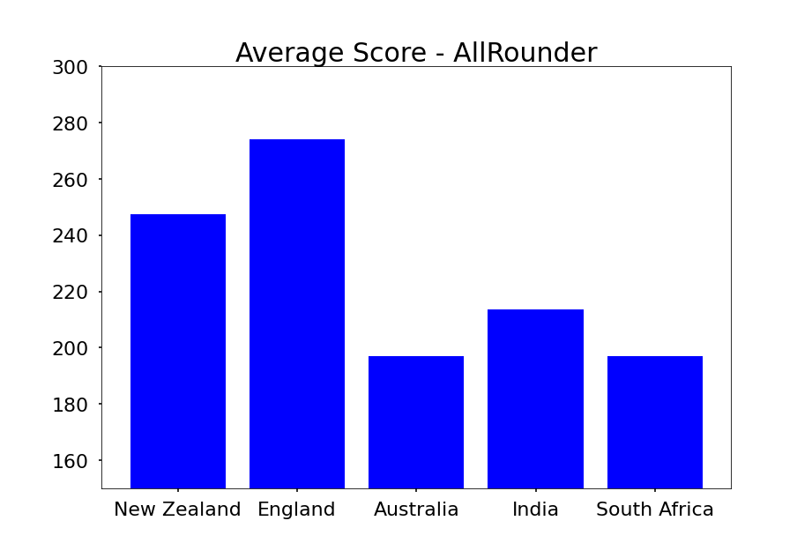
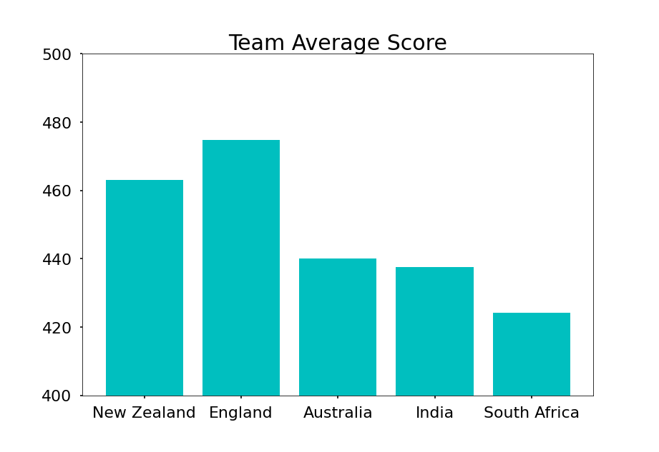
Predict Matches Between Top Cricket ODI Teams
Reason Adhikari
School of Computer Science and Information Systems, NWMSU
Results
Analyzing three individual aspects of top 5 cricket teams, following group rankings is predicted from a penta-series One Day International Cricket match:
England
New Zealand
Australia
India
South Africa
Also, England has most skillful set of batsmen and all-rounders and New Zealand has most skillful set of bowlers.
Project predicts the outcome of next series between top five ODI Cricket teams, Individual players’ rankings are used and calculated to get best team.
Conclusions
Introduction
ICC ODI ranking’s webpages were scrapped using requests and Beautiful Soup. Team and individual scores were extracted and calculated to give top-5 teams’ rankings based on batsmen, bowlers, and allrounders. Team performance in next series is predicted based on those scores.
Tools & Method
International Cricket Council:
https://www.icc-cricket.com/
Resources
Acknowledgments
adhikariReason/cricket-prediction-webmining
Dr. Nathan Eloe - Professor
Project Repo

