Slide 1
Progress Update: Week 3 (Revised) and Week 4
Edge-Compute Feasibility of Cooperative Perception Fusion for Connected Autonomous Vehicles
Ganesh Adhikari | CS 7000 | Advisor: Dr. Liangkai Liu | October 2026

Slide 2
In One Paragraph
We finished the accuracy evaluation on the larger dataset and measured how much computer power each model needs. V2VNet is clearly the most accurate, and it improves detection for every vehicle. when2com turns out to be bigger, slower and less accurate than a vehicle working alone. All models fit in a Jetson Nano's memory, but none is fast enough to run on it in real time without optimisation.

Slide 3
Week 3 (Revised): Three Fixes
You asked for | What we did
At least 20 scenes | Used 20 scenes: 14 train, 3 validation, 3 test. All results come from the 3 test scenes the models never saw.
Point-cloud pictures, not just numbers | Rendered detections for every test scene. Two comparison figures follow.
Per-class AP | Not possible: the released models detect one class (vehicle). We report accuracy per vehicle instead, which shows who benefits from cooperation.

Slide 4
Accuracy
mAP is the standard detection score (higher is better). IoU 0.5 and 0.7 mean a box must overlap the true object by at least 50% or 70%.
Model | mAP@0.5 | mAP@0.7 | Change vs alone
Lowerbound (no cooperation) | 0.554 | 0.491 | reference
V2VNet | 0.753 | 0.715 | +0.199
when2com | 0.501 | 0.465 | -0.053

Slide 5
Accuracy per Vehicle (mAP@0.5)
Vehicle | Alone | V2VNet | when2com
Agent 1 | 0.545 | 0.750 (+0.204) | 0.535 (-0.010)
Agent 2 | 0.700 | 0.868 (+0.168) | 0.677 (-0.023)
Agent 3 | 0.626 | 0.789 (+0.162) | 0.487 (-0.139)
Agent 4 | 0.335 | 0.589 (+0.254) | 0.278 (-0.057)
Agent 5 | 0.505 | 0.759 (+0.253) | 0.473 (-0.033)
Average | 0.554 | 0.753 (+0.199) | 0.501 (-0.053)
V2VNet helps every vehicle. The vehicle with the worst view (agent 4) gains the most.
when2com is below the baseline for every vehicle, so this is consistent, not a one-off.

Slide 6
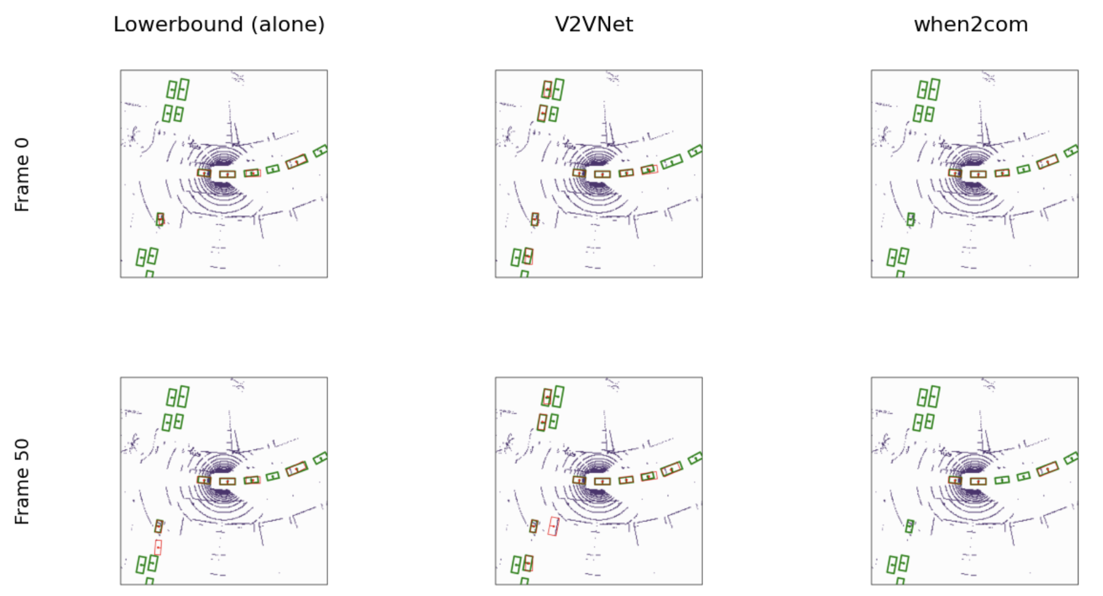
What It Looks Like: Scene 19
Figure 1. Agent 4, scene 19 (4 vehicles), frames 0 and 50. Green boxes are ground truth, red boxes are detections.

Slide 7
Scene 19: What the Picture Shows
Cars found (by eye, incl. our car) | Alone | V2VNet | when2com
Frame 0 (14 cars) | 5 | 8 | 4
Frame 50 (14 cars) | 5 (+1 false alarm) | 9 (+1 false alarm) | 3
Our own car is one of the 14. The box at the centre of the rings is agent 4's own vehicle. All three models find it every time, and they also find the cars on the road right beside it.
Far, hidden cars are where cooperation helps. Alone, agent 4 finds none of the parked cars on the left. V2VNet finds three of them using the other vehicles' data.
when2com does worse than alone. It finds none of the parked cars and misses the lower left car the others find.
Not perfect. In frame 50, the vehicle alone and V2VNet each show one false alarm. Cars at the far right are missed by all.

Slide 8
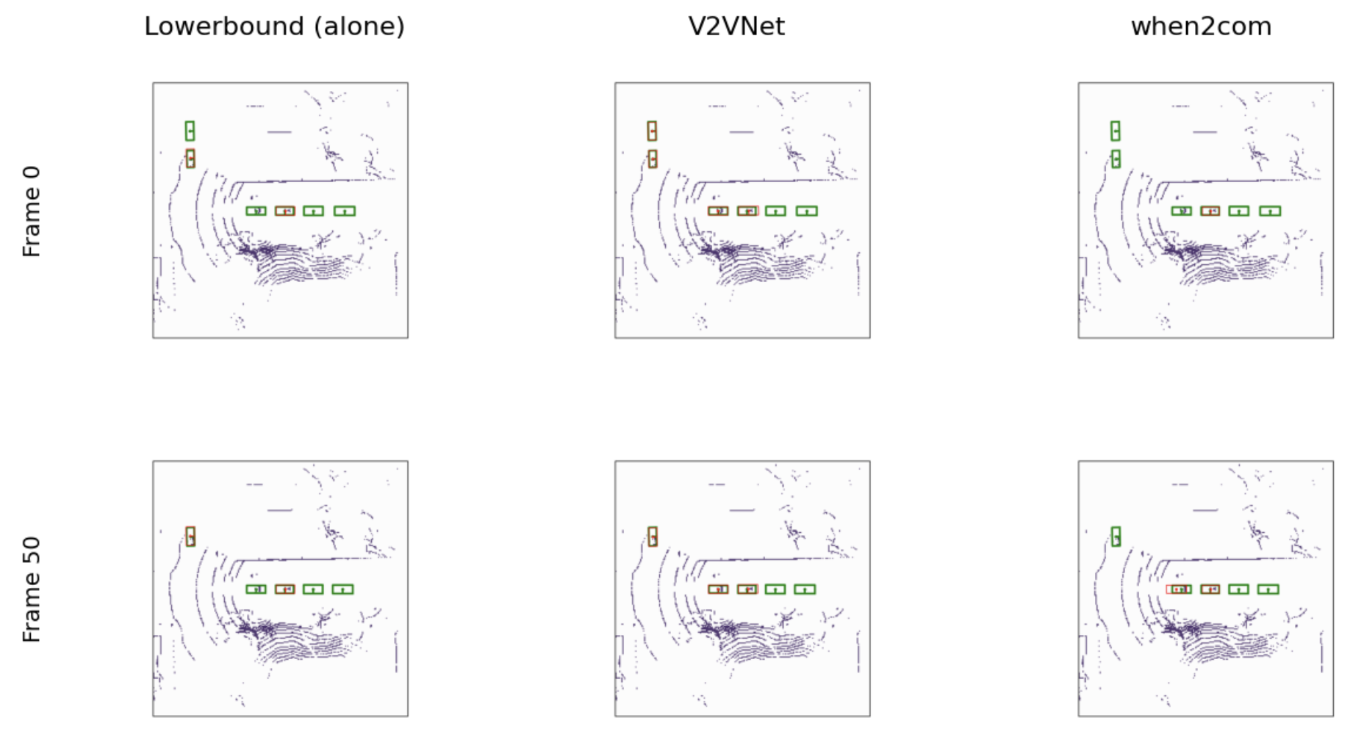
What It Looks Like: Scene 8
Figure 2. Agent 4, scene 8 (all 5 vehicles), frames 0 and 50. Green boxes are ground truth, red boxes are detections.
The vehicle is at the centre of the rings, and its own box is the second one in the row of four. Alone, it misses far-away cars. V2VNet finds them using the other vehicles' data. when2com finds fewer.

Slide 9
Scene 8: What the Picture Shows
Cars found (by eye, incl. our car) | Alone | V2VNet | when2com
Frame 0 (6 cars) | 2 | 4 | 1
Frame 50 (5 cars) | 2 | 3 | 2
Same pattern, smaller gap. V2VNet finds the most and when2com the fewest, but fewer cars are in view here.
Top left (frame 0). Alone finds the nearer car only. V2VNet finds both. when2com finds neither.
Our own car. The second box in the row of four. All three models find it, so it is part of every count above.
The car behind us (first box). Alone misses it, V2VNet finds it, when2com finds it only sometimes (with a loose box in frame 50).
The two cars ahead. Missed by all three models. We first thought they had no LiDAR points, but a recount shows points near the nearer one. The reason is not yet explained.

Slide 10
Our Own Car in the Pictures
It is in the ground truth. In scene 8 every vehicle's view has a box at the centre of the grid, about 1 m from the sensor. The roadside unit's view has none.
All three models find it every time. It has very few LiDAR points on it (2 cells in scene 8). A likely reason is that the box is always at the same place, so a model can predict it without seeing it. We have not tested this.
Effect on the scores. Each model gets one easy correct car in every frame. This probably raises all the accuracy numbers and shrinks the gaps. The ranking probably stays the same.
LiDAR point counts. Two ways of counting points on each car gave different answers for the far cars, so we do not report them yet. We will fix the method and recount.

Slide 11
Why Agent 4?
The per-vehicle table shows how each vehicle scores alone and with V2VNet.
Agent 4 is the weakest alone (0.335) and gains the most from V2VNet (+0.254). A car that is missed alone and found with help is easiest to see here.
We did not start with agent 4. We first looked at agent 1, and the three models looked almost the same in that frame, so we moved to agent 4.
Caution: agent 4 is the best case for cooperation, not a typical one. The per-vehicle table covers all five vehicles and is the fair summary.

Slide 12
Why These Scenes and Frames?
The test set has 3 scenes (5, 8 and 19). We show two.
Scene 19 was the first one we opened. Scene 8 is the only scene with all 5 vehicles, so it checks the full setting. Scene 5 (4 vehicles, like 19) is not shown, but its pictures exist.
Pictures were saved for every 25th frame (0, 25, 50, 75) to keep the run quick. We picked frames 0 and 50.
In scene 19 these two showed the clearest difference. We reused them for scene 8 without checking the others, so the differences there are smaller.
How to read the pictures: they are examples that explain the numbers. The evidence is in the tables, which cover all 300 test frames.

Slide 13
Scope Note
We use five vehicles and no roadside unit. V2VNet and when2com are vehicle-to-vehicle methods and all available models were trained this way. Roadside units are left for future work.

Slide 14
Week 4: Can These Models Run on a Jetson Nano?
We measured each model on a cloud T4 GPU and compared the results with the Nano's published limits: 4 GB memory, 472 GFLOPS at 16-bit precision (about 236 GFLOPS at 32-bit), and our assumed 100 ms target (10 updates per second).
Model | Weights | Peak memory | Time on T4 | Est. Nano time per vehicle*
Alone (baseline) | 32 MB | 0.93 GB | 97 ms | 66 to 220 ms
V2VNet | 84 MB | 1.02 GB | 181 ms | 135 to 450 ms
when2com | 125 MB | 1.07 GB | 187 ms | 131 to 436 ms
*From the model's compute (FLOPs), assuming 16-bit precision. Low end assumes the Nano runs at full speed, high end at a realistic 30%. The T4 itself ran at about 20% of its peak. At 32-bit, which the models use today, these times double.

Slide 15
How We Estimated the Nano Time
1. Count the work. PyTorch's built-in counter measured the operations (FLOPs) in one frame. Example: V2VNet needs 318.9 GFLOPs for all 5 vehicles.
2. Split per vehicle. Each test frame runs all 5 vehicles at once, but a real car runs only its own share: 318.9 / 5 = 63.8 GFLOPs.
3. Divide by the Nano's speed. The Nano's published peak is 472 GFLOPS (16-bit): 63.8 / 472 = 135 ms. This is the ideal case, at full speed.
4. Adjust for real-world speed. Chips rarely reach their peak. On the T4, our models reached only about 20% of its peak, so we also show 30%: 135 / 0.30 = 450 ms.
Model | GFLOPs per vehicle | Ideal (100%) | Realistic (30%)
Alone (baseline) | 31.2 | 66 ms | 220 ms
V2VNet | 63.8 | 135 ms | 450 ms
when2com | 61.7 | 131 ms | 436 ms

Slide 16
What This Means
Memory is fine. Every model uses about a quarter of the Nano's 4 GB.
Speed is the problem. At realistic speed, all three models are over 100 ms. The fusion models need about 4.5 times the target. The models also run in 32-bit today, which halves the Nano's speed, so converting to 16-bit is a must.
V2VNet is worth its cost. It takes about twice the compute and gives 36% better accuracy.
when2com is not. It is the largest and slowest model and less accurate than the baseline.
Where to optimise. Half of V2VNet's compute is its message-passing step, which runs 3 rounds. Running fewer rounds is the first thing to test.

Slide 17
Next Week
Time each part of the models separately to confirm where the delay comes from.
Try V2VNet with 1 or 2 message rounds and see how much speed we gain and accuracy we lose.
Try half-precision to see whether the models get closer to the 100 ms target.
Limits to keep in mind: Nano times are estimates from compute counts and published specs (see the estimation slide), not tests on the device. Each test runs all five vehicles together, so the per-vehicle time is one fifth of the total. Times cover the network only, not the final box clean-up step.

