Slide 1
HACKATHON · AUTONOMOUS AI & AGENT ORCHESTRATION
AgentAutopsy
Black-Box Flight Recorder for AI Agent Systems
The Problem
The Solution
Multi-agent failures require hours of manual log-digging
Current tools show what happened, not why
Autonomous agent: monitors, detects, and auto-generates root-cause incident reports
Debugging: hours → minutes; clear explanations for all stakeholders

Slide 2
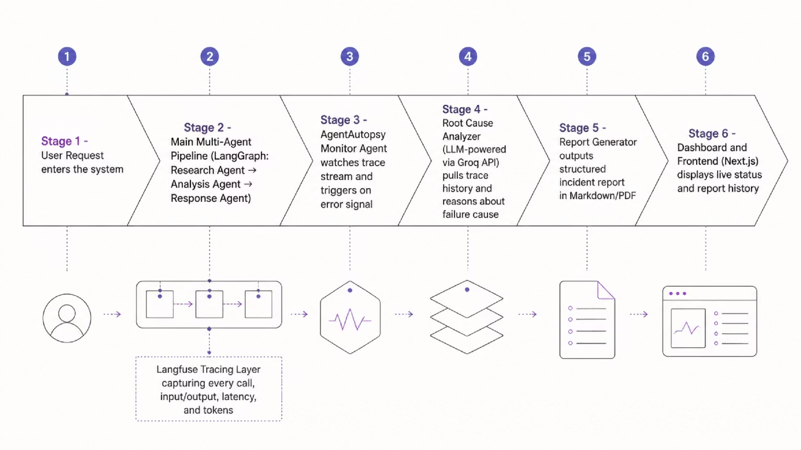
ARCHITECTURE
High-Level Architecture
External dependencies: Groq API (Llama 3.3 70B) for reasoning, Langfuse Cloud for distributed tracing.

Slide 3

WORKFLOW
How AgentAutopsy Works
Monitor Agent
Analyzer Agent
Report Generator
Deliver & Store
SQLite memory enables pattern recognition across recurring failures — each incident improves future diagnosis.

Slide 4


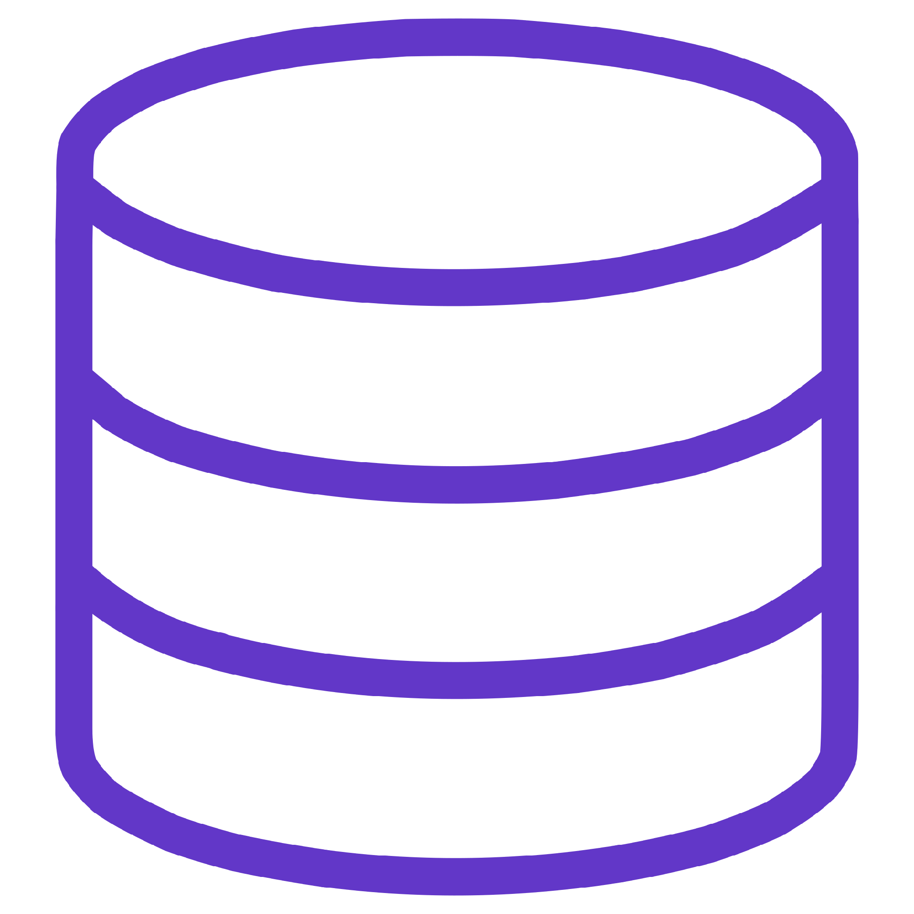

TECHNICAL DESIGN
Technical Stack & Infrastructure
Backend
Frontend
FastAPI (Python) — trace ingestion, report retrieval, rate-limited endpoints
Next.js + Tailwind CSS — live pipeline status, incident history dashboard
Data Layer
APIs & Security
SQLite for incident reports and trace metadata
Langfuse SDK, Groq API (Llama 3.3 70B); API keys via environment variables, RBAC on dashboard

Slide 5
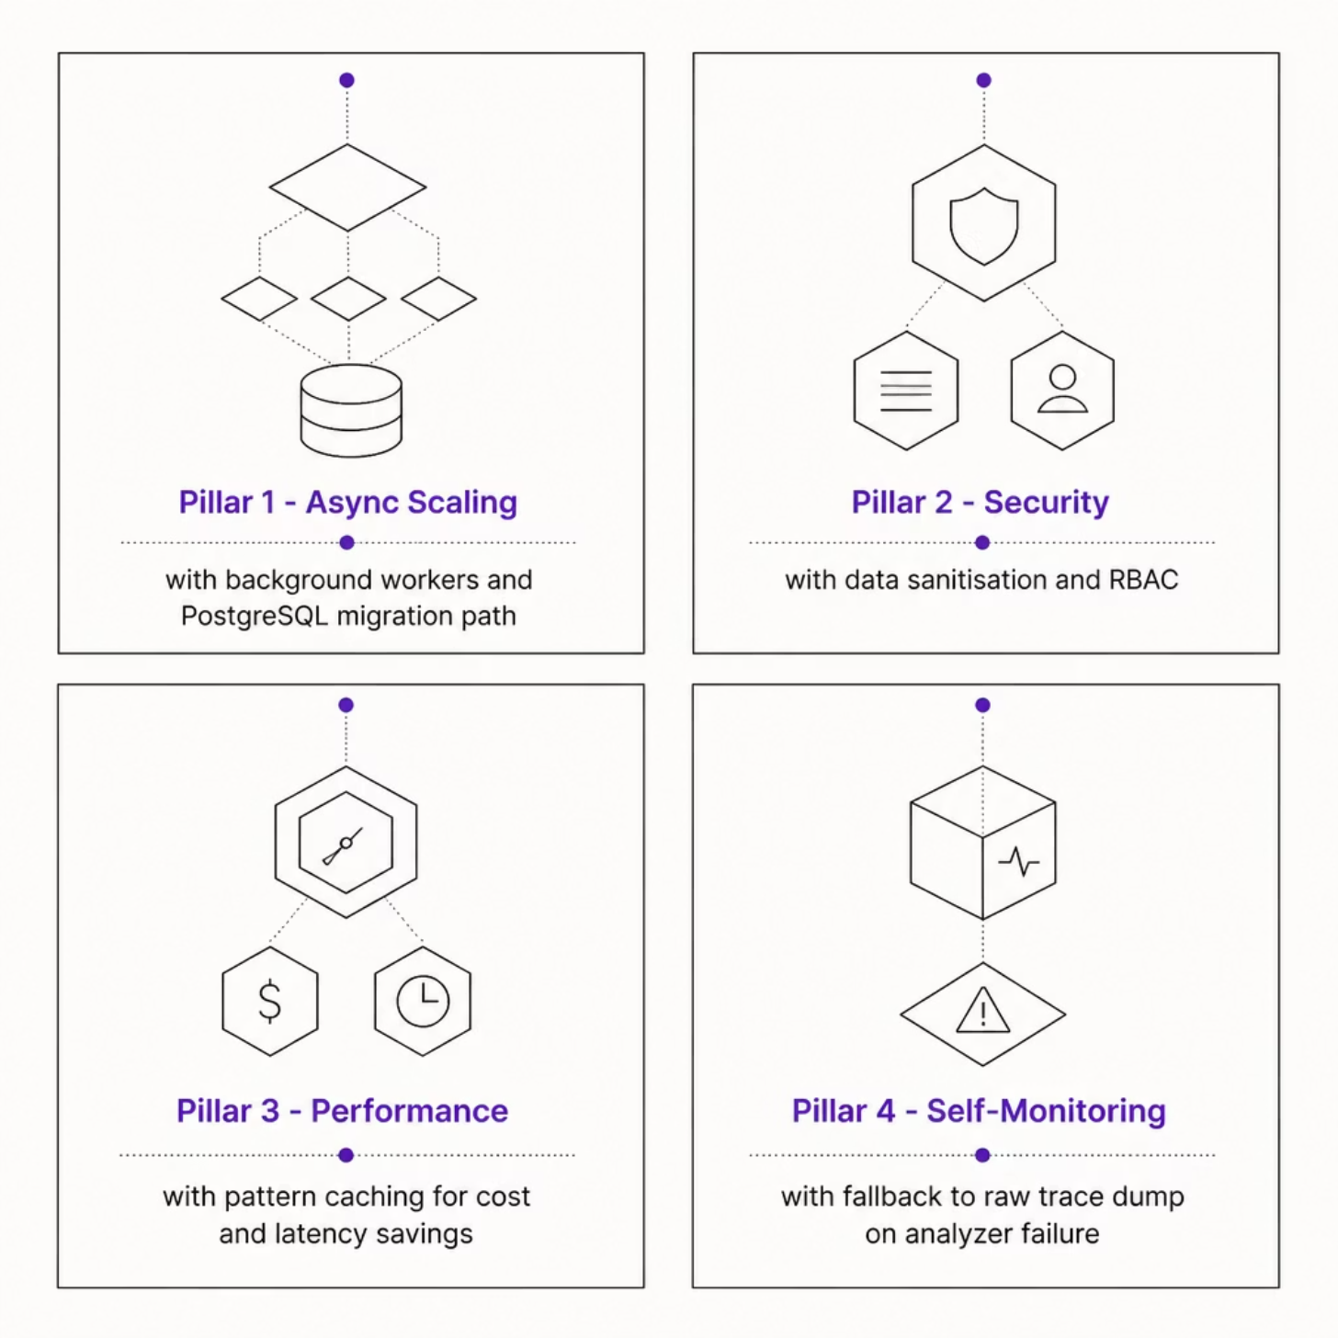

RELIABILITY
Scalability & Reliability
Rate Limiting
Security
IP-based throttling (10 req/min) prevents abuse and ensures stability
Sensitive trace data sanitised before storage; role-based dashboard access
Performance
Self-Monitoring
Cache repeated failure patterns — reduces cost and latency on recurring errors
If Analyzer fails, falls back to raw trace dump — no silent failures

Slide 6
ROADMAP
Execution Roadmap
Phase 1 — Round 1
Deploy
Core LangGraph pipeline · Langfuse tracing · Basic failure detection demo
Render (backend) + Vercel (frontend) — both free tiers
1
2
3
4
Phase 2 — Round 2
Future
Full root-cause analyzer · Next.js dashboard · Live failure injection demo
Predictive failure alerts · Slack/email notifications · CrewAI & AutoGen support
Stack: LangGraph · FastAPI · Next.js · Langfuse · Groq API · SQLite · Tailwind CSS

