Slide 1
TCAD TCL Script Generator for Sentaurus Visual
MSDLab, DESE, IISc
ADHISH JS
Internship
22/12/2025 - 26/01/2026

Slide 2
OUTLINE
Problem Statement
The solution – Python TCL Generator
Implemened Modes
Inputs of TCL Generator
3D and 2D Command Generation Flow
GUI Version
Conclusion

Slide 3
Problem Statement
Analyzing TCAD simulation results in Sentaurus Visual (SVisual) requires repetitive manual steps
loading files.
creating plots.
linking axes.
exporting data.
Difficult to manage for:
Multiple nodes
Multiple TDR/PLT files
Multiple cutlines and parameters

Slide 4
The Solution – Python TCL Generator
A Python utility that accepts high-level user parameters (Node IDs, Cut locations, Parameters) and algorithmically generates a complete, error-free TCL script.
Supports:
3D analysis (cutplane → cutline).
2D analysis (direct cutline).
PLT-based transient plots.
Two versions:
Terminal-based.
GUI-based.

Slide 5
IMPLEMENTED MODES
MODE 1
MODE 2
MODE 3
Automates the extraction of 1D data curves from complex 3D TCAD simulation files (.tdr).
Workflow Logic:
Load: Imports 3D structure (.tdr).
Cutplane: Creates a 2D slice from the 3D body (Axis: X/Y/Z).
Cutline: Creates a 1D line on that 2D plane (Straight or L-shaped).
3D Structure → Cutplane → Cutline → 1D Plot.
Automates the extraction of 1D data curves from complex 2D TCAD simulation files (.tdr).
Workflow Logic:
Load: Imports 2D structure (.tdr).
Cutline: Creates a 1D line on that 2D plane (Straight or L-shaped).
2D Structure → Cutline → 1D Plot.
Automates transient analysis from PLT files (.plt).
Workflow Logic:
Load: Imports PLT file.
Create 1D Plot.
Create Curves OuterVoltage, Tmax).
Export PNG and CSV.
PLT File → 1D Plot → Curves → Outputs.

Slide 6
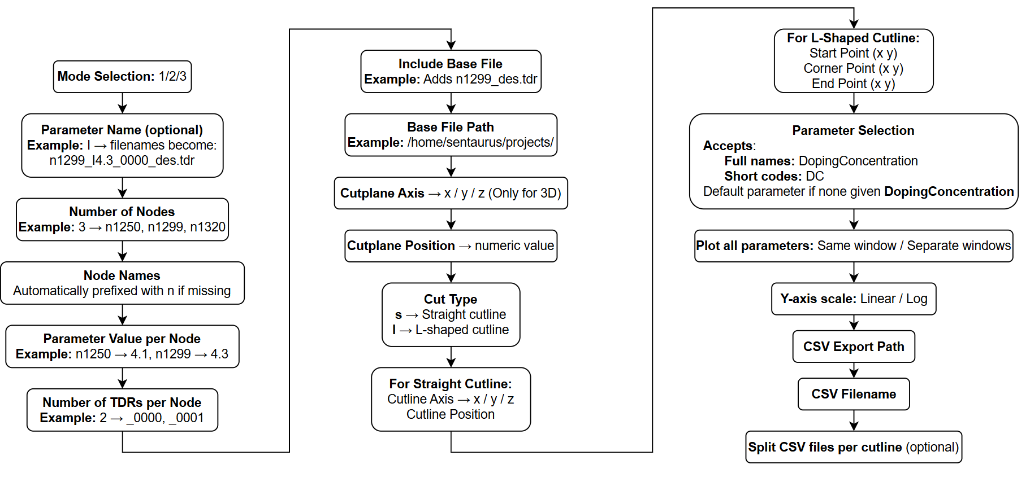
INPUTS OF TCL GENERATOR

Slide 7
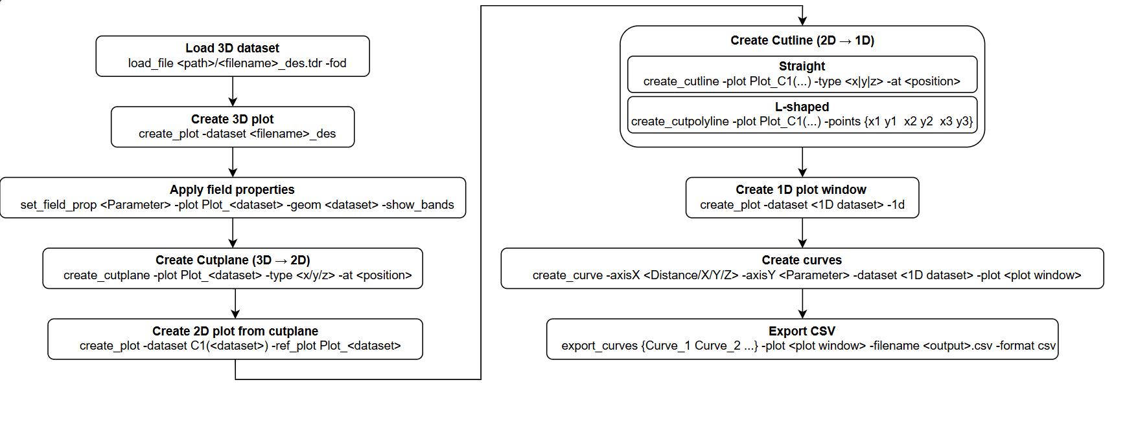
3D COMMAND GENERATION FLOW

Slide 8
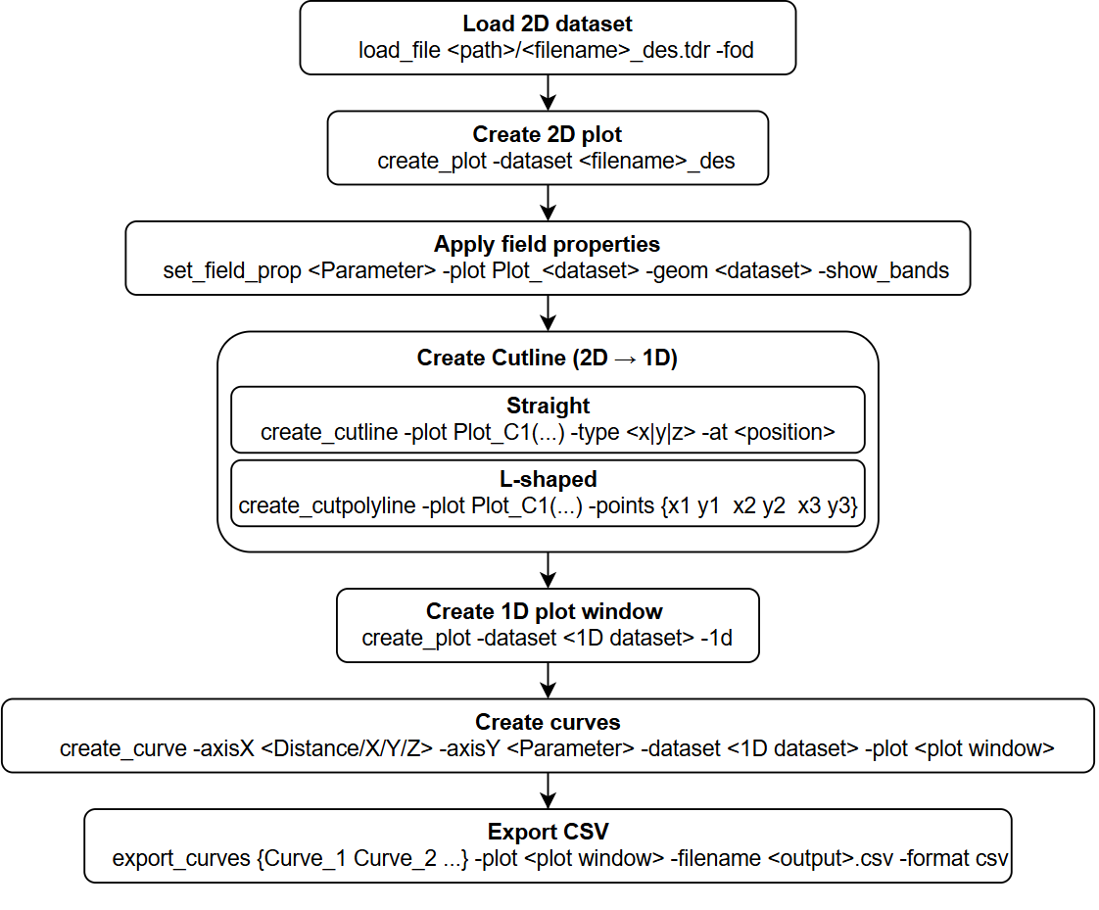
2D COMMAND GENERATION FLOW

Slide 9
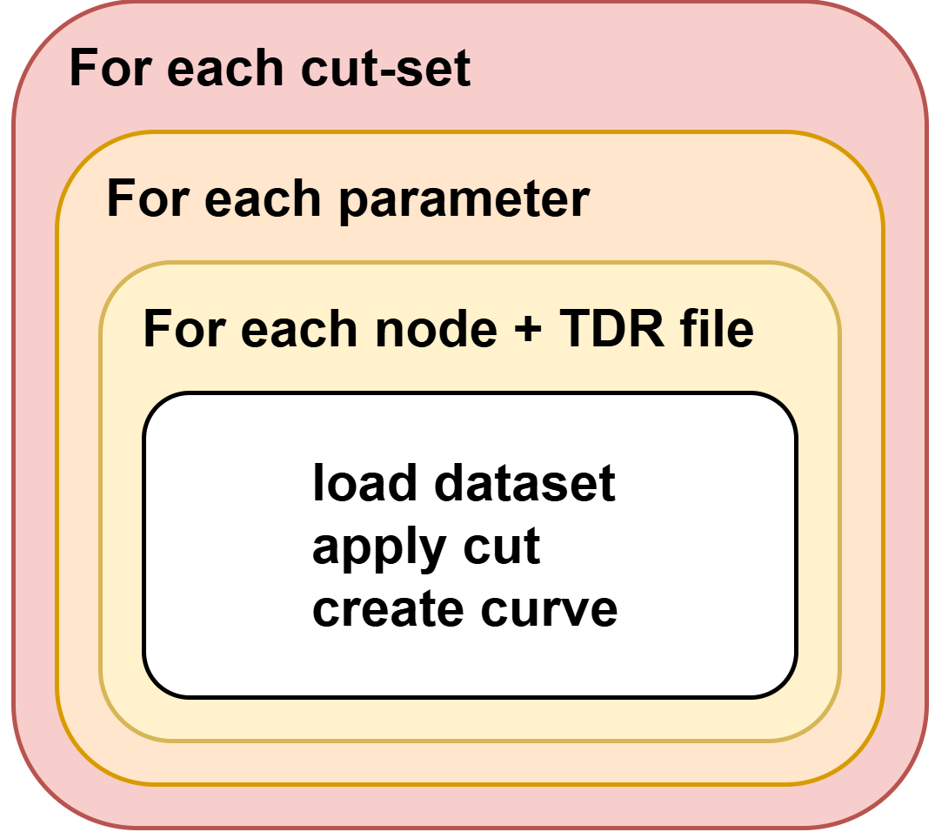
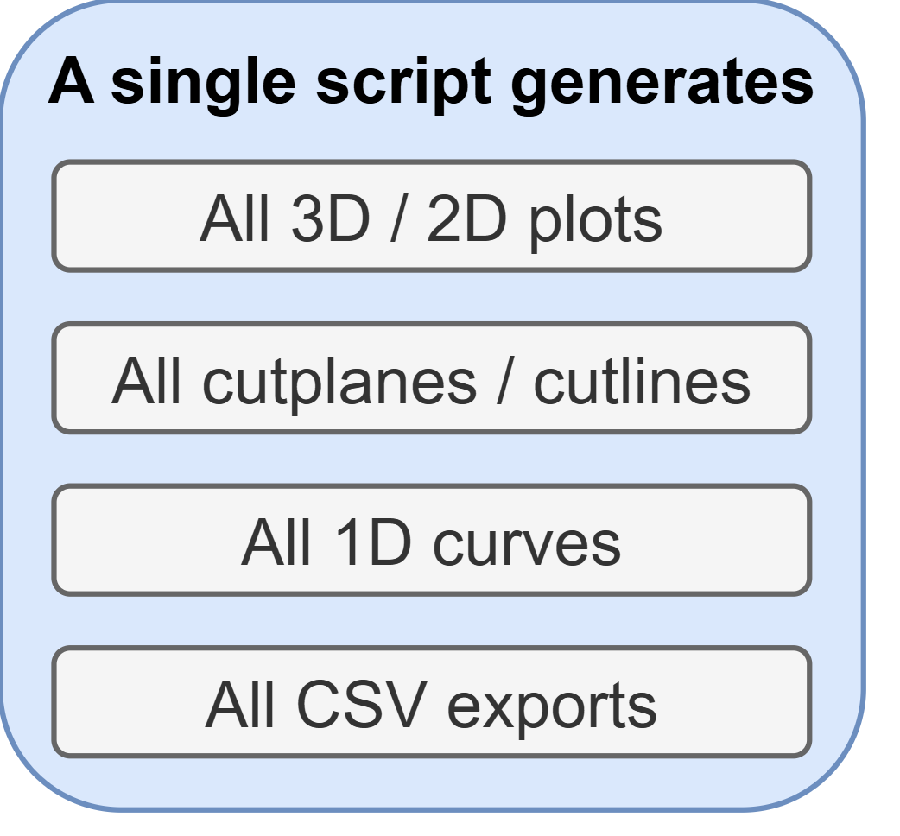
LOOP STRUCTURE AND OUTPUT

Slide 10
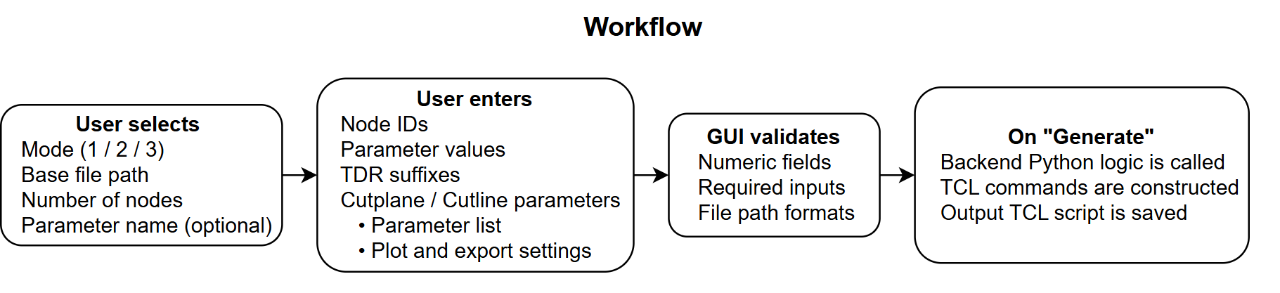
GUI VERSION
Graphical User Interface (GUI) version of the TCL Generator.
Provides structured input fields, dropdowns, and validation for TCAD TCL script generator

Slide 11
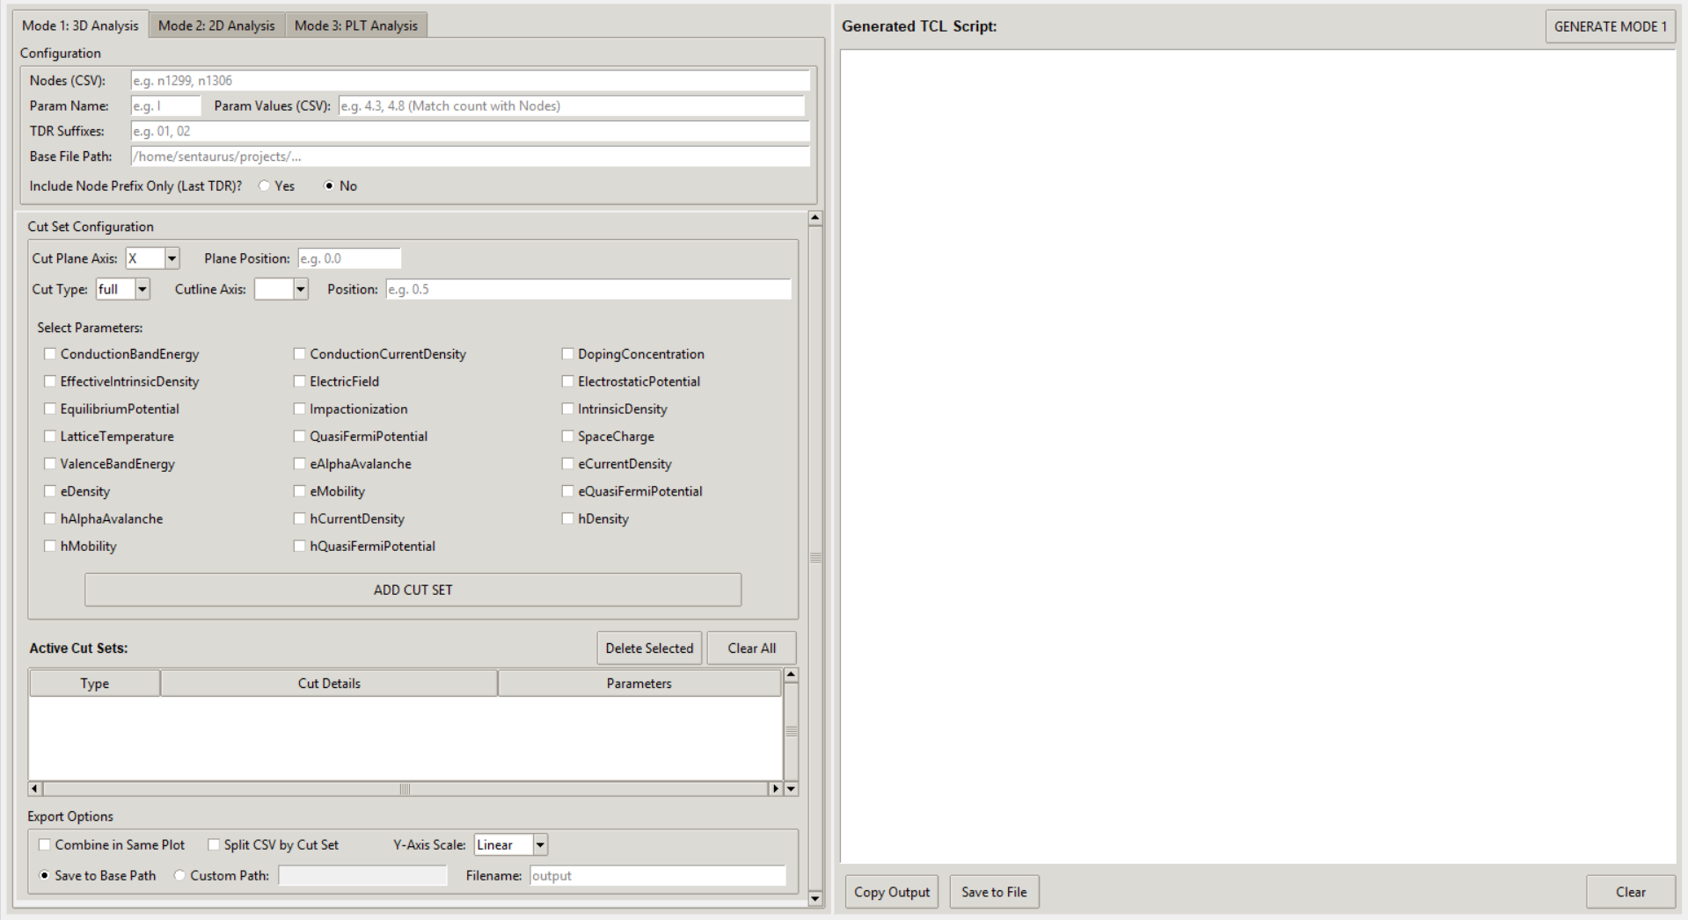
GUI VERSION: MODE 1
GUI Workflow : MODE 1

Slide 12
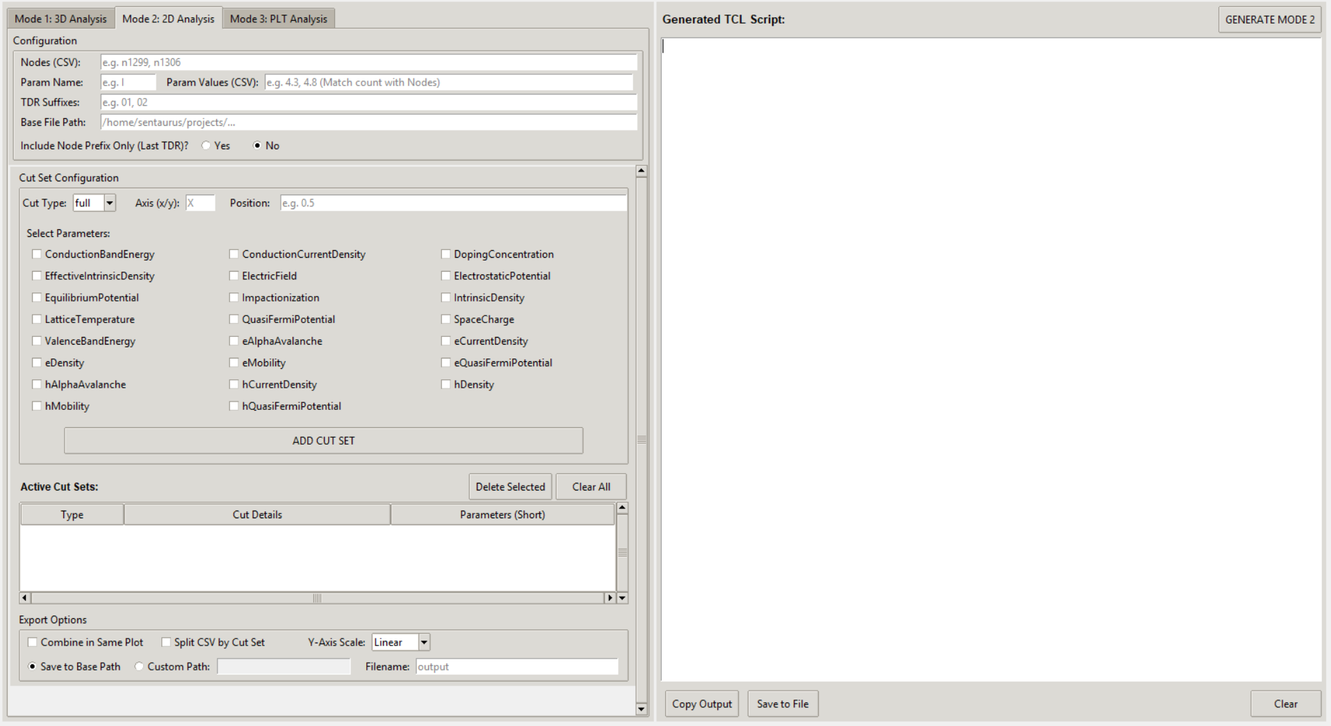
GUI VERSION: MODE 2

Slide 13
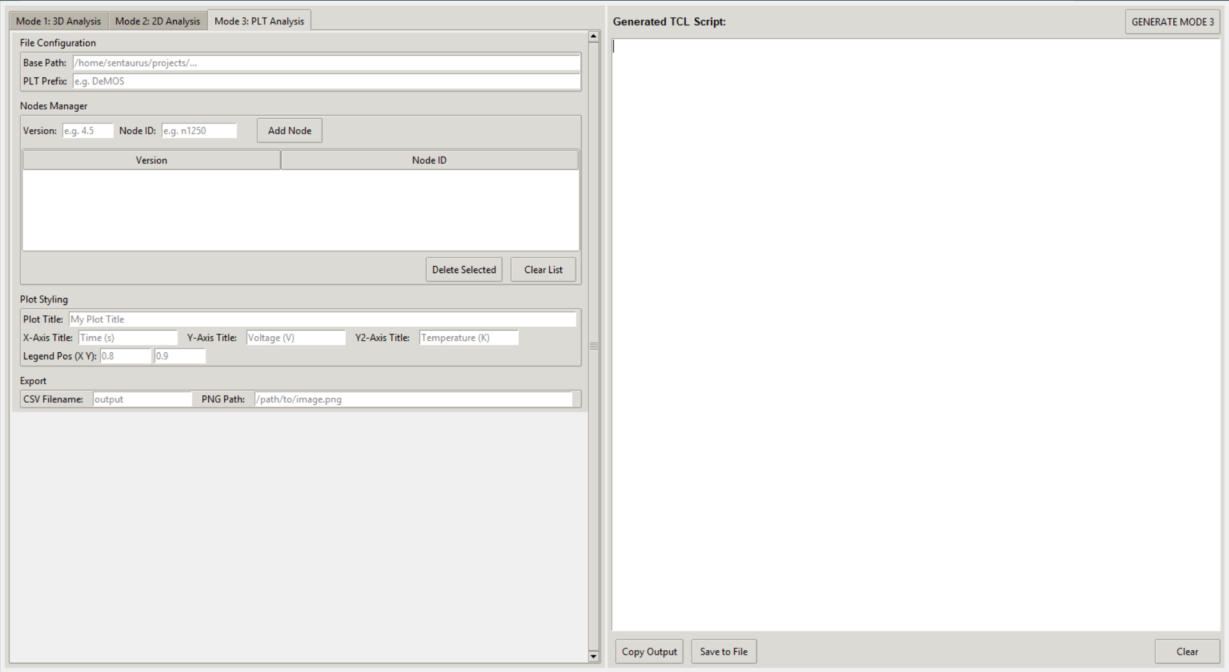
GUI VERSION: MODE 3

Slide 14
CONCLUSION
Developed a Python-based TCL script generator for Sentaurus Visual.
• Implemented:
– Multi-node and Multi-TDR support
– Multi-cutline (set) handling
– Parameter short-code mapping
• Provides two user interfaces:
– Terminal-based version
– GUI-based

